Slide 1
MECH 3550 : Simulation & Visualization
Solidworks Motion Analysis

Slide 2
Motion Analysis Overview
You can use Motion Analysis (available with the SOLIDWORKS Motion add-in from SOLIDWORKS Premium) to accurately simulate and analyze the motion of an assembly while incorporating the effects of Motion Study elements (including forces, springs, dampers, and friction).
A Motion Analysis study combines motion study elements with mates in motion calculations. Consequently motion constraints, material properties, mass, and component contact are included in the SOLIDWORKS Motion kinematic solver calculations.
A Motion Analysis study also calculates loads that can be used to define load cases for structural analyses.
To use the SOLIDWORKS Motion solver in a motion study, select Motion Analysis from the motion studies type list in the Motion Manager.
Spider Joint MotionAnalysis
Hub Analysis

Slide 3
SimulationXPress
SOLIDWORKS SimulationXpress offers an easy-to-use first pass stress analysis tool for SOLIDWORKS users. SimulationXpress can help you reduce cost and time-to-market by testing your designs on the computer instead of expensive and time-consuming field tests.
For example, you might want to examine the effects of a force applied to the faucet. SimulationXpress simulates the design cycle and provides stress results. It also shows critical areas and safety levels at various regions in the faucet. Based on these results, you can strengthen unsafe regions and remove material from overdesigned ones.
SimulationXpress uses the same simulation technology that SOLIDWORKS Simulation uses to perform stress analysis. More advanced simulation capabilities are available within the SOLIDWORKS Simulation line of products. The wizard interface of SimulationXpress uses elements of the full Simulation interface to guide you through a step-by-step process to specify fixtures, loads, material, run the simulation, and view the results.

Slide 4
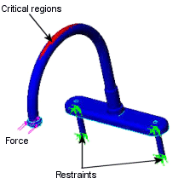
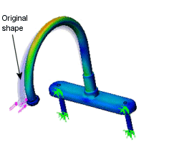
Visualization of Stress Under Given Forces

Slide 5
Why Use SimulationXpress?
After building your design in SOLIDWORKS, you might need to answer questions like: Will the part break?
How will it deform?
Can I use less material without affecting performance?
Without simulation tools, these questions can be answered only by expensive and time-consuming product development cycles that typically include the following steps: Build your model in the SOLIDWORKS CAD system.
Prototype the design.
Test the prototype in the field.
Evaluate the results of the field tests.
Modify the design based on the field test results.
This process continues until a satisfactory solution is reached. Simulation can help you accomplish the following tasks: Reduce cost by testing your model using the computer rather than field tests.
Reduce time to market by reducing the number of product development cycles.
Optimize your designs by simulating concepts and scenarios before making final decisions.

Slide 6
Stress Analysis
Stress or static analysis calculates the displacements, strains, and stresses in a part based on material, fixtures, and loads. A material fails when the stress reaches a certain level. Different materials fail at different stress levels. SimulationXpress uses linear static analysis, based on the Finite Element Method, to calculate stresses. Linear static analysis makes several assumptions to calculate stresses in the part.

Slide 7
Examples of SimulationXpress
Static Analysis of Cantilever Beam
Static Analysis of Shaft
Motion Analysis of SpiderAssembly

