Slide 1
MECH 3550 : Simulation & Visualization
Building Simple Simulation Models

Slide 2
Time Steps

Slide 3
C Programs
M/M/1 Queue Simulation
Alternates
Single Product Inventory System
https://www.programiz.com/c-programming/examples

Slide 4
Microsoft Excel Visual Basic Programs
M/M/1 Queue Simulation
Alternates
Single Product Inventory System
visualbasic.happycodings.com/forms/

Slide 5
Basic Simulation Modeling Advantages
Most complex, real-world systems with stochastic elements cannot be accurately described with a mathematical model that can be evaluated analytically. Thus a simulation is often the only type of investigation possible.
Simulation allows one to estimate the performance of an existing system under some projected set of operating conditions.
Alternative proposed system designs (or alternative operating policies for a single system) can be compared via simulation to see which best meets a specified requirement.
In a simulation we can maintain much better control over experimental conditions than would generally be possible when experimenting with the system itself.
Simulation allows us to study a system with a long time frame-e.g. an economic system-in compressed time, or alternatively to study the detailed workings of a system in expanded time.

Slide 6
Basic Simulation Modeling Disadvantages
Each run of a stochastic simulation model produces only estimates of a model’s true characteristics for a particular set of input parameters. Thus, several independent runs of the model will probably be required for each set of input parameters to be studied. For this reason, simulation models are generally not as good at optimization as they are at comparing a fixed number of specified alternative system designs.
However, an appropriate analytic model can often easily produce the exact true characteristics of that model for a variety of sets of input parameters. Thus, if a “valid” analytic model is available or can easily be developed, it will generally be preferable to a simulation model.
Simulation models are often expensive and time consuming to develop.
The large volume of numbers produced by a simulation study or the persuasive impact of a realistic animation often creates a tendency to place greater confidence in a study’s results than is justified.
If a Model is not a “Valid” representation of a system under study, the simulation results, no matter how impressive they appear, will provide little useful information about the actual system.

Slide 7
Pitfalls of a Successful Simulation Study
Failure to have a well-defined set of objectives at the beginning of the simulation study.
Failure to have the entire project team involved at the beginning of the study.
Inappropriate level of model detail
Failure to communicate with management throughout the course of the simulation study
Misunderstanding of simulation by management.
Treating a simulation study as if it were primarily an exercise in computer programming
Failure to have people with a knowledge of simulation methodology and statistics on the modeling team
Failure to collect good system data
Inappropriate simulation software
Obliviously using simulation-software products whose complex macro statements may not be well documented and may not implement the desired modeling.

Slide 8
Pitfalls of a Successful Simulation Study Cont.
Belief that easy-to-use simulation packages, which require little or no programming, require a significantly lower level of technical understanding.
Misuse of animation
Failure to account correctly for sources of randomness in the actual system
Using arbitrary distributions (e.g. normal, uniform, or triangular) as input to the simulation
Analyzing the output data from one simulation run using formulas that assume independence
Making a single replication of a particular system design and treating the output statistics as the “true answers”
Failure to have a warmup period, if the steady-state behavior of a system is of interest
Comparing alternative system designs on the basis of one replication for each design
Using the wrong performance measures

Slide 9
Examples of Queueing Systems
System | Servers | Customers
Bank | Tellers | Customers
Hospital | Doctors, nurses, beds | Patients
Computer System | Central processing unit, input/output devices | Jobs
Manufacuting system | Machines, workers | Parts
Airport | Runways, gates, security check-in stations | Airplanes, travelers
Communications network | Nodes, links | Messages, packets

Slide 10
Measures of Performance of Queuing Systems
time t]
Notes:
http://slideplayer.com/slide/4822328/15

Slide 11
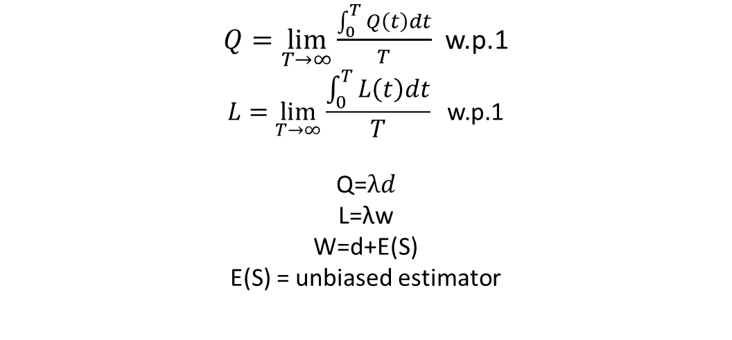
Measures of Performance of Queuing Systems Cont.
$Q=\lim_{T→∞}{\frac{\int_{0}^{T}{Q\left(t\right)dt}}{T}}$ w.p.1
$$L=\lim_{T→∞}{\frac{\int_{0}^{T}{L\left(t\right)dt}}{T}} \text{w}\text{.}\text{p}\text{.1}$$
Q=$λd$
L=λw
W=d+E(S)
E(S) = unbiased estimator
$ρ=λ/(sω$)

Slide 12
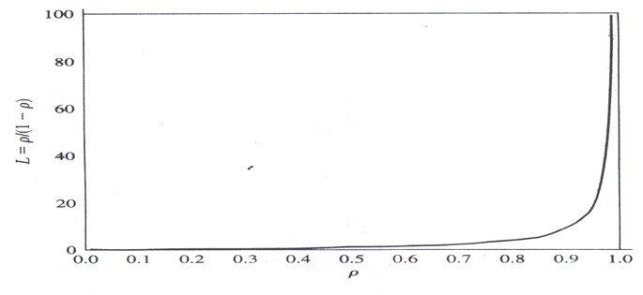
Plot of L for the M/M/1 queue
Notes:
https://ch.mathworks.com/help/simevents/gs/building-a-simple-discrete-event-model.html?s_tid=gn_loc_drop#a1076612269b1

