Slide 1
Powerpoint Flow Simulation
MECH 3550
Prof Swanson

Slide 2
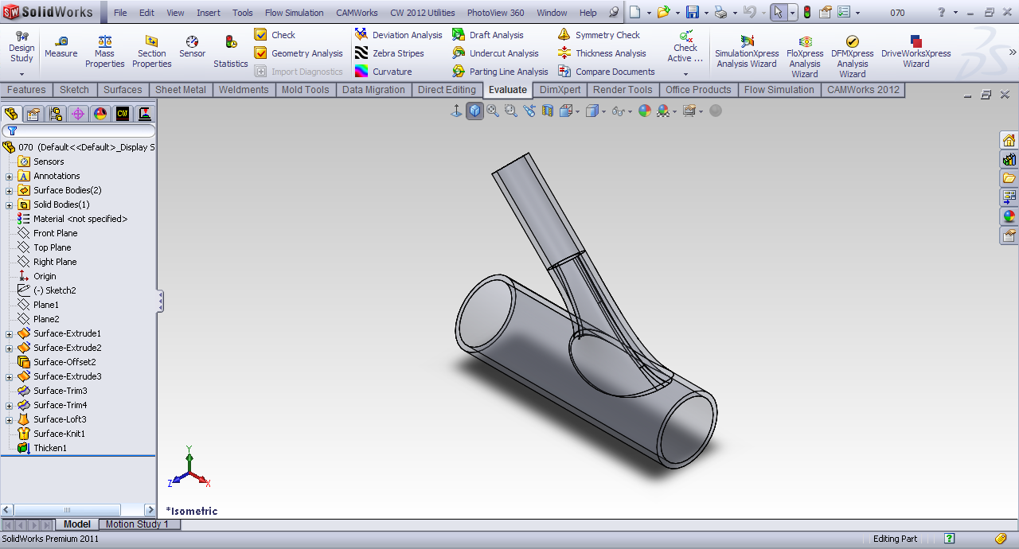
Step 1: Open the Part File

Slide 3
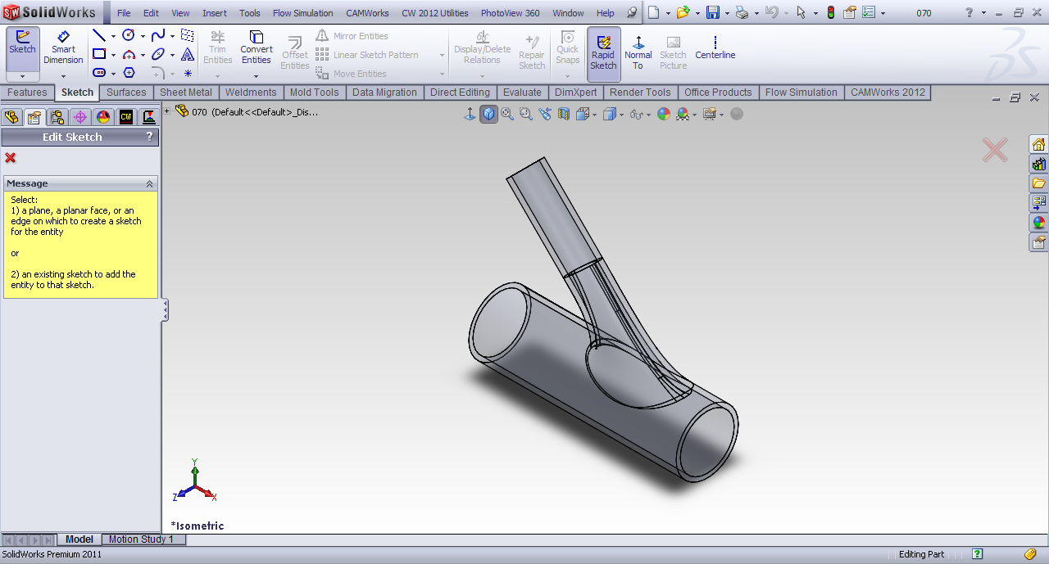
Step 2: First of all we have to create lids to close the open pipe. Choose Sketch

Slide 4
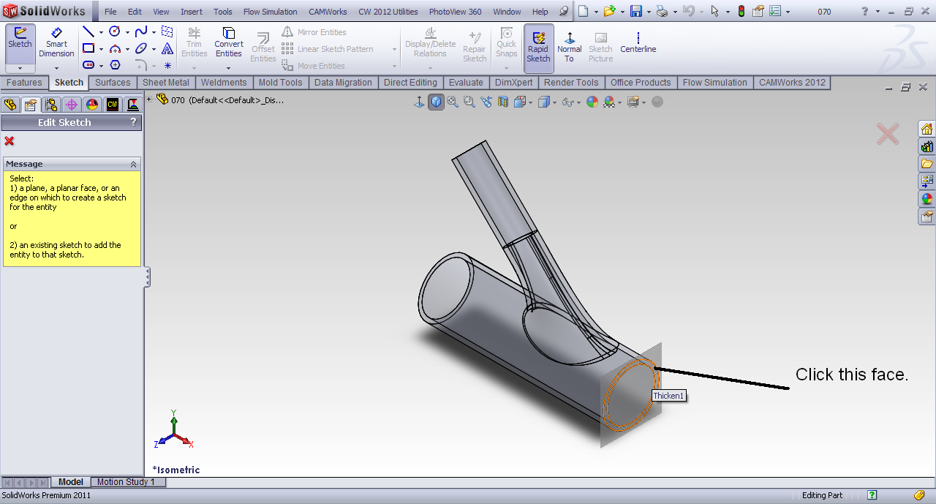
Step 3: Choose the first face to create the lid

Slide 5
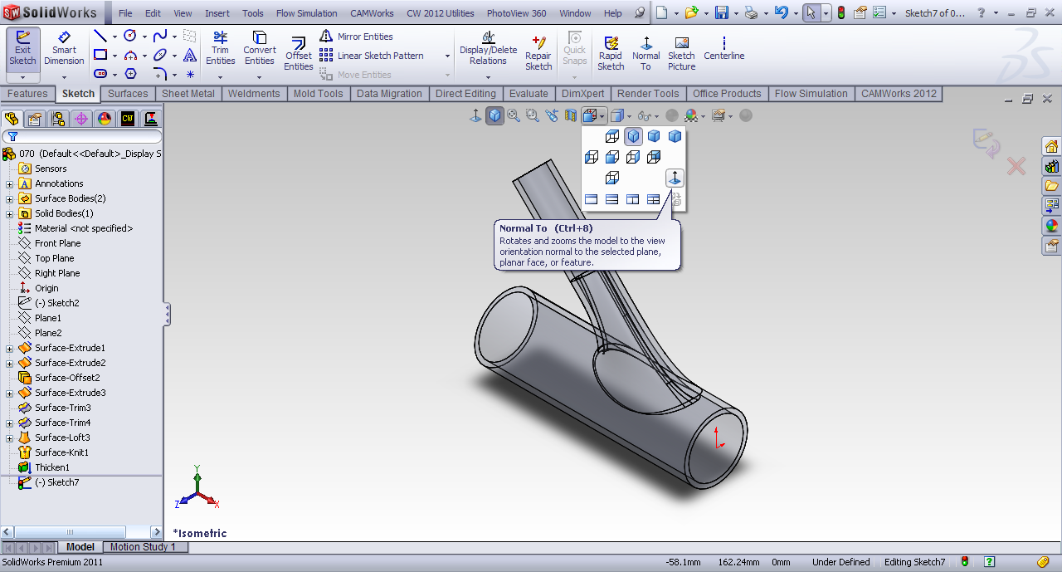
Step 4: Go to Normal View

Slide 6
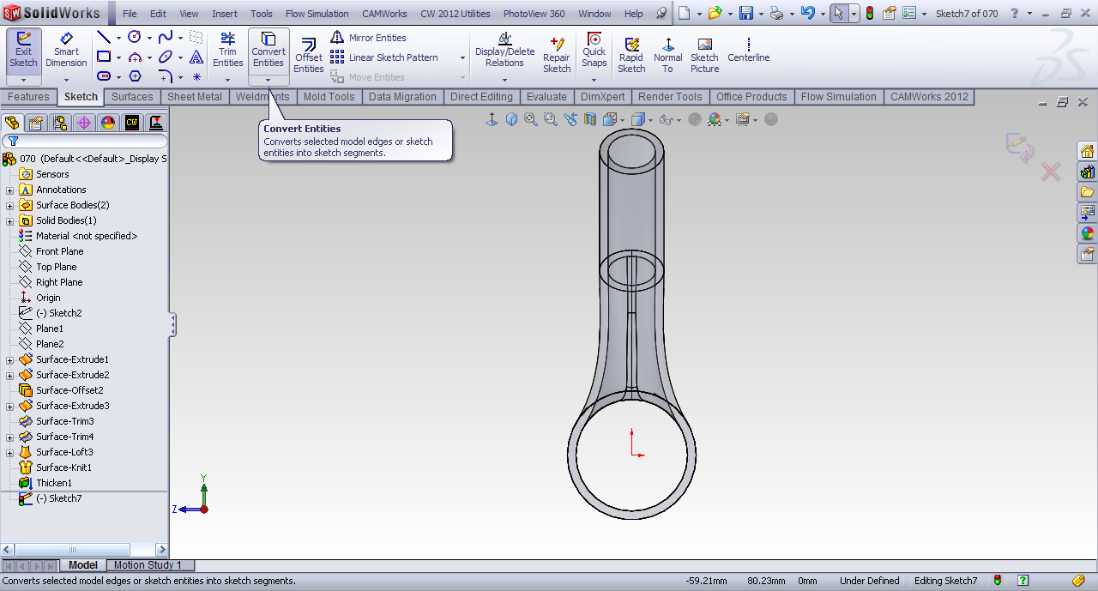
Step 5: Select Convert entities option.

Slide 7
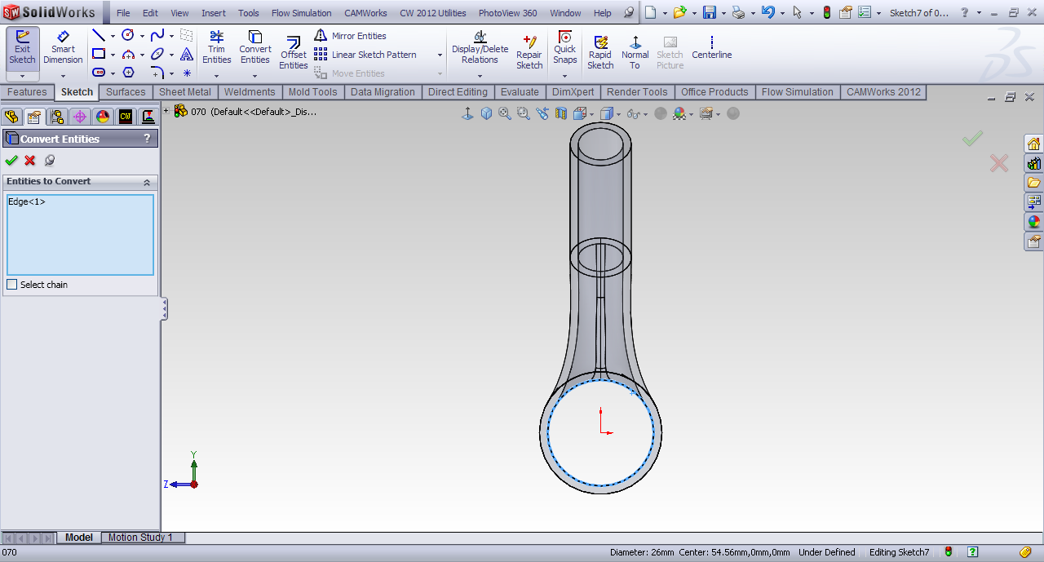
Step 6: Select the inner circle of the face

Slide 8
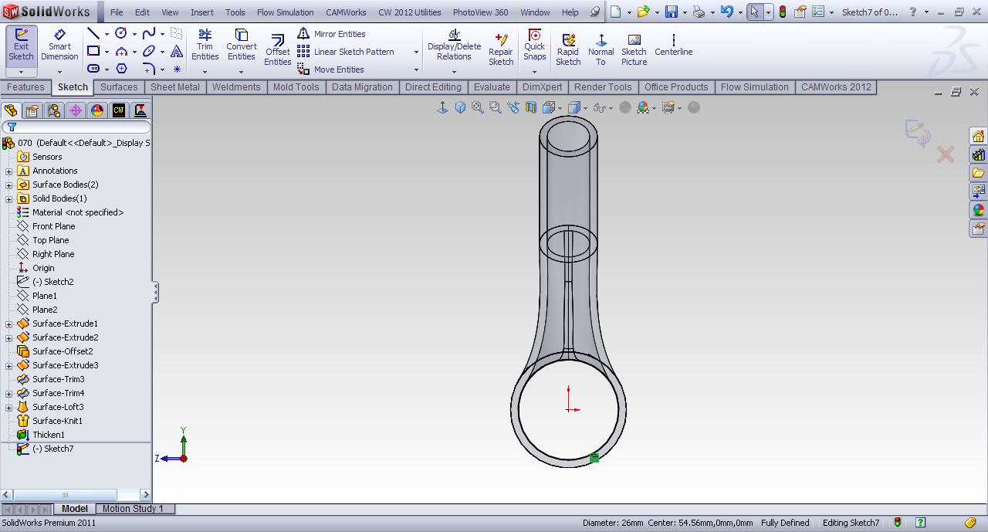
Step 7: Click Ok

Slide 9
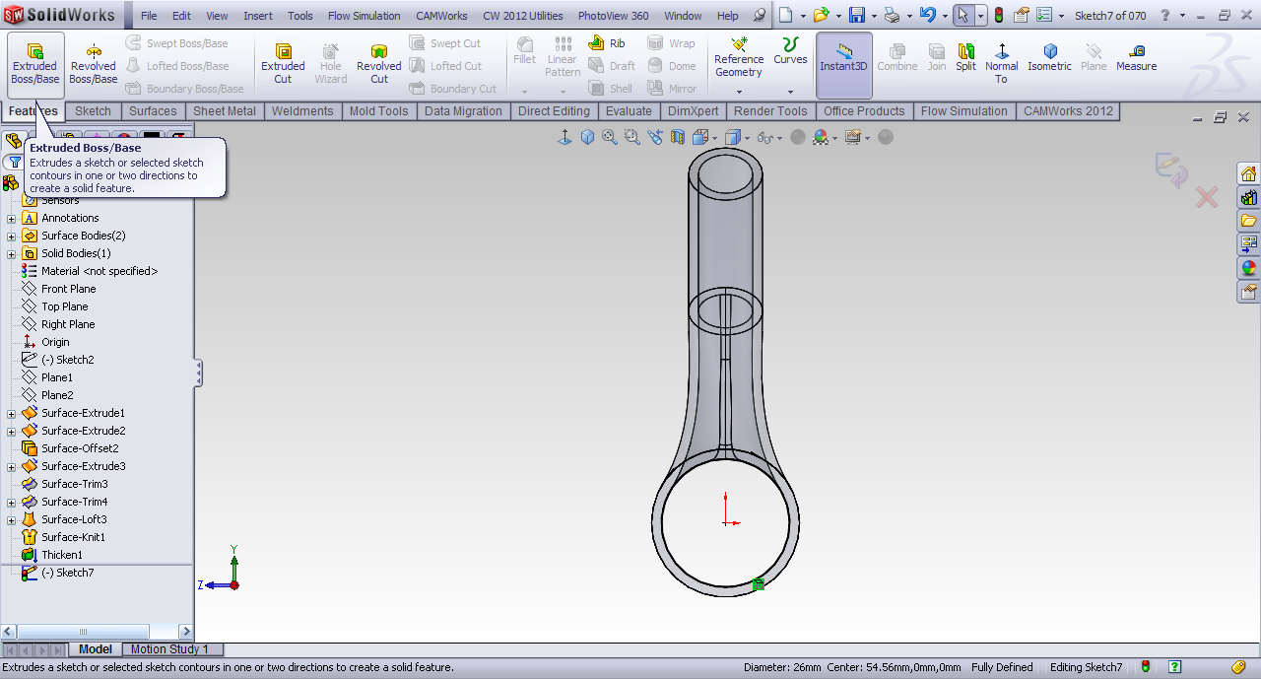
Step 8: Choose Extruded/boss in features tab

Slide 10
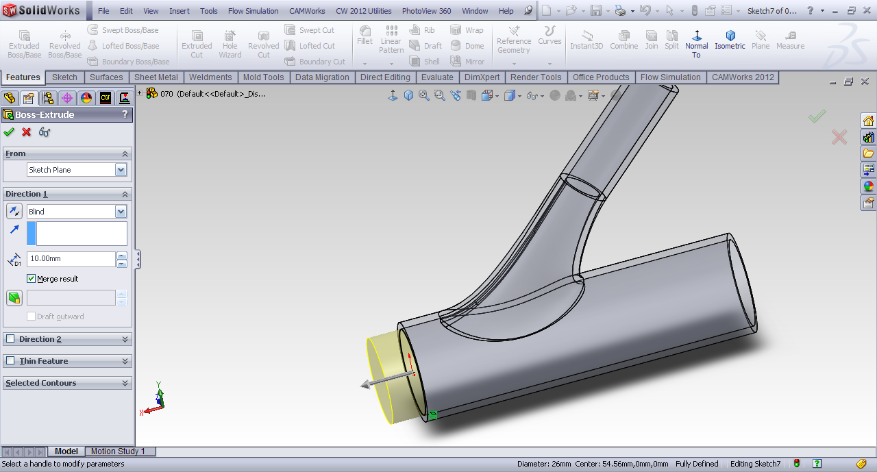
Step 9: The extrude property manager will show

Slide 11
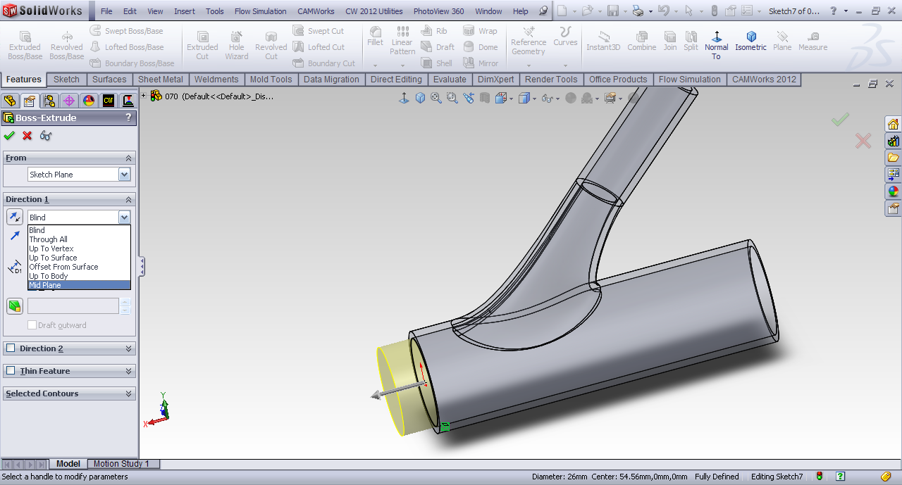
Step 10: In extrusion type choose mid plane. Because in most of the problems we requires surface contact rather than a line contact.

Slide 12
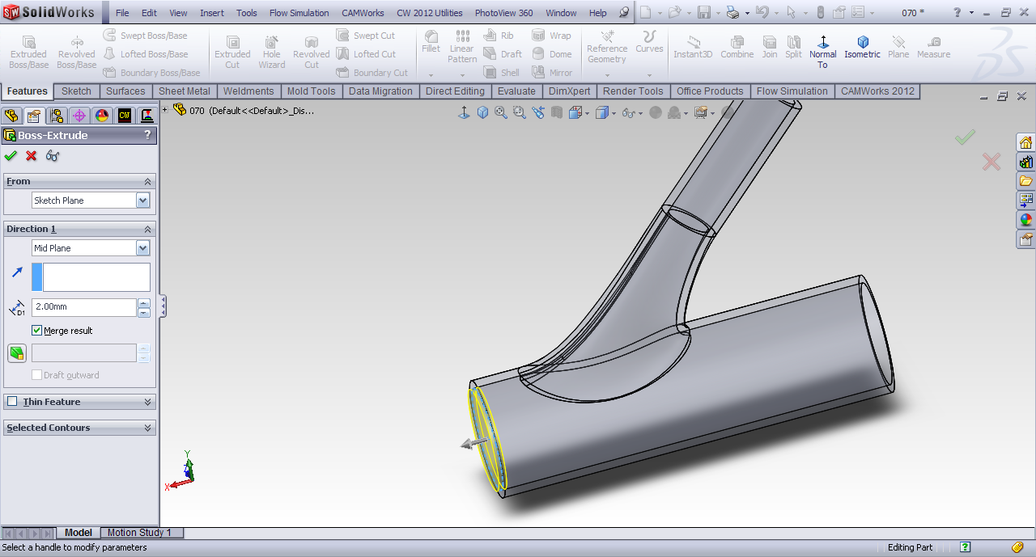
Step 11: Change the height to 2mm. The height of lid is kept same as the thickness of pipe.

Slide 13
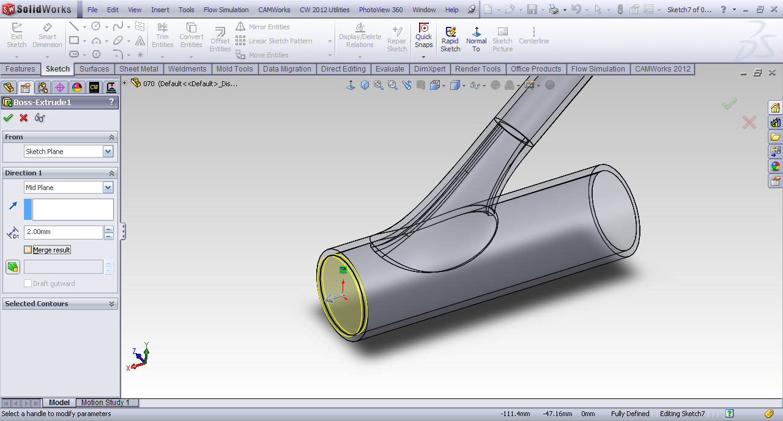
Step 12: Uncheck the Merge result. Because we want different bodies.

Slide 14
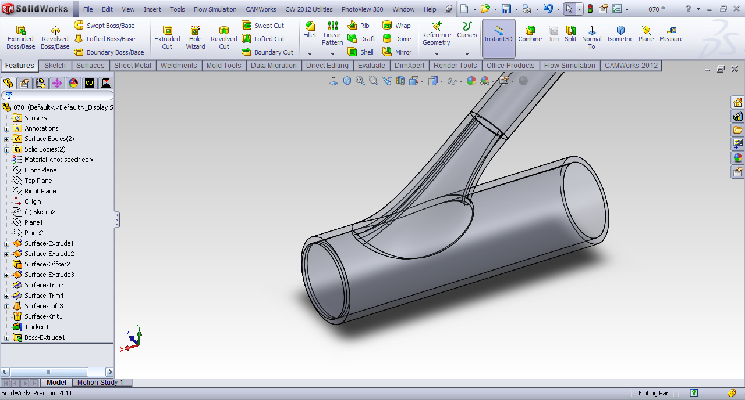
Step 13: Click OK

Slide 15
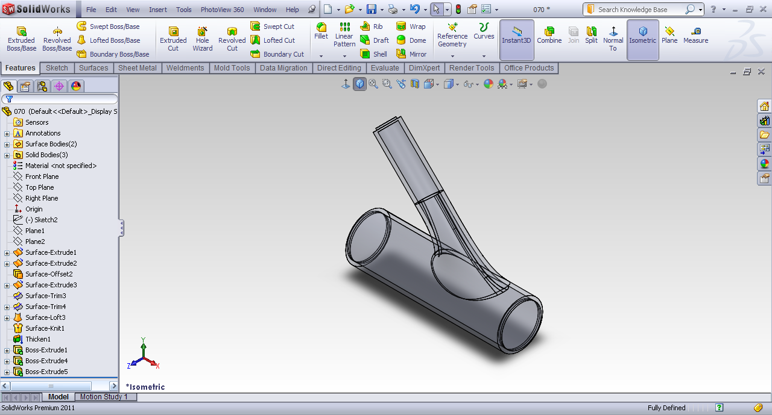
Step 14:Repeat the same steps with any other openings.

Slide 16
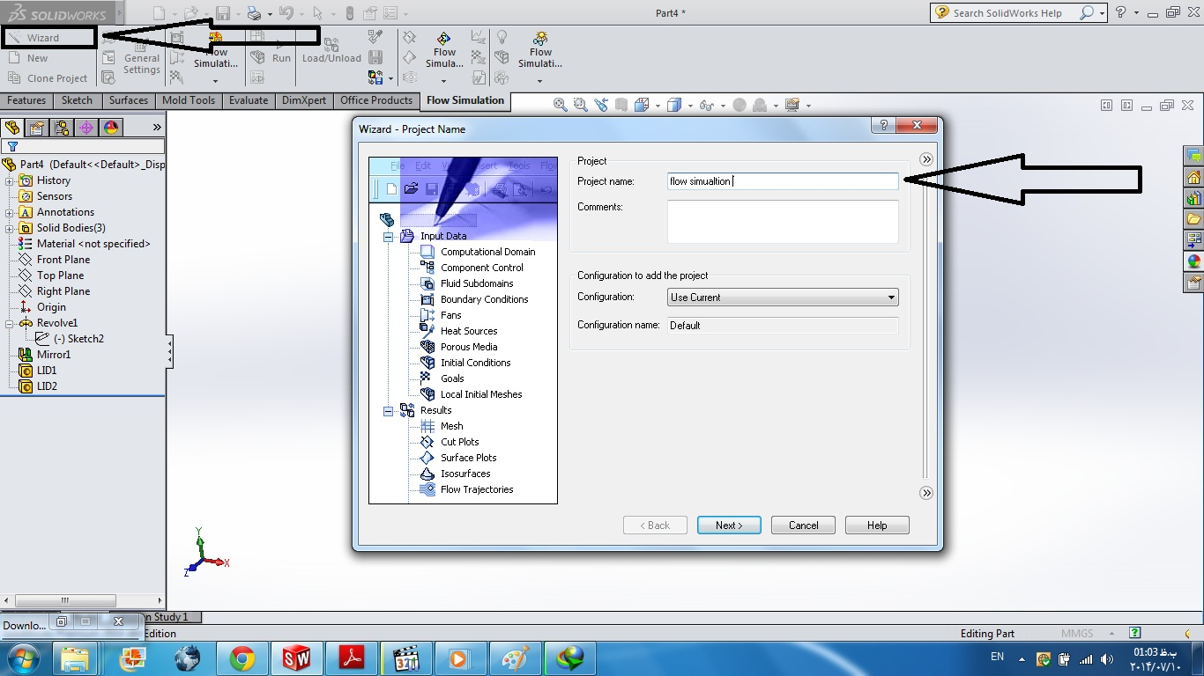
Step 15

Slide 17
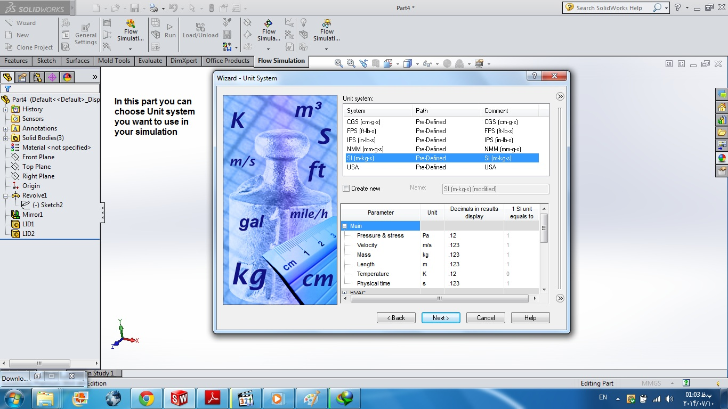
Step 16

Slide 18
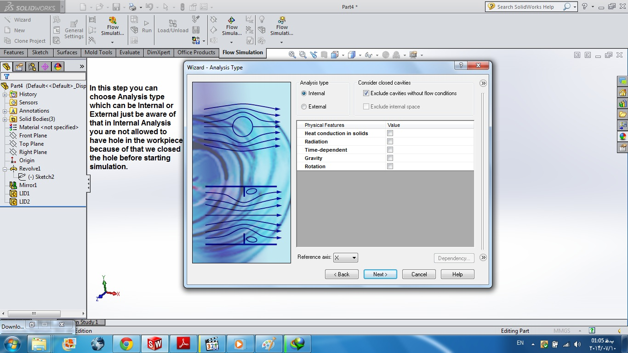
Step 17

Slide 19
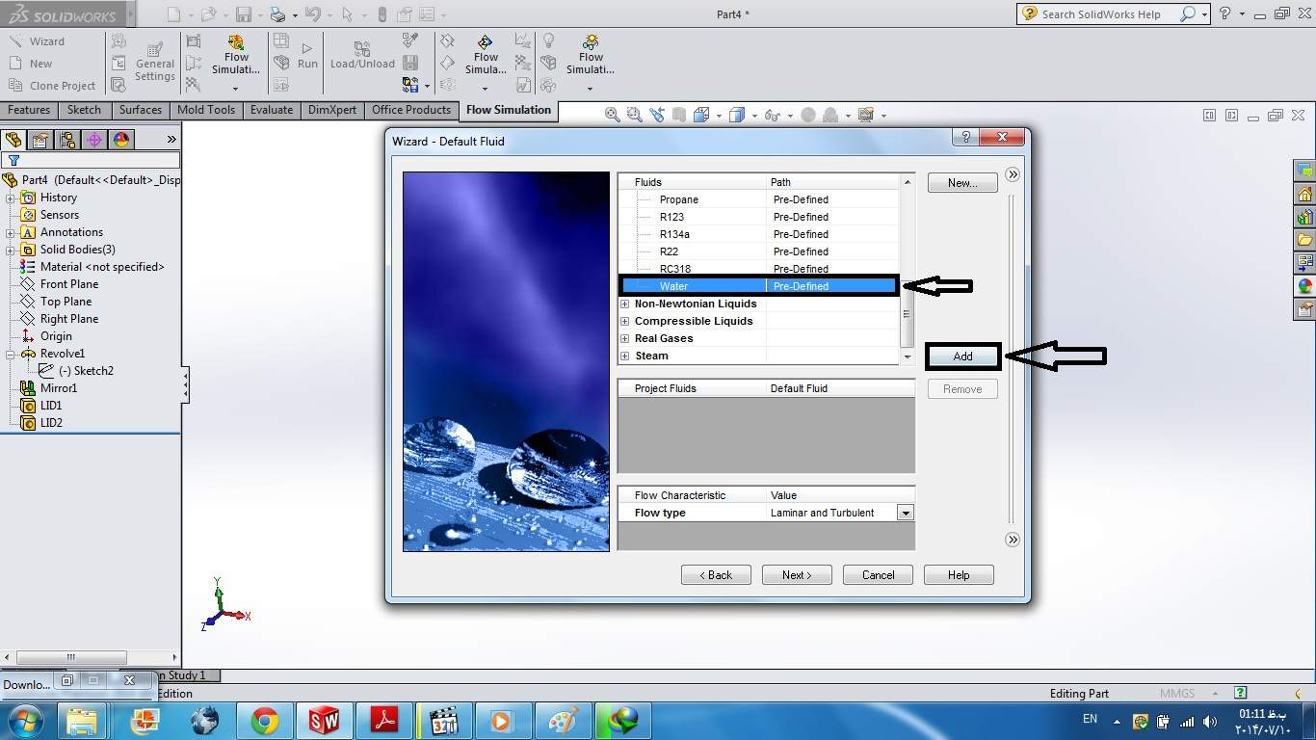
Step 18

Slide 20
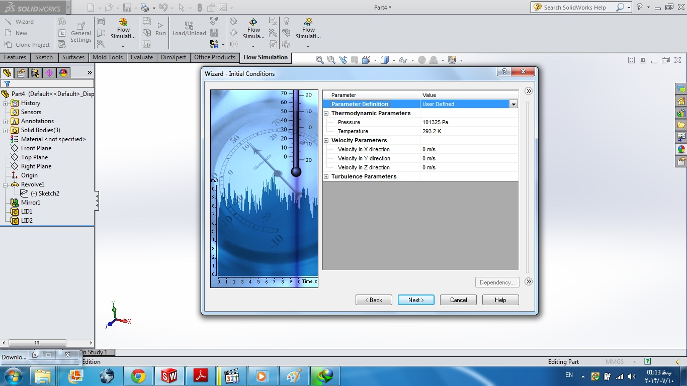
Step 19

Slide 21
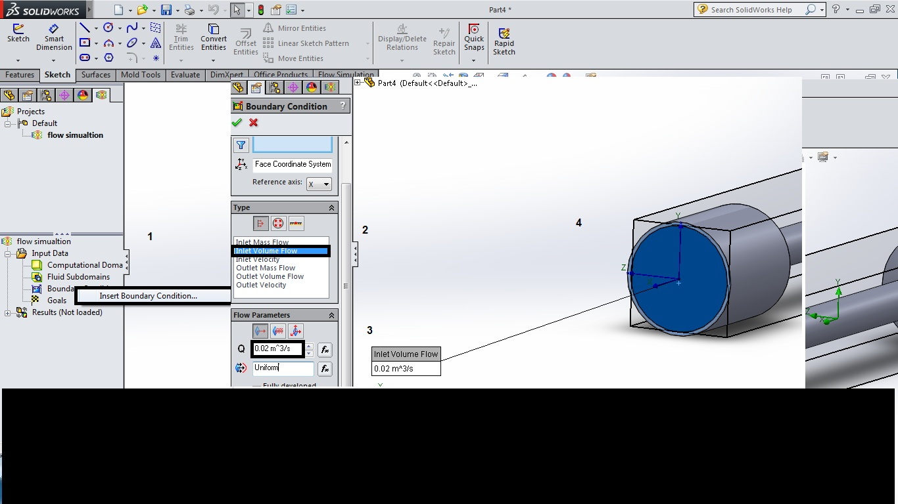
Step 20

Slide 22
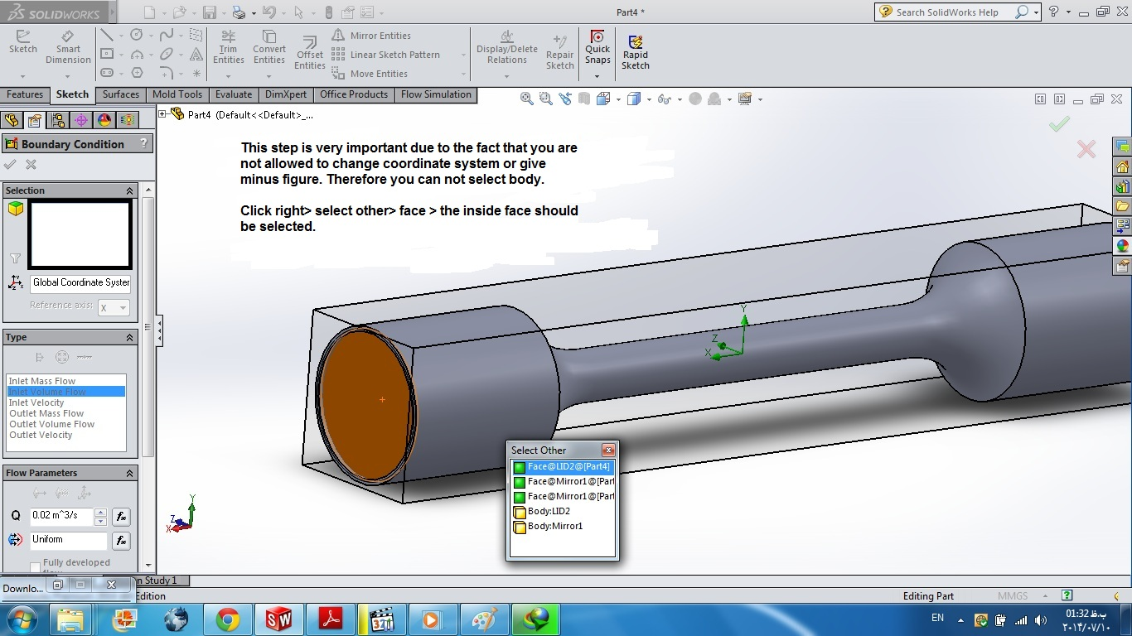
Step 21:

Slide 23
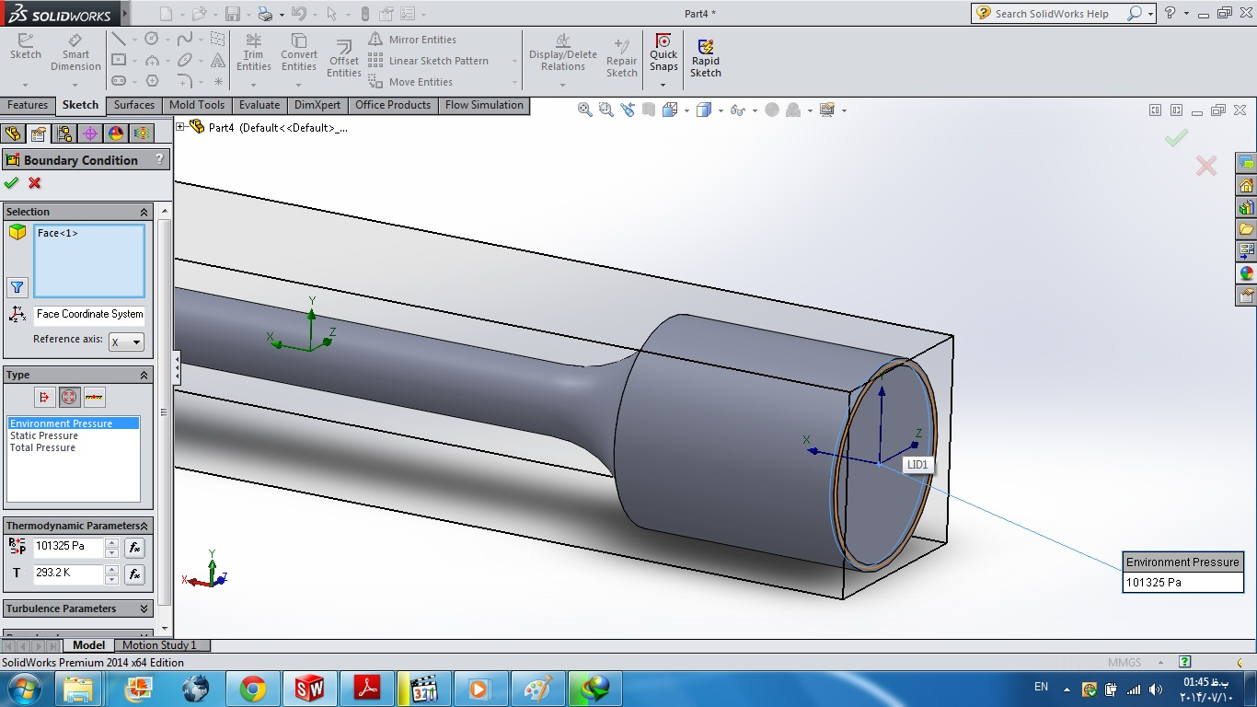
Step 22:

Slide 24
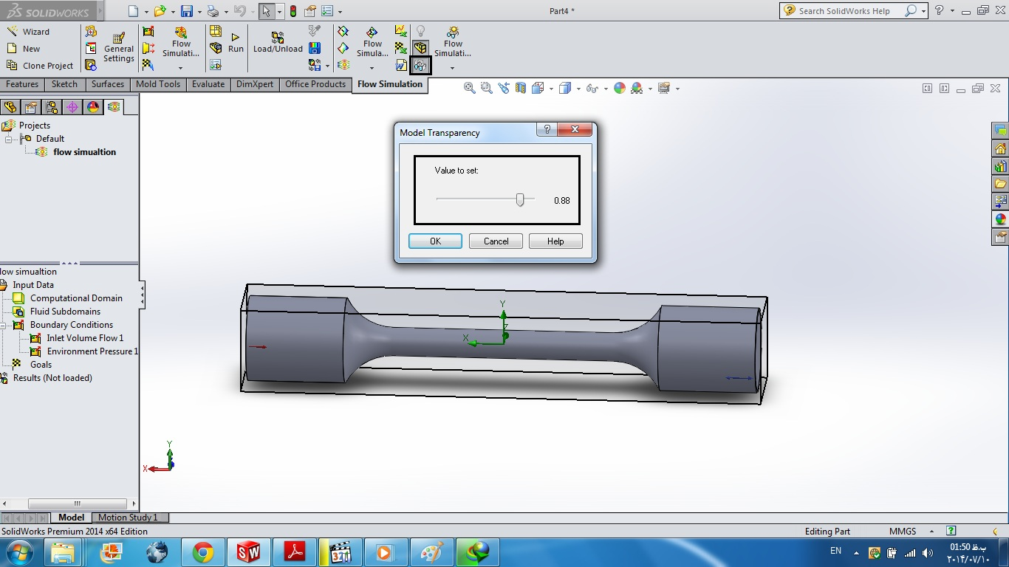
Step 23:

Slide 25
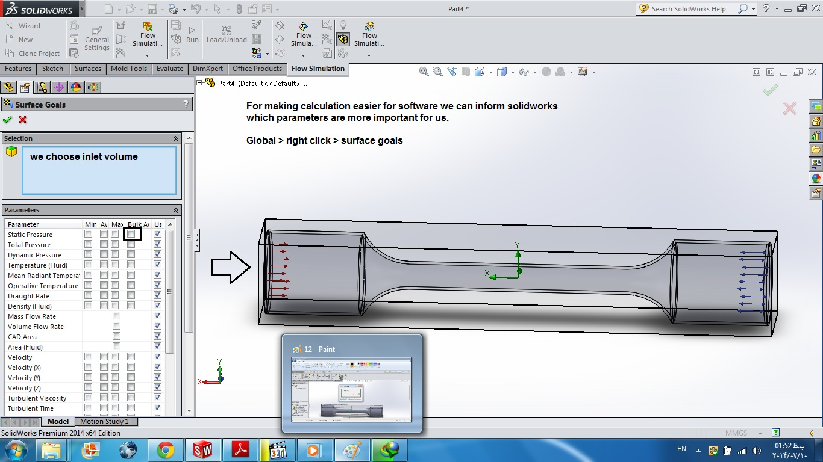
Step 24:

Slide 26
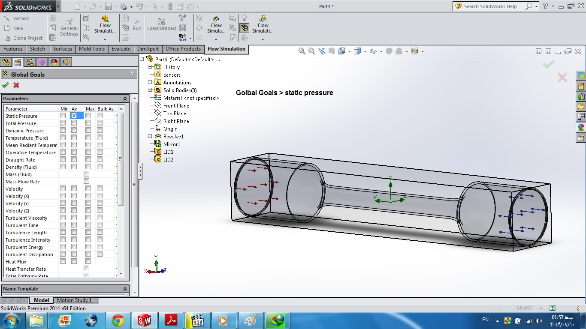
Step 25:

Slide 27
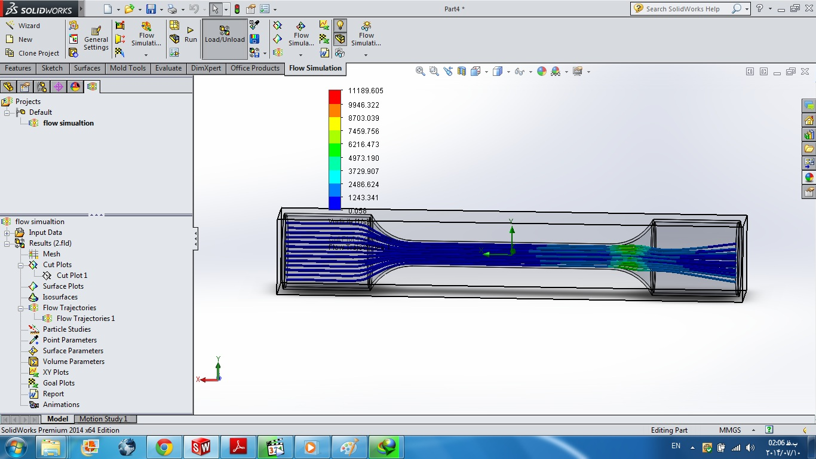
Step 26:

Slide 28
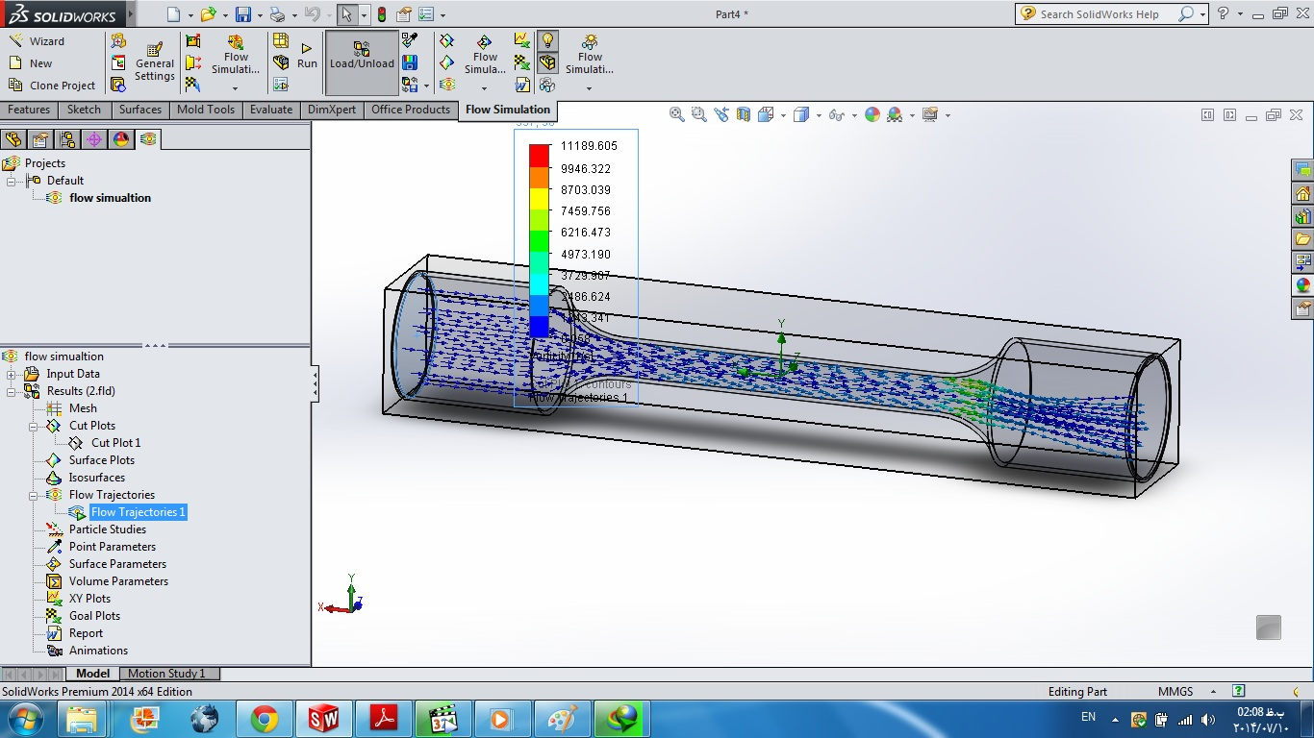
Step 27:

Slide 29
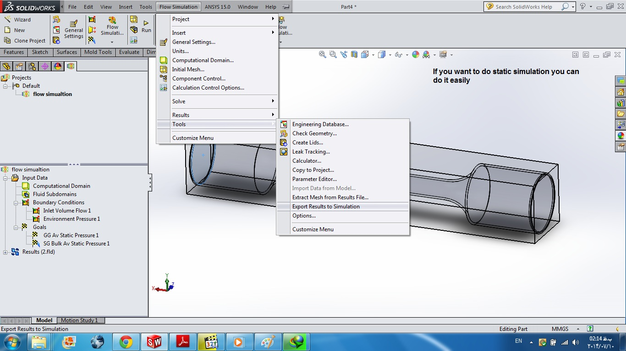
Step 28:

Slide 30
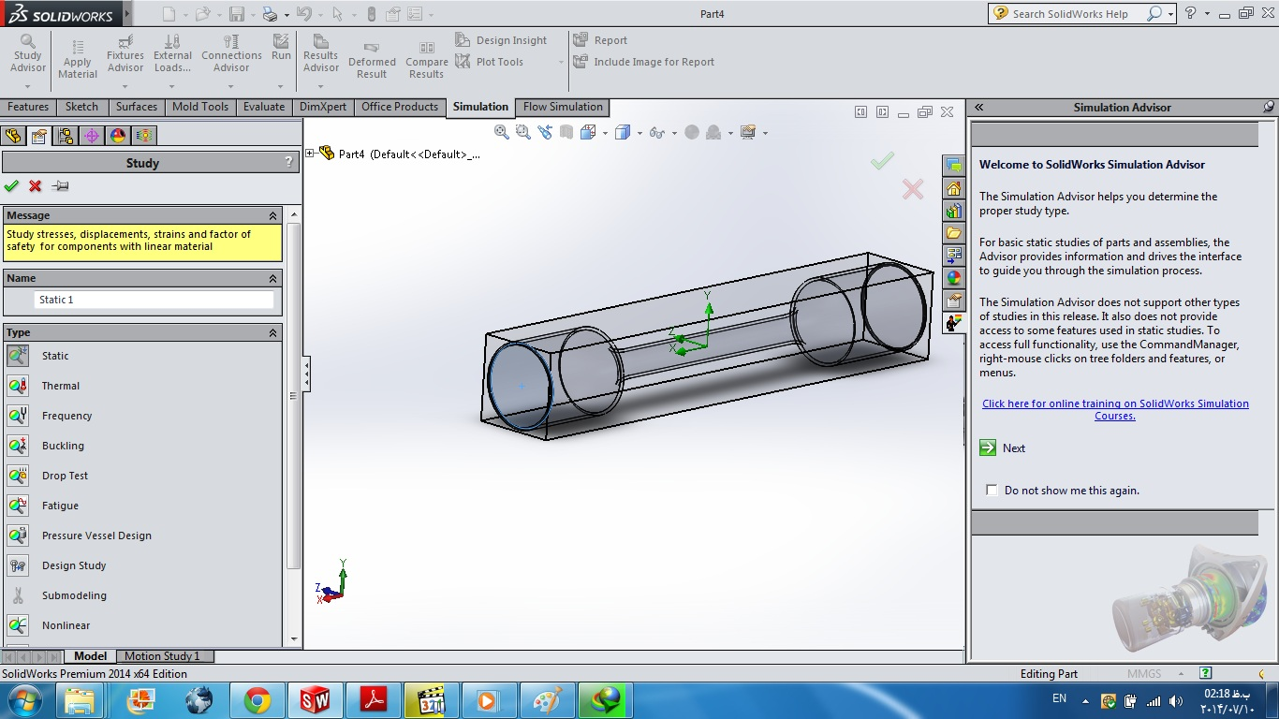
Step 29:

Slide 31
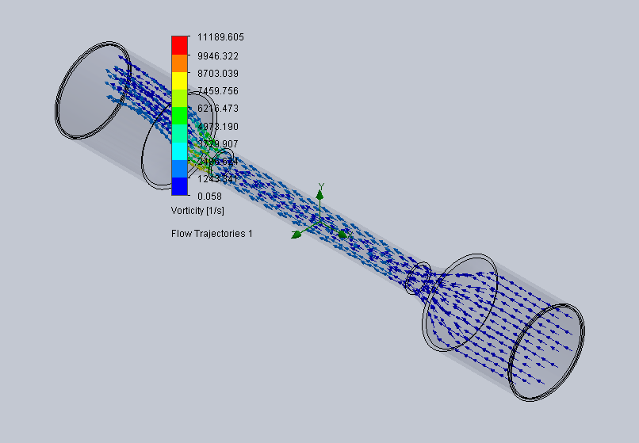
Step 30:

