Slide 1
FloXpress Lecture
MECH 3550
Prof Swanson

Slide 2
Step 1: Open the Part File

Slide 3
Step 2: First of all we have to create lids to close the open pipe. Choose Sketch

Slide 4
Step 3: Choose the first face to create the lid

Slide 5
Step 4: Go to Normal View

Slide 6
Step 5: Select Convert entities option.

Slide 7
Step 6: Select the inner circle of the face

Slide 8
Step 7: Click Ok

Slide 9
Step 8: Choose Extruded/boss in features tab

Slide 10
Step 9: The extrude property manager will show

Slide 11
Step 10: In extrusion type choose mid plane. Because in most of the problems we require surface contact rather than a line contact.

Slide 12
Step 11: Change the height to 2mm. The height of lid is kept same as the thickness of pipe.

Slide 13
Step 12: Uncheck the Merge result. Because we want different bodies.

Slide 14
Step 13: Click OK

Slide 15
Step 14:Repeat the same steps with any other openings.

Slide 16
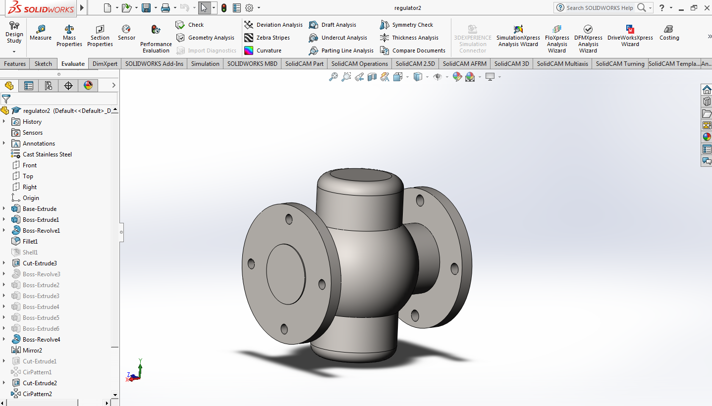
Step 15: Click Evaluate>> FloXpress

Slide 17
Step 16: The FloXpress Property Manager will show. Click Next.

Slide 18
Step 17: Click View Fluid Volume to check the fluid volume.

Slide 19
Step 18: The Volume will be highlighted. Click Next.

Slide 20
Step 19: In this type choose the type of fluid. We will keep Water for default fluid.

Slide 21
Step 20: Under Inlet conditions choose Pressure.

Slide 22
Step 21: right click the face and select the Select Other option and choose the inner face of the lid (you can cycle faces by right clicking the body).

Slide 23
Step 22: Let's keep other settings same. Click Next.

Slide 24
Step 23: Choose Pressure for Outlet type too.

Slide 25
Step 24: Under Outlet face select the inner face of the lid.

Slide 26
Step 25: Change the pressure value to 10000. Since the direction of flow is always from high pressure to lower pressure. if the value of pressure is higher at outlet than it will not flow. Click next.

Slide 27
Step 26: Click Play to solve the model. It will take a while.

Slide 28
Step 27: Under vector plot you can click play to see the animation of flow of water.

Slide 29
Step 28: Click Generate Report

