Slide 1
Nicotine & tobacco: what lies beneath
Jessica Vignapiano
Victoria Vignapiano
Samantha Vinci
Tiffany Andron

Slide 2
Objectives
To discuss the harmful effects that lie beneath nicotine/tobacco containing products
To inform students of the following products containing nicotine/tobacco:
Cigarettes
Chewing tobacco
Electronic cigarettes/”Vapes”
To address the negative health effects and oral manifestations that result from the use of these products
To educate smokers/non-smokers about alternatives and smoking cessation

Slide 3
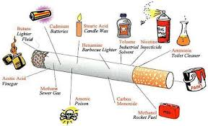
What is in a cigarette?
Nicotine (an addictive substance contained in tobacco), hydrogen cyanide, formaldehyde, lead, arsenic, ammonia, benzene, carbon monoxide, radioactive elements, nitrosamines, polycyclic aromatic hydrocarbons (PAHs), tar, etc.

Slide 4
Harmful effects: cigarettes
Oral | Systemic
Oral cancer | Cancers: Lung, heart, throat, thyroid, etc.
Gingivitis and Periodontal disease | Chronic Obstructive Pulmonary Disease (COPD)
Halitosis (bad breath) | Heart disease
Stained teeth and tongue | Stroke
Nicotinic stomatitis (smoker’s palate) | Asthma
Delayed healing post oral surgery | Emphysema
Increased buildup of plaque and tartar | Diabetes
Increased risk of leukoplakia (white patches) | Blindness, cataracts, age-related macular degeneration
Black Hairy Tongue | Reproductive effects in women

Slide 5
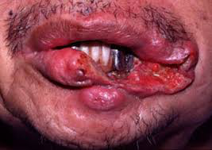
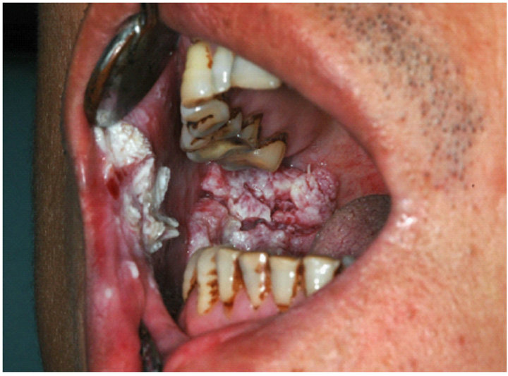
Oral cancer

Slide 6
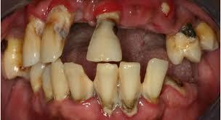
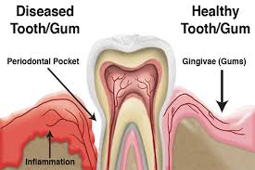
Dental effects

Slide 7
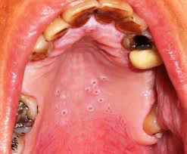
Nicotinic stomatitis

Slide 8
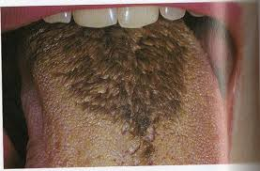
Black hairy tongue

Slide 9
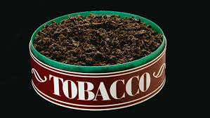
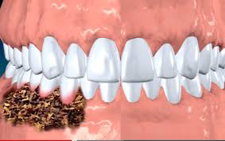
What is chewing tobacco?
Chewing tobacco- a form of smokeless tobacco containing nicotine used by chewing and/or placing a portion between the gingiva and cheek or gingiva and upper lip
Chewing tobacco is known to contain at least 28 carcinogens (cancer-causing chemicals)
The main carcinogens in chewing tobacco are tobacco-specific nitrosamines (TSNAs), formaldehyde, acetaldehyde, arsenic, benzopyrene, nickel, and cadmium
Nicotine is absorbed 3-4 times more from chewing tobacco as opposed to a cigarette. The nicotine from chewing tobacco remains longer in the bloodstream

Slide 10
Harmful effects: chewing tobacco
Oral | Systemic
Development of gingivitis and recession | Cancers: Pancreatic, esophageal, and stomach
Leukoplakia | Increased risk of heart disease including heart attack and stroke (risk not as great compared to smoking)
Abrasion (wearing down of teeth) | Increased heart rate
Oral cancers: Cheek, gums, lips, tongue, floor and roof of the mouth | High blood pressure
Staining of teeth | Arrhythmia (irregular heartbeat)
Tooth decay/tooth loss | Oropharyngeal tumors

Slide 11
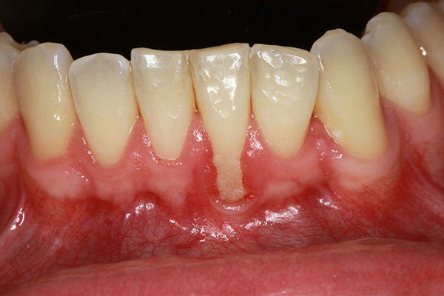
Gingivitis and recession

Slide 12
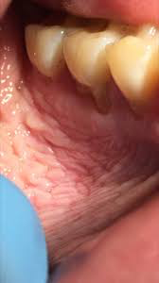
Leukoplakia

Slide 13
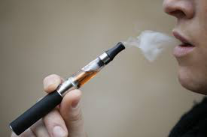
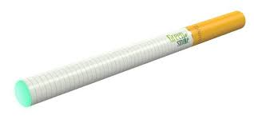
Electronic cigarettes/”Vapes”
Electronic cigarettes- battery powered devices that heat a liquid- usually containing nicotine mixed with chemicals (propylene glycol, and glycerin) -into a vapor that users can inhale
They deliver nicotine to the body without delivering any smoke
When heated and vaporized, propylene glycol or glycerin can degrade into formaldehyde and acetaldehyde
One of the biggest safety risks of e-cigarettes is the potential for their lithium-ion batteries to explode, sometimes into a person’s face or eyes

Slide 14
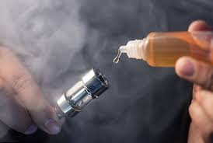
Electronic CIGARETTES

Slide 15
Harmful effects: E-cigarettes
Similar to cigarettes and chewing tobacco. E-liquids contain nicotine which increases the risk of high blood pressure and diabetes. The flavoring agents used can cause a chronic lung disease called Bronchiolitis Obliterans
Aside from the oral and systemic effects of nicotine, e-cigs also produce common side effects such as:
Dry skin
Dry mouth
Rash/burning sensation on face
Itchiness
Puffy/dry eyes
Caffeine sensitivity
Minor nose bleeds

Slide 16
It is never too late to quit!
24 hours ➔ Risk of heart attack begins to drop
3 months ➔ Less fatigue; lungs begin to repair; smoker’s cough begins to disappear
1 year ➔ Risk of coronary heart disease is half that of a smoker; risk of stroke, lung disease and lung cancer continue to lower
5 years ➔ Risk of stroke is similar to persons who never smoked
10 years ➔ Heart and circulatory system greatly repaired
15 years ➔ Risk of coronary heart disease is the same as persons who never smoked; risk of lung cancer is almost the same as persons who never smoked

Slide 17
The role of the dental hygienist
ASK | EVERY PATIENT ABOUT TOBACCO USE
ADVICE | EVERY TOBACCO USER TO QUIT
ASSESS | DETERMINE WILLINGNESS TO QUIT. PROVIDE INFORMATION ON QUITLINES
ASSIST | REFER TO QUITLINES
ARRANGE | REFER TO QUITLINES

Slide 18
Image references
http://file.scirp.org/Html/4-1460136_33707.htm
http://adruniverse.blogspot.com/2012/02/mouth-cancer.html
http://www.entusa.com/hpv_&_oral_cancer.htm
http://www.healthygumsmontana.com/tag/periodontal-disease/
https://www.efp.org/patients/what-is-periodontitis.html
http://tidatabase.org/smoking-gum-disease-tooth-loss/
http://northiowatoday.com/2017/02/11/editorial-improve-the-health-of-your-heart-quit-chew/
https://ecigarettereviewed.com/chewing-tobacco/
https://www.sciencesource.com/archive/Chewing-tobacco-damage-SS2257722.html
https://www.sciencesource.com/archive/Chewing-tobacco-damage-SS2257722.html

