Slide 1
Medical Experimentation
and
African American
Women
By, Saba Tanvir

Slide 2
Thesis
Medical Experimentation, though a global horror, experienced by various ethnic groups and their governments (Nazi-Germany/Holocaust); African American women have had a particularly torrid and consistent relationship with government sanctioned and university approved medical experimentation such as: compulsory sterilization, birth control, and population control.

Slide 3
Eugenics
Eugenics was a very popular social movement, which claimed to be a method of improving and preserving the desired groups in the population. Eugenics originally emerged from Darwin’s theory of evolution, which stated, “species that become successful and dominant are those best suited to survival in the environment in which they are living” (Rothman 7).

Slide 4
Late 19th and Early 20th Century
Supporters of Eugenics took Darwin’s theory to an extreme level and used the theme “survival of the fittest” to abandon who were “unfit”. Eugenics was practiced all over the world and was also promoted by governments and influential people of the time. Eugenics reached its peak in United States in the late 19th and early 20th centuries. Eugenics in the U.S. was a way to reduce or even eliminate black population because they were believed to be the unfit of the society.

Slide 5
Eugenics in United States
Eugenics existed in the U.S. in many different forms such as: genetic screening, birth control, promoting differential birth rates, marriage restrictions, segregation, compulsory sterilization, forced abortions and forced pregnancies.

Slide 6
Compulsory Sterilization
Compulsory Sterilization was a government policy; According to which, people must go under surgical sterilization. This was to prevent the reproduction and multiplication of members of the population that were considered to be carriers of defective genes and African American women were thought to be the carrier of these diseases.

Slide 7
Unnatural Causes: Is Inequality Making Us Sick?
Is a documentary series directed by Adelman, L. and produced by California Newsreel in 2008. Chapter 2: When the Bough Breaks in this documentary focuses on the phenomenon that African American women are most likely to give birth to premature or low birth weight babies than white women regardless of their education and income levels. According to the documentary, that this can be due to racial inequalities African American women face on daily basis and how this chronic stress can affect their children.

Slide 8
Over Sexuality
African American women were always perceived as over sexual. Over the many decades they have been victims of many degraotypes such as: Mammy and Jezebel (Covert, 2013).

Slide 9
Birth Control
Birth control is a method used to control pregnancy. Contraceptive pill, which was a very popular method of birth control, was approved in the United States in 1960.

Slide 10
African American women and “The Pill”
For African American women, it was a conspiracy that was introduced to hold them back by reducing them in numbers.

Slide 11
The Pill
Is a documentary film directed by Gazit, C, & Steward, D and published by the Steward/Gazit Productions, Inc. in 2008. This documentary film talks about how the contraceptive pill was invented in the 60s. This film also focuses on how the pill was uses against African American women with out their consent. It was being prescribed to them by their doctors as Aspirin or other mild painkillers. These women had no idea that by making a simple doctor visit will change their entire lives. They no longer will be able to have children they always wanted.

Slide 12
Population Control
Population control was a term that was introduced around the same era as the birth control pill. It was introduced to keep the growing population of America under control. But in reality it was a government conspiracy used to keep only African American population under control.

Slide 13
CRACK
CRACK is an organization that pays Black drug addicts to give up their fertility permanently and in returns they offer them rewards in cash form. And unfortunately 60% of their clients are Blacks. This organization advertises “ Don’t Let Pregnancy Ruin Your Drug Habit”(projectprevention 2013).

Slide 14
Elaine Riddick, Victim of Forced Sterilization
http://www.youtube.com/watch?v=IzYQLHHCxq8

Slide 15
Social Media

Slide 16
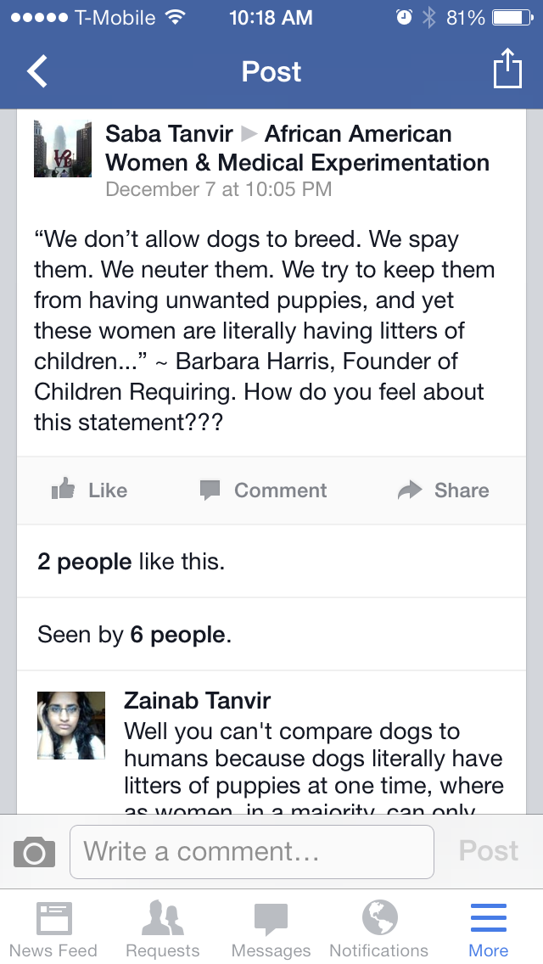

Slide 17
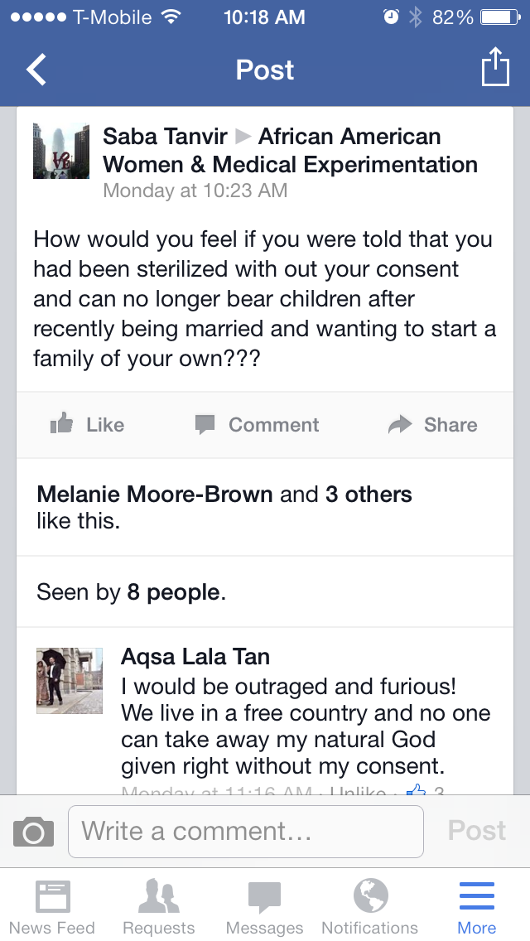

Slide 18
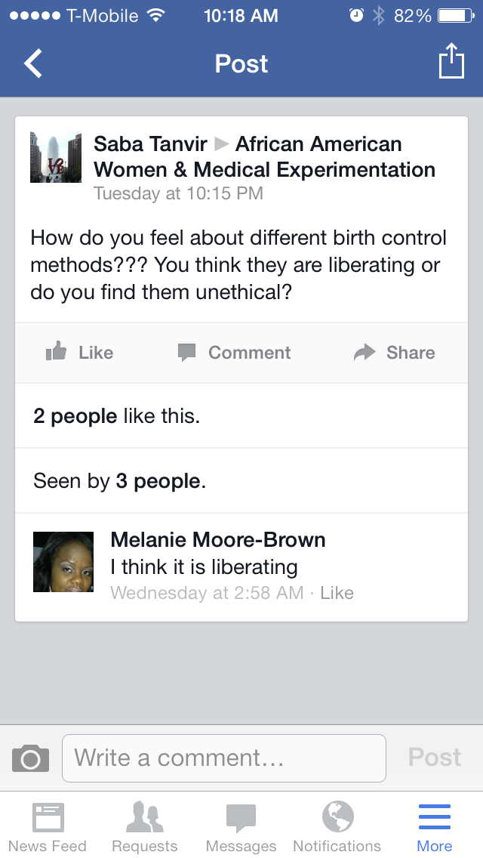

Slide 19
Bibliography
Adelman, L. (2008). Unnatural Causes: Is Inequality Making Us Sick? California Newsreel.
Gazit, C, & Steward, D. (2008). The Pill. United States: Steward/Gazit Productions, Inc. American Experience.

