Slide 1
Cementicles, Cemental Spurs, Concrescence
Silvia Solis

Slide 2
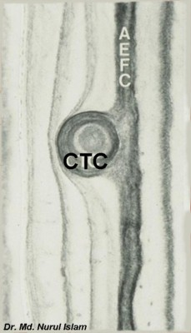
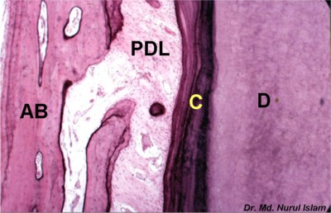
Cementicles
Are mineralized bodies of cementum found either attached to the Cemental root surface or lying free in the periodontal ligament
They form from the apposition of cementum around cellular debris in the periodontal ligament
They become attached or fused from the continued apposition of cementum, and may interfere with periodontal treatment, as well as being noted on radiographs.

Slide 3
Cemental Spurs
Can be found at or near the Cemental enamel junction
There are symmetrical spheres of cementum attached to the Cemental root surface, similar to enamel pearls.
Cemental spurs result from irregular deposition of cementum on the root
They can present some clinical problems in differentiation from calculus and may be noted on radiographs; yet, because they are hard dental tissue, they are not easily removed, and thus may also interfere with periodontal treatment.

Slide 4
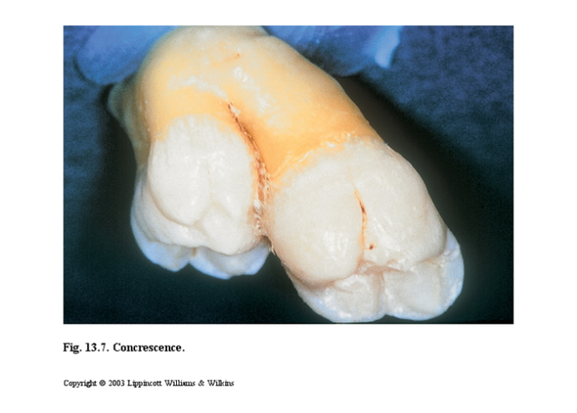
Concrescence
This is the union of the root structure of two or more teeth through the cementum only, mainly occurring with permanent maxillary molars
The teeth involved are originally separate but join because of the excessive cementum deposition on one or more teeth after eruption.

Slide 5
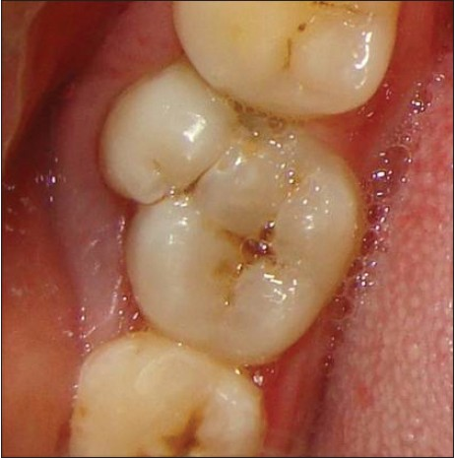
Traumatic injury or crowding of the teeth in the area during the apposition and maturation stage of tooth development may be the cause.
This may present problems during extraction and endodontic treatment, and preoperative radiographs are important in the detection of this disturbance

Slide 6
Role of the Dental Team
Concrescence, Cementicles and Cemental spurs can be seen on radiographs
Cementicles and Cemental spur can interfere with periodontal treatment
Concrescence can present problems during extraction and endodontic treatment
Record and document any radiographic findings

