Slide 1
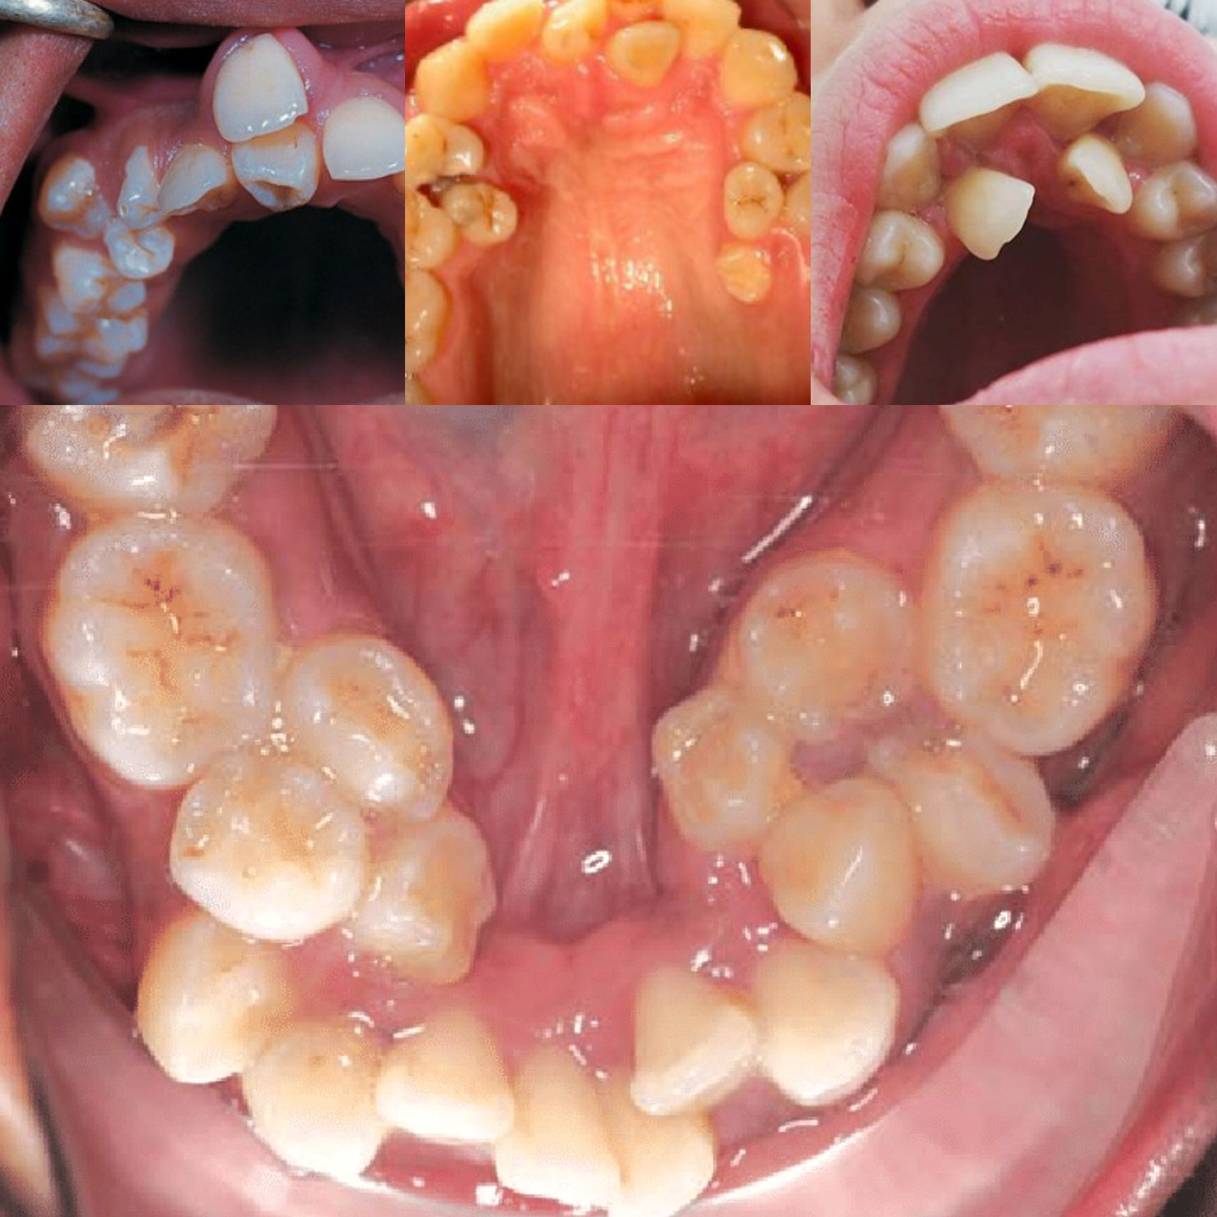
SUPERNUMERARY TEETH
By: SANA SHOAIB

Slide 2
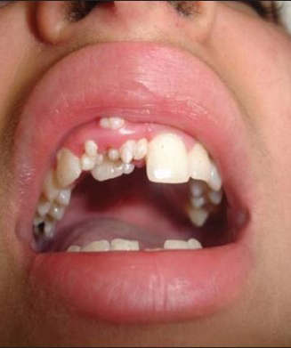
Supernumerary teeth
It is also called as hyperdontia.
It is defined as any tooth or tooth substance in excess of the usual configuration of 20 deciduous or 32 permanent teeth.
The teeth may be multiple, unilateral or bilateral, and some maybe malformed while others appear normal.
85% are in the anterior part of maxilla.
They could appear as premolars and 4th molar too.
Most common location is the Maxillary midline – Mesiodens.

Slide 3
Mesiodens
It is the most common cause for an unerupted upper central incisors.

Slide 4
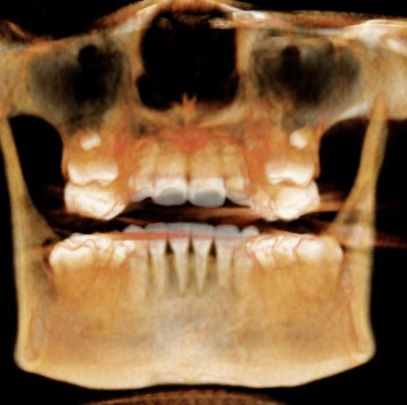
ETIOLOGY
Still unknown. Most possible causes are:
HEREDITARY – most commonly.
TOOTH GERM DICHOTOMY THEORY – it states that during early tooth development, dental lamina was divided into two equal parts or different size, thus giving rise to two teeth with similar size or one normal tooth and one dysmorphic tooth.
HYPERACTIVITY OF DENTAL LAMINA – Over-proliferation of dental lamina epithelial cells can lead to formation of supernumerary teeth.

Slide 5
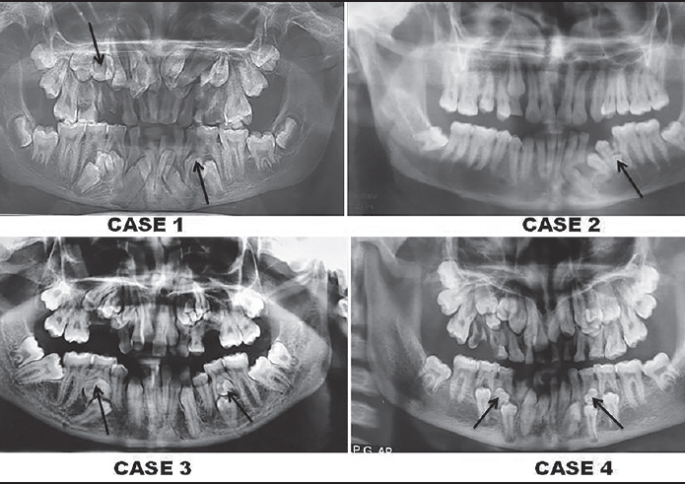
Cleidocranial Dysplasia and Gardener’s Syndrome
The most common syndromes associated with supernumerary teeth are:
Cleidocranial dysplasia and Gardener’s syndrome.
Cleidocranial dysplasia is a rare genetic condition that affects teeth and bones.
In case of Gardener’s syndrome the defect in APC gene allows certain cells to multiply in a disorderly manner.

Slide 6
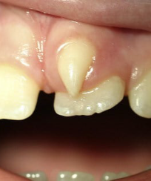
How Do These Teeth Affect Oral Health?
The most obvious effect of a supernumerary tooth is on the appearance of the person’s smile, but not all of the concerns are cosmetic. They often remain impacted leading to crowding and alignment problems for the normal series of teeth, sometimes making it harder for them to erupt. In serious cases, they can cause root resorption in the surrounding teeth. When erupted they cause crowding, diastema, malocclusion and periodontitis.

Slide 7
Diagnosis & Treatment
A dentist will diagnose hyperdontia by inspecting the mouth.
They will also take X-rays to check for any extra teeth that have not erupted through the gingiva .
Treatment depends on whether the supernumerary teeth are likely to cause complications.
Usually, extra teeth cause no symptoms. A person may have no idea that they are there, and a dentist may only detect them on an X-ray.
If supernumerary teeth are causing no symptoms or complications, they may not require treatment.

Slide 8
Dental hygiene care
In case of erupted hyperdontia, dentists will make a plan for according to the patient’s case. It can extracted if:
The patient is having difficulty brushing or flossing teeth due to the extra tooth
The extra tooth is causing pain or discomfort
Chewing properly is hindered due to the extra tooth
The extra tooth is causing crowding of the other teeth
After tooth extraction, some people may require orthodontic treatment to correct malocclusion or other alignment issues. Traditional braces are often the best solution for such issues as they can correct mild to severe alignment issues.
As a dental hygienist, teach your patient about interdental care(flossing) and an appropriate tooth brushing technique which suits well in with the awkwardly placed tooth. If appropriate care is not taken, these misaligned or crowded teeth will nurture calculus ,dental caries and eventually leading to further complications.

