Slide 1
Dental Fluorosis
BY SULU SAMOYLOV

Slide 2
Dental Fluorosis
Is an abnormal condition of the tooth enamel caused by excessive exposure to fluoride while a child's teeth are forming under the gums. Excessive fluoride affects the formation of tooth enamel;
occurs when fluoride interacts with mineralizing tissues, causing alterations in the mineralization process.

Slide 3
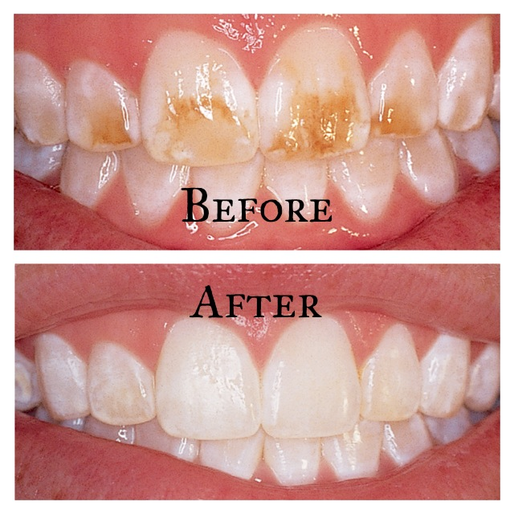
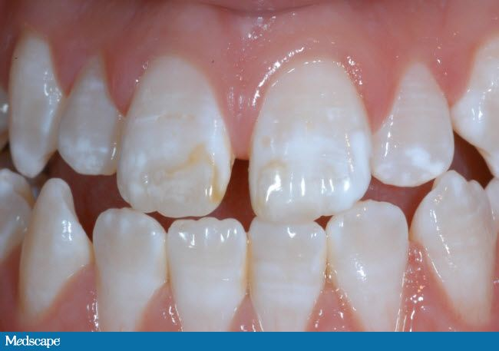
The white opaque appearance of fluorosed enamel is caused by a hypomineralized enamel subsurface

Slide 4
causes
young children under six often use too much toothpaste that contains fluoride, and they consistently swallow it. This alone has been the biggest cause of excess fluoride ingestion;
some children drink fluoridated water and also drink large amounts of bottled beverages that have fluoride in them. Carbonated drinks and juices have fluoride in varying amounts. Still other children are offered foods high in fluoride (fish with bones, tea, poultry products, cereals, or infant formula made with fluoridated water) in addition to fluoridated water;
finally, fluorosis may be caused by some prescribed fluoride supplements without determining the amount of fluoride exposure the child has in his or her environment.

Slide 5
symptoms
Can range from mild to severe. Very mild fluorosis is seen as tiny white spots on 25% of a tooth surface. Mild fluorosis covers 26% to 50% of a tooth surface. Moderate fluorosis compromises all of a tooth's surface and is most characterized by brown discoloration of the tooth. Severe fluorosis involves pitting of the enamel and more serious brown staining. Approximately 94% of dental fluorosis is very mild to mild.

Slide 6
classification
Normal-Enamel shows no evidence of fluorosis. The surface of the tooth is smooth, glossy, and typically has a pale, creamy white color
Very mild Evidence of fluorosis in the enamal is shown by areas with parchment-white color that total up to 25% of the tooth surface. This includes fluorosis seen only on the incisal edges of anterior teeth and cusp tips of bicuspids or molars (“snowcapping”)

Slide 7
Classification Cont’d
Mild Parchment-white fluorosis can be seen on more than 25% but less than 50% of the tooth surface
Moderate Light to very dark brown staining occurs on the enamel, along with the parchment-white coloration of fluorosis
Severe All enamel surfaces are affected, and the anatomy of the tooth may be altered. Discrete or confluent pitting of the enamel surface exists. Dark-brown stain is usually present and may be widespread, presenting a corroded appearance of the teeth.

Slide 8
Fluorosis treatment
Bleaching is a conservative method for restoring the color of intrinsic discoloration of teeth. The combination of McInnes solution and power bleaching is effective procedure for bleaching of fluorosis stained teeth;
cosmetic restorations: bonding, veneers, crowns.

Slide 9
Role of dental hygienist
participate in parent education about fluoride usage and good dental habits;
teach children about proper tooth brushing—especially the amount of toothpaste to use—and encourage periodic testing of the water for fluoride levels in the community or at a child's home, where filters that may lower fluoride concentrations in tap water may be used.

