Slide 1
Project RainCar
IND4850 – Senior Project
Presented by: Shaul Ranglin
Fritzpatrick Roque
Roy St. Furcy
Ethan Wong

Slide 2
Presentation Outline
Intro
Rainfall as an energy source
Market analysis
Design goals/ Product Description
Initial Designs
Intermediate Designs
Final/Detailed Designs
Manufacturing plan
Product analysis failures and possible improvements
Conclusions

Slide 3
Introduction
In recent years, renewable and sustainable energy has been the engineering trend.
Hydroelectric, wind, and solar has popular “green energy” technologies.
However, rain energy is still not being captured.

Slide 4
Rainfall as an Energy Source
The potential energy from a single rainfall could produce approximately 120KJ of energy.
Average monthly rain fall in New York City ranges from 3.25 to 4.25 inches.
The amount of energy that could be potentially capture is staggering.

Slide 5
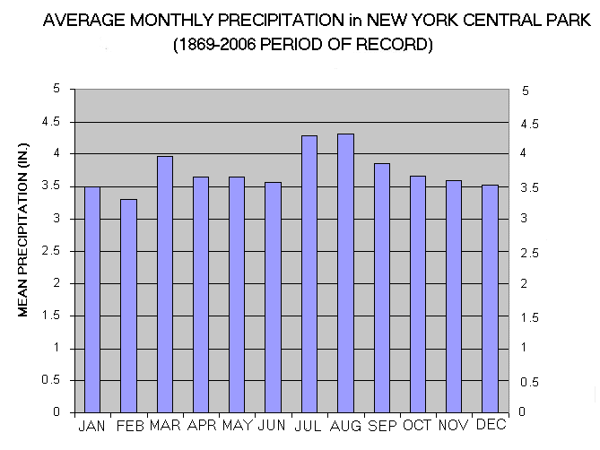
http://www.climatestations.com/images/stories/new-york/nyprcp4.gif
Source: http://www.climatestations.com/images/stories/new-york/nyprcp4.gif

Slide 6
Market Analysis
Gas prices are pushing the sales of hybrid cars to a new level.
Electric cars have become more appealing to consumers.
The market for alternative energy in cars is climbing.
Camry hybrid had over a 1000 percent increase in sales since August 2011 to August 2012
Chevy Volt most popular sold over 4,700 units in August 2012.

Slide 7
Design Goals/ Product
The goal of this project is to design and fabricate a proof of concept vehicle that capture the potential energy within rain and convert it to useful energy.
The Rain Car will utilize the water from a 1 liter bottle and use it to propel a vehicle forward.

Slide 8
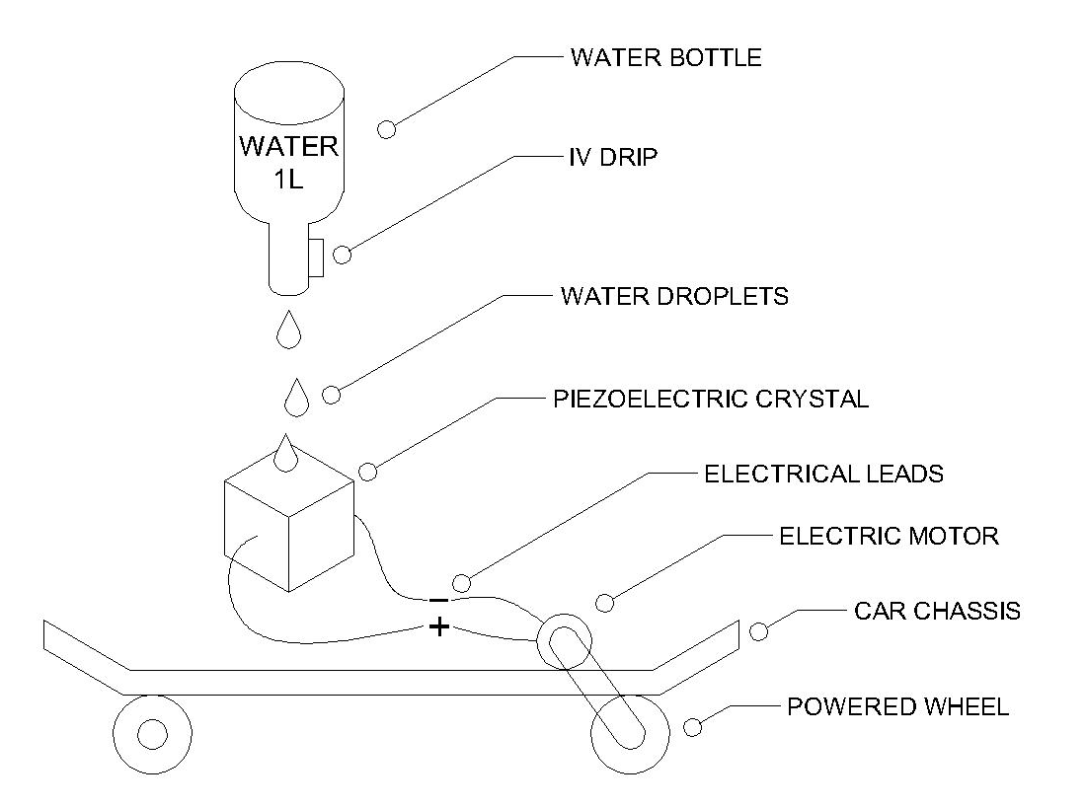
Initial Concept Sketch

Slide 9
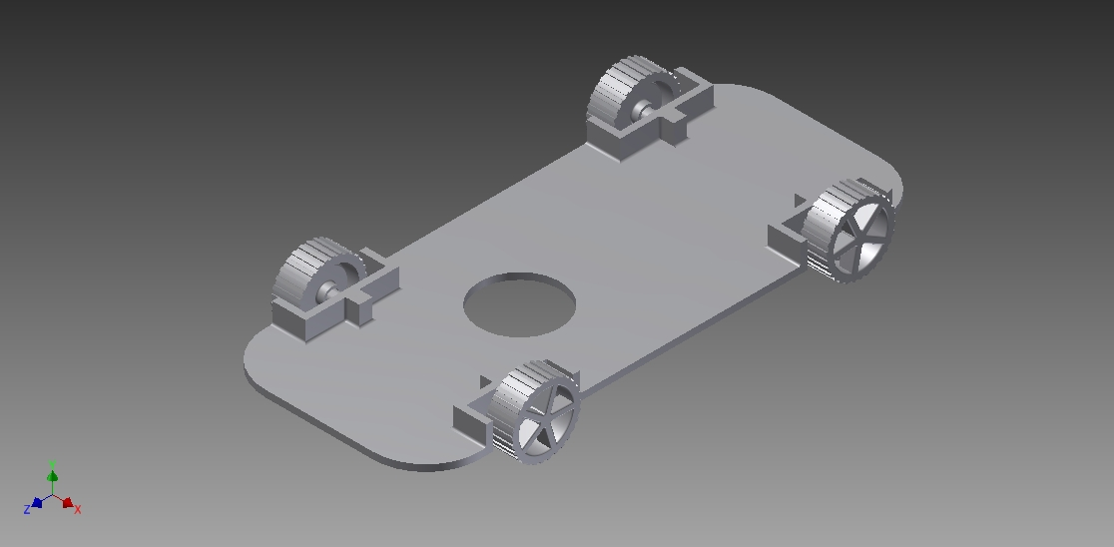
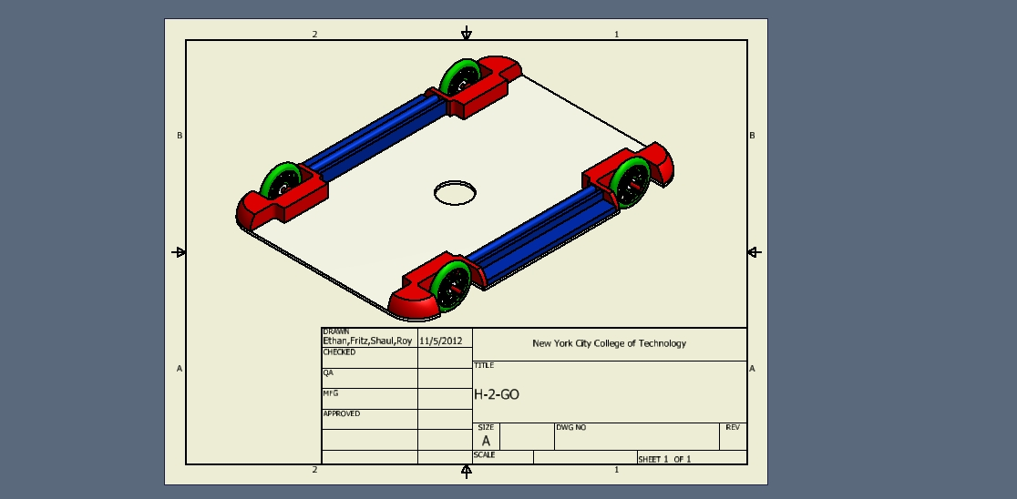
Initial Designs

Slide 10
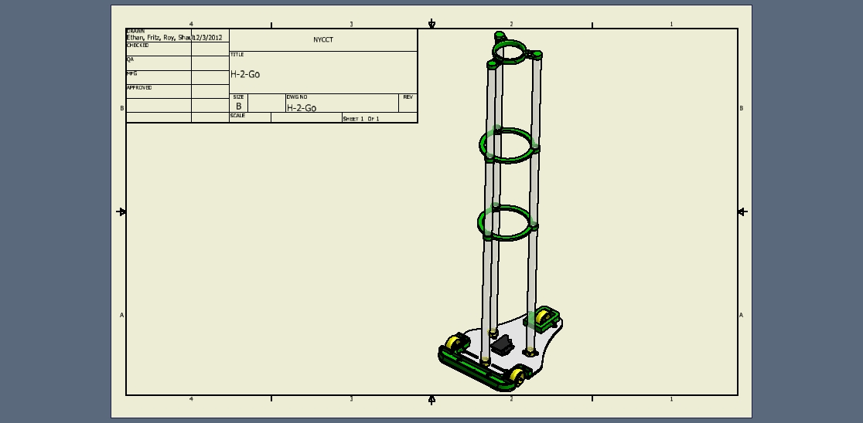
Intermediate Design

Slide 11
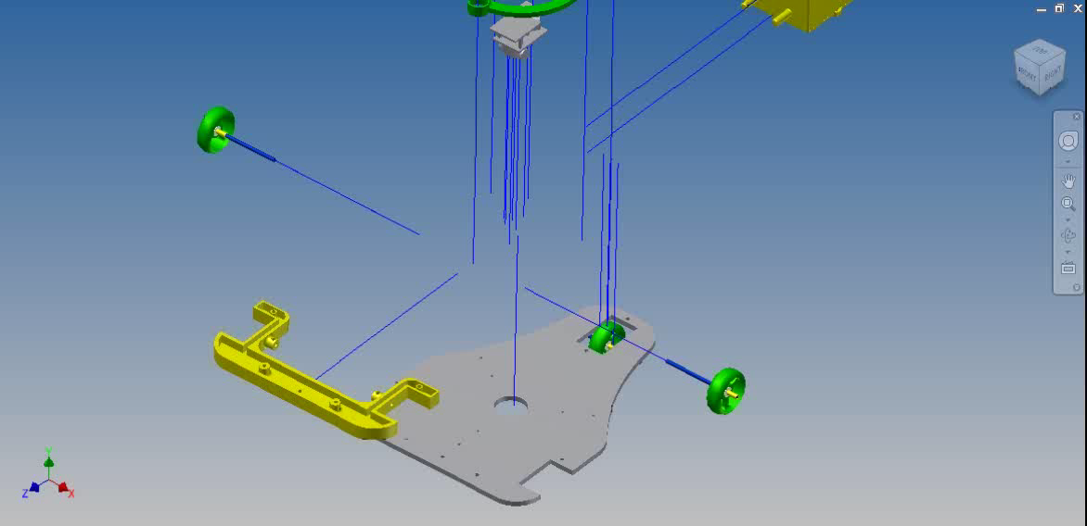
Design

Slide 12
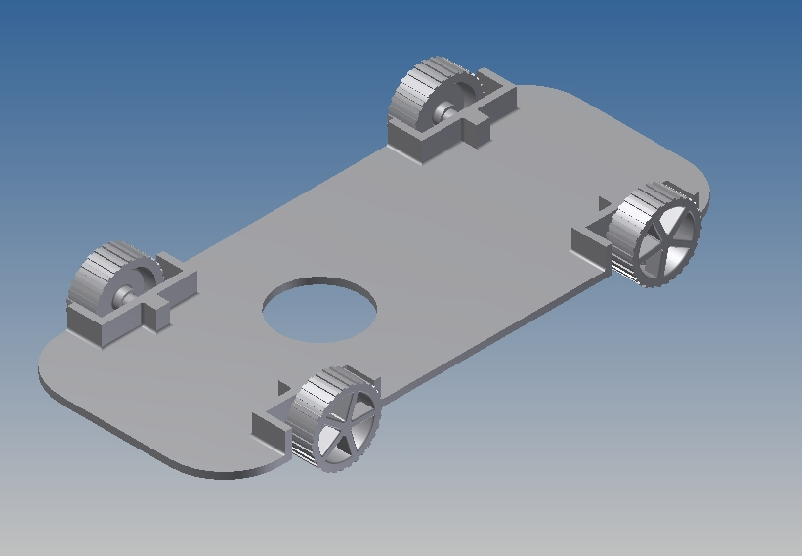
Design
Prototype
Disadvantage
10 x 14 rectangle
Wheel contain too much traction
There was a unnecessary material area; Add more weight
Advantage
Not limited adding new equipment if need

Slide 13
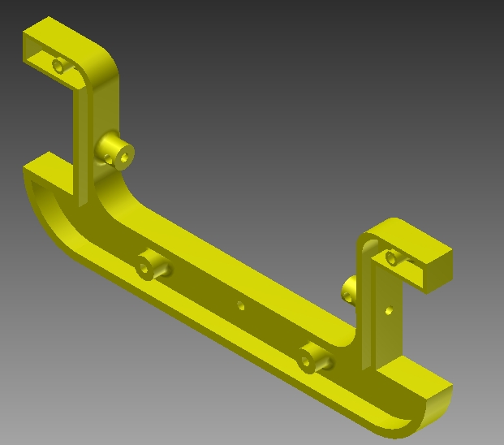
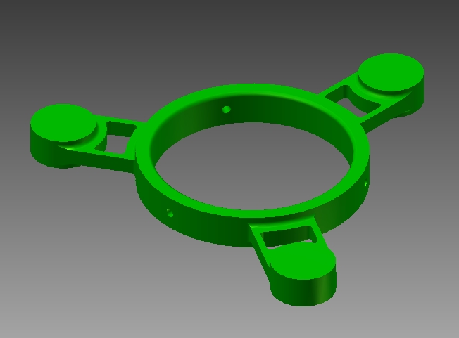
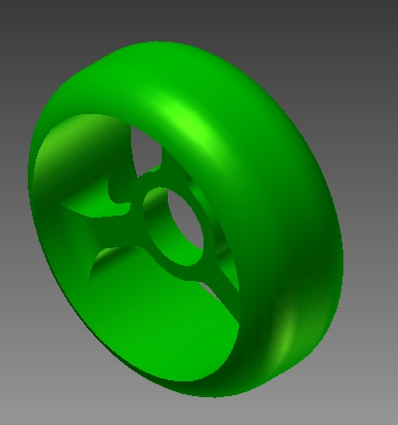
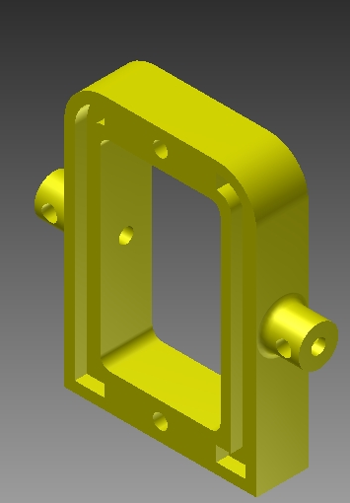
Design
3D printed part made from three dimensional solid objects from a digital model.
Acrylonitrile butadiene styrene (ABS)
Fast prototyping

Slide 14
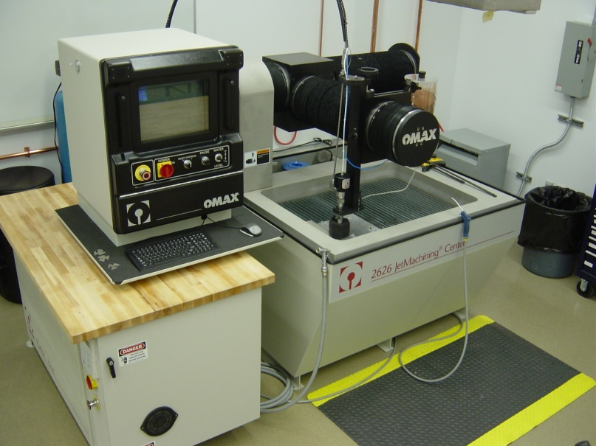
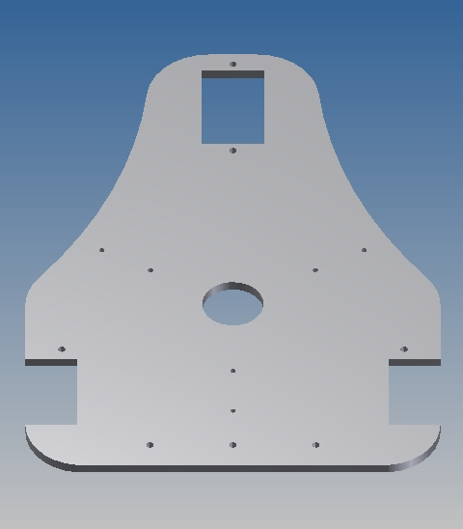
Design
Equipment: Water Jet Cutter Omax.
Using Sand and High pressure water .
Manufacture process that create a 2D shape to the customer requirement.

Slide 15
Manufacturing Plan
Facility - The Voorhess building of Citytech proves to be the most cost-efficient and readily available space for manufacturing this product.
Staffing - There will be a four man team working on the production of the rain car.
Design-We will be using a 3D design program to model the parts of the car.
Production - Using the files created we will 3D print some parts and use a water jet for the rest of the manufactured parts.
Notes:
There will be a four man team working on the production of the rain car. At least two of the staff members will be available at the facility to work on the car. One person will be responsible for directing the work and aiding with the production. Documentation and scheduling will fall under the responsibility of at least two people. Consultation will be provided by a professional in mechanical engineering.

Slide 16
Manufacturing Plan
Materials - The following list of materials will be used:
  1 liter container
  Drip chamber
  4’ by 3’ Plexiglas
  1+ meter PVC pipe
  Chassis (1’x 6”)
  Motor (12V)
  Bearings
  Piezoelectric microphone transducers
  Wires

Slide 17
Gantt chart

Slide 18
Product analysis
Our design relies heavily on the water creating a current
Charging the capacitors and the power output when it discharges moves the vehicle.
The 3wheel design reduces the total material used.
Weight of the design and motor capabilities match so successful power to weight ratio.

Slide 19
Failure
Water spillage
Vehicle may tip over
Voltage overload for capacitor
Electrical shortage

Slide 20
Conclusions
The design of the Rain Car was both a challenging and rewarding project for those involved.
The design of the chassis for the rain powered vehicle completed its design objectives.
The piezoelectric elements used in the rain car project work admirably to generate electrical charge per drop of water.
Throughout the course of this design project, team members were constantly challenged to go above and beyond current designs.

