Slide 1
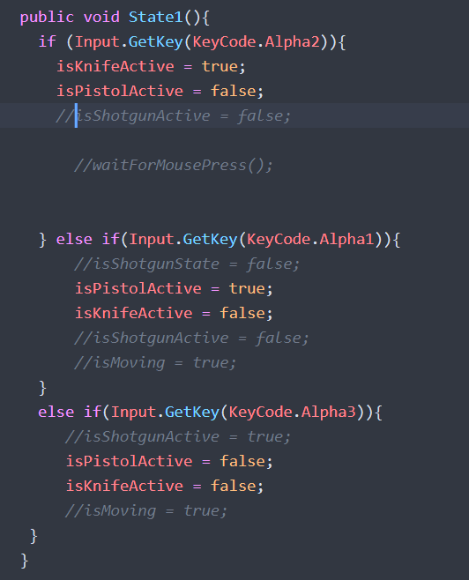
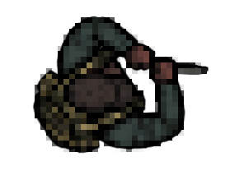
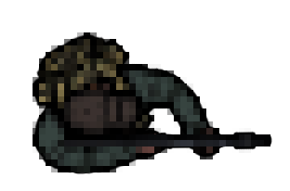
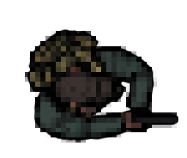
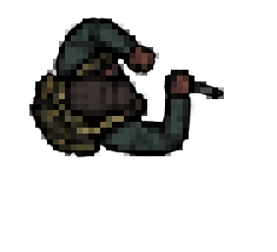
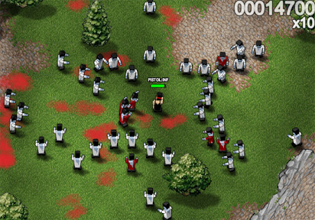
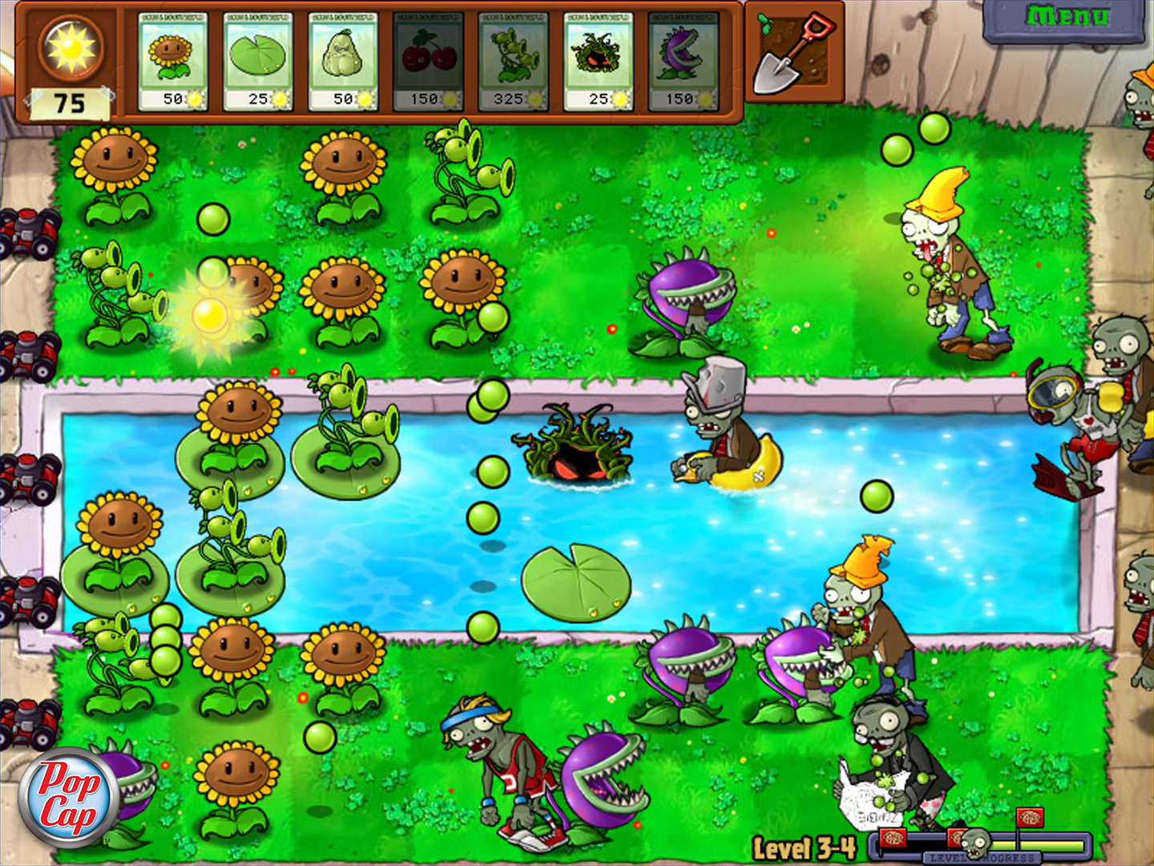
9/20 (Area 51 Raid Unity Game) Sabrina Ramos | Programmer Department of Emerging Media Technology
Introduction:
9/20 is a project heavily inspired by the “Raid Area 51” Facebook events that consists of creating a 2D top-down survival shooter game where the main character (Solider Briggs) fends off waves of civilians trying to break into Area 51 to uncover government secrets.
My Roles: Game Designer, Programmer, and Animator.
My responsibilities were focused heavily on animation integration, mechanics, and controls of the player and enemies.
My Overall Goal: to produce a functioning prototype that reflects most of the concepts in the GDD; showcases the animations, attacks, player mechanics, and survival aspects of 9/20.
My Skills Include:
- Understanding C# in Unity.
- Integrating 2D assets into the scene.
- Developing scripts for movement.
Assets and Code:
Conclusion:
While we collectively were able to produce a functioning prototype, there were various aspects of the game that got scrapped from the final version which is something moving forward we wanted to continue working out, outside of City Tech. This included more backstory and understanding behind the game’s lore based on the Facebook events. The path we took towards expanding the main ideas of the game truly showed the concept of our idea, but could further be expanded through additional content like the end goal of 51 waves with a boss fight, new weapons, and other concepts added in. Overall, 9/20 is a combination of slight lore, action, and “grind-like” play styles that can keep players engaged.
Materials:
Unity Game Engine
Laptop/Desktop
Discord (File Integration)
Github Repo (Final File Version)
2D Assets
SFX Files
BG Music Files
Character Sheets (GameArt.org)
Schedule (Month by Month):
February
➢ Revamp current version of Unity Project (9/20); beginning to separate sections for groupwork.
➢ Adjusting existing scripts and fixing current bugs in prototype version.
➢ Eliminating clutters of un-needed scripts and finalize the scripts needed for the project.
➢ Backtracking Unity files and creating backup saves to be shared with group members.
➢ Beginning levels (1-2) to be completed with functioning mechanics.
➢ Playtesting between all members.
March
➢ Animations for new weapon loadouts should be nearly complete.
➢ Mapping controls for weapon swapping and different bullet damage per weapon.
➢ Ensuring the player moves smoothly within the play space (basic mechanics running).
➢ Weapon damage (equipment addition may be implemented if enough time) to be considered and altered.
➢ Playtesting between all members.
April
➢ Implementing stronger and weaker enemies and have them scripted for different levels for difficult differences.
➢ Adjusting existing and new prefabs for player interaction (and new mechanic implementation).
➢ Feedback for enemy and player interaction (takes damage, loses health, heals, death, etc).
➢ Playtesting and Demo Structure Set-Up.
May
➢ Intensive playtesting for demo showcase by the end of May.
➢ Final touches, updates, and removals.
➢ Poster set up for culmination.
➢ Final presentation for culmination.
Results:
9/20’s final product included a playable demo that initially showcased infinite waves for our survival system. This further included multiple weapons that the player can swap and unlock with progression, animations that were mapped to the weapon changes through various key presses, basic player functionality for movement controls through the keyboard keys (WASD) and mouse movement for aiming (clicking to shoot bullets or knife). Ultimately, a lot of the final product was changed because of time constraints, however, ensuring we had a functioning prototype was the main goal we collectively wanted to achieve.
Inspiration(s):
Boxhead Zombies and Plants vs Zombies
The Process:
The project begins with meeting with my technical advisor and ensuring the concept of the game is manageable between myself and my team members. Slowly begin implementing the 2D animation assets, weapons, movement, and enemy functionality to properly gain feedback from the user. This further includes different elements being worked on and checked throughout the way to iron out any bugs that may arise.

