Slide 1
COMD3504
Library Workshop
Prof. Monica Berger

Slide 2
Goals
Citation
1
Your research questions
2
Searching Art Full Text
3
Searching Academic Source Complete
4
Searching for books
5

Slide 3
What is a citation (bibliographic entry)?
3

Slide 4
    Alvarez, Nadia, and Jack Mearns. “The benefits of writing and performing in the spoken word poetry community.” The Arts in Psychotherapy, vol. 41, no. 3, July 2014, pp. 263-268. ScienceDirect, doi:10.1016/j.aip.2014.03.004.

Slide 5
What is a citation (bibliographic entry)?
3
Ontiveros, Randy J. In the Spirit of a New People: The Cultural Politics of the Chicano Movement. New York UP, 2014. [+ URL if online]

Slide 6
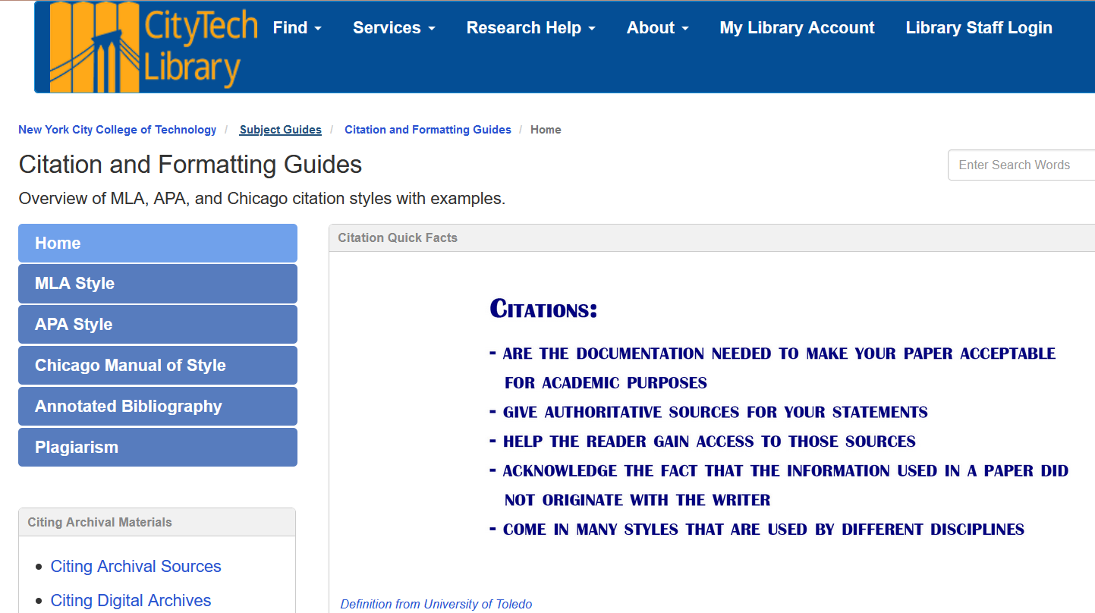

Citations and writing support guide
Get citations from library products
Zoterobib good for websites
Easybib

Slide 7
Why Cite?

Slide 8
If I am not quoting text, do I need to cite?

Slide 9
Your research topics

Slide 10
Example research questions + related questions / search words (keywords)
how design affects littering behavior in individuals (Lola)
How album cover art influences the audience’s perception of the music. (Nina)
AI and album cover design (Fenix)
generative AI as a productivity tool for designers? (Lyonel)
emulate nature in UX design (Sarahjane)
Impact of stage design on concert experience (Jonathan)
game aesthetics as marketing tool (Ziqi)
design activism revolutionized African-American graphic design (Jennell)
What type of design? Packaging? Garbage cans? – littering + design
“album cover art” + perception
“artificial intelligence” + “album cover design”
A bit broad … “generative artificial intelligence” or “generative ai” + productivity + design*
Nature + “user experience design” or “ux design”
“stage design” + “concert experience”
“game aesthetics” + marketing + “game industry”
“design activism” “African American graphic design”

Slide 11
Background info? How? Why?
Google, Wikipedia, library encyclopedias [OPPOSING VIEWPOINTS], newspaper articles (NY Times)

Slide 12
What is a database?
Where do I find the library’s databases?
How do I login at home?

Slide 13
Academic Search Complete http://cityte.ch/asc

Slide 14
Art Full Text http://cityte.ch/aft

Slide 15
OneSearch

Slide 16
Connect with the library!
We’re here to help you

Slide 17
Thank you
Monica Berger
mberger@citytech.cuny.edu

