Slide 1
James Tiptree Jr. (Alice Bradley Sheldon)
Presented By: Kimberly Beltran

Slide 2
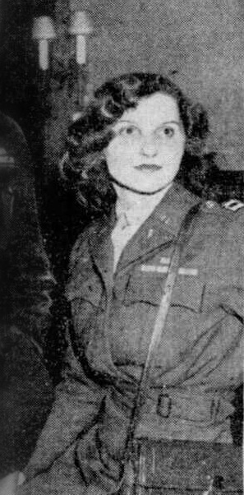
Intro and Background
Birth: August 24th, 1915. → Chicago, Illinois
Death: May 19th, 1987. → McLean, Virginia
Her mother (Mary Hastings Bradley) was also an author
Alice illustrated for two of her mom’s children’s books: Alice in Jungleland (1927) and Alice in Elephantland (1929).
1967 she began writing several science fiction stories and submitted them to magazines as “James Tiptree Jr.”
Her first story published was “Birth of a Salesman” (1968).

Slide 3
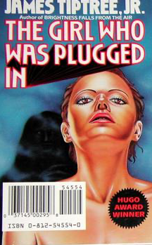
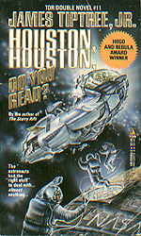
Major Works
“The Girl Who Was Plugged In” (1974)
A suicidal 17-year-old girl (Philadelphia Burke) gives up her life to become a remote controller for a celebrity named Delphi.
She connects through a satellite that projects her mind into Delphi’s body
The girl loves her new life and falls for a film director (Paul Isham), causing her to want to leave her old body behind
Paul finds out about the controller situation, and he thinks that Delphi is real, just enslaved by Burke.
He breaks into the lab and rips the wires, killing Burke and disconnecting Delphi
“Houston, Houston Do You Read?”
(1976)
Spaceship called Sunbird, which was originally meant for a voyage around the sun, is thrown off course when after hitting a solar flare.
Space crew receives radio transmissions from women in Australia who inform them that the Sunbird mission was considered “lost in space” centuries ago.
Remaining population of Earth is almost entirely female, and it is maintained by cloning the survivors of the pandemic.
The men from Sunbird crew start to become violent and behaving inappropriately, proving to the Gloria crew that they cannot introduce these men to the new society.
“The Women Men Don’t See” (1973)
There is a plane crash and the pilot is able to “land” the plane on a sandbar close to a jungle
A man (the narrator with a big ego) goes to find fresh water and a mother (who leaves her daughter on the plane with the pilot) goes with him.
When they get stuck at the coast overnight, the man is sexualizing the woman
Woman takes something from the aliens so that they can come back and help her and her daughter out of there
Aliens help the narrator and woman get back to the plane and her and her daughter go with the aliens.

Slide 4
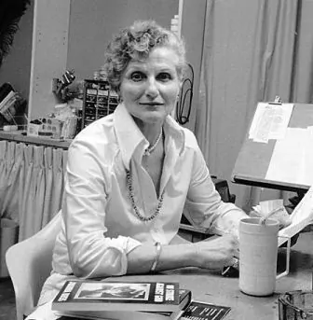
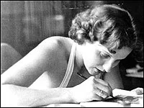
Writing Style and Themes
Wrote about love, death, gender, and human/alien nature
Very precise and detailed in her writing using complex language throughout her stories
Associated her personal adventures into her writing
Ex: The Women Men Don’t See takes place in Mexico and she was able to use her creativity to use Spanish language in her story
Her stories mainly touched on gender issues and the male and female roles in society.
It is common for the female characters to want to run away, have a different life, or for the men to question and sexualize them

Slide 5
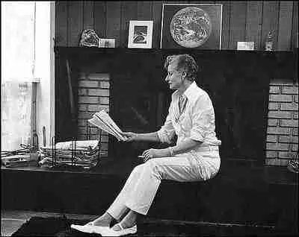
Impact
Before it was known that “James Tiptree Jr.” was actually a woman, the writer was considered “a man who understood women.”
She made a point that female authors have a difficult time being published, which is why she decided to use a male name
This was proven when she tried to publish under the name “Raccoona Shelden” and had a hard time getting her work out until “James Tiptree Jr.” recommended her.
She inspired Julie Phillips to write a biography of her life: James Tiptree Jr. “The Double Life of Alice B. Sheldon.”

Slide 6
Awards, Accolades, and Recognition
1974: Nebula Award for Best Short Story (Love Is the Plan the Plan Is Death)
1977, 1974: Hugo Award for Best Novella (Houston, Houston, Do You Read?)
1977: Nebula Award for Best Novella (Houston, Houston, Do You Read?)
1977: Jupiter Award for Best Novella (Houston, Houston, Do You Read?)
1978: Nebula Award for Best Novelette (The Screwfly Solution)
1984: Locus Award for Best Short Story (Beyond the Dead Reef)
1987: World Fantasy Award For Best Collection/Anthology (Tales of the Quintana Roo)
In March 1992, there was an award that came about in memory of her called the Otherwise Award (Tiptree Award).
This award is for Science Fiction or Fantasy Fiction that best “explores or expands gender roles.”

Slide 7
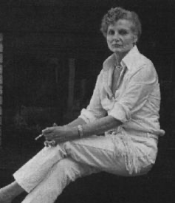
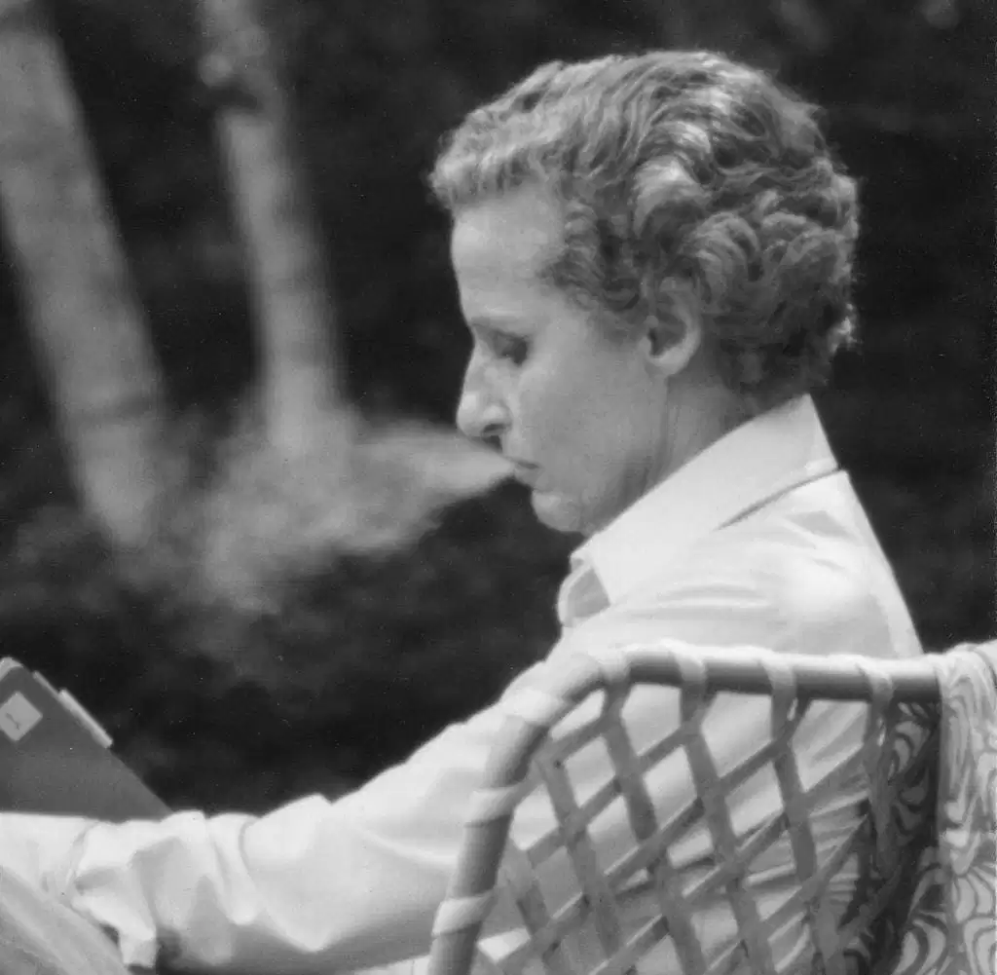
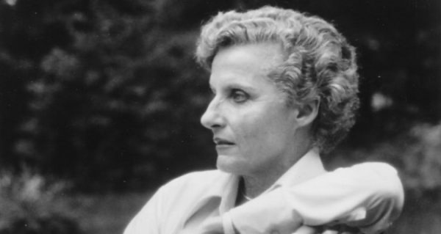
Conclusion
Alice Sheldon has had a lasting impact on society. Through her work, she was able to touch on gender issues and the weight men held in society at the time. In her career, she won a great deal of awards through James Tiptree Jr. that recognized her talent in combining science fiction and real-world problems. She was able to use her creativity to get her message across while also keeping the audience entertained.

Slide 8
Class Discussion Questions
1. Do you think that the endings of Alice Sheldon’s stories are what she wanted for herself and that she wrote them to live vicariously through her characters? (Women being free from men or free to do what they’d like)
2. If other female Science Fiction writers also used a male name at the time, do you think it could have helped their careers the way it helped Alice Sheldon’s?

Slide 9
Sources
Encyclopedia Britannica. (n.d.). James Tiptree Jr.
https://www.britannica.com/biography/James-Tiptree-Jr
Chen, C. (2019, April 18). James Tiptree Jr. upended gender roles in science fiction. Vox.
https://www.vox.com/the-highlight/2019/4/18/18282660/james-tiptree-jr-feminist-dystopian-science-fiction
Tiptree, J. (n.d.). Houston, Houston, Do You Read?
https://writingatlas.com/story/james-tiptree-jr-houston-houston-do-you-read-/#:~:text=By%20James%20Tiptree%20Jr.%2C%20first,the%20last%20humans%20on%20Earth.
SuperSummary. (n.d.). The Girl Who Was Plugged In Summary.
https://www.supersummary.com/the-girl-who-was-plugged-in/summary/
Science Fiction Awards Database. (n.d.). James Tiptree Jr.
https://www.sfadb.com/James_Tiptree_Jr
Encyclopedia of Science Fiction. (n.d.). James Tiptree Jr. Award.
https://sf-encyclopedia.com/entry/james_tiptree_jr_award
Ceraldi, R. (2017, October 17). The Woman Behind James Tiptree Jr. JSTOR Daily.
https://daily.jstor.org/the-woman-behind-james-tiptree-jr/
Green, M. (2006, November 12). The Secret Sci-Fi Life of Alice B. Sheldon. NPR.
https://www.npr.org/2006/11/12/6468136/the-secret-sci-fi-life-of-alice-b-sheldon

