Slide 1
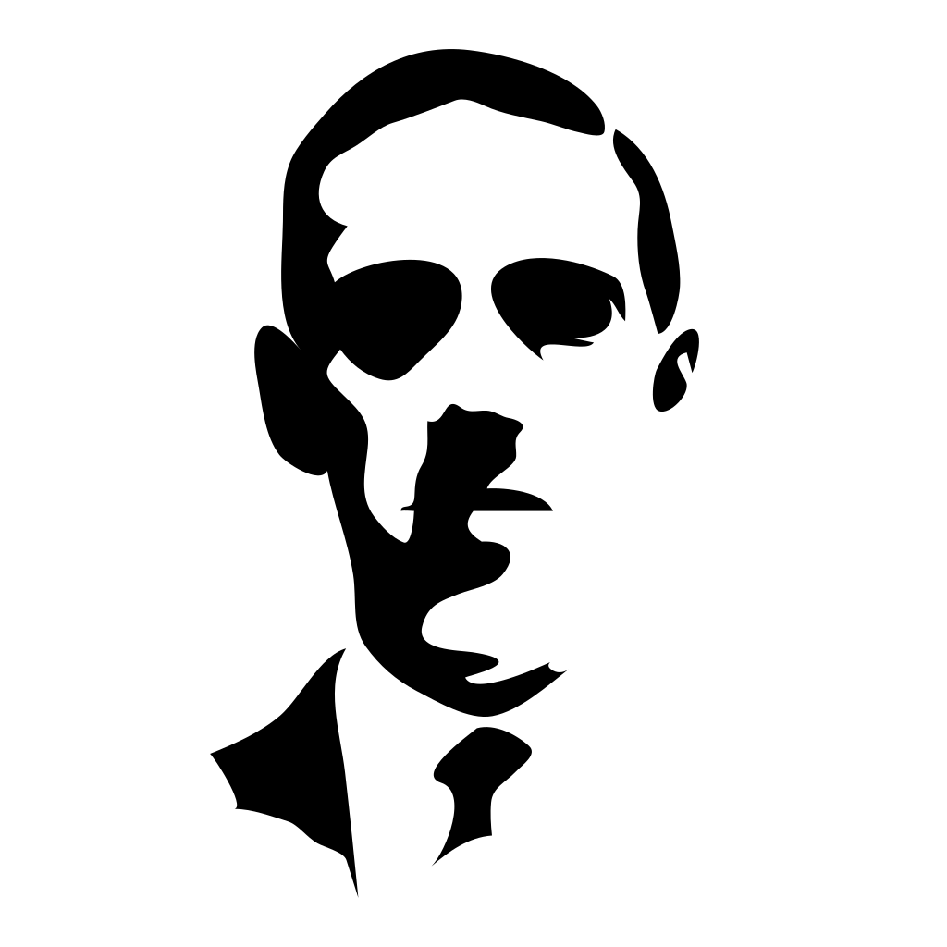
The man who Cursed the world
H.P Lovecraft
By Isaiah Santiago

Slide 2
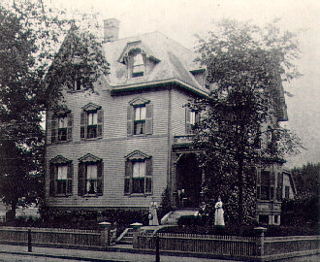
Prodigal Childhood of Howard Phillips Lovecraft
Born August 20th, 1890, in 454 Angell street Providence Rhode island, Mr Lovecraft would grow up under the care of his mother Sarah Susan Phillips Lovecraft and his father Winfield Scott Lovecraft for 3 years together until on business his father in Chicago would have a nervous breakdown and remain at the nearby Butler Hospital for five years before dying on July, 19th, 1898.
After the death of his father Howard had to live his days with his mother, two aunt and grandpa however despite losing a father figure H.P was very much a prodigy in reading and writing starting at only age two when he would recite poetry.
By age five he had adopted the pseudonym “Abdul Alhazred” because of his love for the literary piece of “Arabian nights”, later this fictional name would become a character in his books that would write the most compelling fictional artifacts in all media named the Necronomicon.
454 Angell Street, Providence, RI Lovecraft’s Home

Slide 3
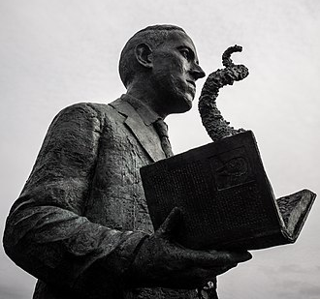
Hardships of Howard’s Upbringing
Growing up H.P Lovecraft would suffer from countless physiological mental illness because of his constant need to read Gothic novels and weird fictions supplied by his encouraging grandfather and scholars at the school he attended for the time.
The death of his grandfather in 1904, (who had wealth and ownership of finances) plunged the lovecraft family into a financial crisis leading to their relocation, with later thoughts of suicide killing his astronomical motivations, he would leave his education without a diploma and developing a love hate relationship with his mother from 1908 to 1913, (She would later die in 1921 under comatose due to a nervous breakdown in 1919).

Slide 4
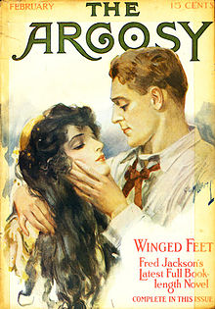
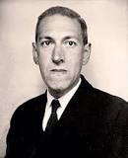
How he began to write in his own style
In 1914 when he read a love story in pulp magazine written by Fred Jackson named “The Argosy” he felt the urge to initiate a literary debate. This action would gather the attention of Edward F Daas who would offer him a job leading Lovecraft to eventually take the president's position at the “UAPA”, (United amateur press association). In this invigorating event Lovecraft would say: “In 1914, when the kindly hand of amateurdom was first extended to me, I was as close to the state of vegetation as any animal well can be... With the advent of the United I obtained a renewal to live; a renewed sense of existence as other than a superfluous weight; and found a sphere in which I could feel that my efforts were not wholly futile. For the first time I could imagine that my clumsy gropings after art were a little more than faint cries lost in the unlistening world.”
A fellow writer named W. Paul Cook who after reading the early works of Lovecraft such as “The Alchemist” and “The Beast in the cave” would urge the writer to continue his passions therefore leading to the successful launch of more books such as “The Tomb” and “Dragon” in 1917. In the years before moving back to his hometown in 1926 H.P would quietly marry a woman named Sonia Haft Greene and move in with her, begin writing the famous “Weird Tales series” to support them both until her hat shop went bankrupt, both would move out in separate directions in search of better work opportunities. Though despite his NY friends Frank Belknap Long, Rheinhart Kleiner, Samuel Loveman, he would actually suffer from depressive episodes causing him to write more bleaker stories, these would become heavier until 1926 with perhaps his most famous piece “The Call of Cthulhu”. A story which he crafted after his experiences traveling along the eastern coast of the U.S.

Slide 5
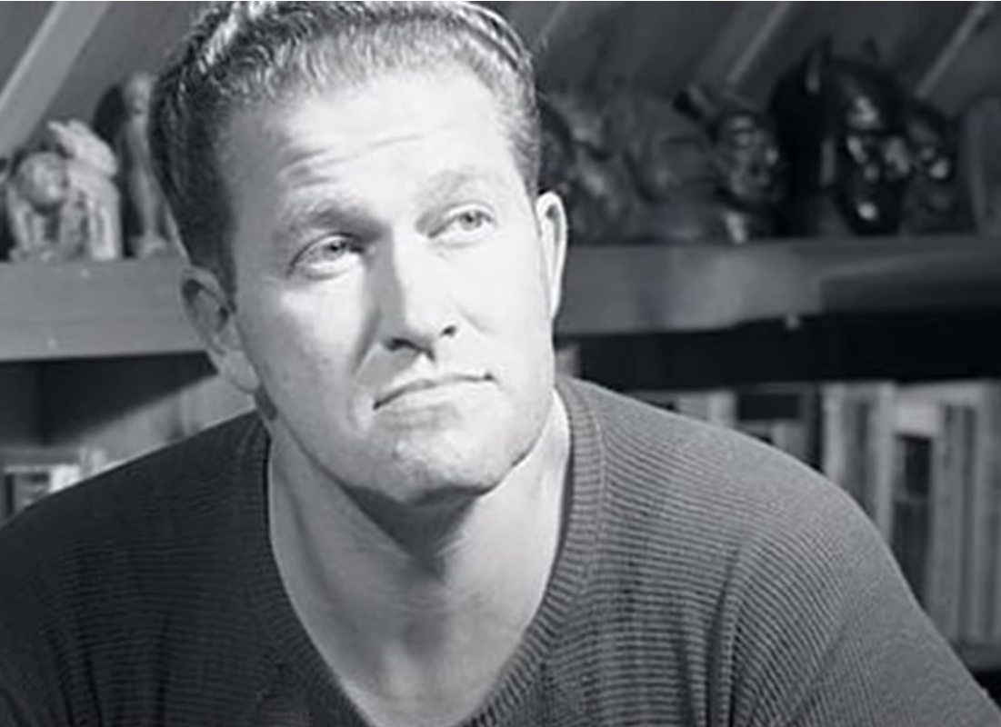
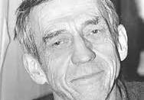
Final days and Influences
The mere idea of cosmic horror is one to be admired by all gothic literary enthusiast however when it comes to achievements for his contribution to societies evolved standards of horror H.P Lovecraft sadly may have had fame and some friends but no true accountable recognition until after his death. Between his aunt’s death in 1932 and his diagnosis with intestinal cancer Mr. Lovecraft had sold mostly “Ghost stories” which he wrote poetry and non-fiction for money to get by until writing his larger works which has a tendency not to sell well. Only later would he admit himself to the Jane Brown Memorial Hospital on March 10th, 1937 where he would stay for five days until dying.
Others following in his footsteps such as August W. Derleth and Donald Wandrei who worked under Weird Tales as well would take his creations and build an entire Mythos around H.P Lovecraft’s Monsters under the newly founded Arkham House publishing firm.

Slide 6
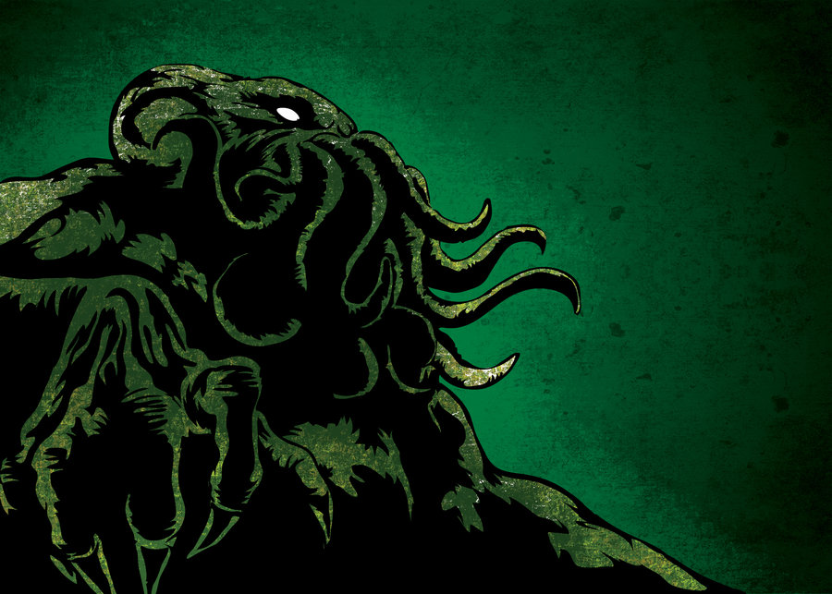
THE END

Slide 7
CITED SOURCES/Information:
Donovan K. Loucks, 20th of August, 2012, https://www.hplovecraft.com/life/friends.aspx
Donovan K. Loucks, 20th of March 2018, https://www.hplovecraft.com/life/biograph.aspx
1995-2024, Al von Ruff/ISFDB team, https://isfdb.org/cgi-bin/eaw.cgi?165
Dec 4, 2018, Frogwares, https://www.youtube.com/watch?v=0APF-1f5pc0
Dec 27, 2023, The Editors of Encyclopaedia Britannica, https://www.britannica.com/biography/H-P-Lovecraft

