Slide 1
Waste Heat Utilization in Waste-to Energy (WTE) Plants Using a Solid State Heat Engine Driven by Shape Memory Alloy (SMA)
Eduardo Cristi and Masato R. Nakamura
Department of Mechanical Engineering Technology and Industrial Design
New York City College of Technology (City Tech)
City University of New York (Cuny)
300 Jay Street, Brookyn, NY 11201

Slide 2
Background
Current situation? At least 70% of heat generated in a power plant is wasted. Utilizing waste heat contribute energy efficency.
Coal fire plant
Natural Gas fire plants
Biomass power plants
Nuclear Power plant
Geothermal Plant
Solar thermal Plant
89.5% of energy came from heat powerlplants in 2009

Slide 3
Objective
Why Wasted heat utilization? At least 70% of heat generation in a power plant is wasted. Utilizing waste heat contribute energy efficiency.
Why SMA Engine? Self sustaining, SMA deos not require any specific hest source, help heat exchange processe

Slide 4
Methodology
How our research will be conducted
CAD modeling simulation
Pysical model (prototype)
IR camera Thermal Analysis
Then compare Simulation With Real life data

Slide 5
3-1 cad modeling

Slide 6
Physical Model
Picture of physical model
Picture of experimental work

Slide 7
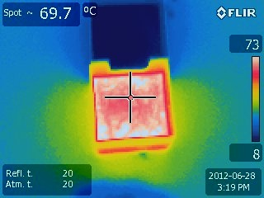
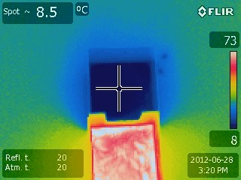
Thermal Images
These pictures are of water tempeture of a small scale model of a Dr. Johnson engine
They explain the small amount of energy diffrence required to activate the SMA engine.

Slide 8
Results and discusuions

Slide 9
Result and discussion part 2

Slide 10
Summary and future work

