Slide 1
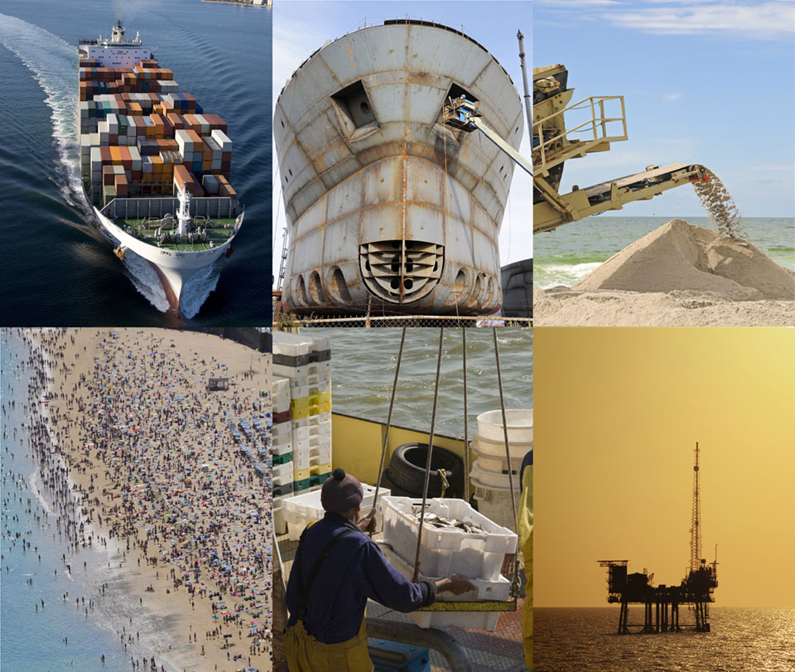
Ocean pollution Environmental and Economical effects
Presented by: Ahmed Zanaty
Prof. Sean Macdonald
ECON 2505ID
Spring 2019

Slide 2
Types Of Ocean Pollution Damages
Environmental
Economical
Is the degradation of the environment through depletion of resources such as air, water and soil; the destruction of ecosystems and the extinction of wildlife. It also defined as any change or disturbance to the environment perceived to be undesirable.
Damages that usually involve loss of profits, loss of wages and earnings (past and future), loss of future earning capacity, damage to real and personal property and loss of value.

Slide 3
Ocean Pollutants
The majority of the waste we produce on land eventually reaches the oceans, whether intentionally or not — and there are various ways by which this happens. For example:
Littering
Sewage
Ocean mining
Oil spills
Agricultural runoff
Toxic chemicals
Air pollutants
Maritime transportation

Slide 4
Top Countries

Slide 5
Benefits of Oceans
1. Ocean Produces more oxygen than forests:
It is often thought that rainforests are the primary source of oxygen on the planet, but the truth is that rainforests are only responsible for 28% of the oxygen on earth while oceans are responsible for the 70%.
2. The Ocean regulates the Earth climate:
The ocean absorbs CO2, to keep the carbon cycle, and accordingly temperatures on earth, in balance. It is like our global climate control system.
3. It is an important source of food:
The ocean is the number one source of protein for more than a billion people. Fish accounts for about 15.7% of the animal protein consumed globally
4. Many jobs are related to sea activities:
The estimates on the most recent official statistics indicate that 59.6 million people in the world were engaged in fisheries and aquaculture in 2016. In the U.S. close to three million jobs(8) are directly dependent on the resources of the oceans and Great Lakes.

Slide 7
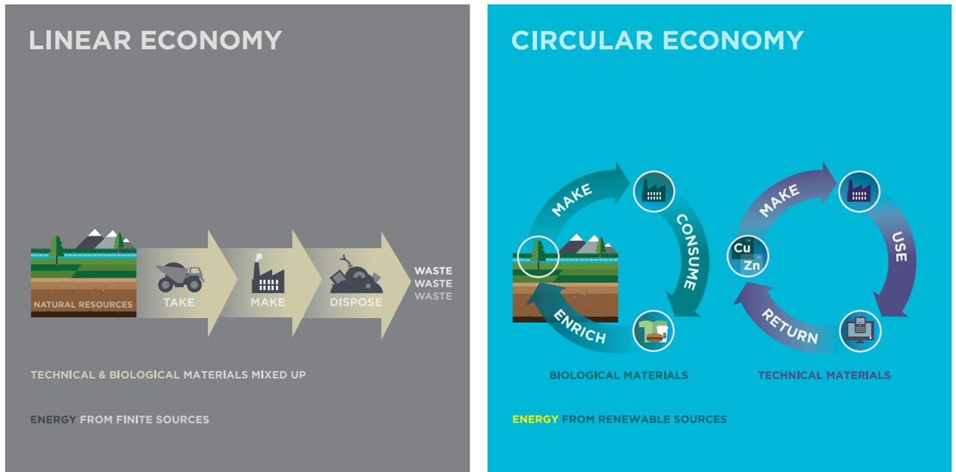
It all depends on you!
Cradle to grave is a model of modern manufacturing in which material flows in a linear, one way cycle. Resources are extracted, shaped into products, sold and eventually disposed of in landfills.

