Slide 1
Green Infrastructure
Fadwa Mini, Martine Alexis
& Sandira Ramdat
ECON 2505 - HD23

Slide 2
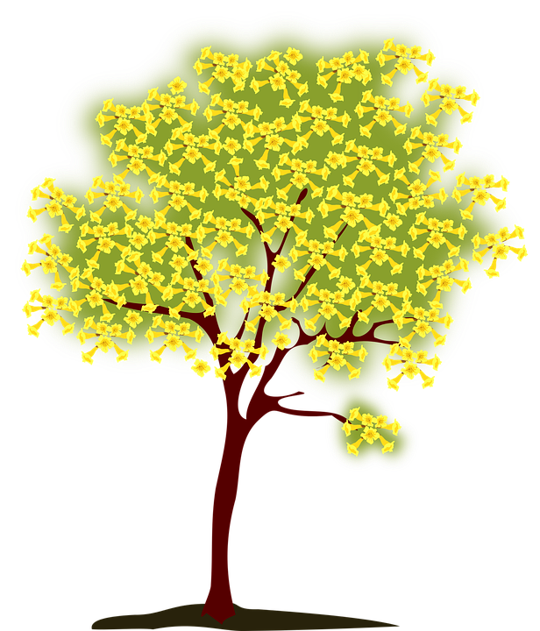
Thesis Statement
“The utilization of green infrastructure maintains environmental conservation and ultimately promotes economic sustainability throughout different communities.”

Slide 3
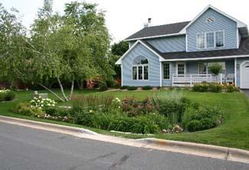
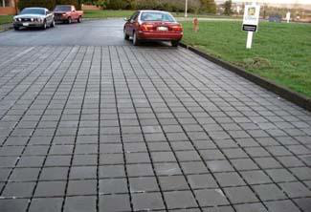
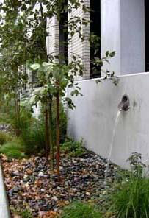
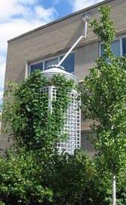
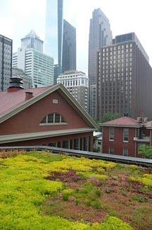
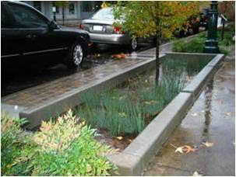
Types of Green Infrastructure

Slide 4
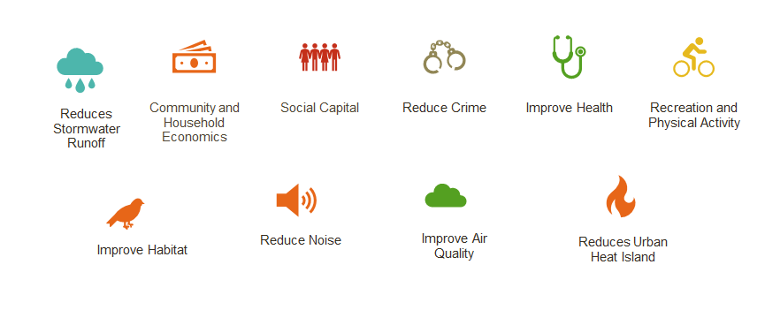
Benefits

Slide 5
Green Infrastructure for Climate Resiliency
Climate change is affecting us today. As different regions of the country become drier, wetter or hotter.

Slide 6
Green Infrastructure for Climate Resiliency
Study:
Heavy rain and runoff have increased in frequency and intensity worldwide in the past decades.
They are expected to become more frequent and intense as global temperature has raised
The average 100-year floodplain is projected to increase 45 percent by the year 2100, while the annual damages from flooding are predicted to increase by $750 million. United States Environmental protection Agency,2017

Slide 7
Green Infrastructure for Climate Resiliency
green infrastructure can help improve community resiliency today and in the future.
green infrastructure can help manage both localized and riverine floods. In areas impacted by localized flooding. By reducing stormwater runoff

Slide 8
Green Infrastructure for Climate Resiliency
Seattle’s Street Edge Alternatives (SEA) project was done utilizing green infrastructure specifically bioswales technique to capture and treat stormwater runoff. Seattle Public Utilities found that bioretention combined with narrowing the roadways.
Result
cost savings for the city about 15–25 percent, or $100,000– $235,000 per block.

Slide 9
References:
Benefits of Green Infrastructure. (2018). Retrieved May 15, 2019, from https://www.epa.gov/green-infrastructure/benefits-green-infrastructure
Erica Oberndorfer, et al. (2007). Green Roofs as Urban Ecosystems: ecological structures, functions and services. BioScience. Vol. 57, No. 10. Retrieved from https://academic.oup.com/bioscience/article/57/10/823/232363
Johnston, D. M., Braden, J. B., Price, T. H. (2006). Downstream economic benefits of conservation development. Retrieved on May 14, 2019, from http://citeseerx.ist.psu.edu/viewdoc/download?doi=10.1.1.629.5417&rep=rep1&type=pdf
Philadelphia: A water department reduces crime. (n.d.). Retrieved May 15, 2019, from https://www.vibrantcitieslab.com/case-studies/a-water-department-reduces-crime/
The Value of Green Infrastructure. (2010). Retrieved on May 12, 2019, from https://www.cnt.org/sites/default/files/publications/CNT_Value-of-Green-Infrastructure.pdf
United States Environmental protection Agency. (2017). Manage flood risk. Retrieved on May 12, 2019, from https://www.epa.gov/green-infrastructure/manage-flood-risk
United States Environmental Protection Agency. (2018). What is green infrastructure? Retrieved on May 14, 2019, from https://www.epa.gov/green-infrastructure/what-green-infrastructure

