Slide 1
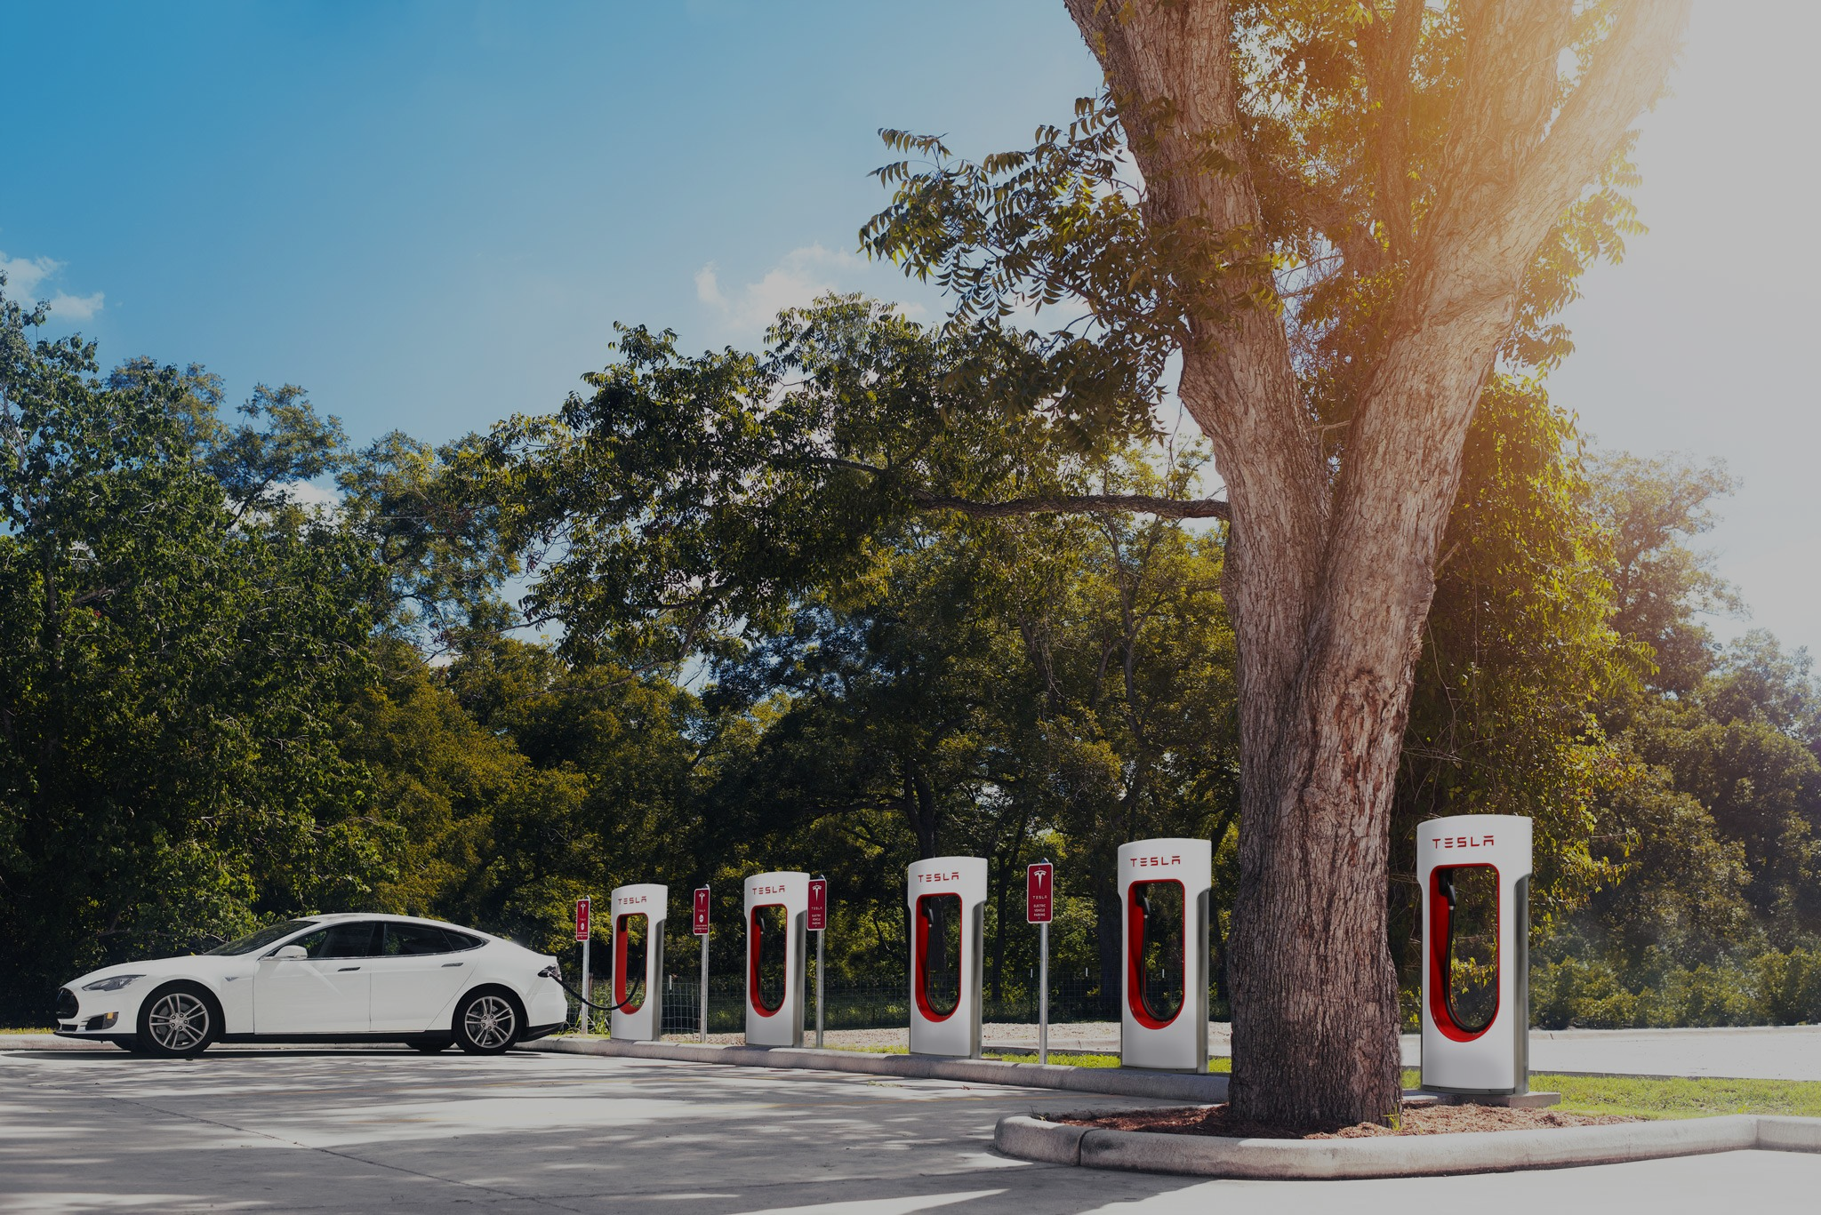
Do electric cars have a negative or positive affect on the environment?
By: Nicolas Rios | Gabby Yolanda | Fua Jian Pan | Lisebeth Rivas | John Aberin
Environmental Economics | ECON 2505 | Prof. Sean P. MacDonald

Slide 2
Gas Powered Car Vs Hybrid Car Vs Electric Car
The main difference between gas and hybrid cars is the way the engine functions.
A hybrid car combines a gasoline-powered engine with an electric motor
A traditional vehicle gets its power from the engine only.
In a hybrid, a complex system of electronic and mechanical controls manages the engine and motor to obtain the best efficiency for different driving conditions.
The primary difference between a hybrid car and an electric car is that the hybrid car derives some of its power from a conventional gasoline engine.
A true electric car gets all of its power from electrical sources, and thereby is a completely non-polluting zero-emission vehicle (ZEV).

Slide 3
Co2 emissions
Carbon dioxide is a colorless, odorless gas found in our atmosphere. Its chemical formula is Co2, which means it is one carbon atom bonded to two oxygen atoms. It is a waste product in our bodies, and is also produced by burning fossil fuels.
The extra carbon dioxide increases the greenhouse effect. More heat is trapped by the atmosphere, causing the planet to become warmer than it would be naturally. The increase in global temperature contributing to global warming.
Facts:
The amount of Co2 created from burning one gallon of fuel depends on the amount of carbon in the fuel. Typically, more than 99% of the carbon in a fuel is emitted as Co2 when the fuel is burned.
Diesel creates about 15% more Co2 per gallon.
The average passenger vehicle emits about 411 grams of Co2 per mile.
Every gallon of gasoline creates about 8,887 grams of Co2 when burned.

Slide 4
Are there any greenhouse gas emissions associated with the use of vehicles other than what comes out of the tailpipe?
Driving most vehicles creates tailpipe greenhouse gas emissions.
Producing and distributing the fuel used to power your vehicle also creates greenhouse gasses.
Gasoline, for example, requires extracting oil from the ground, transporting it to a refinery, refining the oil into gasoline, and transporting the gasoline to service stations. Each of these steps can produce additional greenhouse gas emissions.
Electric vehicles (EVs) have no tailpipe emissions; however, emissions are created during both the production and distribution of the electricity used to fuel the vehicle.

Slide 5
How does the EPA measure Co2 emissions from vehicles?
The Environmental Protection Agency (EPA) and automobile manufacturers measure vehicle fuel economy and CO2 emissions using a set of standardized laboratory tests.
These tests were designed by the EPA to mimic typical driving patterns. The EPA and the Department of Transportation use these values to ensure that manufacturers meet federal greenhouse gas and corporate average fuel economy (CAFE) standards

Slide 6
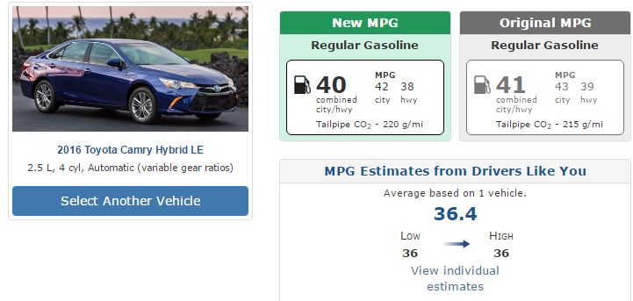
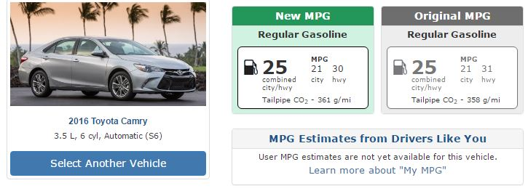
GAS VS HYBRID

Slide 7
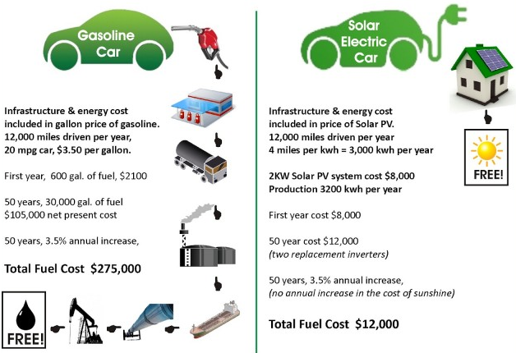
Compared to your average mid size sedan

Slide 8
What is a lithium-ion battery
A lithium-ion battery or li-on battery for short is a type of rechargeable battery in which lithium ions move from the negative electrode to the positive electrode during discharge and back when charging.
The lithium in the batteries, for example, is super light and conductive—that’s how you get a lot of energy without adding a lot of weight. So that’s why companies choose a lithium-ion batteries for their cars.

Slide 9
How do all electric cars produce greenhouse gasses
Electric cars don't need gas, but it still might get its energy from burning carbon. It depends on how your local grid generates electricity.
If you use coal-fired power plants to produce the electricity, then all-electrics don’t even look that much better than a traditional vehicle in terms of greenhouse gases.
If your local grid incorporates a fair amount of renewable solar and wind energy, like California, your electric vehicle is pretty clean.

Slide 10
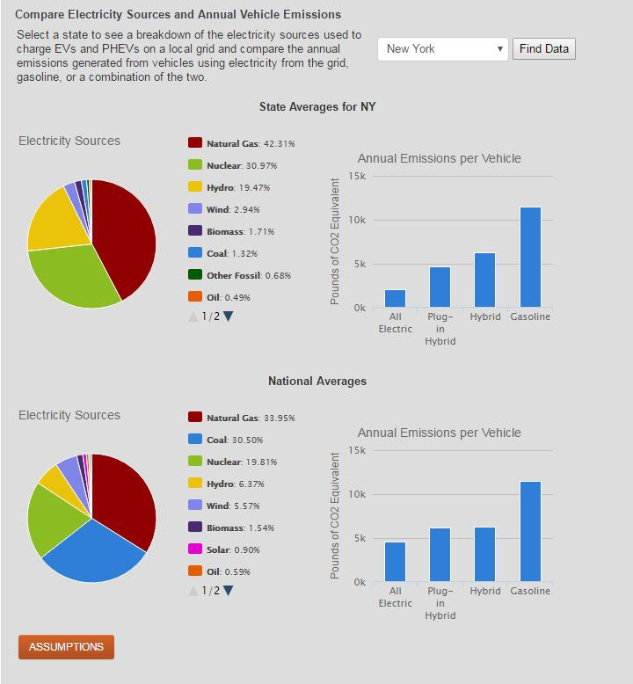

Slide 11
Gasoline incorporated into an all electric car
It takes as much energy to produce a gallon of gasoline as a Model S consumes in 20 miles of driving, according to Department of Energy data.
When you add all those extra expenditures up, “an electric car like the Model S has almost four times lower CO2 per mile than an equivalent gas-powered car,” says a Tesla spokesperson.

Slide 12
The Future
Fast-forward 15 years, to when your electric car is on its last legs. Where is the battery going to go? The good news is: not to a landfill. Thankfully this has been the case for decades, no lithium ion batteries are allowed to be disposed of in landfills
Battery recyclers are piloting technologies to recover a lot of materials from those batteries.
Electric car batteries can still be useful for energy storage, whether in a single building or as part of grids that incorporate more solar and wind. That can help offset the environmental costs of making the batteries in the first place.

Slide 13
Works Cited
(n.d.). Retrieved May 24, 2017, from https://www.tesla.com/gigafactory
(n.d.). Retrieved May 24, 2017, from https://nepis.epa.gov/Exe/ZyNET.exe/P100CZFN.TXT?ZyActionD=ZyDocument&Client=EPA&Index=2011%2BThru%2B2015&Docs=&Query=&Time=&EndTime=&SearchMethod=1&TocRestrict=n&Toc=&TocEntry=&QField=&QFieldYear=&QFieldMonth=&QFieldDay=&IntQFieldOp=0&ExtQFieldOp=0&XmlQuery=&File=D%3A%5Czyfiles%5CIndex Data%5C11thru15%5CTxt%5C00000003%5CP100CZFN.txt&User=ANONYMOUS&Password=anonymous&SortMethod=h%7C-&MaximumDocuments=1&FuzzyDegree=0&ImageQuality=r75g8%2Fr75g8%2Fx150y150g16%2Fi425&Display=hpfr&DefSeekPage=x&SearchBack=ZyActionL&Back=ZyActionS&BackDesc=Results page&MaximumPages=1&ZyEntry=1&SeekPage=x&ZyPURL
Jaffe, E. (2015, July 10). Mapping Where Electric Vehicles Actually Cause More Pollution Than Gas Cars. Retrieved May 24, 2017, from https://www.citylab.com/environment/2015/06/where-electric-vehicles-actually-cause-more-pollution-than-gas-cars/397136/
Study: Electric Vehicles Pollute More Than Gas-powered Cars. (n.d.). Retrieved May 24, 2017, from https://www.thenewamerican.com/tech/item/23226-study-electric-vehicles-pollute-more-than-gas-powered-cars
The ‘electric cars aren’t green’ myth debunked. (n.d.). Retrieved May 24, 2017, from http://shrinkthatfootprint.com/electric-cars-green

