Slide 1
How Cattle Farming is Damaging Rainforest?
Group Members:
Shuyi Wu
Md Bhuiyan
Qilun Chen

Slide 2
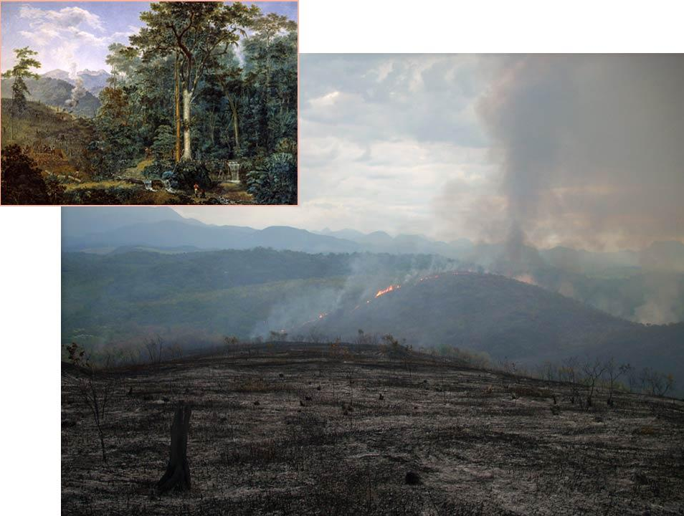
Developing Land for Animal Husbandry
Slash-and-Burn
Cut down the border trees into fault lines
Burn the woods with a big fire

Slide 3
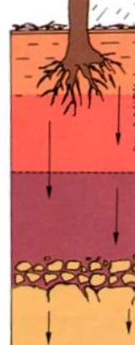
Impacts of Cattle Farming on Ecosystem
(Atmosphere)
Carbon dioxide Emissions
Clearing and burning of forests releases billions of tons of carbon dioxide
Other greenhouse gases
cows absorb significantly less carbon than most other agricultural systems
Soil Erosion
Greatly reduces rainfall and groundwater
Land without vegetation protection
Reduce rainwater seepage
Reduce groundwater and rainwater into rivers

Slide 4
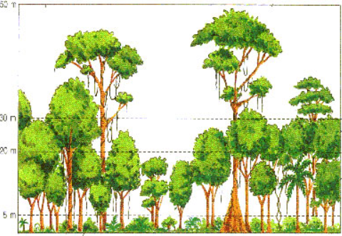
Impacts of Cattle Farming on Ecosystem
(Biosphere)
Energy Flow in Rainforest Biosphere
Destroy Ecological Balance
Tree Layering
Top Vegetation
Reduce Biodiversity
There may be no species or drugs found

Slide 5
Conclusion
Some steps for saving rainforests and, on a broader scale, ecosystems around the world can be saved:
Teach others about the importance of the environment and how they can help save rainforests.
Restore damaged ecosystems by planting trees on land where forests have been cut down.
Encourage people to live in a way that doesn't hurt the environment.
Establish parks to protect rainforests and wildlife.
Support companies that operate in ways that minimize damage to the environment.

Slide 6
Reference
Effect of carbon sources on sulfidogenic bacterial communities during the starting-up of acidogenic sulfate-reducing bioreactors. (2010, January 06). Retrieved from https://www.sciencedirect.com/science/article/pii/S0960852409016046
Fargione, J., Hill, J., Tilman, D., Polasky, S., & Hawthorne, P. (2018). Land clearing and the biofuel carbon debt. Science, 319(5867), 1235-1238.
Gradwohl, J., & Greenberg, R. (2013). Saving the tropical forests. Routledge.
Jepma, C. J. (2014). Tropical deforestation: a socio-economic approach. Routledge.
Phillips, O. L., Aragão, L. E., Lewis, S. L., Fisher, J. B., Lloyd, J., López-González, G., ... & Van Der Heijden, G. (2019). Drought sensitivity of the Amazon rainforest. Science, 323(5919), 1344-1347.
Ramsey, A., ONeill, W., Prior, G., & Mucci, M. (2011). The way they were: The view from the hill of the 25 years that remade Australia. Sydney: University of New South Wales Press.

Slide 7
Thank You!

