Slide 1
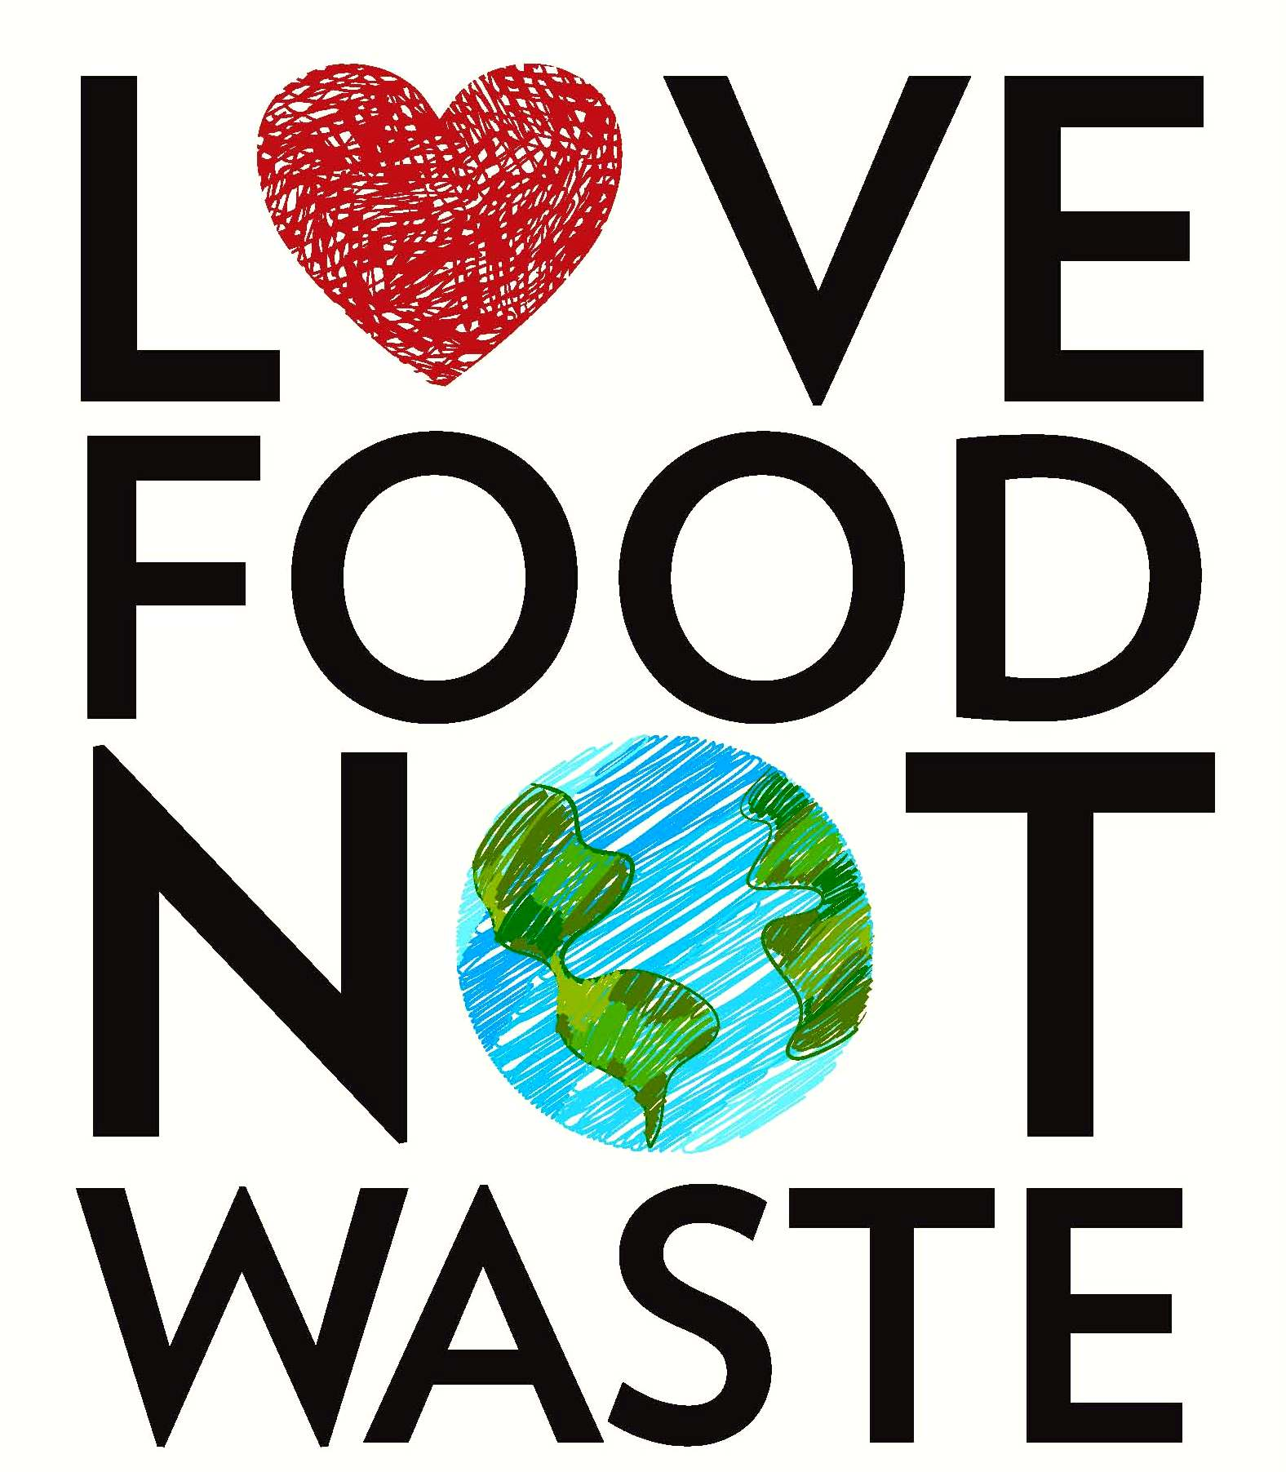
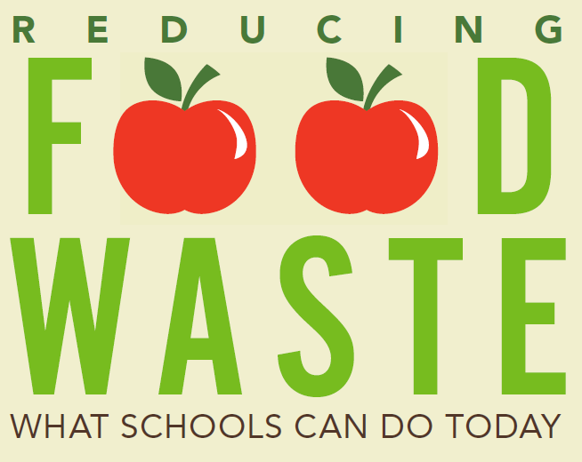
End School Food Waste
ECON 2505, Sec. HD21
Yanhong Liu
May 21, 2019

Slide 2
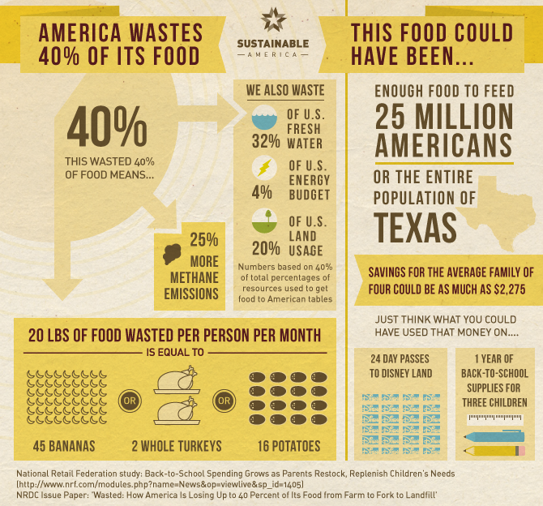
America is the No.1 Food Waste Country in the World. Food Waste is the No.1 contributor to landfills in America.

Slide 3
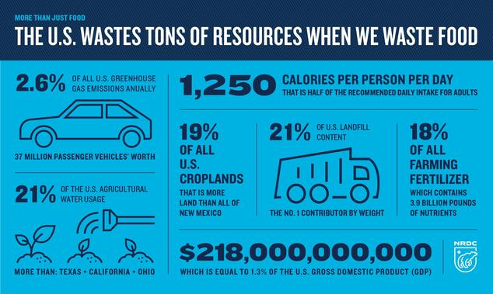

Slide 4
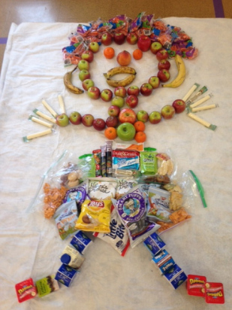
One of the biggest categories of waste for many schools is milk.

Slide 5
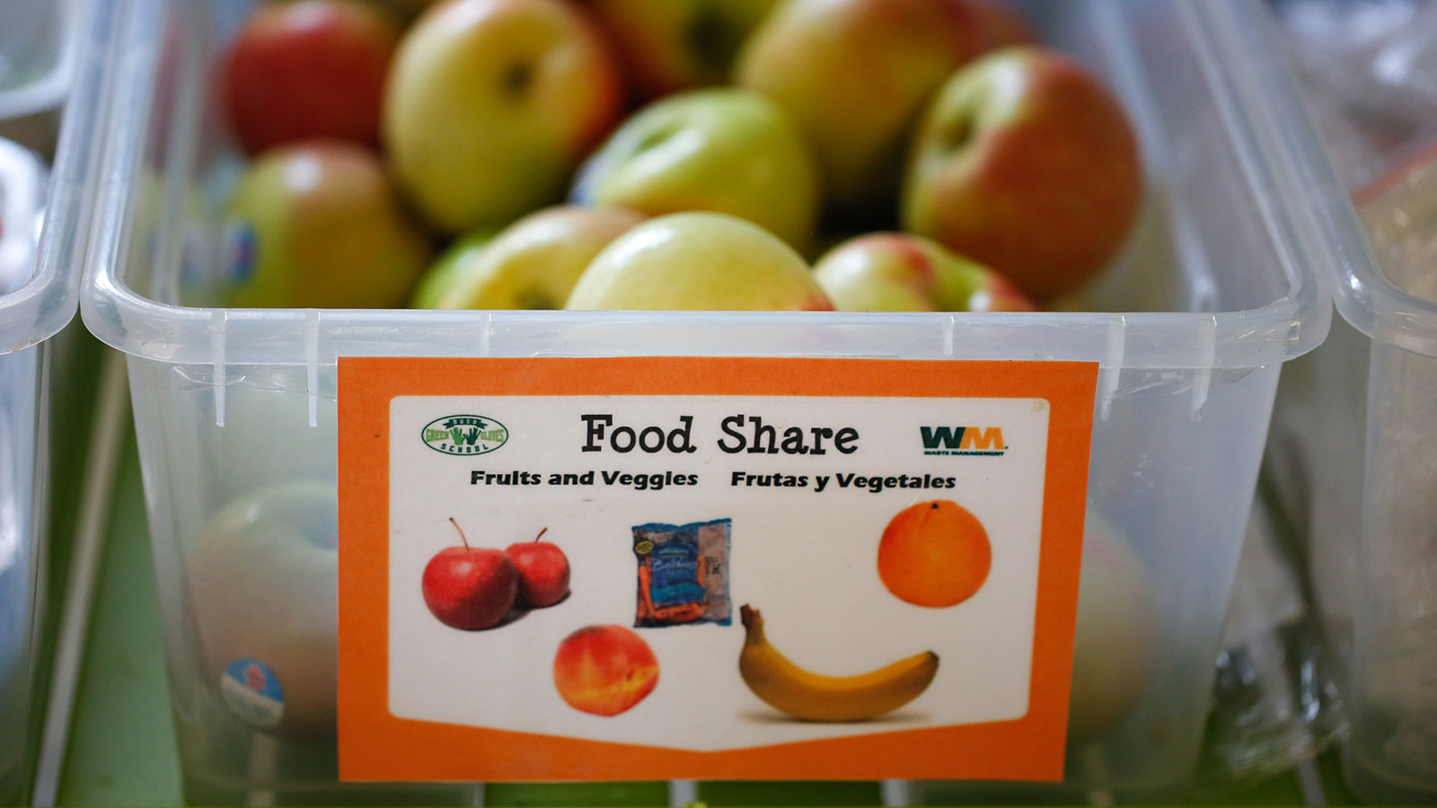
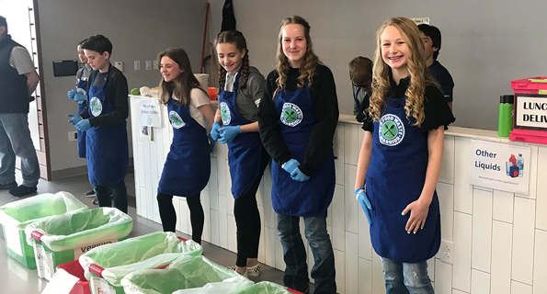
What School Can Do to End Food Waste?
Allowing students to keep a lunch or breakfast food item for consumption later after the day
Setting up a table for kids to place items they are not going to consume (packaged or pre-portioned items)
Letting kids self-serve to choose some food what they want to eat
Composting food waste for school gardens
Collecting excess wholesome food after mealtimes to donate to charitable organizations

Slide 6
Conclusions
When kids waste food, they not only waste resources, waste money, generate landfill feeding stuffs, but also set patterns of behavior for life.
Saving Food, actually, is
Saving Money
Saving Resource
Saving Energy
Saving Environment
Teaching kids how to save food at school is a skill they take with them to their homes and beyond, widening the impact with the environment and set patterns of sustainable lifestyle.

Slide 7
Reference
Adam Chandler, July 15,2016. Why Americans Lead The World In Food Waste. Retrieve from https://www.theatlantic.com/business/archive/2016/07/american-food-waste/491513/
CarmenByker ShanksPhD, RDNJinanBannaPhD, RDElena L.SerranoPhD, January 6, 2017. Food Waste in the National School Lunch Program 1978-2015: A Systematic Review, Retrieve from https://www.sciencedirect.com/science/article/pii/S2212267217305981
Emily S. Rueb, June 2, 2017, https://www.nytimes.com/2017/06/02/nyregion/compost-organic-recycling-new-york-city.html
Stacy A. Blondin, PhD, Sean B. Cash, PhD, Jeanne P. Goldberg, PhD, Timothy S. Griffin, PhD, and Christina D. Economos, PhDAll of the authors are with Tufts University Friedman School of Nutrition Science and Policy, Boston, MA. “Nutritional, Economic, and Environmental Costs of Milk Waste in a Classroom School Breakfast Program”, American Journal of Public Health 107, no. 4 (April 1, 2017): pp. 590-592. DOI: 10.2105/AJPH.2016.303647
Zach Conrad, Meredith T. Niles, Deborah A. Neher, Eric D. Roy, Nicole E. Tichenor, Lisa Jahns. April 18, 2018 Relationship between food waste, diet quality, and environmental sustainability. https://journals.plos.org/plosone/article?id=10.1371/journal.pone.0195405

