Slide 1
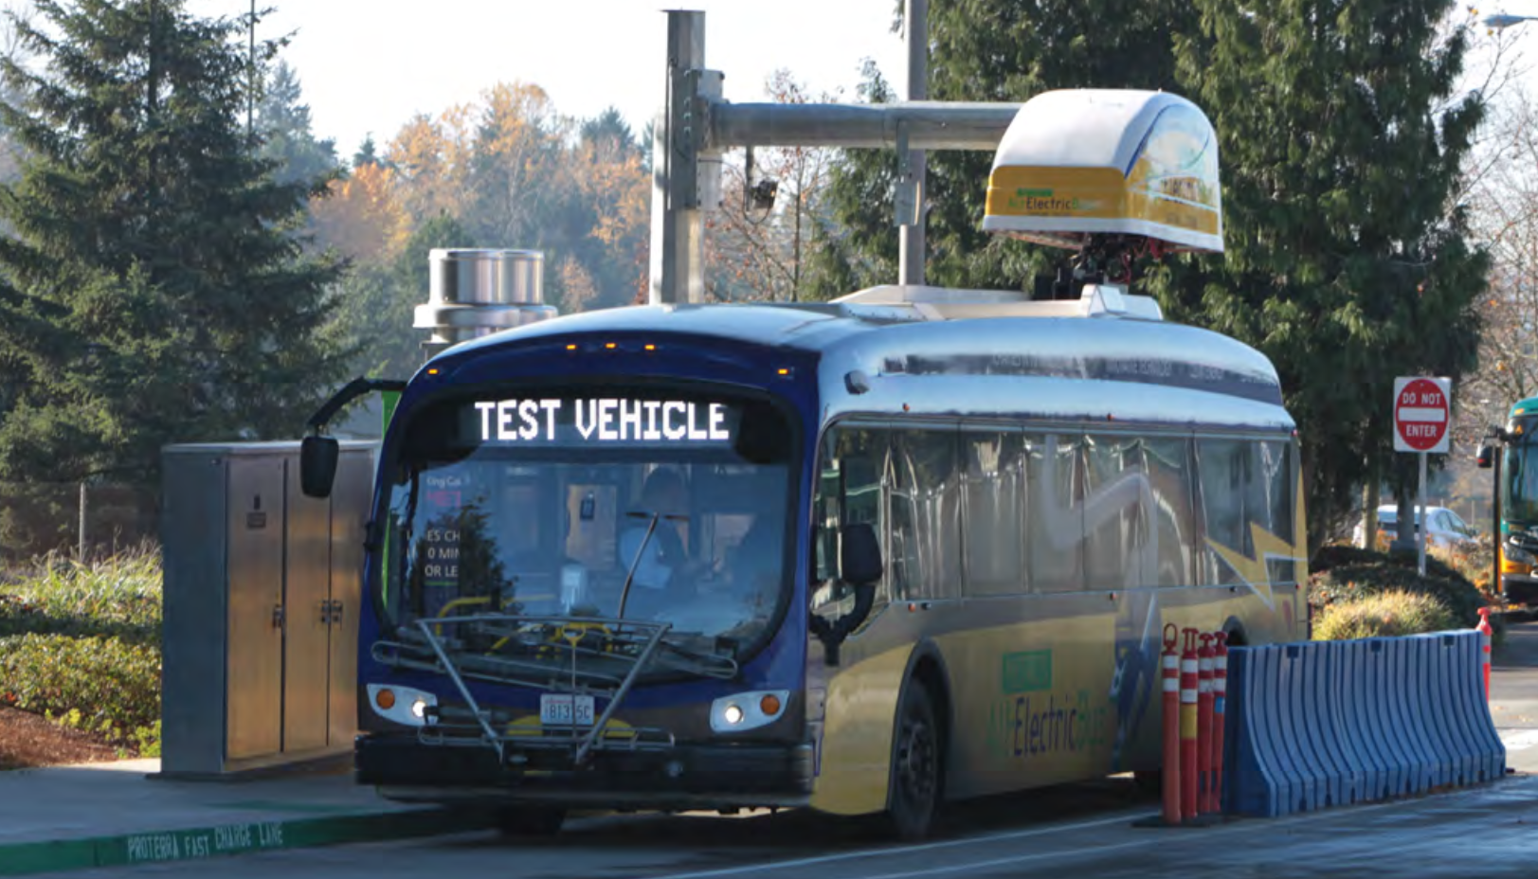
Electric Is The Future
Hemraj Mohabir
Course: Econ2505ID
Instructor: Sean P. MacDonald

Slide 2
Introduction
Buses play a key role in in our country transportation system
Buses reduce the number of individual cars on our roads
American buses remains dirty
Electrical bus can be our solution
Benefits of electrical buses

Slide 3
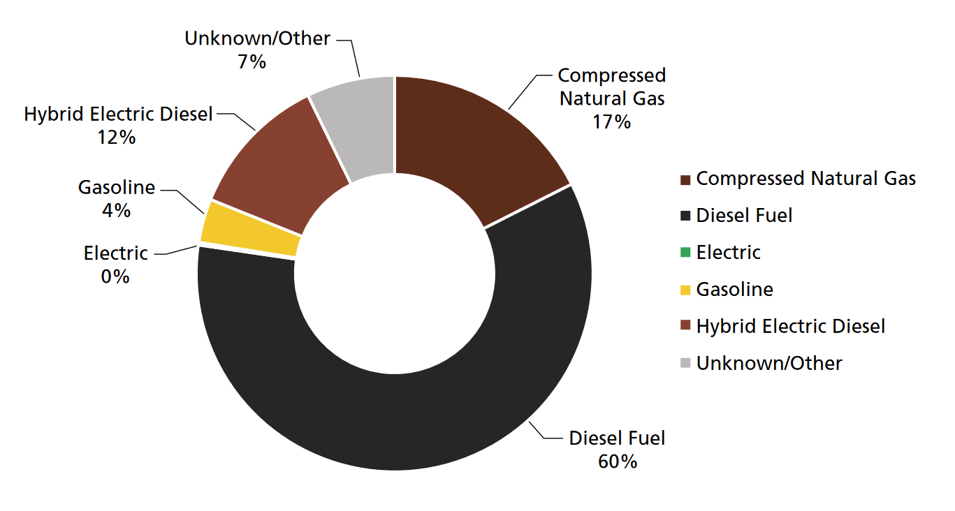
America’s Buses Still Using Fuels
Today, most of the nation’s public bus fleet continues to run on diesel
Distance Traveled per Gallon of Diesel Fuel Type
American Public Transportation Association, 2016 Public Transportation Fact Book, February 2017

Slide 4
Danger cause by diesel
Respiratory diseases
Cancer
World Health Organization, International Agency for Research on Cancer, “IARC: Diesel Engine Exhaust Carcinogenic” (press release), 12 June 2012

Slide 5
Replacing diesel buses
Replacing all of America’s school buses with electric buses
Replacing all of the diesel-powered transit buses with electric buses
Electric school bus can save districts money
The amount money it saves in the state of Chicago
American Public Transportation Association, 2016 Public Transportation Fact Book, February 2017

Slide 6
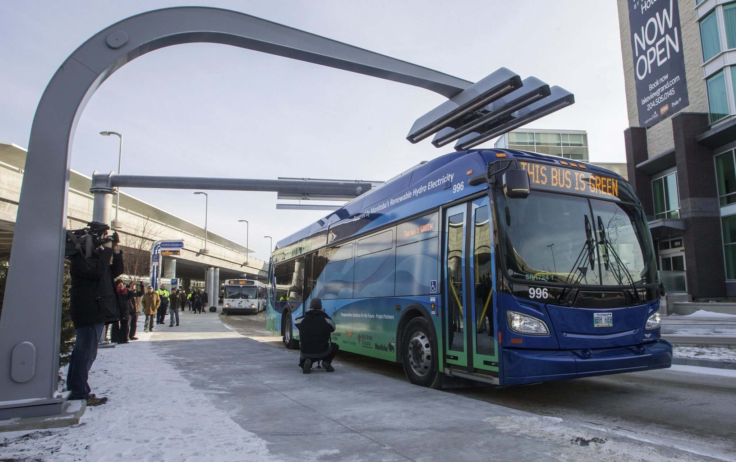
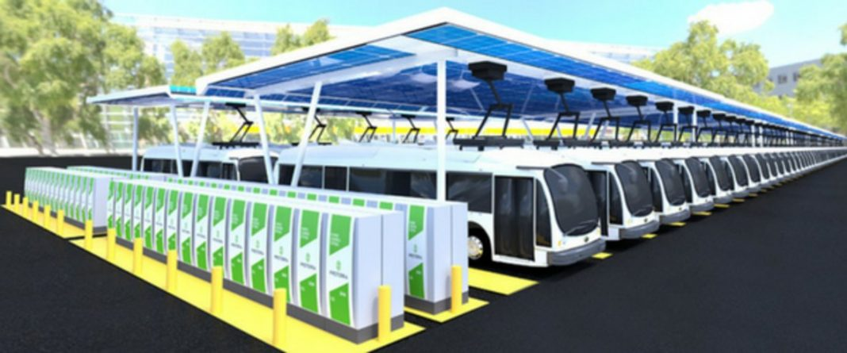
Charging Station
1

Slide 7
Bibliography
American Public Transportation Association (APTA), Transit Ridership Report: Third Quarter 2017, November 2017
American Public Transportation Association, “Public Transportation Industry Is a Green Industry,” (press release), 22 April 2016
Robert Pudlewski, “When Will Alt-Fuels Replace Diesel, Gas Powered School Buses” School Transportation News, 13 April 2017
Federal Transit Administration, U.S. Department of Transportation, National Transit Database – 2016, October 2017
American School Bus Council, Environ-mental Benefits, 12 January 2018.
American Public Transportation Association, 2016 Public Transportation Fact Book, February 2017
World Health Organization, International Agency for Research on Cancer, “IARC: Diesel Engine Exhaust Carcinogenic” (press release), 12 June 2012
Chicago Transit Authority, Electric Bus, accessed 6 February 2018

