Slide 1
Energy and Water Mapping
By: Pablo Sanchez, Henry Lam, Joshua Veliz

Slide 2
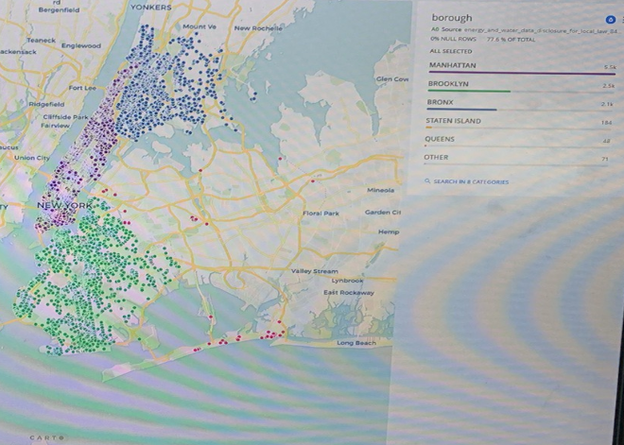
Energy and Water Consumption Map Throughout All Five Boroughs

Slide 3
Summary
The data that we selected was the energy and water consumption throughout the five boroughs of New York City. This data shows a visual representation of what parts of the city consume greater amounts of energy and water.
The reason that we chose this particular data to work with was because it was interesting being able to actively see the boroughs that we live in and how much of these resources they consume. Manhattan was pretty obvious that would have the most consumption but for the other boroughs it was surprising seeing the data mapped out.

Slide 4
Environmental Significance
The environmental significance shown by the map is that in the center of the city there's a lot more and unneeded use of both water and energy. This spreads out to both the Bronx and Brooklyn which also play a large role, and in the outskirts Staten Island and Queens which do not make up much compared to its neighbors. This could be a problem in the near future because population is only going to increase and if certain laws or policies aren't placed to monitor this consumption it will have a toll on the environment.
If water is being used more, we will have less fresh water and pumping more water than it can be replenished, the less ground water we will have.

Slide 5
Remediation
Some changes that could be made to fix this problem is using alternative power methods like solar panels mainly in the central city because of the constant power demand that is needed to keep it lit. Also having a cycle in which areas like Time Square go into an energy saving mode in times of the day where the energy consumption is not necessary would drastically decrease these numbers. The positive impact can be measured by comparing the consumption from before to the new data that is collected.

Slide 6
Conclusions
We concluded from the project that some parts of the city consume much more energy and water than others. Manhattan was at the top followed by Brooklyn, and the Bronx. If something is not done to control this usage it can be detrimental and cause irreversible damage to the environment. Thanks to resources like carto this information can be visualized and we can work on areas that need it most.

