Slide 1
Calculus
Yahya Salim & Sally Leveque
DEN1218 Section E612

Slide 2
What is Calculus?
Hardened biofilm (plaque)
It forms when plaque that has remained in the oral cavity calcifies.
When not removed, it becomes detrimental to the gingival health because it serves as a reservoir for additional plaque accumulation and can push the epithelial tissue away from the tooth causing recession and bone loss.
Appears radiopaque on radiographs

Slide 3
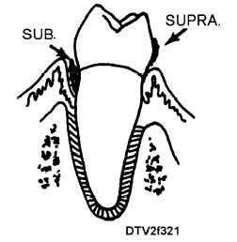
Types of Calculus
Calculus is classified by its location on the tooth surface.
Supragingival calculus is found on the clinical crown coronal to the gingival margin.
Subgingival calculus is found on the clinical crown apical to the gingival margin.

Slide 4
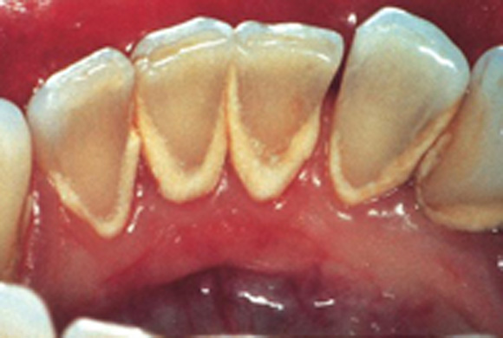
Supragingival Calculus
Appears white, creamy yellow or gray in color
Consistency is somewhat hard
Can be seen clinically

Slide 5
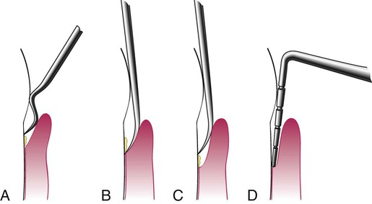
Subgingival Calculus
- Appears dark green, brown or black in color
- More accurately detected clinically using an explorer rather than radiographically

Slide 6
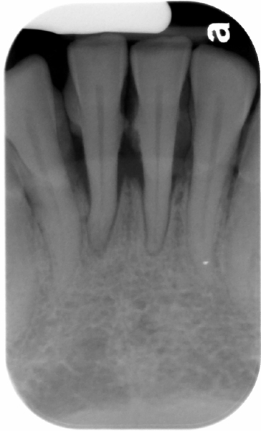
Calculus on mandibular central incisors appearing as tiny projections

Slide 7
Calculus on mandibular central incisors appearing nodular

Slide 8
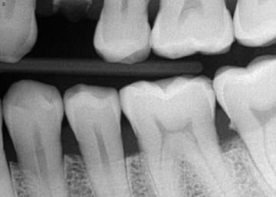
Calculus shown on the mandibular second molar

Slide 9
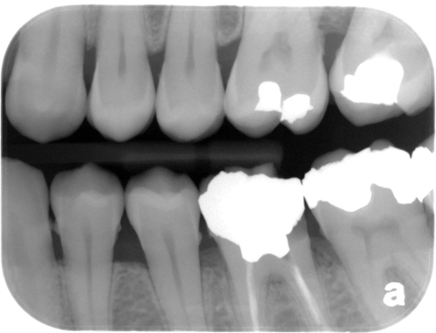
Calculus found on multiple teeth as shown on a bite-wing

Slide 10
References
https://en.wikipedia.org/wiki/Calculus_(dental)
https://www.perio.org/consumer/difference-between-plaque-and-calculus
http://drgstoothpix.com/2013/06/19/periodontal-radiographic-assessment-irritating-factors-natural-and-man-made/
Dental Radiography Principles and Techniques 5th edition
Clinical Practice of the Dental Hygienist 12th edition

