Slide 1
Systemic and topical corticosteroids
Presented by group 4:
Sally Leveque, Yu Jing Mei,
Wen Wen Dong, Lidia Burliuk

Slide 2
What are corticosteroids?
Corticosteroids are a class of steroid hormones broken down into two classes:
Glucocorticoids - reduce inflammation such as itching, redness, swelling and allergic reactions; aid in stress response; immunosuppression treatment
Mineralocorticoids - control electrolyte and water balance of the body
Presented by Sally Leveque

Slide 3
Why important for the dental professional?
Treatment of various oral lesions and ulcers
Has applications to endodontics and restorative dentistry such as the use as a cavity liner and pulp capping agent
Perioperative use to reduce post-surgical edema¹
Children who use a corticosteroid inhaler are at a greater risk for caries
Presented by Sally Leveque

Slide 4
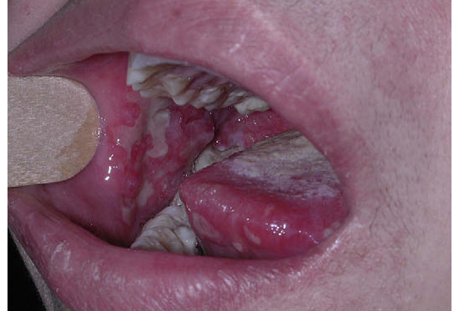
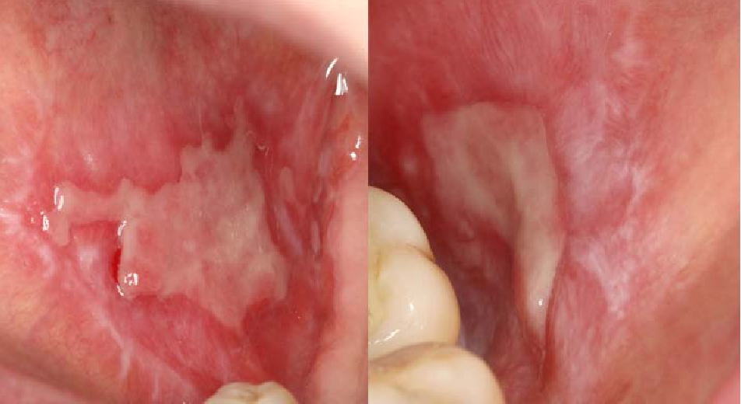
Oral/Facial conditions corticosteroids are intended to treat
Pemphigus vulgaris - Oral lichen planus
Photo credit: SemanticScholar.org
https://www.semanticscholar.org/paper/Pemphigus-vulgaris-and-paraneoplastic-pemphigus.-Edgin-Pratt/4b6c82df976110dea3c72826a85bc7d2b0d55301/figure/2
Photo credit: SemanticScholar.org
https://www.semanticscholar.org/paper/Oral-Lichen-Planus-Studies-of-factors-involved-in-Danielsson/3ac16191d584bef86b93eee5c13aca9d3eeb2710/figure/0
Presented by Sally Leveque

Slide 5
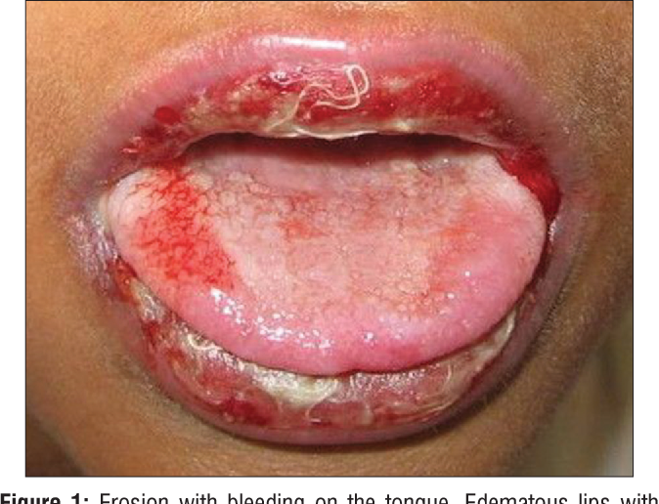
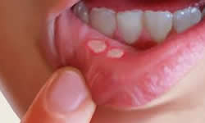
Oral/Facial conditions corticosteroids are intended to treat (cont’d)
Oral erythema multiforme - Aphthous ulcers
Photo credit: Modern Dentistry AU
http://www.moderndentistry.com.au/mouth_ulcers.php
Photo credit: SemanticScholar.org
https://www.semanticscholar.org/paper/Drug-induced-Oral-Erythema-Multiforme%3A-A-Diagnostic-Taqi/6ec3c14ac12f98a1edba2def2d9c9efe7b14127f/figure/0
Presented by Sally Leveque

Slide 6
Oral/Facial conditions corticosteroids are intended to treat (cont’d)
Stomatitis
- Mucous membrane pemphigoid
Bell’s palsy
Ramsay Hunt syndrome
TMJ disorders
Presented by Sally Leveque

Slide 7
Other diseases and conditions corticosteroids are intended to treat
Adrenal crisis - Multiple sclerosis
Addison’s disease - Leukemia
COPD - Lupus
Contact dermatitis - Arthritis
Asthma - Leukemia
Crohn’s disease - Organ transplantation
Allergies
“Corticosteroids have revolutionized the management of several disabling conditions and saved many lives.²”
Presented by Sally Leveque

Slide 8
How does corticosteroid work in our body?
Decreasing inflammation which body fight with foreign substances such as bacteria and virus.
Reducing activity of immune system which body tissue self-damage such as transplantation, corticosteroid can stop self-attack or keep tissue damaged as low as possible.
Presented by Yu Jing Mei

Slide 9
How does corticosteroid work in our body?
Local steroid treatment:
joint injection
eye drops,
ear drops,
skin creams.
2. Systemic steroid treatment:
It circulates through bloodstream to body sites
Examples: Oral medicines or
Medicines that are delivered into vein(IV) or muscle(IM)
Note: local steroid treatment is preferred to prescribe instead of systemic steroid treatment to reduce risks of side effects when possible.
Presented by Yu Jing Mei

Slide 10
Adrenal Crisis
Definition:
It is the condition that when body doesn't produce enough cortisol from adrenal glands.
Causes:
Adrenal glands are damaged: Addison disease or surgery.
Pituitary gland is damaged and cannot release ACTH hormone.
Taking corticosteroids for long time, and suddenly stop.
Stress .
Presented by Yu Jing Mei

Slide 11
Taking corticosteroids for long could cause adrenal crisis?
Taking corticosteroids for long could lead to adrenal glands not functioning properly or even stop functioning.
Adrenal crisis occurs frequently after stop using corticosteroids.
Higher dosage of corticosteroids taken has higher percentage( 21.5%, while low dose has 2.4%) of suffering adrenal crisis.
Systemic corticosteroids treatment has higher percentage(52.2%) of suffering adrenal crisis then local corticosteroids treatment(4.2%).
Long duration of corticosteroid treatment( more than 1 year) has higher percentage(27.4%) than short duration of corticosteroid treatment( less than 28 days, 1.4%).
Presented by Yu Jing Mei

Slide 12
Corticosteroids Types:
Common Systemic Corticosteroids Drugs | Drugs Common Topical Corticosteroids Drugs
Methylprednisolone (Medrol) | Triamcinolone (Dermazon)
Prednisone (Deltasone) | Mometasone (Nasonex)
Prednisolone (Omnipred) | Hydrocortisone (Texacort)
Fluticasone (Flovent; Flonase Inhaler) | Betamethasone (Diprolene)
Presented by Wen Wen Dong

Slide 13
Methylprednisolone (Medrol)
Labeled indications:
Allergic--atopic dermatitis; drug hypersensitivity; seasonal allergic rhinitis serum sickness;
Dermatologic--Bullous. Contact, and exfoliative dermatitis; mycosis fungoides; Stevens-Johnson syndrome; severe psoriasis; severe seborrheic dermatitis;
Endocrine--congenital adrenal hyperplasia; hypercalcemia associated cancer; nonsuppurative thyroiditis; primary or secondary adrenocortical insufficiency;
GI--To tide the patient over a critical period of Crohn disease or ulcerative colitis;
Hematologic--Acquired hemolytic anemia; Congenital hypoplastic anemia; erythroblastopenia; immune thrombocytopenia;
Neoplastic--Palliative management of leukemias and lymphomas;
Ophthalmic--P.O.:Severe allergic conjunctivitis; allergic corneal marginal ulcer; Injection: other ocular inflammation conditions unresponsive to topical corticosteroid;
Renal--Induce diuresis with or without uremia;
Respiratory--aspiration pneumonitis; asthma; berylliosis; disseminated pulmonary tuberculosis;
Presented by Wen Wen Dong

Slide 14
Methylprednisolone (Medrol)
Off-label indications:
Adjunct therapy for acute spinal cord injury;
Moderate to severe acute distress respiratory syndrome and severe alcoholic hepatitis;
A preventive agent in bronchiolitis obliterans syndrome;
Hormonal resuscitation in cardiac organ recovery;
Acute cellular and antibody-mediated rejection in cardiac implant;
Adjunct in management of acute exacerbation of chronic obstructive pulmonary disease;
Adjunct treatment of Pneumocystis pneumonia in HIV-infected patients;
MOA of Methylprednisolone
Methylprednisolone binds to the glucocorticoid receptor---move into the nucleus---resulting in either enhancement or suppression of transcription with specific DNA sequence;
Glucocorticoids impair a variety of T cell functions, and moderate-to-high dose induce T cell apoptosis while keeping B cell function and antibody production preserved;
Presented by Wen Wen Dong

Slide 15
Contraindications:
Documented hypersensitivity to drug or components;
Systemic fungal infection;
Intrathecal administration;
Liver or attenuated virus vaccine;
Idiopathic thrombocytopenic purpura;
Caution:
Like other glucocorticoids, must be used with great caution in patients with peptic ulcer, heart disease or hypertension with HF, certain infectious illness such as varicella and tuberculosis, diabetes, osteoporosis or glaucoma
Presented by Wen Wen Dong

Slide 16
Prednisone (Deltasone)
Indications: (it has similar use of methylprednisolone, here are the different use)
GI disease--use it during acute episode of Crohn disease;
Neoplastic disease--Tx of acute leukemia and aggressive lymphomas;
Renal disorders--induce diuresis without uremia;
Respiratory disease--Tx of acute exacerbations of COPD; allergic bronchopulmonary aspergillosis;
MOA of prednisone:
By reversing capillary permeability, suppressing the migration of fibroblasts and leukocytes, controlling the rate of protein synthesis;
Presented by Wen Wen Dong

Slide 17
Contraindications:
Documented allergic cross-reactivity for corticosteroid is limited;
Hypersensitivity to prednisolone;
Systemic fungal infection;
Liver or attenuated virus vaccine;
Caution:
May cause hypercortisolism or suppression of hypothalamic-pituitary-adrenal (HPA) axis, particularly in younger children or in patients receiving high dose for prolonged periods.
Presented by Wen Wen Dong

Slide 18
Triamcinolone (Dermazon)
Indications:
Dermatoses--corticosteroid-responsive;
Oral inflammation--adjunctive treatment and temporary relief oral inflammation and ulcerative lesions resulting from trauma;
MOA of triamcinolone:
To induce of phospholipase A2 inhibitor proteins and sequential inhibition of the release of arachidonic acid.
Contraindications:
Hypersensitivity of triamcinolone;
Fungal, viral or bacterial infections of the mouth or throat;
Caution:
Topical corticosteroids may cause manifestations of Cushing’s syndrome, hyperglycemia, or glycosuria.
Presented by Wen Wen Dong

Slide 19
Mometasone (Nasonex)
Indications:
Allergic rhinitis--seasonal perennial
Nasal congestion associated with seasonal rhinitis;
Nasal polyps;
Seasonal allergic rhinitis--prophylaxis
MOA of mometasone
Depress the formation, released, and activity of endogenous chemical mediators.
Contraindications:
There is no significant contraindications. No systemic effects on adrenal suppression; No changes in epithelial thickness;
Presented by Wen Wen Dong

Slide 20
Adverse reactions of Methylprednisolone (Medrol)
Effects on dental treatment: ulcerative esophagitis.
ADVERSE REACTIONS:
Congestive heart failure in susceptible patients, osteoporosis, impaired wound healing, facial erythema, acne, depression, increased sweating, headache, convulsions, glaucoma, trouble sleeping, swollen face lips, or tongue, increased thirst, increased urination, muscle weakness, suppression of growth in children, increased susceptibility to infections.
Drug Interactions:
Methylprednisolone (Medrol) should not be used together with Aspirin, Warfarin, or Heparin. It significantly increases chances of side effects and may cause dangerous bleeding.⁹
Presented by Lidia Burliuk

Slide 21
Adverse reactions of Prednisone (Deltasone)
Effect on dental treatment: no significant effects or complications reported.
ADVERSE REACTIONS:
Congestive heart failure in susceptible patients, severe allergic reactions (anaphylaxis), impaired wound healing, ulcerative esophagitis, peptic ulcer, changes in vision, confusion, excitement, restlessness, headache, nausea, vomiting, thinning skin, facial erythema, acne, trouble sleeping, weight gain, increased thirst, increased urination, increased susceptibility to infections.
Drug Interactions:
Prednisone (Deltasone) should not be used together with diabetes medications: sulfonylureas, biguanides, thiazolidinediones, and metiglinides. It may result in an increase in blood glucose levels. Also taking NSAIDs with prednisone may increase risk of stomach issues such as ulcers and bleeding.⁹
Presented by Lidia Burliuk

Slide 22
Adverse reactions of topical Triamcinolone (Dermazone)
Effects on dental treatment: ulcerative esophagitis, perioral dermatitis, atrophy of oral mucosa, burning, and irritation.
ADVERSE REACTIONS:
Burning, itching, irritation, dryness, folliculitis, hypertrichosis, acneiform eruptions, hypopigmentation, perioral dermatitis, allergic contact dermatitis, maceration of the skin, secondary infection, skin atrophy, striae, miliaria.
Contraindications:
Triamcinolone (Dermazone) cream is contraindicated in those patients with a history of hypersensitivity to any of the components of the preparation. Should not be used on unhealed or open wounds.⁹
Presented by Lidia Burliuk

Slide 23
Adverse reactions of nasal Mometasone (Nasonex)
Effects on bleeding: shown to cause localized epistaxis (nosebleed) with prolonged use. Effect on dental treatment: no significant effects or complications reported.
ADVERSE REACTIONS:
Headache, pharyngitis, epistaxis, diarrhea, vomiting, sore throat, nose bleeds, cough, vision problems, conjunctivitis, otitis media, asthme, wheezing, sinusitis, increased susceptibility to infections, oral candidiasis.
Drug Interactions:
Mometasone (Nasonex; Elocon) should not be used together with an antibiotic (clarithromycin), antifungal medications (ketoconazole, itraconazole), an antidepressant (nefazodone), or antiviral medications to treat HIV/AIDS. It significantly increases chances of side effects.⁹
Presented by Lidia Burliuk

Slide 24
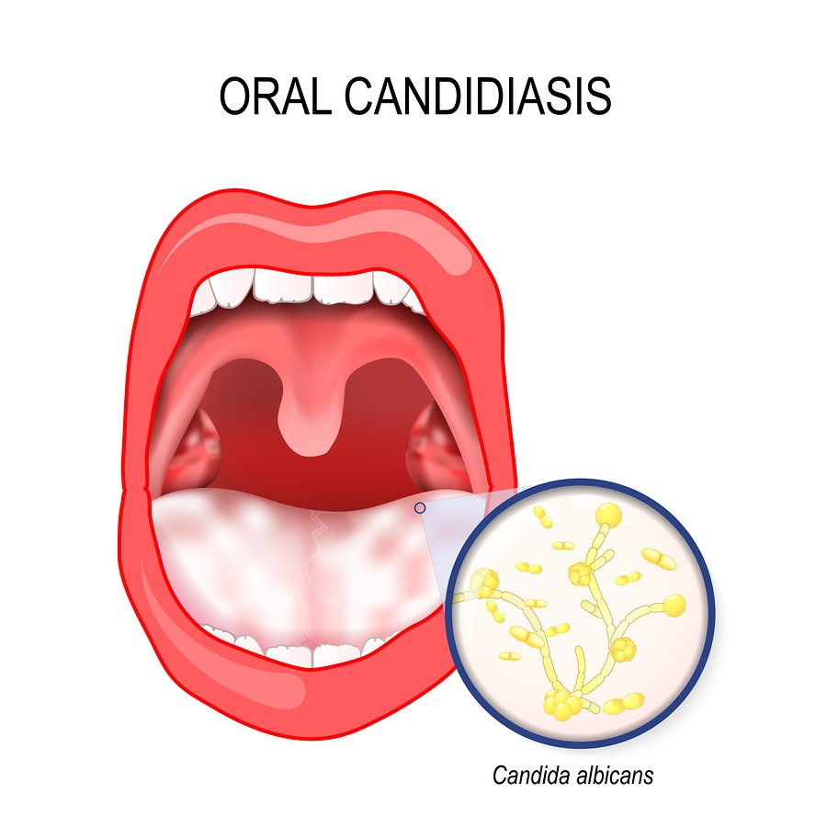
Oral candidiasis (oral thrush)
Oral candidiasis is a common opportunistic infection caused by an overgrowth of Candida species in the oral cavity. It has been associated with long term Inhaled corticosteroids use in patients with the bronchial asthma.⁸
Oral candidiasis is usually treated with antifungal medications (fluconazole, clotrimazole, miconazole, or nystatin)
DH consideration for steroid inhaler users:
We should explain to our patients why it's important to brush and rinse oral cavity after each inhalation. We may also refer patient to the pharmacist to review the proper aerosol inhalation technique and consider the need for inhaler chamber (spacer) and alternative metered-dose inhaler device, if needed.
https://www.interdent.com/gentle-dental/resources/oral-thrush/
Presented by Lidia Burliuk

Slide 25
References
Sanghavi, Jatan and Amita Aditya. “Applications of corticosteroids in dentistry.” Journal of Dental and Applied Sciences 4.1 (2015): 19.
Kallali, Basavaraj, Kamlesh Singh, and Vidhi Thaker. “Corticosteroids in dentistry.” Journal of Indian Academy of Oral Medicine and Radiology 23.2 (2011): 128.
Brent Wisse, David Zieve. “Acute adrenal crisis.” U.S National of Medicine,7 May 2017.
Leonie H.A. Broersen, Alberto M. Pereira, Jens Otto L. Jorgensen and Olaf M. Dekkers. “Adrenal Insufficiency in Corticosteroids Use: Systematic Review and Meta-Analysis.” The Journal of Clinical Endocrinology & Metabolism, vol.100, isu.6, pg.2171-2180, 1 June 2015.
Ocejo, Antonio, and Ricardo Correa. “Methylprednisolone.” StatPearls Publishing, no.1,2019.
Passali, Desiderio, et al. “Mometasone Furoate Nasal Spray: A systematic Review.” Multidisciplinary Respiratory Medicine, vol.11, no.1, 2016.
Dekhuijzena, Richard, Batsioubc, Maria, Bjermerd, Bosnic-Anticeviche, Sinthia, Chrystyncf, Henry, Papig, Alberto, Rodríguez-Roisinh, Roberto, Fletcheri, Monica, Woodc, Lucy, CifrabcJoan, Alessandra, B.Sorianoj and Price, David B. “Incidence of oral thrush in patients with COPD prescribed inhaled corticosteroids: Effect of drug, dose, and device.” Journal of Respiratory Medicine 120 (2016): 54-63.
https://www.drugs.com/

