Slide 1
New York City College of Technology Department of Dental Hygiene DEN 2300 Case Presentation
Presented by: Sally Leveque
December 14, 2019

Slide 2
Patient Profile
Mr. S. is a 61 year old African-American male.
Middle-class, lives in the city limits with his wife. Has access to medical care and has dental insurance.
His last dental visit was October 2019. He is in the middle of root canal treatment for #31. A periapical radiograph was taken at that time.
Last hygiene visit was March 2018.
Patient states using a soft-bristled brush twice daily with Colgate or Aim toothpaste, flosses when he remembers, does not uses mouthrinses or a tongue cleaner.

Slide 3
Chief Complaint(s)
Patient stated he knows he needs to do a better job with his oral health.
Mr. S. has generalized supragingival calculus on the the facial and lingual aspect of his mandibular anteriors, along with moderate staining.
He is sometimes embarrassed when he is speaking to others, he wants to feel confident again.

Slide 4
Health History Overview
Blood pressure readings: 1st: 154/114 pulse 83, 2nd: 145/110 pulse 77,
3rd: 149/108 pulse 74.
ASA: II
Medical Conditions
The patient presents with Stage 2 hypertension.
Current medications: 2 tumeric supplements once daily. The patient was prescribed Amplodipine for management of his hypertension. However, he began taking a OTC herbal supplement instead.

Slide 5
Explanation of Stage 2 Hypertension
During stage 2 hypertension the heart is working harder to pump blood. It is diagnosed when BP readings consistently range from 140/90 mm Hg or higher. If left untreated, Stage 2 hypertension can result in: coronary artery disease, an enlarged heart, heart failure, a transient ischemic attack (mini-stroke), stroke, dementia, and kidney damage just to name a few.
Can result from the following: obesity, a high-salt diet, smoking, stress, old age, thyroid disorders, kidney disease and a family history of the disease.
A patient may or may not present with: fatigue, dizziness, chest pain, difficulty breathing, blood in urine.
DePalma, Sondra M., et al. "Hypertension guideline update: A new guideline for a new era." Journal of the American Academy of PAs 31.6 (2018): 16-22.
Moran, Andrew E., et al. "Cost-effectiveness of hypertension therapy according to 2014 guidelines." New England Journal of Medicine 372.5 (2015): 447-455.

Slide 6
Management of Stage 2 Hypertension
Treatment includes: prescribed antihypertensive medication, lifestyle changes including diet and exercise
Patient was prescribed Amplodipine but is very apprehensive about taking prescription medication. He feels the side effects outweigh the benefits.
Patient currently manages his condition with changes in diet and OTC dietary supplement “Blood Pressure Wellness” by Bio Nutrition.
Carey, Robert M., and Paul K. Whelton. "Prevention, detection, evaluation, and management of high blood pressure in adults: synopsis of the 2017 American College of Cardiology/American Heart Association hypertension guideline." Annals of internal medicine 168.5 (2018): 351-358.
Moran, Andrew E., et al. "Cost-effectiveness of hypertension therapy according to 2014 guidelines." New England Journal of Medicine 372.5 (2015): 447-455.

Slide 7
Dental Hygiene Management
Be mindful that side effects of many antihypertensive medications include: xerostomia, taste alterations, gingival enlargement, increased bleeding, lichenoid reactions and orthostatic hypotension.
It is recommended that patients have morning appointments which are short.
When changing patients positions, it must be done slowly to reduce the risk of orthostatic hypotension.
Popescu, Sanda Mihaela, et al. “Hypertensive Patients and Their Management in Dentistry.” ISRN Hypertension, vol. 2013, 2013, pp. 1–8., doi:10.5402/2013/410740.
Southerland, Janet, et al. “Dental Management in the Patient with Hypertension: Challenges and Solutions.” Clinical, Cosmetic and Investigational Dentistry, Volume 8, 2016, pp. 111–120., doi:10.2147/ccide.s99446.

Slide 8
Comprehensive Assessments

Slide 9
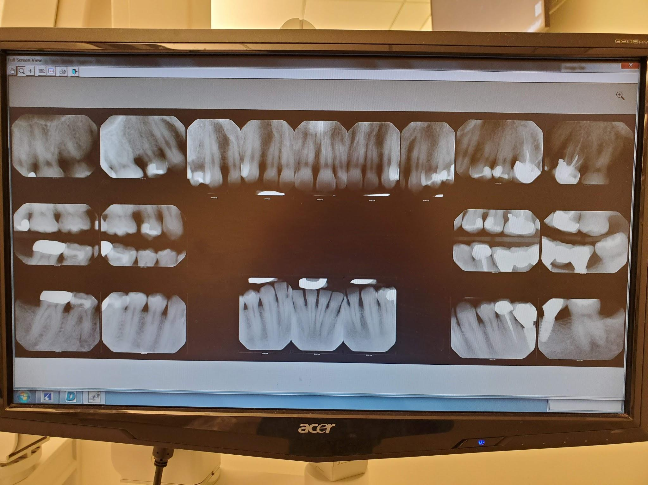
Radiographs

Slide 10
Radiographic Findings
Periapical pathology on #30
Possible fracture and caries on #3D and #5D
Calculus noted on mandibular anteriors

Slide 11
Summary of Clinical Findings
Extraoral findings: Keloids scar on the back of head (patient stated this was from a surgery 20 years ago). The patient also has asymptomatic bilateral TMJ clicking.
Intraoral findings: Bilateral linea alba and the posterior ⅔ of the tongue was coated white.
Occlusion: Angles classification I, overjet 5mm, overbite 60%.
Deposits: The patient has generalized moderate supra and subgingival calculus.
Staining: The patient has localized moderate stain on maxillary anterior lingual areas.

Slide 12
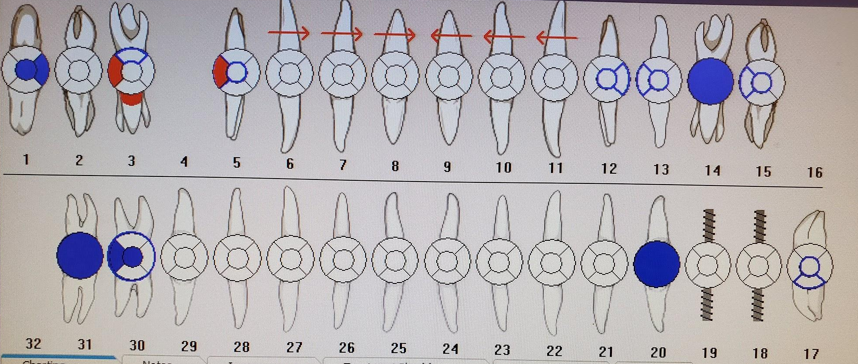
Dental Charting
Class I and II amalgam restorations on #1,30
Class I and II composite restoration on #3,5,12,13,15,17,30
PFM on #14,20,31
Implant supported 3 unit fixed bridge #18,19 with an extra pontic
Possible caries detected on #3,5

Slide 13
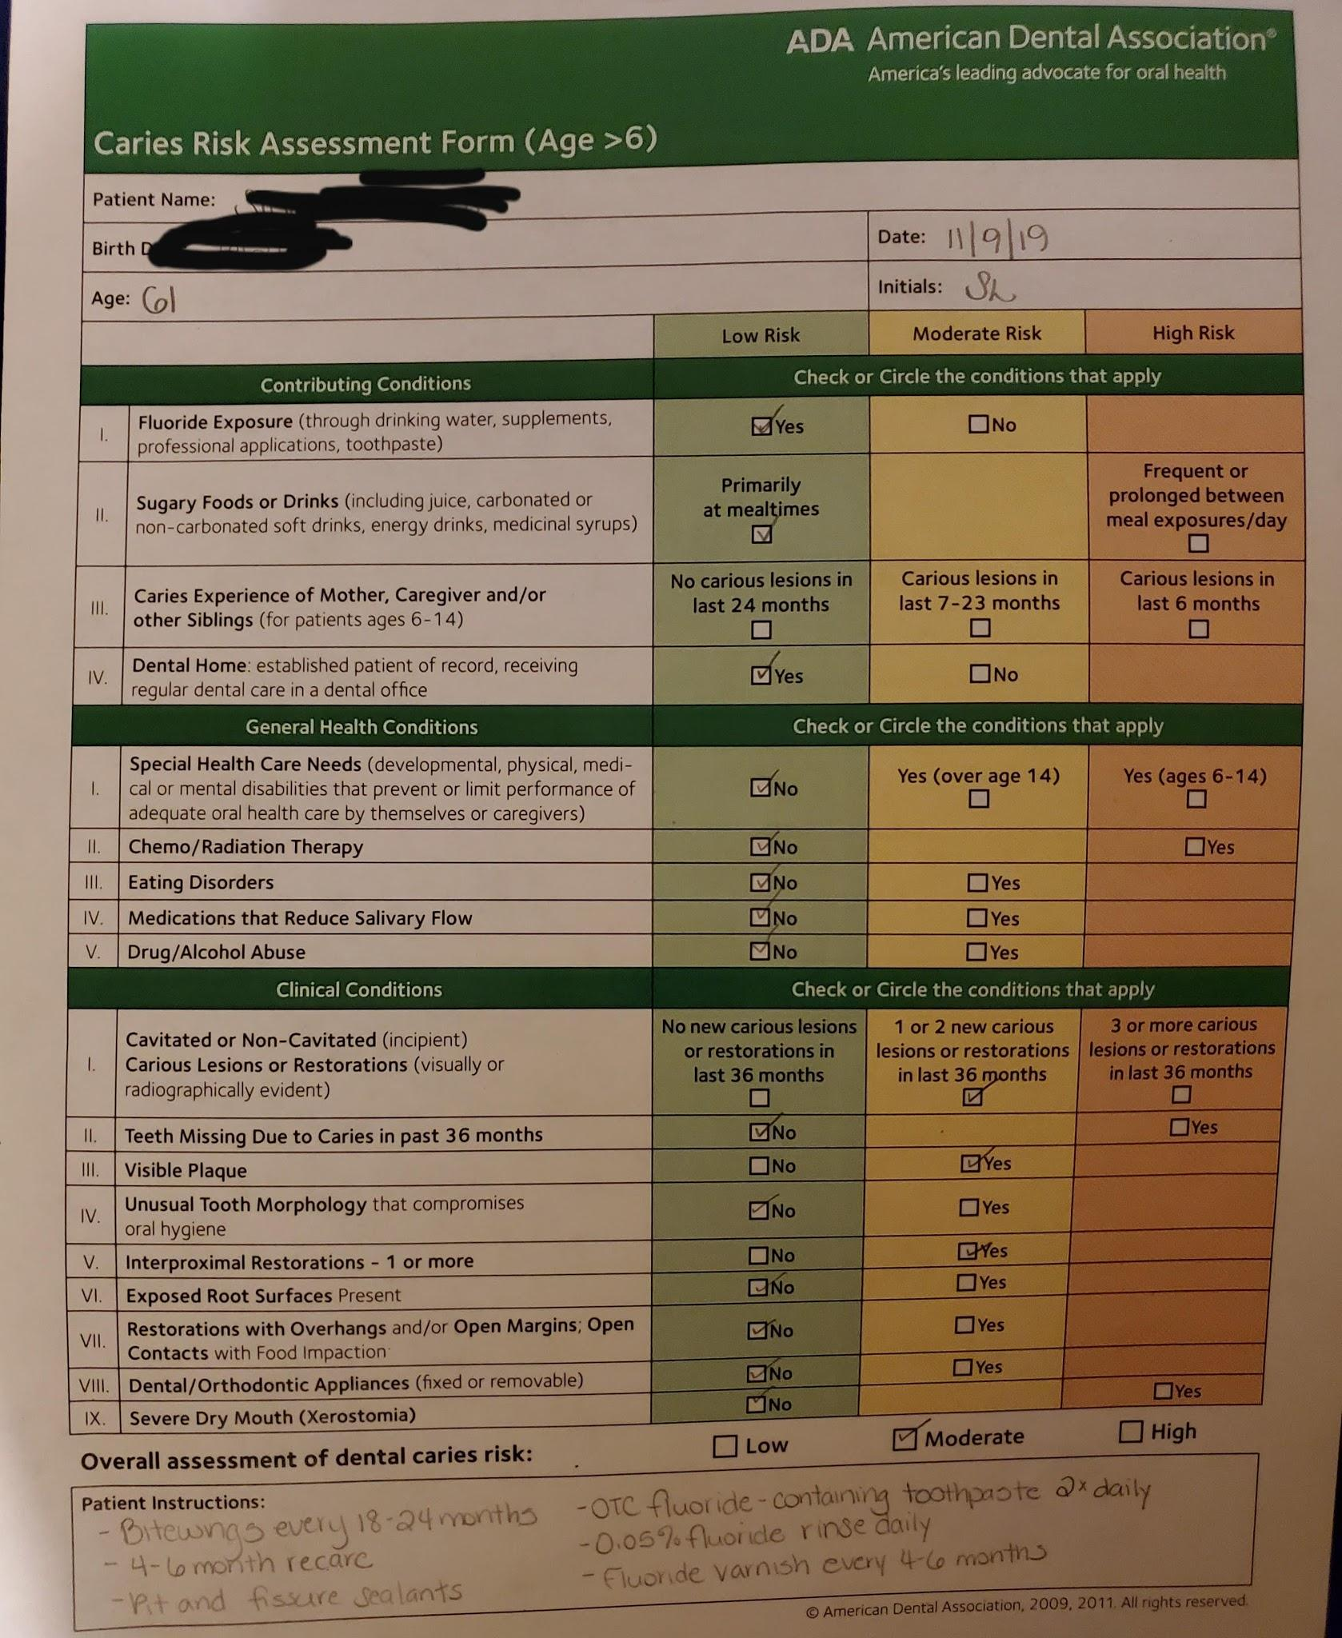
Caries Risk Assessment
Clinical evidence shows caries on cervical and distal of #3 and distal of #5.
Radiographic evidence caries noted on distal of #3,5.

Slide 14
Gingival Description and Periodontal Status
Gingival description: The gingiva shows generalized inflammation. It is pink in color with pigmentation and spongy texture. The margins on anterior regions are rolled and slightly bulbous on posterior regions. There was minimal BOP on and anterior regions and moderate on posterior regions.

Slide 15
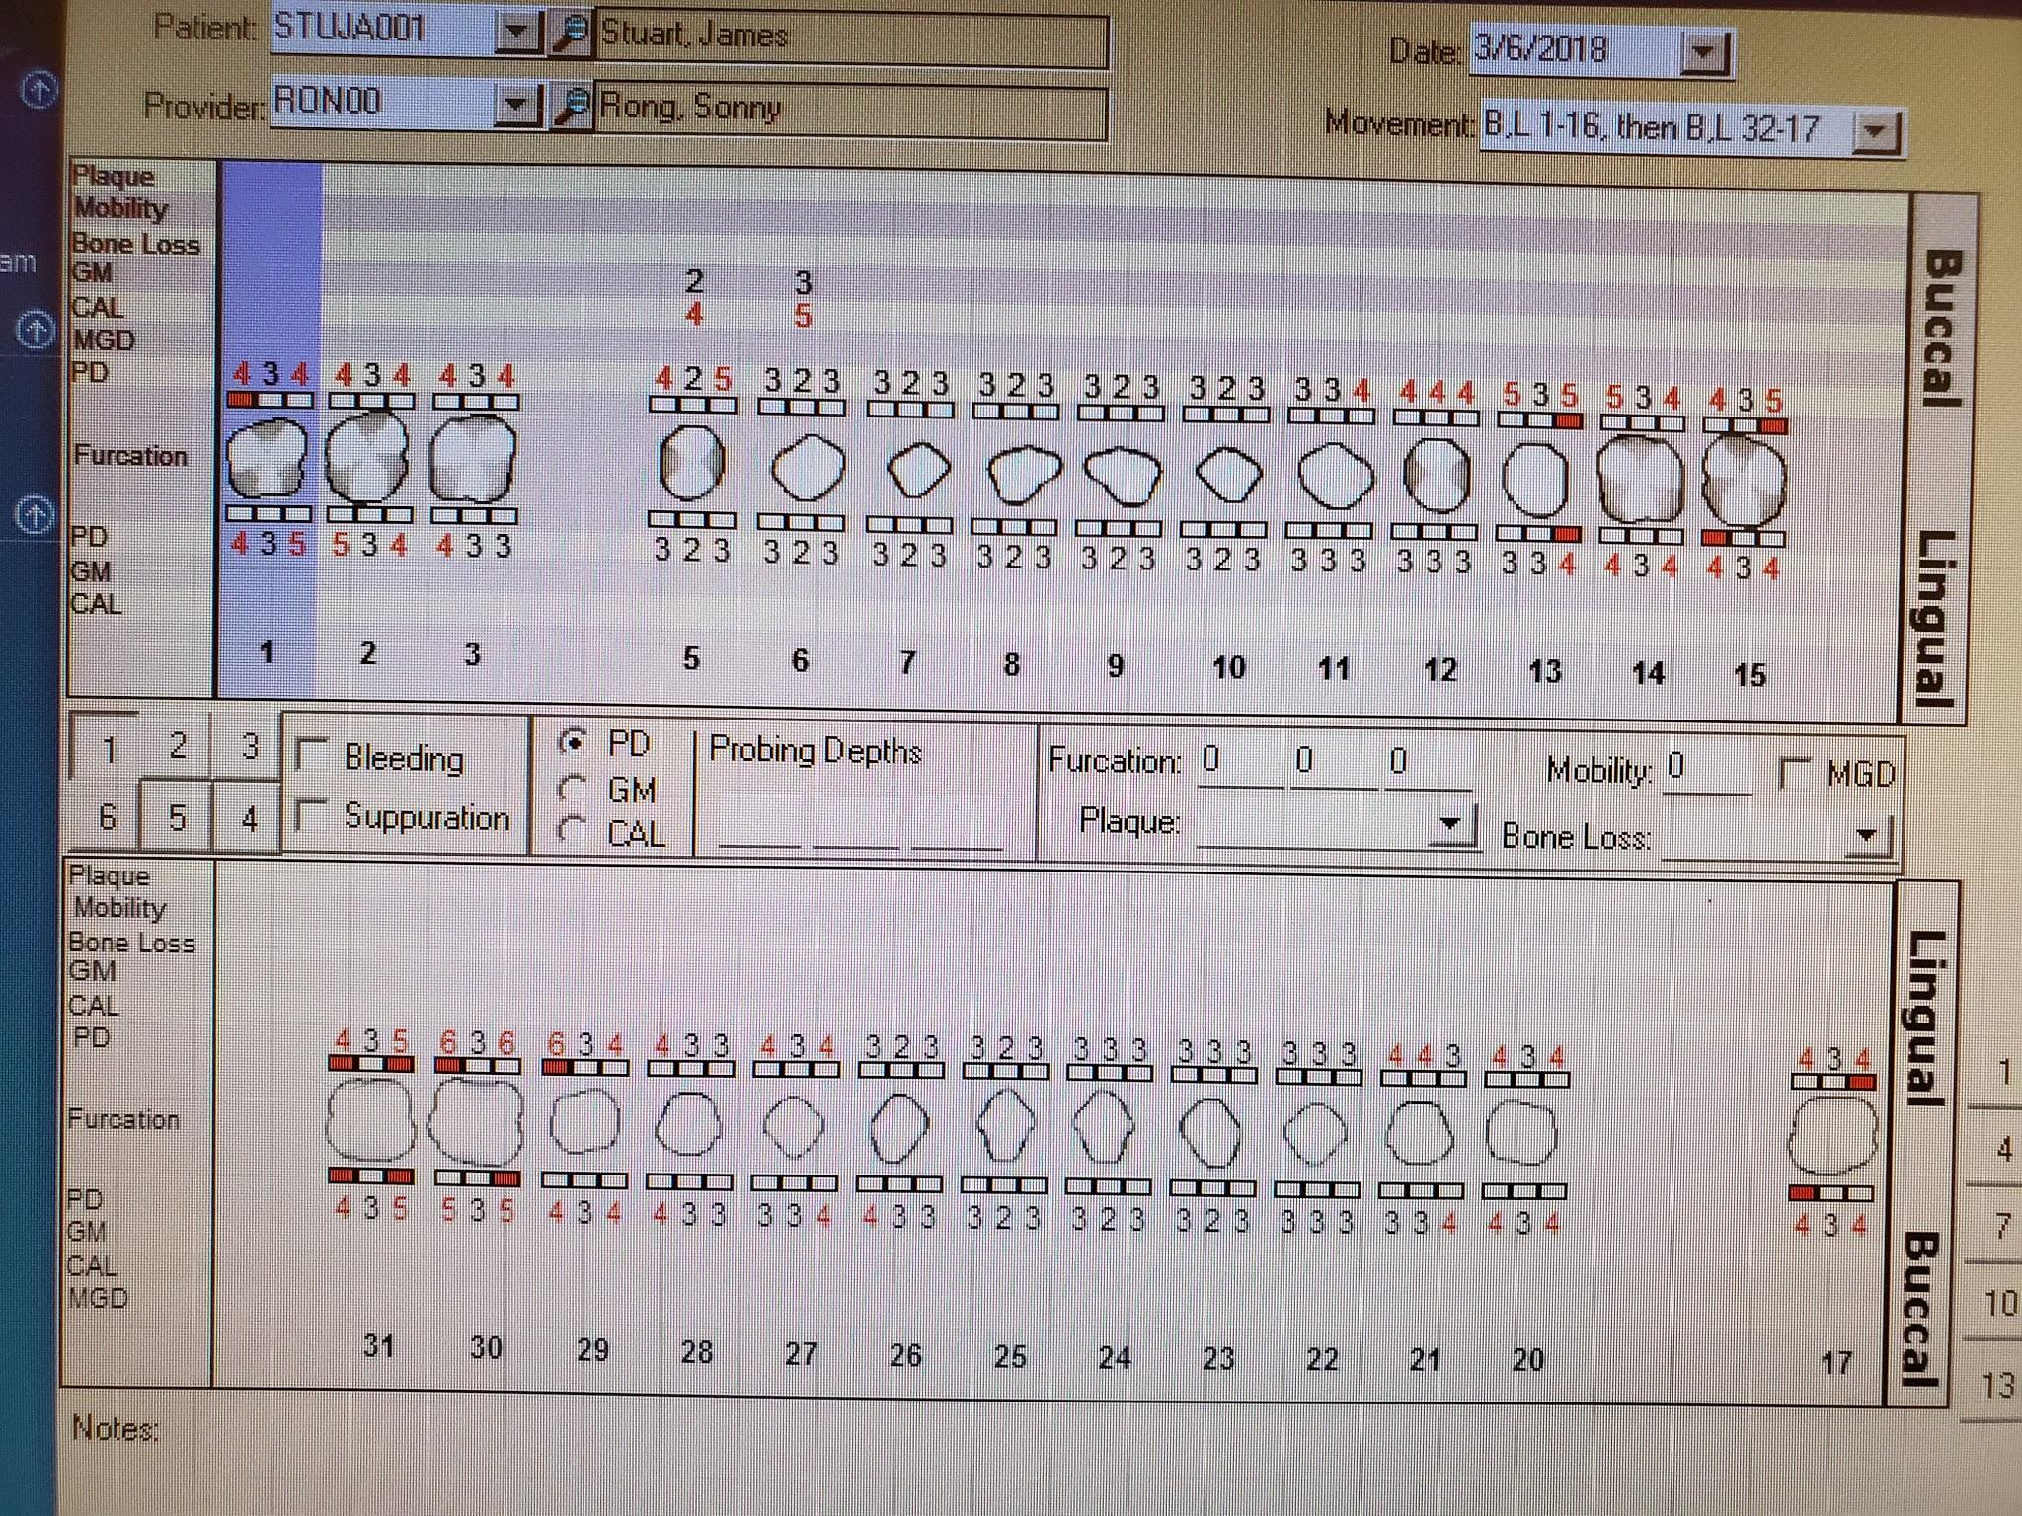
Periodontal Charting
Areas of 5 and 6mm PD were noted around the area where patient is currently having root canal treatment.

Slide 16
Dental Hygiene Diagnosis
Periodontal diagnosis: Medium type I localized type II due to localized 4-5mm PD, moderate BOP and radiographic evidence of bone loss on posterior regions.
Risk for caries: The patient is at a moderate risk for caries due to radiographic evidence of 2 active caries, poor oral hygiene and irregular prophylaxis.

Slide 17
Dental Hygiene Care Plan
The original treatment plan designed would complete treatment in 2 visits.
OHI for the current visit consisted of teaching the patient how to use superfloss.
Debridement consisted of completing quadrants 2 and 3.
Due to scheduling, the second visit would be 2 weeks later.
The second visit would include OHI reviewing superfloss and educating patient on the benefits of certain toothpastes and mouthrinses.
Debridement would include completing quadrants 1 and 4.
Engine polish with medium coarse paste and applying 5% NaF varnish.

Slide 18
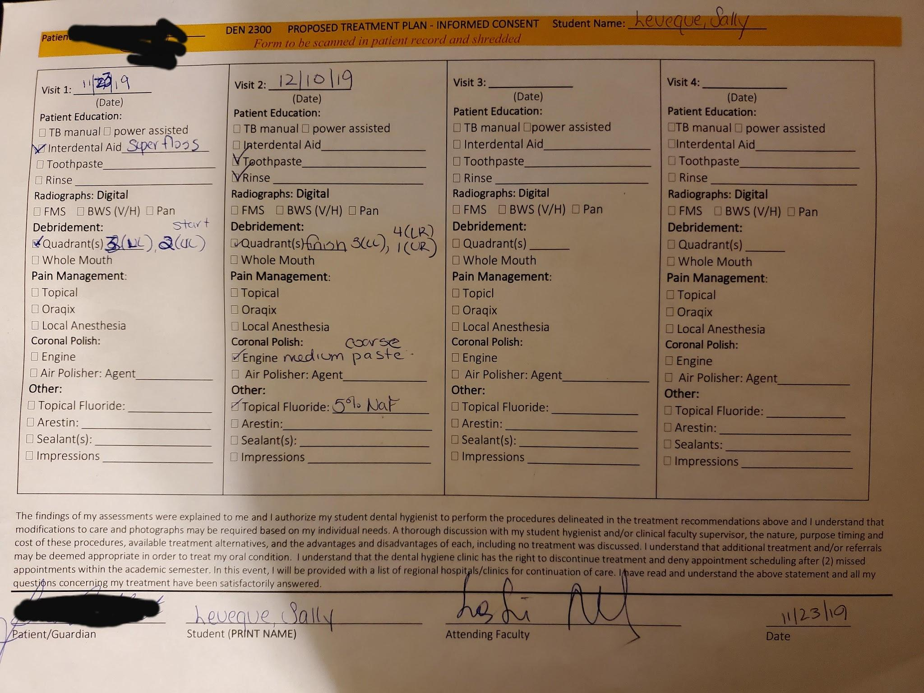
Consent for Treatment

Slide 19
Implementation of Treatment
Preventative Services:
Taught patient how to use superfloss to clean under the pontic of his fixed bridge as there was notable biofilm and debris.
Taught patient how to use proxabrush since he had numerous diastemas.
5% sodium fluoride varnish was applied to aid in caries prevention and patient is considered at moderate risk.

Slide 20
Implementation of Treatment (continued)
Debridement performed:
Ultrasonic and hand instruments used on all quadrants.
It was challenging to debride the areas around the fixed bridge and the tooth that was currently undergoing root canal treatment.
The patient did not require any means of pain management.
Using medium coarse paste to engine polish removed all extrinsic stains.

Slide 21
Evaluation of Care
I believe the patient will now keep up with his oral hygiene.
The patient seemed motivated about his home care especially when he was shown the food debris removed with the superfloss from under his pontic.
Upon completion of treatment he was very excited and could not stop smiling because the calculus and stain which he previously saw while looking in the mirror were now gone!

Slide 22
Referrals
A referral was given to the patient for the following reasons:
Caries noted clinically and radiographically on #3D and 5D
Periapical pathology noted radiographically on #30
A small fracture of the distal marginal ridge of #13
Referral given to see a cardiologist regarding blood pressure readings.

Slide 23
Continued Care Recommendations
As a medium case value patient with a moderate risk for caries, the patient was given a 4 month recare.

Slide 24
Final Reflection
What went right?
Time management during debridement was excellent. Debridement was completed in one visit instead of the originally planned two visits.
What went wrong?
For his previous appointments in 2018, due to his high blood pressure readings, the patient needed and obtained medical clearance for treatment in our clinic. However, during his recare, the blood pressure readings were higher than what he was cleared for. Thus, on his first visit, no type of invasive treatment could be done until he received a new clearance from his doctor.

Slide 25
Final Reflection (continued)
The patient obtained a new medical clearance prior to his subsequent visit which stated treatment can proceed if his systolic reading is less than 140. During the visit he was asked if he has been taking the medication the doctor prescribed and he replied “No. My mother is a retired nurse and she told me not to take it because high blood pressure medication will kill you.” He then showed me that he purchased an OTC herbal supplement which claims to manage high blood pressure. At this point I prayed his systolic would be under 140. I was relieved that once his blood pressure was taken, the systolic was 139!

