Slide 1
Top 25 Drugs of 2012
By: Sera Laganelli
Allison Contrera

Slide 2
Lyrica pregabalin
Analgesic
Treat nerve pain
Effects on Dental Treatment:
Xerostomia

Slide 3
Diovan valsartan
Angiosten II receptor blocker
Hypertenstion
Effects on Dental Treatment:
none

Slide 4
Lantus Solostar Insulin Glargine
Insulin
Type I & II diabetes
Effects on Dental Treatment:
Should treat patients in morning to prevent hypoglycemia.

Slide 5
Epogen Epoetin Alfa
Growth factor
Treat anemia in chemotherapy patients
Effects on Dental Treatment:
none

Slide 6
Atorvastatin Lipitor
Antilipemic agent
Prevention of cardiovascular disease, lowers cholesterol
Effects on Dental Treatment:
none

Slide 7
Truvada Emtricitabine and Tenofovir
Antiretroviral agent
HIV treatment
Effects on Dental Treatment:
none

Slide 8
Lantus Insulin Glargine
Insulin
Type I & II diabetes
Effects on Dental Treatment:
Should treat patients in morning to prevent hypoglycemia.
(same as Lantus Solostar)

Slide 9
Januvia Sitagliptin
Antidiabetic agent
Type II diabetes
Effects on Dental Treatment:
Should treat patients in morning to prevent hypoglycemia.

Slide 10
Plavix Clopidogrel
Antiplatelet agent
Angina, prevention of MI or stroke
Effects on Dental Treatment:
increased bleeding
no elective surgery for 1 year after stent placement

Slide 11
Avastin Bevacizumab
Antineoplastic agent
Treatment of metastatic colon cancer
Effects on Dental Treatment:
xerostomia
stomatitis
altered taste
gingival bleeding

Slide 12
Spiriva Tiotropium
Anticholinergic agent
COPD treatment
Effects on Dental Treatment:
xerostomia
ulcerative stomatitis

Slide 13
OxyContin Oxycodone
Analgesic, Opioid
Manage moderate to severe pain
Effects on Dental Treatment:
xerostomia

Slide 14
Atripla Efavirenz, Emtricitabine, Tenofovir
Antiretroviral agent
HIV treatment
Effects on Dental Treatment:
xerostomia
Abnormal taste

Slide 15
Singulair Montelukast
Leukotriene-Receptor Antagonist
Treatment of chronic asthma
Effects on dental treatment:
Dental pain
increased bleeding

Slide 16
Rituxan Rituximab
Immunosuppressant Agent
Treatment of non-Hodgkin lymphomas.
Effects on Dental Treatment:
no significant effects.

Slide 17
Neulasta Pegfilgrastim
Colony stimulating factor
Decrease risk of infection
Effects on Dental Treatment:
none

Slide 18
Copaxone Glatiramer Acetate
Biological
Management of multiple sclerosis.
Effects on Dental Treatment:
salivary gland enlargement
candidiasis
ulcerative stomatitis

Slide 19
Remicade Infliximab
Immunosuppressant Agent
Treatment of rheumatoid arthritis
Effects on Dental Treatment:
none

Slide 20
Enbrel etanercept
Antirheumatic
Treatment of rheumatoid arthritis.
Effects on Dental Treatment:
none

Slide 21
Humira Adalimumab
Antirheumatic
Treatment of active rheumatoid arthritis.
Effects on Dental Treatment:
None

Slide 22
Cymbalta Duloxetine
Antidepressant
Treatment of major depressive disorder Effects on Dental Treatment:
Xerostomia
increased bleeding
Use caution when using local anesthetics.

Slide 23
Advair Diskus Fluticasone & Salmeterol
Beta2-Antagonist
Treatment of asthma and COPD
Effects on Dental Treatment:
Candidiasis with the use of inhaler

Slide 24
Crestor Rosuvastatin
Antilipemic Agent
Treatment high cholesterol
Effects on Dental Treatment:
none

Slide 25
Abilify aripiprazole
Antipsychotic Agent
Treatment of schizophrenia, bipolar disorder, depression and autism
Effects on Dental Treatment:
extrapryamidal symptoms
xerostomia

Slide 26
Can you guess the…
NUMBER ONE
DRUG!!!

Slide 27
Nexium esomeprazole
Proton Pump Inhibitor
Treatment of GERD
Off label use: prevention of recurrent peptic ulcer bleeding
Effects on Dental Treatment:
Xerostomia

Slide 28
Cardiovascular Disease
4 of the top 25 drugs
1 in every 4 deaths in U.S.
Leading cause of death for both men and women.
Costs the United States$108.9 billion each year

Slide 29
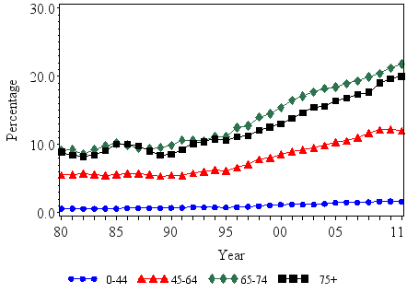
Diabetes
3 of the top 25 drugs
167% increase from 1980 through 2011

Slide 30
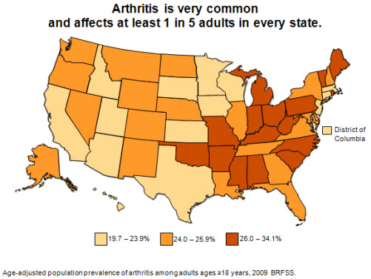
Arthritis
3 of the top 25 drugs

Slide 31
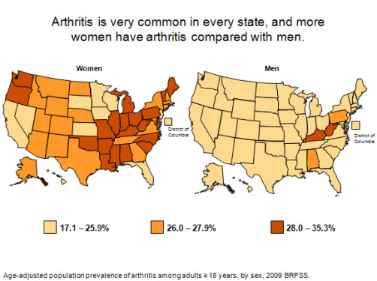
Arthritis

Slide 32
Mental Illness
Number 2 drug
Estimated 1 in 10 U.S. Adults Report Depression
25% of all U.S. adults have a mental illness and nearly 50% of U.S. adults will develop at least one mental illness during their lifetime

Slide 33
References
www.cdc.gov
www.drugs.com
Wynn, Richard L., Timothy F. Meiller, and Harold L. Crossley. Drug Information Handbook for Dentistry: Including Oral Medicine for Medically-compromised Patients & Specific Oral Conditions. Hudson, OH: Lexi-Comp, 2006. Print.

