Slide 1
Nasmyth’s Membrane Dentigerous Cyst
By: Sera Laganelli

Slide 2
Nasmyth’s Membrane
Definition:
The thin cuticular remains of the enamel organ which surrounds the enamel of a tooth.

Slide 3
Nasmyth’s Membrane
Residue on teeth formed from:
Reduced enamel epithelium
Oral epithelium
Dental cuticle

Slide 4
Nasmyth’s Membrane
Occurs in development of the enamel and can be seen on newly erupted teeth in both dentitions.
Coating that surrounds the enamel during eruption so the tooth can erupt without bleeding.

Slide 5
Nasmyth’s Membrane
Stain:
Green-gray residue
Easily picks up stating from food and drinks.
Stain is hard to remove
Extrinsic stain
Usually worn away by mastication and cleaning

Slide 6
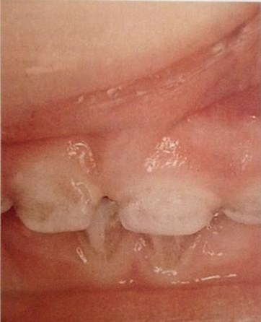
Nasmyth’s Membrane

Slide 7
Nasmyth’s Membrane
Role of Dental Team:
Clean teeth to help remove stain
Teach importance of tooth brushing
Assure parents that this is an extrinsic stain and can be removed

Slide 8
Dentigerous Cyst
Definition:
It is a cyst that forms from the accumulation of fluid between the reduced enamel epithelium and the crown of an unerupted tooth and attaches to the tooth neck at the cementoenamel junction.

Slide 9
Dentigerous Cyst
2nd most common type of dental cyst.
Occurs on impacted or developing teeth.
Occurs mainly in permanent dentition.
Occurs most often in:
3rd molars
Canines
2nd premolars

Slide 10
Dentigerous Cyst
Cyst is formed when fluid builds up inside the developmental sac surrounding an unerupted tooth. The fluid accumulates after the enamel crown has finished forming, and the cyst ends up joined to the tooth.

Slide 11
Dentigerous Cyst
Typically no symptoms.
Usually found on radiographs.

Slide 12
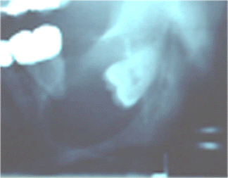
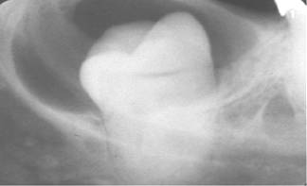
Dentigerous Cyst

Slide 13
Dentigerous Cyst
Can cause displacement of the affected tooth and adjacent teeth.
Cysts associated with maxillary teeth can grow into the maxillary sinus space.
Can cause jaw pain or even jaw fracture in extreme cases.

Slide 14
Dentigerous Cyst
The cyst must be surgically removed either alone or alone with the associated tooth.
A biopsy must be done on the cyst to make sure it is not cancerous.

Slide 15
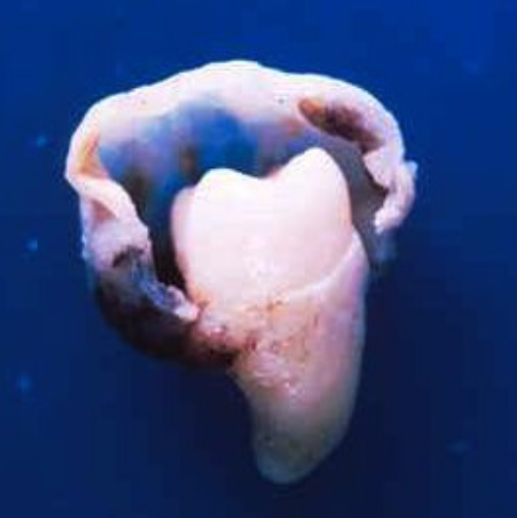
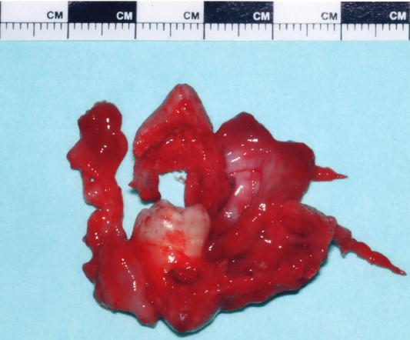
Dentigerous Cyst

Slide 16
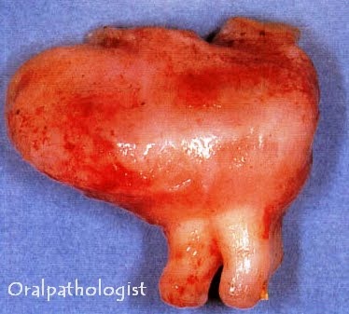
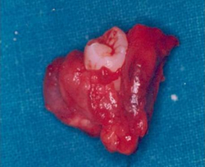
Dentigerous Cyst

Slide 17
Dentigerous Cyst
Role of Dental Team:
Perform and review radiographs for abnormalities.
Inform patient of complications associated with the cyst.
Recommend surgical removal.

