Slide 1
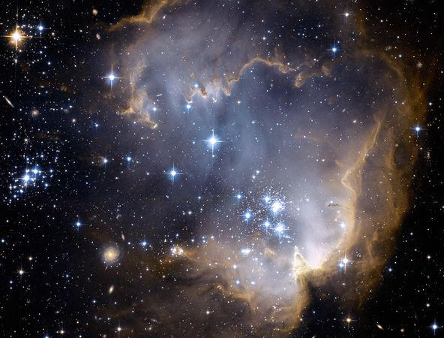
The Hubble Telescope by Shannon Brown
On April 24, 1990, the Hubble telescope was launched with the Discovery space shuttle.
The images sent from the Hubble were blurred. It was discovered that the blur stemmed from a spherical aberration (increased refraction of light rays when they strike the mirror) in the primary mirror. COSTAR, for Corrective Optics Space Telescope Arial Replacement was later equipped with the Hubble to fix the error.
The Hubble discovered the age and size of the universe. Also, black holes, dark energy, why explosions occur and stars die.
The rising costs to continue to send astronauts into space to fix or update the equipment has become an expense that NASA may not want to support in the future. Other advances have surfaced: lasers and robots to perform the same duties as the Hubble.

