Slide 1
New York City College of Technology
Department of Dental Hygiene
Case Presentation
Shan Li

Slide 2
Patient Profile
Ms. G is a 52-year-old Hispanic female.
Her last dental visit was 2/02/2015 and cleaning was done, Her last X-ray was 2/02/2015 and the 2 PA taken.
The patient states that she uses a manual toothbrush twice a day with Colgate toothpaste. She does not use mouth rinse, and flosses daily. She is not a drinker and not a smoker.

Slide 3
Chief Complaint
Patient states “Bleeding from the gums”.
Ms. G bleeds from her gums every time she toothbrushes and especially in the lower anterior.
Ms. G was really concerned about the gum bleeding. She does not have health insurance so she come to our school to get the deep cleaning.
Ms. G also mentioned she did not feel great with the overall appearance of her teeth. She wanted to get teeth whitening.

Slide 4
Health History Overview
Blood Pressure: 129/77, Pulse: 57, temperature :96. ASA: II due to dental anxiety.
Medical Conditions:
None
Current Medications:
None

Slide 5
Comprehensive Assessments

Slide 6
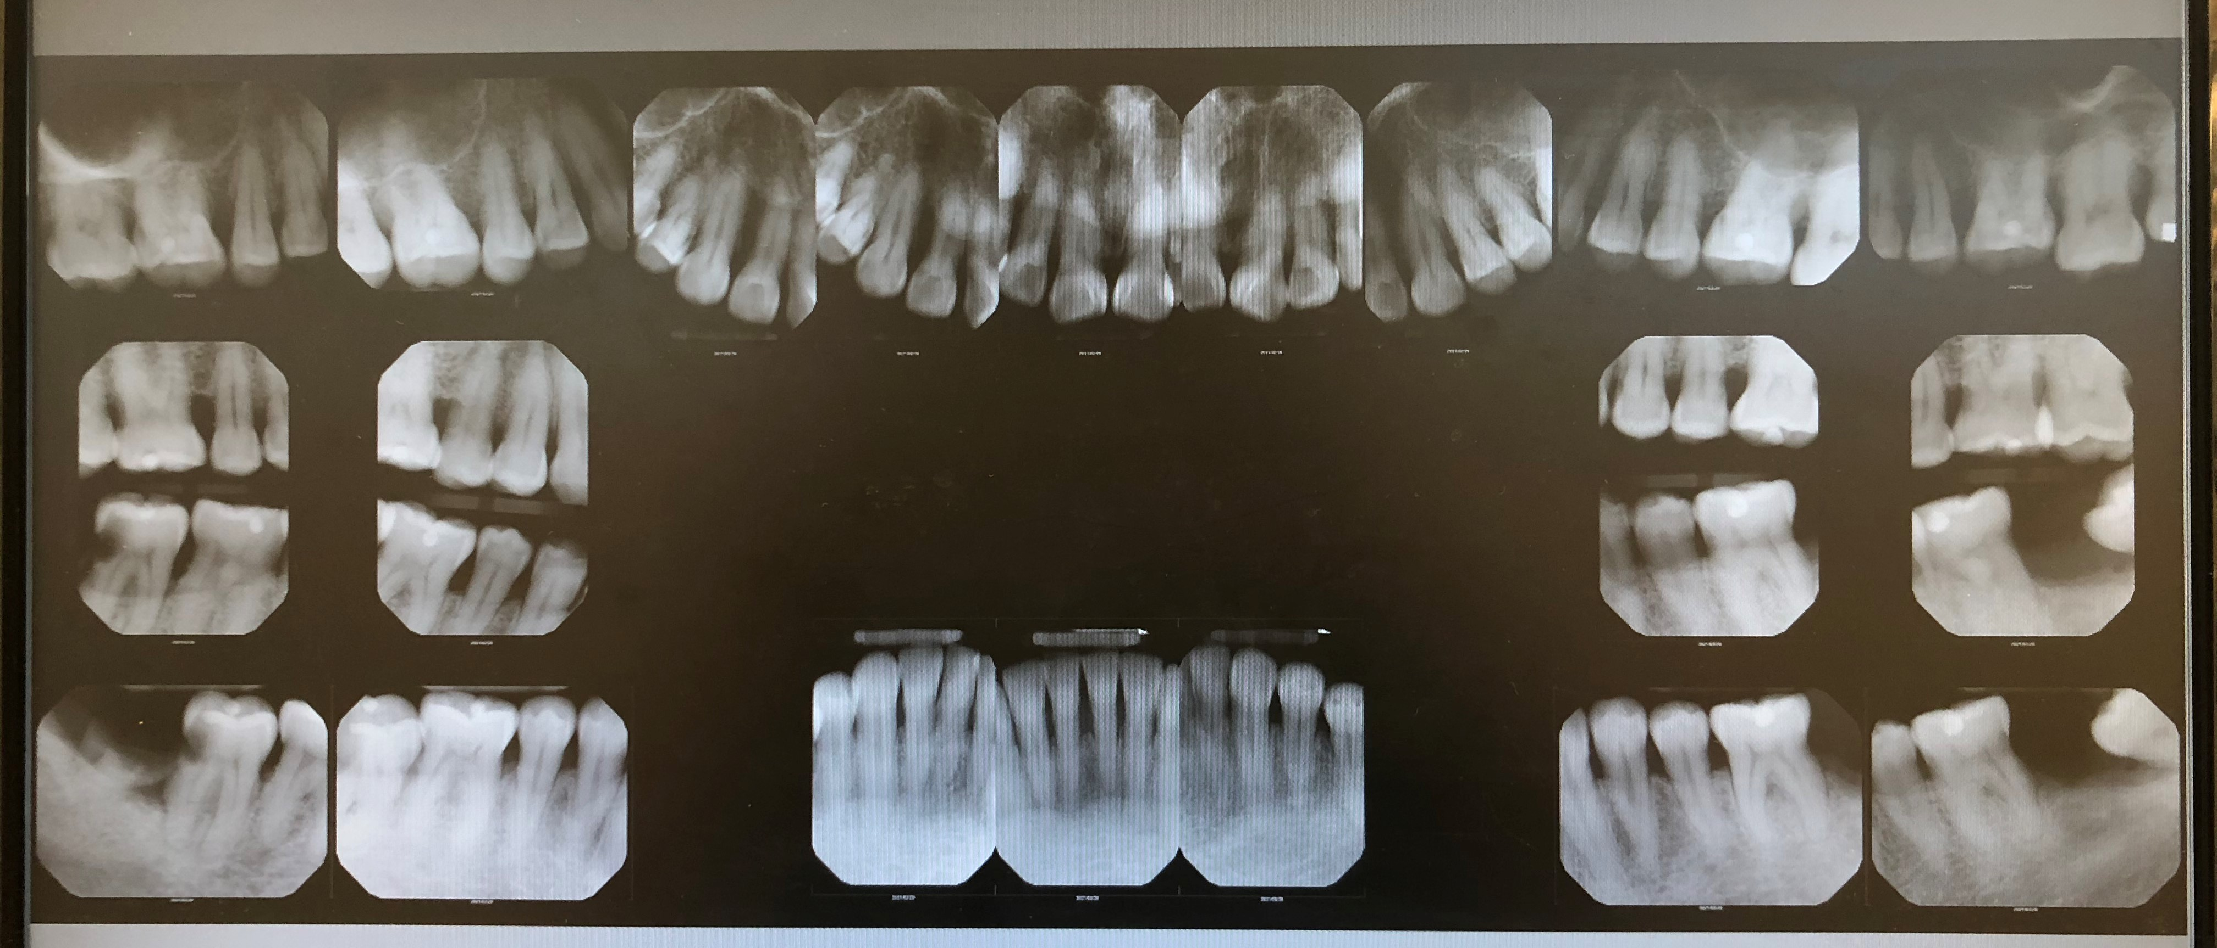
Radiographic evidence of localized moderate bone loss about 50% present on molars/premolars on all quadrants and lower anterior .
Radiographic evidence:
Composite restoration on #2-L,# 15-L.
Amalgam restorations on #16-O.
Missing tooth on #1 and #18.
Root tip on #32.
Caries on #17-O and 31-D.

Slide 7
Summary of Clinical Findings
Extraoral/Intraoral Findings: Bilateral enlargered, movable, soft tonsillar lymph nodes (asymptomatic). Coated tongue on the 2/3 of tongue, bite mark on left side of buccal mucosa. Bilateral enlargered red tonsils.
Occlusion: bilateral class III, overjet 0mm and overbite 0%. Crowded on lower anterior teeth.
Attrition: #22-27 and 6-11.
Deposits: Generalized heavy subgingival calculus on all quadrants. Localized moderate supragingival calculus on the lower anterior teeth. Localized medium extrinsic stains on the lingual aspect of the lower anterior teeth.

Slide 8
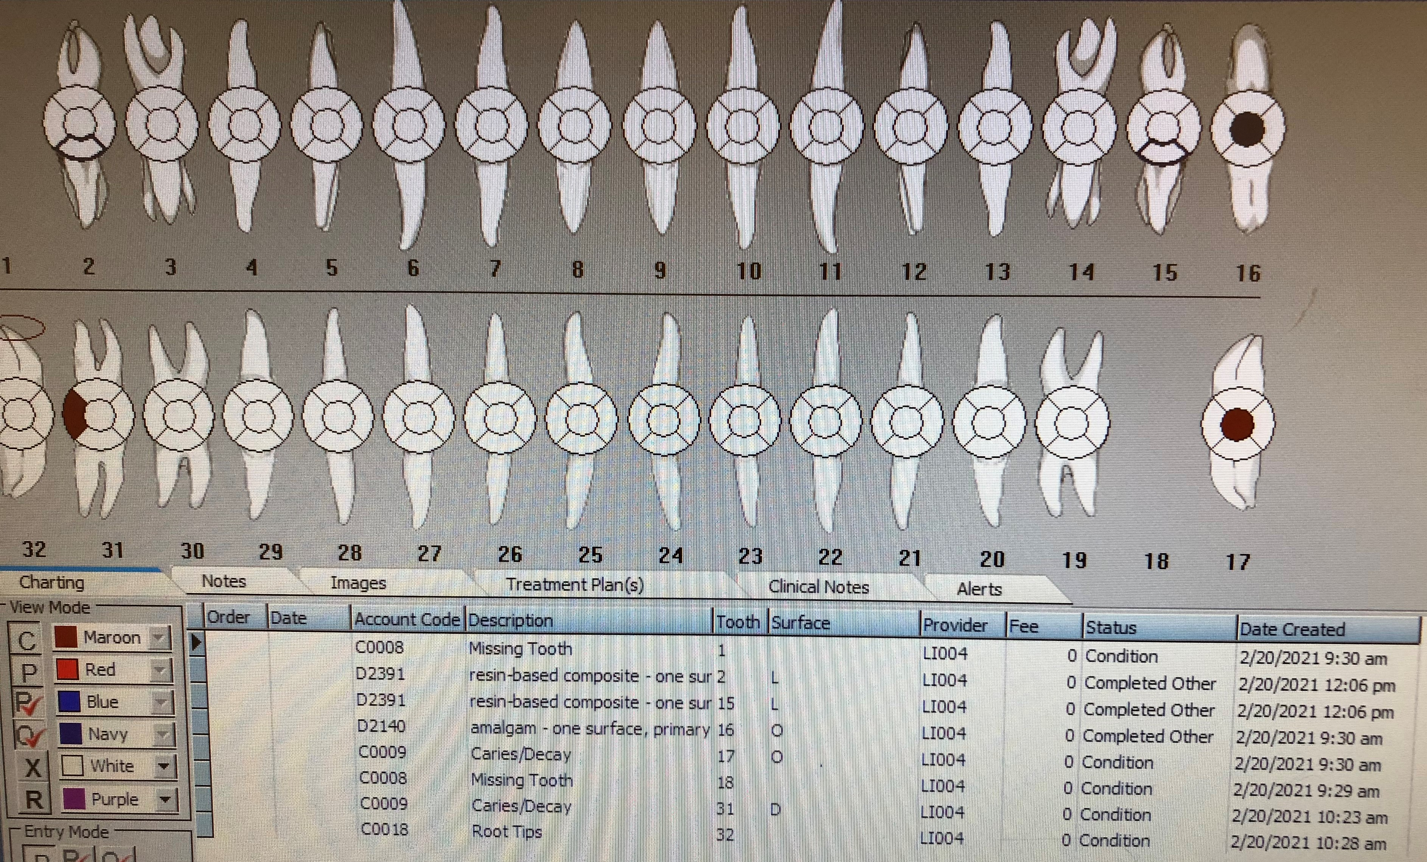
Dental Charting
Composite restoration on #2-L,# 15-L.
Amalgam restorations on #16-O.
Missing tooth on #1 and #18.
Root tip on #32.
Caries on #17-O and 31-D.

Slide 9
Gingival Description and Periodontal Status
Gingival Description: Generalized red, rolled, inflamed marginal gingiva with localized areas of bulbous papilla on the anterior teeth.
Periodontal Status: Active Periodontal Type III/B with radiographic evidence and furcation degree I and II.

Slide 10
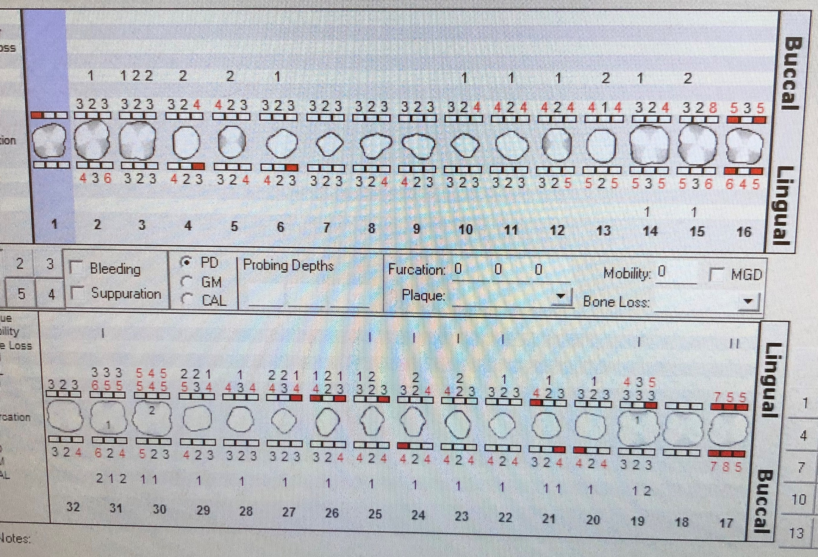
Periodontal Charting
Generalized moderate bleeding on all quadrants.
Localized probing depth readings of 5-6 mm found on the all molars/premolars.
Localized 1-2 mm gingival recession on all molars/premolars and lower anterior, furcations on #19, 30 and 31.

Slide 11
Dental Hygiene Care Plan
Visit One:
PI/OHI: Manual toothbrushing.
Exposure of digital radiographs FMS.
Debridement #2 and #3 with hand instruments and with topical Benzocaine 20%.
Visit Two:
PI/OHI: Dental Flossing, review flossing in the mouth(with her daughter translation).
Debridement of quadrant UL,UR and LR with hand instruments and with topical Benzocaine 20%..
Copy of FMS and referral given.
Visit Three:
PI/OHI: Oral rinse and tooth paste.
Debridement of quadrant LL and residual calculus with hand instruments and with topical Benzocaine 20%..
Engine polish with fine paste and administration 5% of fluoride varnish. Post –op instruction given.

Slide 12
Dental Hygiene Diagnosis
Periodontal Diagnosis:
Type III/B active Periodontitis due to multiple factors:
Patient chief complaint was based on her concern of bleeding gums.
Generalized moderate bleeding on probing and exploring.
Radiographic evidence of generalized horizontal bone loss about 50%.
Generalized moderate inflammation on all quadrants. Localized probing depth readings of 5-7mm found on the molars/premolars and teeth. Generalized recession 1-2 mm
Generalized probing depth readings of 4-5mm on all quadrants.
Furcations on #19, 30 and 31.
Generalized heavy subgingival calculus on all quadrants. Localized moderate supragingival calculus on the lower anterior teeth.
Localized visible biofilm on the mandibular anterior teeth.
Slight mandibular crowding which gave the patient difficulty to maintain free of biofilm.

Slide 13
Implementation
The challenge that I faced throughout her treatment was furcations in #19,30 and 31. I was instructed by the professor how to adapt instrument when scaled the furcation area.
Ms. G was a very cooperative patient, but she did not speak English at all, it made the case really challenging. I had to find a way that she could understand in order to teach her oral hygiene instruction. Also, it was difficult for me to communicate the treatment to the patient. She was only able to answer me “ok” or “good” every time I asked her how she felt, so I had to adjust my instrument and treatment by observing her face expression.

Slide 14
Referrals
The patient was referred to the periodontists because periodontal disease stage III/B. Patient also referred to general dentist for carious lesions.

Slide 15
Continued Care Recommendations
The recare recommendation interval given to the patient is three months.
A 3-month recare was recommended to the patient due to the radiographic evidence of bone loss and the generalized subgingival calculus. She has difficulty to maintain the proper oral hygiene in the lower anterior because the crowded teeth. We would like to be updated about the patient’s incorporation of the oral hygiene instructions and diet in her daily routine because our goal is to help her achieve stable oral health.

Slide 16
Final Reflection
Ms. G was a very cooperate patient, she was willing to change her habit and lifestyle in order to maintain good oral hygiene. She also listened and followed the advice that I gave, I am glad that she went to dental office and got the filling done after the deep cleaning.
I would have adapted the “Gracey” 11/12 and 13/14 instrument for the furcation area. Her calculus was tenacious and deep, and the “after-five” Gracey’s would have helped in the anterior teeth. Overall, the treatment was a success, and the patient and I learned a lot from each other.

