Slide 1
New York City College of Technology
Department of Dental Hygiene
Case Presentation
Shan Li

Slide 2
Patient Profile
Ms. S is a 62-year-old Hispanic female.
Her last dental visit was 3/20/2019 and filling was done, and last dental hygiene visit was in 12/14/2019 and a dental prophylaxis was fulfilled . Her last X-ray was 3/20/2019 and the 1 PA taken.
The patient states that she uses an electric toothbrush twice a day with Colgate toothpaste. She flosses and uses a tongue scraper daily. She stated that she uses Listerine mouth rinse a couple times a day. She is not a drinker and not a smoker.

Slide 3
Chief Complaint
Patient states “Bleeding from the gums”.
Ms. S bleeds from her gums every time she toothbrushes and especially in the lower anterior.
Ms. S was really concerned about the gum bleeding. She comes every couple months to our school for cleaning.
Ms. S also mentioned she did not feel great with the overall appearance of her teeth. She wanted to get teeth whitening.

Slide 4
Health History Overview
Blood Pressure: 130/90, Pulse: 76, temperature :96.9 ASA: II.
Medical Conditions:
Hypothyroidism.
Current Medications:
Vitamin C,D, Calcium and Biotin.
Levothyroxine: 50mg/day for the treatment of Hypothyroidism.

Slide 5
Hypothyroidism
According to the American Thyroid Association, it states; “Hypothyroidism means that the thyroid gland can’t make enough thyroid hormone to keep the body running normally. People are hypothyroid if they have little thyroid hormone in the blood”.
Women are more likely to develop hypothyroidism than men.
The causes of hypothyroidism are radiation treatment to the thyroid, Hashimoto’s Disease, thyroiditis, surgical removal of part or all of the thyroid, and some medications. The signs and symptoms are fatigue, weight gain, puffy face, cold intolerance, depression, dry skin, and slow heart rate.
Ms. S is currently being treated with Levothyroxine 0.05mg/day to control the disease.
References:
https://www.thyroid.org/hypothyroidism/
https://www.niddk.nih.gov/health-information/endocrine-diseases/hypothyroidism

Slide 6
Dental Hygiene Management
The dental hygienist should consult with the physician before proceeding with any dental hygiene treatment for all medical conditions.
There are no contraindications to any dental hygiene care for hypothyroidism.
No precautions are necessary when using a vasoconstrictor for a patient who is controlled under Levothyroxine. The clinician must take into consideration delayed wound healing for patients with Hypothyroidism.
Lee, Kyung-Jin et al. “Management of hyperthyroid patients in dental emergencies: a case report.” Journal of dental anesthesia and pain medicine vol. 16,2 (2016): 147-150. doi:10.17245/jdapm.2016.16.2.147

Slide 7
Comprehensive Assessments

Slide 8
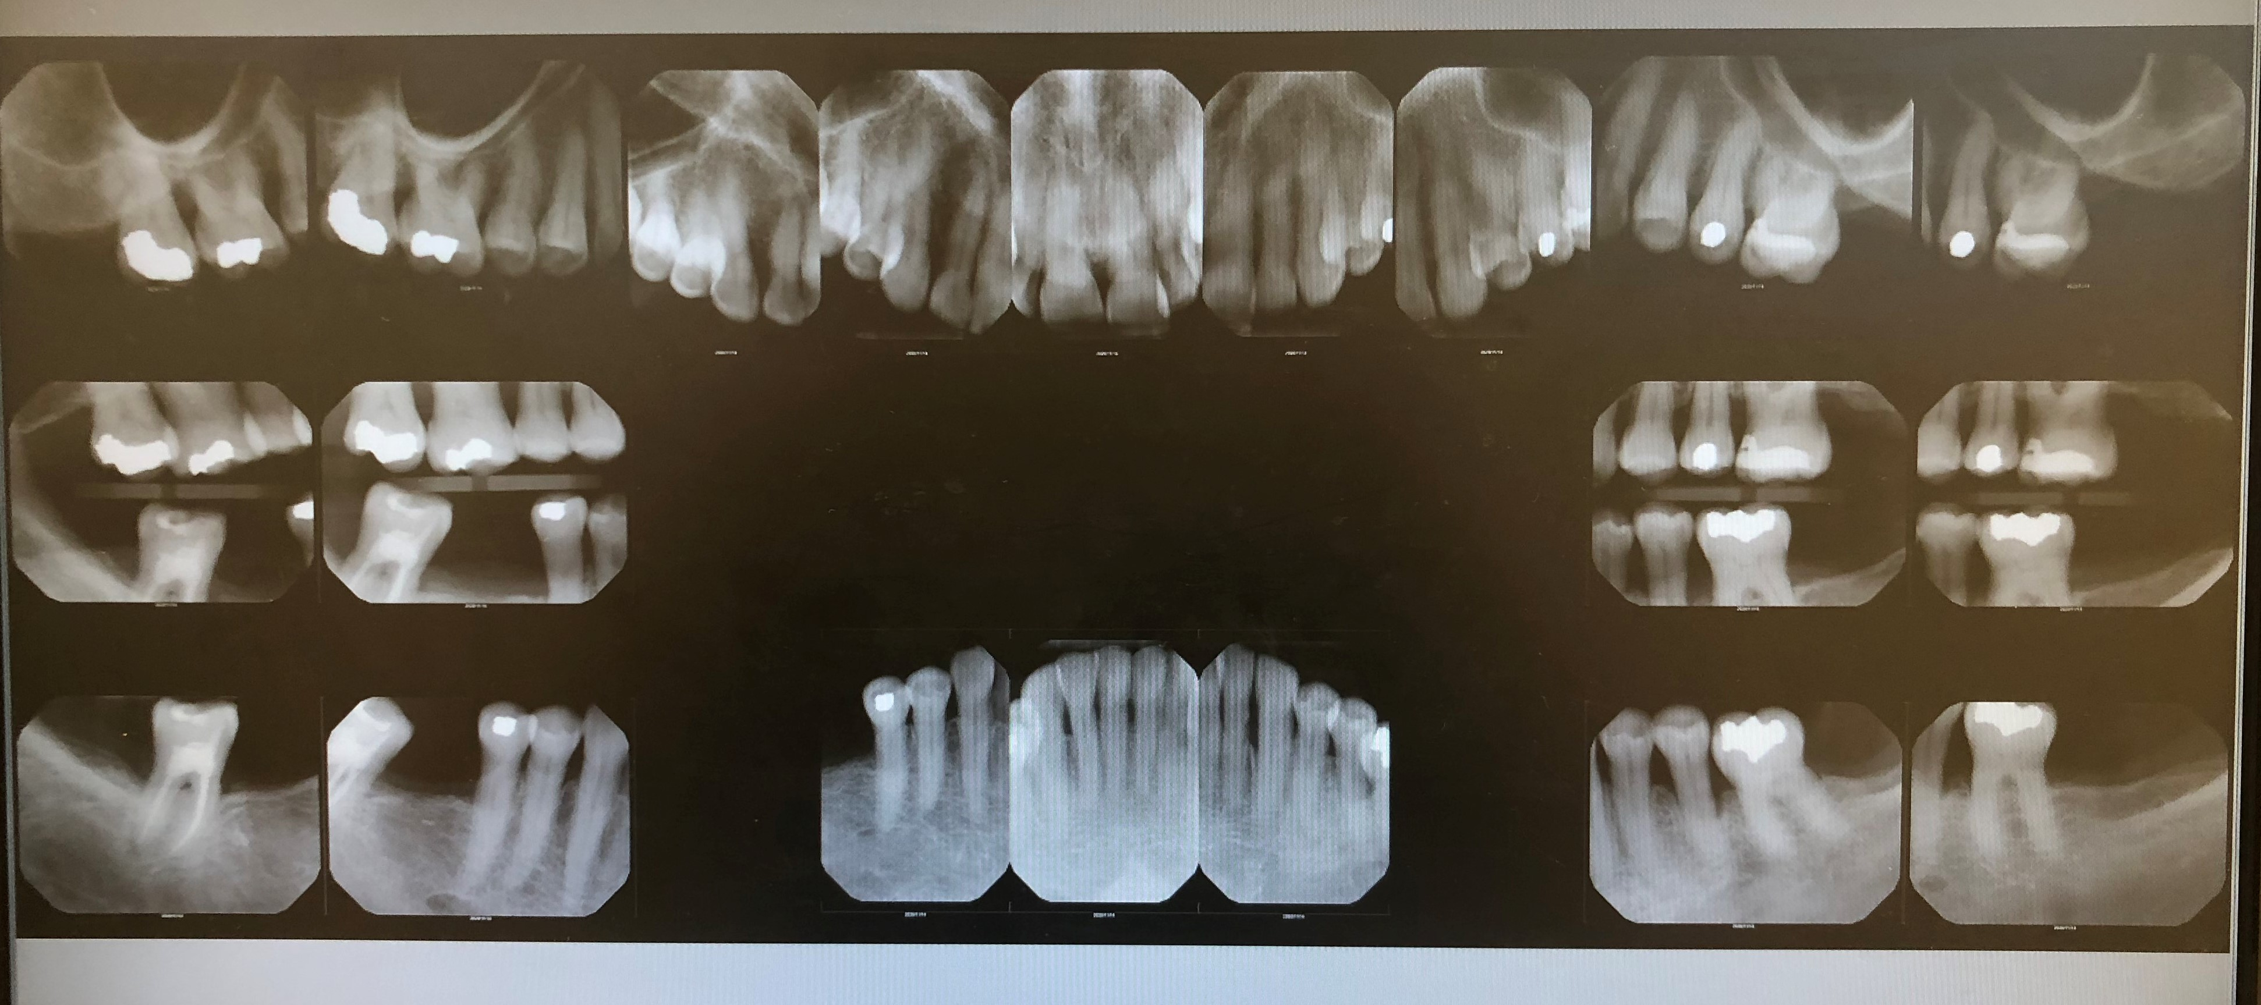
Radiographic evidence of localized moderate bone loss present on molars/premolars on all quadrants. Localized minimal bone loss on upper and lower anterior teeth.
Radiographic evidence of Sealant on #4.
Root canal on #31.
Composite restoration on #14-MO,# 31-O.
Amalgam restorations on #2-DO, #3-O, #13-O, #19-O, #29-O.
Missing tooth on #1, #15, #16, #17, #18, #30.
Localized interproximal subgingival calculus on molars and premolars.

Slide 9
Summary of Clinical Findings
Extraoral/Intraoral Findings: Bilateral submandibular nodes mobile (asymptomatic).3x2 mm red mole slightly raised in anterior right temple area. 5x3 mm black mole slightly raised in left temple area.
Occlusion: Class I by molar in left side and by canine on the right side, overjet 5mm and overbite 25%.
Mobility: Class I on # 22-26 and # 19, Class II on # 20.
Abfraction: All posterior teeth.
Deposits: Generalized heavy subgingival calculus on all quadrants. Localized moderate supragingival calculus on the lower anterior teeth. Localized moderate extrinsic stains on the lingual aspect of the lower anterior teeth.

Slide 10
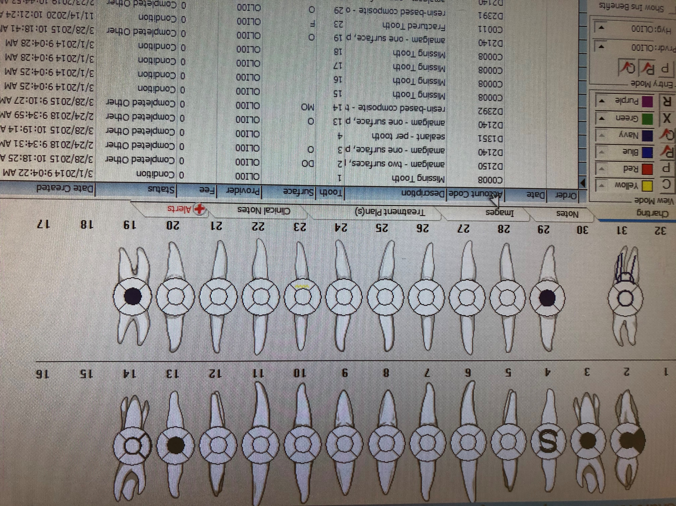
Dental Charting
Sealant on #4.
Root canal on #31.
Composite restoration on #14-MO,# 31-O.
Amalgam restorations on #2-DO, #3-O, #13-O, #19-O, #29-O.
Missing tooth on #1, #15, #16, #17, #18, #30.

Slide 11
Gingival Description and Periodontal Status
Gingival Description: Generalized pink, non stippled, soft, rolled margin on lower anterior. Localized moderate bleeding on probing and inflammation.
Periodontal Status: Active Periodontal Type III/B with radiographic evidence and generalized recession.

Slide 12
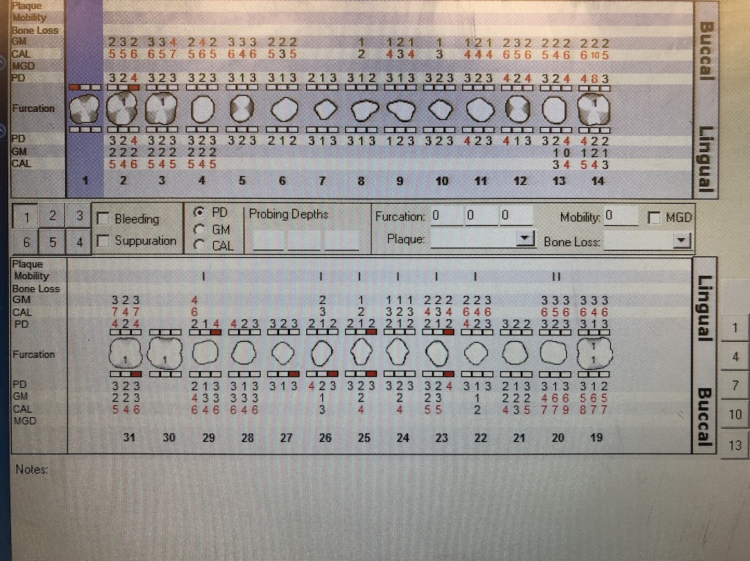
Periodontal Charting
Generalized moderate bleeding on all quadrants.
Localized probing depth readings of 3-5mm found on the all molars/premolars.
Localized gingival recession on all molars/premolars and lower anterior, furcations on #19 and 31. mobility on lower anterior.

Slide 13
Dental Hygiene Diagnosis
Periodontal Diagnosis:
Type III/B active Periodontitis due to multiple factors:
Patient chief complaint was based on her concern of bleeding gums.
Generalized moderate bleeding on probing and exploring.
Radiographic evidence of generalized horizontal bone loss about 40%.
Generalized moderate inflammation on all quadrants. Localized probing depth readings of 3-4mm found on the molars/premolars and teeth. Generalized recession 1-5 mm
Generalized probing depth readings of 2-4mm on all quadrants.
Generalized heavy subgingival calculus on all quadrants. Localized moderate supragingival calculus on the lower anterior teeth.
Localized visible biofilm on the mandibular anterior teeth.
Very slight mandibular crowding which gave the patient difficulty to stay free of biofilm.

Slide 14
Dental Hygiene Care Plan
Visit One:
PI/OHI: Electric toothbrushing.
Exposure of digital radiographs FMS.
Debridement UR with hand instruments.
Visit Two:
PI/OHI: Dental Flossing, oral rinse and toothpaste.
Debridement of quadrant UL,LL and LR with hand instruments.
Engine polish with fine paste and administration 5% of fluoride varnish. Post –op instruction given.

Slide 15
Implementation
The challenge that I faced throughout her treatment was that I was not able to use the Ultrasonics.
Ms. S was a very cooperative patient, she has had a couple of deep cleanings done in our school by Ultrasonic. She asked me why we can not use the Ultrasonic because she thought the hand instruments were too slow. I explained to her that under the CDC guideline we were not allowed to use the Ultrasonics this semester. Hand instrument is the same compared to Ultrasonic but less pain.
A thing that I learned from this treatment was how to adapt the instruments when scaled the furcation area. I was instructed by Professor when scaled furcations area in #19 and 31.

Slide 16
Referrals
The patient was referred to the periodontists because periodontal disease stage III/B.

Slide 17
Continued Care Recommendations
The recare recommendation interval given to the patient is three months.
A 3-month recare was recommended to the patient due to the radiographic evidence of bone loss and the generalized subgingival calculus. She has difficulty to maintain the proper oral hygiene in the lower anterior because the crowded teeth. We would like to be updated about the patient incorporation of the oral hygiene instructions and diet in her daily routine because our goal is to help her achieve stable oral health.

Slide 18
Final Reflection
Ms. S was a very cooperate patient, she was willing to change her habit and lifestyle in order to maintain good oral hygiene.
I would have adapted the “Gracey” 11/12 and 13/14 instrument for the furcation area. Her calculus was not really tenacious but deep, and the “after-five” Gracey’s would have helped in the anterior teeth. Overall, the treatment was a success, and the patient and I learned a lot from each other.

