Slide 1
Oral Health is A Mirror to General Health
BY SHAN LI, CAROL ZHENG, and MI LIM KIM

Slide 2
WHY DENTAL HEALTH PROMOTES OVERALL HEALTH?
The mouth is a window into the health of the body, many diseases can be seen in the mouth, for example:
Systemic disease
Bacteria growth in the oral cavity
Malnutrition

Slide 3
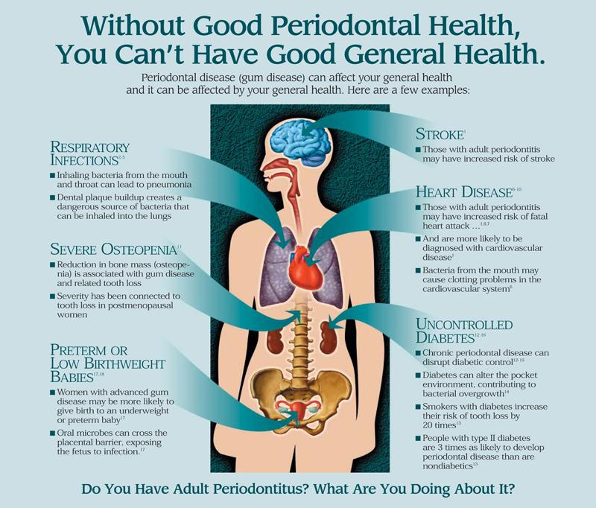
POOR DENTAL HEALTH CAN MAKE OTHER PROBLEM WORSE
Cardiovascular disease
Diabetes
Pneumonia
Notes:
https://www.killinglydentalcare.com/periodontal-disease.html

Slide 4
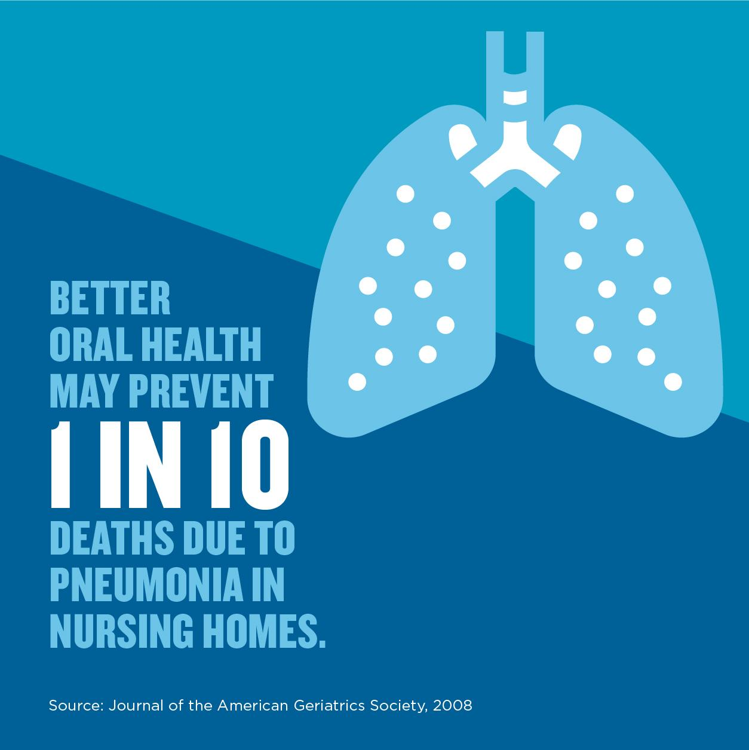
PNEUMONIA & ORAL HEALTH
Healthy gums are the key to lowering your risk for chronic obstructive pulmonary disease and pneumonia. These infections are caused when harmful bacteria associated with periodontal disease is inhaled into the lower respiratory tract.
Notes:
https://www.listerine.in/oral-health-lung-problems-pneumonia-in-elderly

Slide 5
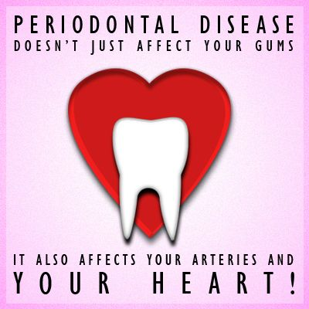
CARDIOVASCULAR DISEASE & ORAL HEALTH
Gum disease (periodontitis) is associated with an increased risk of developing heart disease. Poor dental health increases the risk of a bacterial infection in blood stream, which can affect the heart valves.
Notes:
https://doctorschoen.com/oral-health-heart-disease-connected/

Slide 6
DIABETES & ORAL HEALTH
Poorly controlled diabetes are higher risk for dental disease.
Notes:
People with poorly controlled diabetes are greater risk for dental problems. They are more likely to have infections of their gums and the bones that hold their teeth in place, because diabetes can reduce the blood supply to the gums. High blood sugar may also cause dry mouth and make gum disease worse.
https://mcomiedentistry.com/diabetes-oral-health/

Slide 7
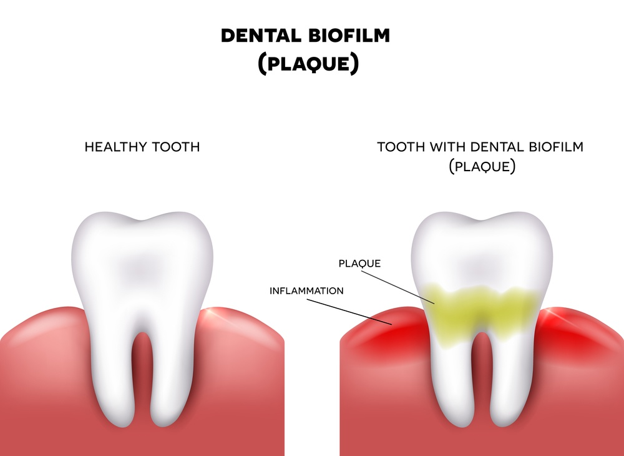
WHAT CAUSE DENTAL DISEASE? PLAQUE!
What is plaque?
Notes:
Dental plaque is the root cause of many oral health issues. It is a sticky, colorless or light yellowish film that is constantly forming on your teeth. Dental plaque usually begins forming on teeth 4-12 hours after brushing, which is why it is so important to brush thoroughly at least twice a day and floss daily.
https://www.ledownsdentistry.com/what-is-plaque-and-why-is-it-harmful/

Slide 8
HOW DOES PLAQUE AFFECT YOUR ORAL HEALTH?
The bacteria in plaque produce acids that attack tooth enamel causing cavities.
The bacteria in plaque can also cause the early stage of gum disease called gingivitis.
If plaque is not regularly removed from your teeth by proper brushing and flossing, it mineralizes into tartar (a hard, yellow or brown deposit that tightly adheres to the teeth can only be moved by a dental professional). If tartar is not removed it can lead to more serious gum disease called periodontitis.

Slide 9
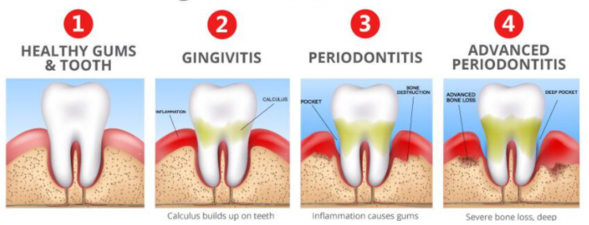
GINGIVITIS VS PERIODONTITIS
https://123dentalemergency.com/how-to-relieve-gum-pain/
Notes:
Gingivitis and periodontitis are both types of periodontal disease.
Gingivitis is an early stage of gum disease caused by plaque buildup on teeth. If plaque isn’t properly removed, it will build up at the gum line and can result in inflammation. Symptoms of gingivitis include irritated or red gums that may bleed when brushing or flossing.
Periodontitis is the later, more severe stages of gum disease, which carries symptoms and health implication such as receding gums, damage to the bone and connective tissue around teeth, and tooth loss.
The key difference is that gingivitis is reversible, while periodontitis is not.

Slide 10
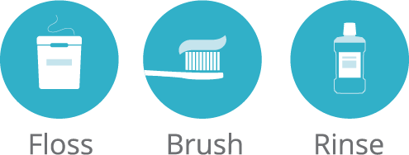
HOW CAN WE PROMOTE A BETTER ORAL HYGIENE? DAILY PLAQUE CONTROL!
Toothbrushing
Flossing
Rinsing
Notes:
https://www.daytondentalsmiles.com/services/general-dentistry/

Slide 11
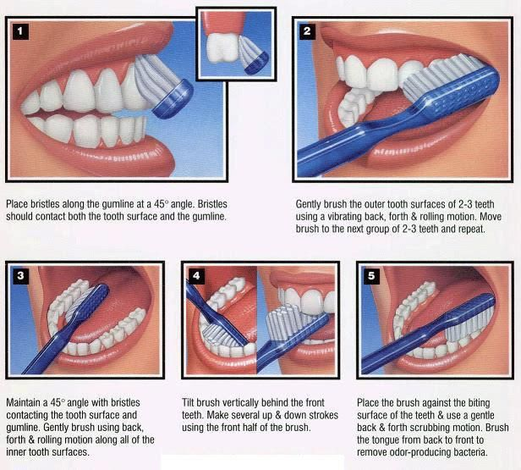
TOOTHBRUSHING REMOVE PLAQUE ON THE SURFACE OF TEETH
Soft toothbrush
Modified bass toothbrushing method
Brush for 2 minutes
Brush at least twice daily
Notes:
https://tube.medchrome.com/2013/04/brushing-technique-bass-and-modified.html?m=1

Slide 12
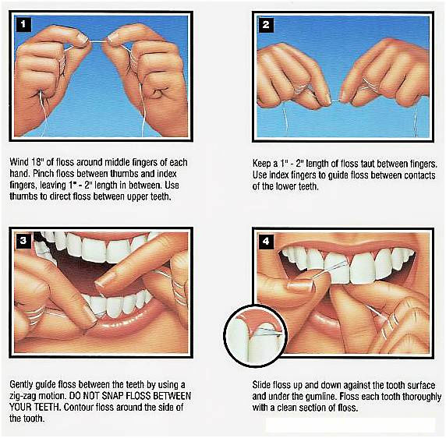
FLOSSING REMOVES PLAQUES BETWEEN TEETH AND UNDER GUMS
Up and down motion
Careful not to cut into gums
Flossing daily
Notes:
https://www.theoaklandpress.com/news/nation-world-news/ask-the-gentle-dentist-yes-flossing-definitely-is-important/article_b1987a43-cff6-5d1f-a281-95a4a2fd71d3.html

Slide 13
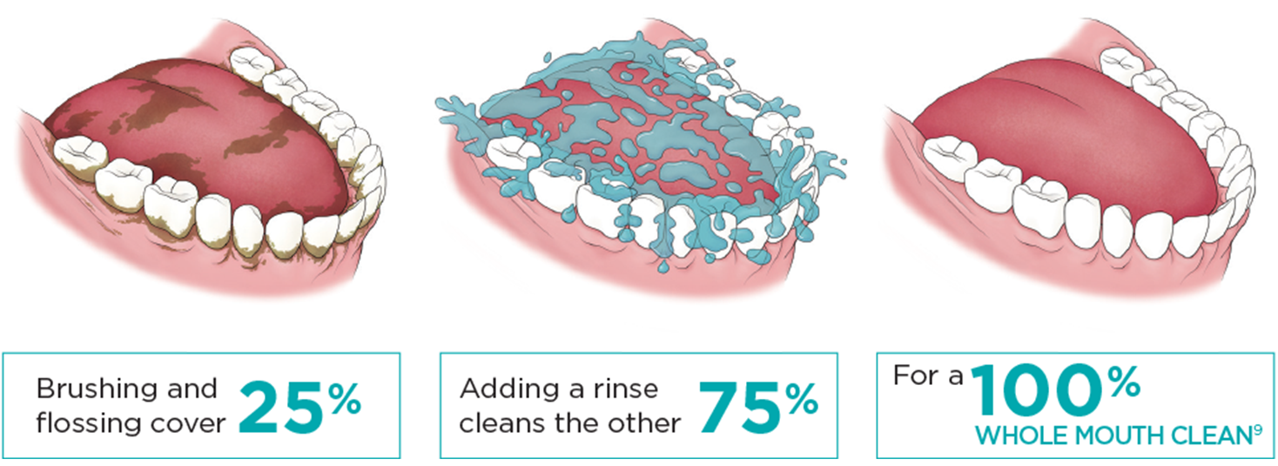
RINSING KILLS BACTERIA IN THE MOUTH
Rinse after brushing
Pour 20ml mouthwash into a cup
Empty the cup into your mouth
Do not dilute the solution with water
Swish for 30 seconds
Spit the solution out
No drinking, no eating, no rinsing with water in 30 minutes
Notes:
https://www.listerineprofessional.com/products/oral-care-routine/go-beyond-brushing

Slide 14
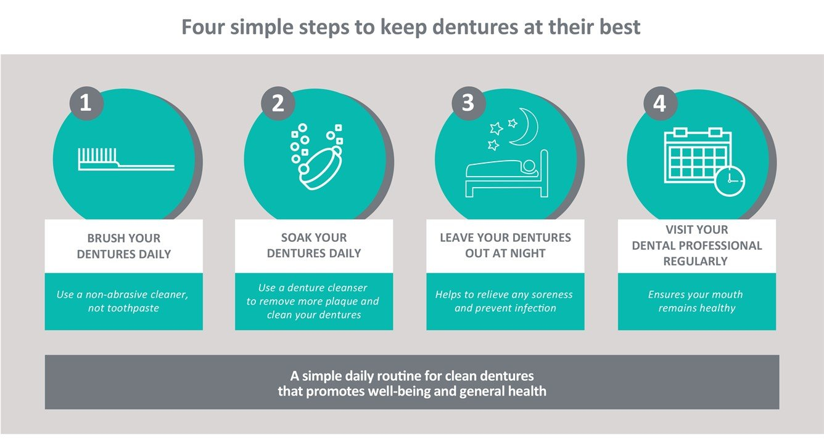
DENTURE CARE PLAQUE WILL ALSO FORM ON DENTURES AND PARTIAL DENTURES
Placing a denture in water (or a denture cleanser solution) when it is not being worn
Use a denture brush or hard nailbrush and scrub off plaque and food particles on teeth including the outside and inside denture under running water
Denture should NEVER be placed in hot or boiling water
Denture should NOT be worn 24 hours a day
Leave out at least 6 hours per day
Notes:
https://www.dentalhealth.org/denturecareguidelines

Slide 15
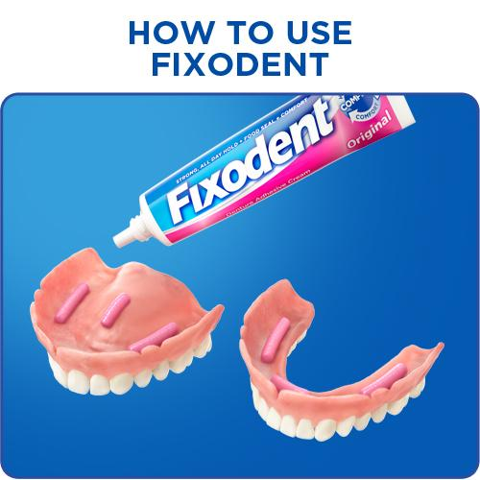
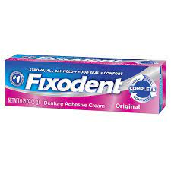
How to use Fixodent?
Notes:
How to use Fixodent Cream Adhesive?
clean and dry dentures
apply dentures and hold thin strips
insert dentures and hold briefly in place
DO NOT use more product than 6 strips or about 3 inches total length
DO NOT use product more than once per day
DO NOT use excess product for poorly fitting dentures
consult your dentist regularly to ensure you have properly fitting dentures. poorly fitting dentures may impair your health.

Slide 16
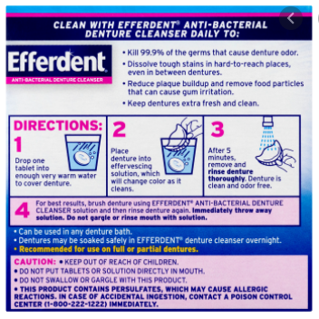
How to use Efferdent?
Notes:
Drop one tablet into warm water but not hot to cover denture or appliance.
Place denture into effervescing solution, which will change color as it cleans.
Remove and rinse denture after 5 minutes.
for best result, brush denture using Efferdent anti-bacterial denture cleanser solution and rinse again. Immediately throw away solution. DO NOT rinse mouth with solution.

Slide 17
References
Ask the gentle dentist: Yes, flossing definitely is important. (2017, January 25). Retrieved April 13, 2021, from https://www.theoaklandpress.com/news/nation-world-news/ask-the-gentle-dentist-yes-flossing-definitely-is-important/article_b1987a43-cff6-5d1f-a281-95a4a2fd71d3.html
Brushing technique: Bass and Modified BASS METHODS. (n.d.). Retrieved April 13, 2021, from https://tube.medchrome.com/2013/04/brushing-technique-bass-and-modified.html?m=1
Dentalhealthorg. (n.d.). Denture care guidelines. Retrieved April 13, 2021, from https://www.dentalhealth.org/denturecareguidelines
Diabetes and your oral health - mcomie family dentistry. (2018, May 14). Retrieved April 13, 2021, from https://mcomiedentistry.com/diabetes-oral-health/
General dentistry in EDMONDS WA. (2019, January 24). Retrieved April 13, 2021, from https://www.daytondentalsmiles.com/services/general-dentistry/
How oral health and heart disease are connected. (2018, February 20). Retrieved April 13, 2021, from https://doctorschoen.com/oral-health-heart-disease-connected/
The importance of going BEYOND Brushing: LISTERINE® PROFESSIONAL. (n.d.). Retrieved April 13, 2021, from https://www.listerineprofessional.com/products/oral-care-routine/go-beyond-brushing
Oral health and Your Lungs: Reducing the risk of pneumonia and COPD. (n.d.). Retrieved April 13, 2021, from https://www.listerine.in/oral-health-lung-problems-pneumonia-in-elderly
Periodontal disease - Killingly, Putnam, DANIELSON, NORTHEASTERN, CT. (n.d.). Retrieved April 13, 2021, from https://www.killinglydentalcare.com/periodontal-disease.html
Schroeder, H. (2017, June 30). What is plaque and why is it harmful? Retrieved April 13, 2021, from https://www.ledownsdentistry.com/what-is-plaque-and-why-is-it-harmful/

Slide 18
THANK YOU!

