Slide 1
STEM CELLS: CURE OR UTOPIA IN REGENERATION OF VITAL TEETH TISSUE?
HANNA KHOMITSEVITCH
SHAN LI
ANARA UTEVOVA
DEN 1200/E601

Slide 2
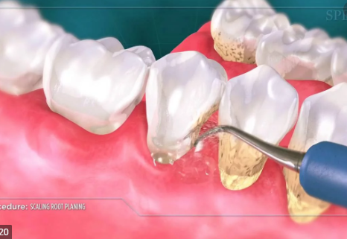
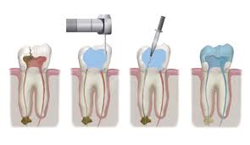
Introduction
periodontitis is a chronic infectious disease that destructive dental support tissue leads to tooth loss. traditional treatment for periodontitis can reduce inflammation and regeneration periodontal support tissue but periodontal membrane regeneration capacity has been limited.
Current root canal therapy are still not able to regenerate the original physiological structure and function of damaged teeth. for instance, after having a root canal therapy done, patients end up having devitalized teeth.
https://www.malkidental.com/blog/2017/06/27/how-much-does-root-canal-184013
https://www.cdgboston.com/periodontal-treatments

Slide 3
Introduction
Our topic is focused on the regeneration of the vital tissues that make up the teeth of the oral cavity, with the help of stem cells such as periodontal ligament mesenchymal stromal cells, periodontal ligament stem cells and dental pulp cells.
The potential use of Mesenchymal Stromal Cells (MCSs) transplantation for tissue regeneration has been thoroughly studied. One of the reasons why we chose this topic was the fact that despite medical advances and progresses.
Experiment also shows PDLSCS (periodontal ligament stem cells) can regenerate periodontal tissue when transplanted to damaged area of periodontal .

Slide 4
Stem cells therapy has been known for its excellent results on regeneration of tissues and organs. However, not much research has been done on regeneration of periodontal and dental pulp tissues.
In our study, we attempted to learn the possible beneficial effects of PDLSCS and DPSC to restore and repair the health of periodontal ligaments and dental pulps of the teeth.
https://www.ncbi.nlm.nih.gov/pmc/articles/PMC7072370/figure/cells-09-00312-f005/

Slide 5
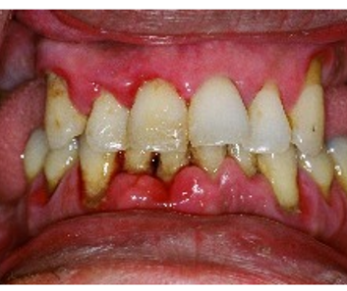
Enhancement of periodontal tissue regeneration by conditioned media from gingiva-derived or periodontal ligament-derived mesenchymal stem cells: a comparative study in rats
Periodontitis is a common disease characterized by the destruction of attachment apparatus and bone loss, and may lead to teeth loss if not treated properly.
The periodontal ligament stem cells conditioned medium (PDLSC-CM) and gingival mesenchymal stem cells conditioned medium(GMSC-CM) known to have a positive effect on attachment apparatus regeneration.
The purpose of this study was to compare the effect on periodontal tissue regeneration of those two treatments.
The randomized controlled study on 90 male rats took place at the Hospital of Stomatology, Shandong University, 2019.
Rats were randomly divided into 5 groups: a control group, an α-MEM (α-Minimal essential medium) group, a GF-CM (gingival fibroblasts conditioned medium) group, a GMSC-CM group, and a PDLSC-CM group. In each group periodontal defect on the left mandibular first molar area was created. and each group received a transplant of collagen membrane contained saline, α-MEM, GF-CM, GMSC-CM, or PDLSC-CM respectively.
Histological analysis was performed 1,2, and 4 weeks after surgery. In each group, the area of regenerated alveolar bone, cementum, and periodontal ligaments were measured.
Statistical analysis was performed with Prism software, and Student-Newman-Keuls test for mean value comparison. P-value of less than 0.05 was accepted as statistical significance.
https://www.indiamart.com/proddetail/treatment-for-periodontal-disease-6886615630.html

Slide 6
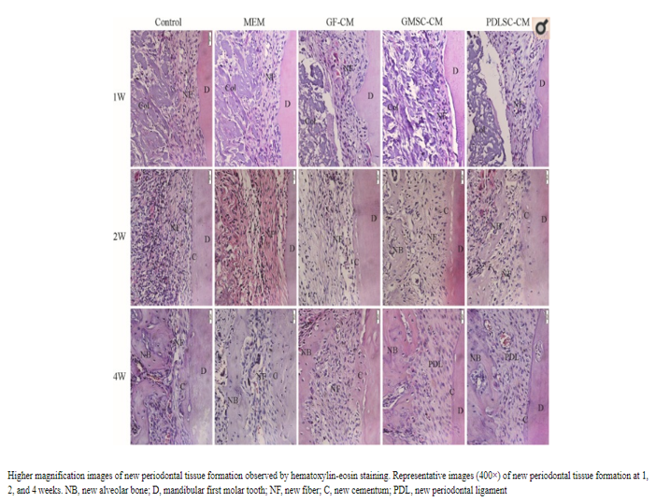
. The authors concluded that both gmsc-cm and pdlsc-cm equally significantly better promote periodontal regeneration in rats compared to other known methods.
those evidences include higher level of:
reducing inflammation,
the formation of new alveolar bone,
the formation of new cementum,
the number and alignment of periodontal ligaments
in comparison to pdlsc-cm, gmsc-cm transplants showed better anti-inflammatory activity
gmsc-cm can be obtained much easier and in higher quantity than pdlsc-cm and therefore can be a promising treatment for periodontal diseases.
https://www.ncbi.nlm.nih.gov/pmc/articles/PMC6998241/

Slide 7
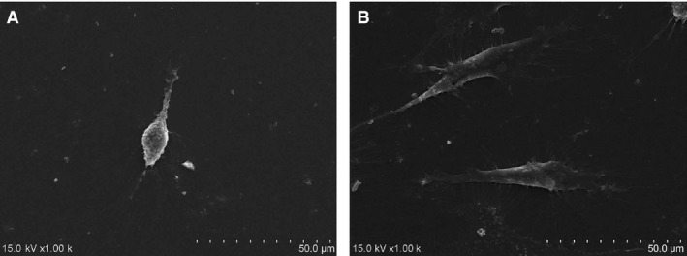
Analyzed MY article(purpose of the study and its design)
• Researcher using PRF（platelet-rich fibrin） and stem cells from rat periodontal ligament and combined it, other four different groups of cells and cells combination to try, to understand the possibility of regenerating the formation of new periodontal ligament fibers and bone.
• cells and cells combination were transplanted into the window that opened by high speed in the rat’s first molar of the buccal mandibular area. experimenter also removed of bone, cementum, and periodontal ligament in order to imitation the damage of the periodontist. they put five different groups of cells and cells combinations into the window.
• 25 rats were killed on day 12 and day 24. samples were extracted from the edges of the rats ‘mandibular window and cut to slices. frozen slices were measured of mRNA by RT-PCR(reverse transcription-polymerase chain reaction) for analysis of gene expression. staining the slices then analysis by micro-CT to observe new bone formation.
https://www.ncbi.nlm.nih.gov/pmc/articles/PMC5783838/

Slide 8
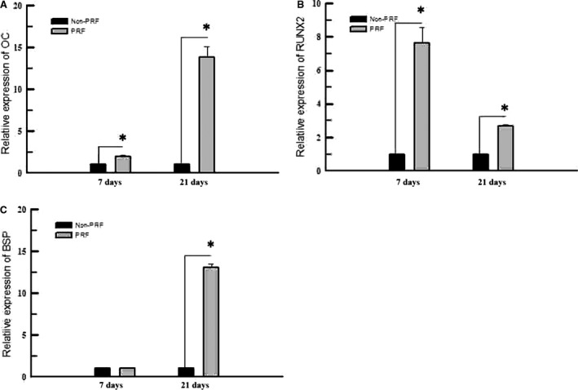
Analyzed MY article(Results and conclusions)
•The researchers are finding that the PRF+CELLS group has a large number of new cellular cementum and PDL（ periodontal ligament） fibers were covering the window area. in contrast, collagen + cell groups were filled with connective tissue which blocked new bone formation. in the PRF group, only a little new cementum and not new bone observed.
RT-PCR was showed highest miRNA expression levels and great amount of new bone formed by micro-CT and histological analysis on PRF+CELLS group
•The authors concluded that platelet-rich fibrin and periodontal ligament stem cell groups had a large amount of new bone formation. the PRF may be good for autologous transplant because it is inexpensive and easy to prepare but PRF+PDLSC combination provided better bone formation during the experiment.
https://www.ncbi.nlm.nih.gov/pmc/articles/PMC5783838/

Slide 9
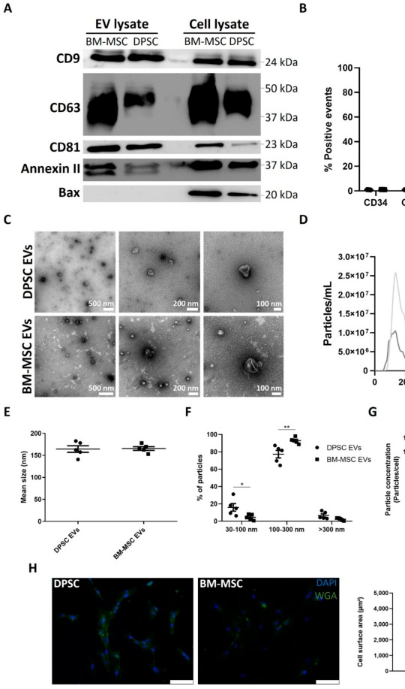
Angiogenic Effects of human dental pulp and bone marrowed-derived mesenchymal stromal cells and their extracellular vesicles
In the study, dental pulp tissue samples were taken from third molars of thirteen healthy donors of 14-23 years of age, both sexes, who were undergoing tooth extraction procedures for orthodontic or therapeutic reasons at Ziekenhuis Oost-Limburg (ZOL, Genk, Belgium).
The study type was Randomized Controlled Trial (RCT).
There were 2 experiment groups: DPSCc that were obtained from third molars of 13 donors and BM-MSCs of 3 different other donors, who were of both sexes, 6-12 years of age. The control group was CM. For study, the donors were selected based on the necessity of extraction of third molars due to undergoing orthodontic or therapeutic reasons. Samples of cells underwent few processes, including isolation of their EVs by differential ultracentrifugation, western blotting, nanoparticle tracking analysis (NTA), microscopy, cytometry, ELISA (a test known for detecting and measuring antibodies in the blood), etc. The research was longitudinal, and it took 9 days.
The purpose of the study was to compare the angiogenic content and functions of dental pulp stromal cells (DPSCs) and bone marrow-derived mesenchymal stromal cells (BM-MSCs) extracellular vesicles (EVs) and conditioned medium (CM) that would help to find possible ways to regenerate damaged dental tissues.
https://www.ncbi.nlm.nih.gov/pmc/?term=32012900%5BPMID%5D&report=imagesdocsum

Slide 10
Results and conclusions
Results:
EVs of cells are more useful in stem cells therapy rather than the cells themselves,
BM-MSC-derived EVs, “have shown promising functional improvements in animal models for myocardial infarction, neurological disorders...and stroke, etc.”
BM-MSC conditioned medium increased in ovo angiogenesis.
Conclusion:
The authors suggest that stem cells are a “powerful tool” because of their self-renewal and ability to differentiate into other cells and might be successfully used for regeneration of tissues in the field of oral and maxillofacial medicine. However, authors point out that key steps of the study, during which the cells had to undergo, such as isolation and characterization of EVs, were very expensive and time-consuming, and this fact could impair their use in clinical practice. The authors also highlight the need for further experiments “to identify the EV fractions and associated proteins that are responsible for the observed functional effects of EVs”. In addition, a comparison is needed between both types of EVs.

Slide 11
Importance of the studies for the dental hygiene profession
The fact that stem cells have the capacity to differentiate into any cell in our body depends on the environment they are placed in; they are a promising treatment for many diseases. since stem cells can be obtained in a sufficient amount from our own body, the treatment should be safe and with minimum side effects, if any. periodontal tissue regeneration accelerated by stem cells is a promising first step in the variety of treatments for many teeth and surrounding tissue conditions: caries, trauma, teeth loss, inflammation, genetic defects, etc.
These studies are important in the dental hygiene field because the chronic periodontal disease has caused a large proportion of tooth loss. One of our member is foreign dentist, She has seen a lot of patients who have lost many teeth due to chronic periodontal disease, and even at a young age, they have to wear removable dentures. Patients always comparing the high cost of treatment with an insignificant effect, many patients give up treatment and choose to have their teeth removed rather than keeping them. After reading those articles, We think stem cells regeneration it is a good direction for the treatment of periodontal disease. first, there are no rejection or ethical limitations to autologous transplantation. second, transplants are easier to obtain and cheaper.

Slide 12
All three of these studies are crucial because attempts to find therapies to restore and regenerate the structure and function of damaged teeth. as we know, for many people, dental care is not accessible, and many people come to seek dental help once teeth are already damaged. current endodontic therapies are widespread and well-studied; however, the teeth that underwent root canal therapy are filled with inorganic materials, which will eventually result in devitalized teeth. the research with dental pulp cells attempted to work on finding a solution to regenerate dental pulp tissues using bone merrowed-mesenchymal stromal cells and dental pulp stromal cells' extracellular vesicles.
I believe that this study needs further investigation because if the authors would be able to restore dental pulp tissues with the use of eves, the public health and communities would greatly benefit from it. moreover, these findings would be useful in disease prevention and dental hygienists can highlight the importance of preserving the health of teeth and significance of dental checkups and oral hygiene services to prevent the diseases, because current treatments of damaged teeth are still expensive and not affordable to everyone.

Slide 13
references
Picture 1: https://www.ncbi.nlm.nih.gov/pmc/articles/PMC7072370/figure/cells-09-00312-f005/
Picture 2: https://www.indiamart.com/proddetail/treatment-for-periodontal-disease-6886615630.html
Qiu, Jiling et al. “Enhancement of periodontal tissue regeneration by conditioned media from gingiva-derived or periodontal ligament-derived mesenchymal stem cells: a comparative study in rats.” Stem cell research & therapy vol. 11,1 42. 3 Feb. 2020, doi:10.1186/s13287-019-1546-9 https://www.ncbi.nlm.nih.gov/pmc/articles/PMC6998241/
Nazir, Muhammad Ashraf. “Prevalence of periodontal disease, its association with systemic diseases and prevention.” International journal of health sciences vol. 11,2 (2017): 72-80. https://www.ncbi.nlm.nih.gov/pmc/articles/PMC5426403/
Picture 2:https://www.cdgboston.com/periodontal-treatments https://www.malkidental.com/blog/2017/06/27/how-much-does-root-canal-184013
Picture 3: https://www.ncbi.nlm.nih.gov/pmc/articles/PMC6998241/
Picture 4: https://www.cdgboston.com/periodontal-treatments
Picture 5: https://www.sciencedirect.com/science/article/pii/S1013905217300822
Liu, Yi, et al. “Periodontal Ligament Stem Cell‐Mediated Treatment for Periodontitis in Miniature Swine.” STEM CELLS, vol. 26, no. 4, 2008, pp. 1065–1073.
•Duan, Xuejing, et al. “Study of Platelet‐Rich Fibrin Combined with Rat Periodontal Ligament Stem Cells in Periodontal Tissue Regeneration.” Journal of Cellular and Molecular Medicine, vol. 22, no. 2, 2018, pp. 1047–1055.
Picture 6: https://www.ncbi.nlm.nih.gov/pmc/articles/PMC5783838/
PictureI 7:https://www.ncbi.nlm.nih.gov/pmc/articles/PMC5783838/
Merckx, Greet et al. “Angiogenic Effects of Human Dental Pulp and Bone Marrow-Derived Mesenchymal Stromal Cells and their Extracellular Vesicles.” Cells vol. 9,2 312. 28 Jan. 2020, doi:10.3390/cells9020312
Zhou, Huan et al. “The proangiogenic effects of extracellular vesicles secreted by dental pulp stem cells derived from periodontally compromised teeth.” Stem cell research & therapy vol. 11,1 110. 6 Mar. 2020, doi:10.1186/s13287-020-01614-w

