Slide 1
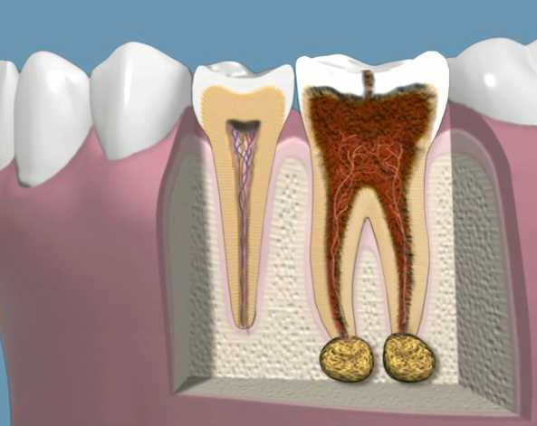
Periapical Pathology
Helen Chen
Saba Haggagi

Slide 2
What Is PAP?
(Periapical Pathology)
Periapical - to be surrounding the apex of the root of a tooth.
Pathology- (derives its roots from the original Greek term for the study of pain and suffering). The medical practice of pathology is dedicated to the general study of disease and its processes as well as the specific diagnosis of disease, since pathologists investigate the clues to diseases and injuries through the examination of organs, tissues, body fluids, cells, and molecules.
How can we identify Periapical Pathology?
Periapical X-ray- a radiographic image that captures the whole tooth from crown to the root, used to detect any unusual changes in the root and surrounding bone structures.

Slide 3
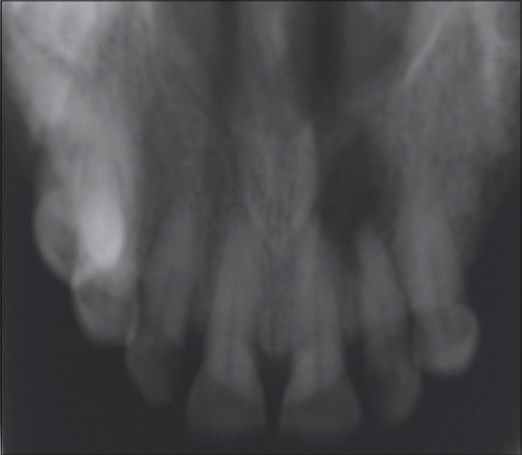
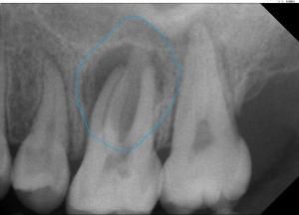
Periapical abscess (dentoalveolar abscess)- abscess in soft pulp of tooth showing a radiolucency at the apex of a tooth with loss of the lamina dura and increased pdl space as a result of infection.
Proximity of the max. sinus can spread abscess into vessels of the cavernous sinus of the brain, resulting in death! Complications include: osteomyelitis, cellulitis,bacteremia, Ludwig's angina, dental cyst, maxillary sinusitis and cavernous sinus thrombosis.
Causes: Trauma, overextension of filling material causing hyperocclusion, incorrectly done endodontic procedures, overinstrumentation, root perforation and untreated dental cavity
Chief Complaint: Pain on biting, pus, swelling, tender to touch, difficulty opening mouth, foul taste, fever...
Periapical Abscess

Slide 4
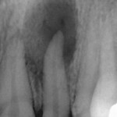
Periapical Granuloma
Granuloma (apical periodontitis) may arise after periapical abscess in a non-vital tooth. Usually asymptomatic, localized, well defined/ circumscribed radiolucency at apex of tooth.
Cause: Deep restoration, large caries, incorrect root canal treatment, infection Growth of granulomatous tissue continuous with periodontal ligament, from root canal into surrounding periradicular tissues through apical and lateral foramina. Consists of granulation inflammatory tissue and usually a connective tissue capsule.
Chief complaint: may exhibit mild pain on biting and sensitivity to percussion.

Slide 5
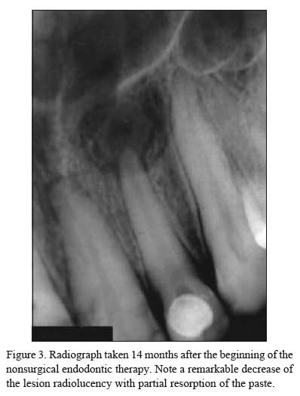
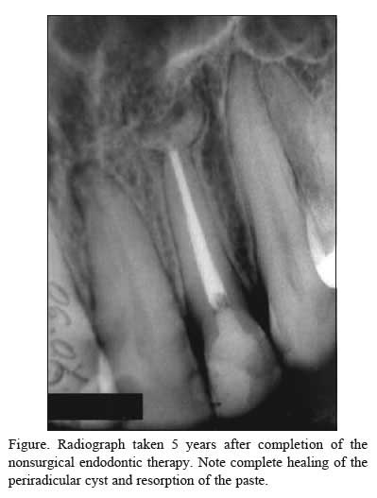
Radicular cyst ( periodontal cyst )
Prior to treatment Post Treatment (months/years)
Radiographically identical to granuloma. May be of greater size, radiolucent, loss of lamina dura near apex and well circumscribed. Proliferation of the epithelial rest, usually asymptomatic, seldom painful, can be located residual, lateral and apical.
Differentiation may be impossible!
Unless characteristics of a cyst are present, such as: displacement of adjacent structures and expansion of outer cortical boundaries of the jaw .
Lesions larger than 1 cm in diameter usually are radicular cysts.

Slide 6
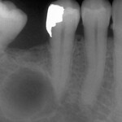
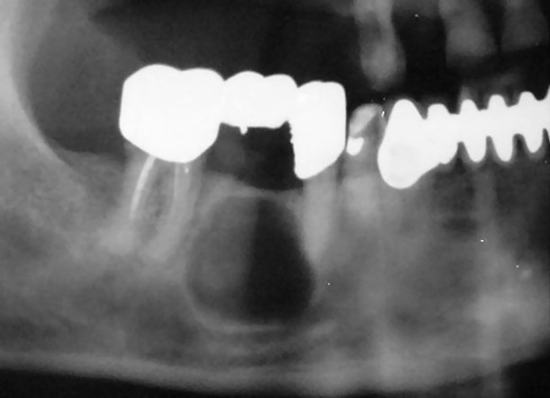
Residual cyst
Develops after removal of a tooth containing a radicular cyst that was not fully extracted
Asymptomatic. Usually small size (less than 1 cm in diameter).
May grow overtime causing severe bone resorption and weakening of mandible/maxilla
Round or oval, well-defined, usually well-corticated.

Slide 7
Periapical Scar
( dense scar tissue in apical region of
maxillary lateral incisor.)
New bone formation(black arrow)
Inflammatory apical lesion that develops around apex of teeth, that has been treated endodontically or surgically
Composed of dense fibrous tissue located at apex of tooth
Asymptomatic, small, well circumscribed, and size of radiolucency may decrease slightly over time

Slide 8
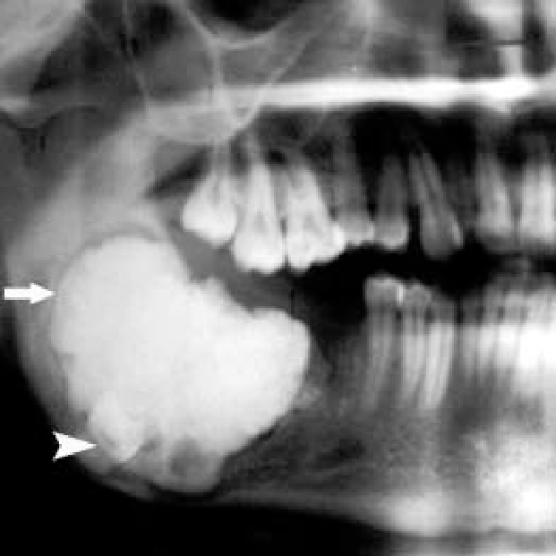
Complex Odontoma
Radiograph shows a radiopaque in the anterior ramus and body of right mandible, the thin radiolucent space around the calcified and impacted tooth.(Please refer to the arrows).
Causes: Infection, trauma, family history and genetic.
Chief complaint: Swelling(painless), unaesthetic appearance.

Slide 9
Cementoma (Periapical cemental dysplasia)
A benign condition mostly seen in patients older than 20 years old and mostly common to women. The lesion usually appears near the periodontal ligament around apex of a tooth (usually mand. incisors).
Usually discovered during intraoral examination radiographically. This is difficult to distinguish from a periapical granuloma in early stage. Vitality testing should be done in order to make this distinction.
No complaints, asymptomatic, harmless.
No treatment is needed.
Only periodic observation required.

Slide 10
Periapical cemental dysplasia Stage I
Early stage development notice the lesion resembles a granuloma or cyst as it appears radiolucent.
Easily confused for Granuloma or Cyst!
Radiograph shows radiolucent in the apex of mandibular anterior teeth.(Please refer to the arrows.)

Slide 11
Periapical cemental dysplasia Stage II
In this stage notice the lesion is developing calcification in the radiolucent area. Also known as Mixed Radiolucent-Radiopaque Stage. (Please refers to the arrows.)
Radiograph shows half radiolucent and half radiopaque,
Radiolucent
Radiopaque

Slide 12
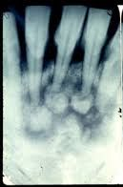
Periapical cemental dysplasia Stage III
This stage appears mostly radiopaque. Calcification is most in this stage.
Notice:
Radiograph shows radiopaque bordered by a thin radiolucent line. This is the mature lesion. (Please refers to the arrows.)

Slide 13
References:
Content source:
Eskandarloo, Amir, and Faezeh Yousefi. “CBCT findings of periapical cemento-osseous dysplasia: A case report.” Imaging science in dentistry vol. 43,3 (2013): 215-8. doi:10.5624/isd.2013.43.3.215 https://www.ncbi.nlm.nih.gov/pmc/articles/PMC3784683/
Neyaz, Zafar & Gadodia, Ankur & Gamanagatti, S & Mukhopadhyay, S. (2008). Radiographic approach to jaw lesions Singapore medical journal. 49. 165-76; quiz 177. https://www.researchgate.net/publication/5550311_Radiographical_approach_to_jaw_lesions
Visnapuu, Vivian & Peltonen, Sirkku & Ellilä, Tero & Kerosuo, Eero & Väänänen, Kalervo & Happonen, Risto-Pekka & Peltonen, Juha. (2007). Periapical cemental dysplasia is common in women with NF1. European journal of medical genetics. 50. 274-80. 10.1016/j.ejmg.2007.04.001. https://www.ncbi.nlm.nih.gov/pubmed/17532280
https://screening.iarc.fr/atlasoral_list.php?cat=E21&lang=1
https://www.google.com/search?q=pathology&rlz=1CARCMY_enUS864&oq=pathology&aqs=chrome..69i57j0l6j69i61.1751j0j7&sourceid=chrome&ie=UTF-8
http://www.contempclindent.org/article.asp?issn=0976-237X;year=2011;volume=2;issue=4;spage=368;epage=371;aulast=Narula
http://www.scielo.br/scielo.php?script=sci_arttext&pid=S0103-64402005000300016
https://www.sciencedirect.com/topics/medicine-and-dentistry/periapical-cyst
https://www.flickr.com/photos/63464118@N06/5773709636/in/photostream/
https://ddmfr.org/tr/residual-cyst-circumscribed/
https://pocketdentistry.com/20-inflammatory-disease/
https://med.nyu.edu/pathology/patient-care/patients/practice-pathology

Slide 14
Thank You!

