Slide 1
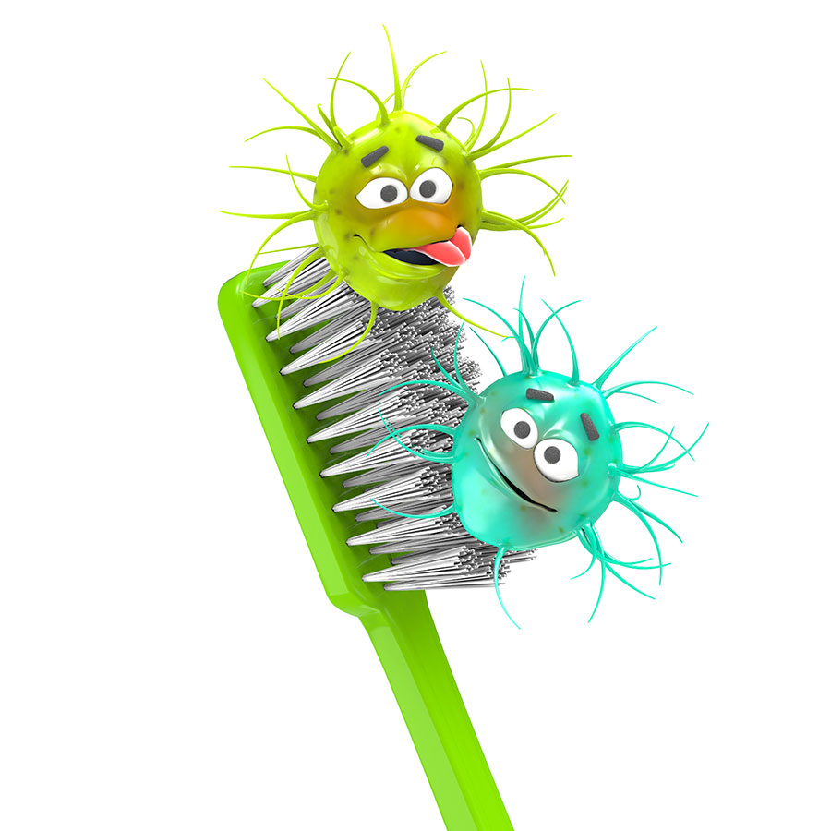
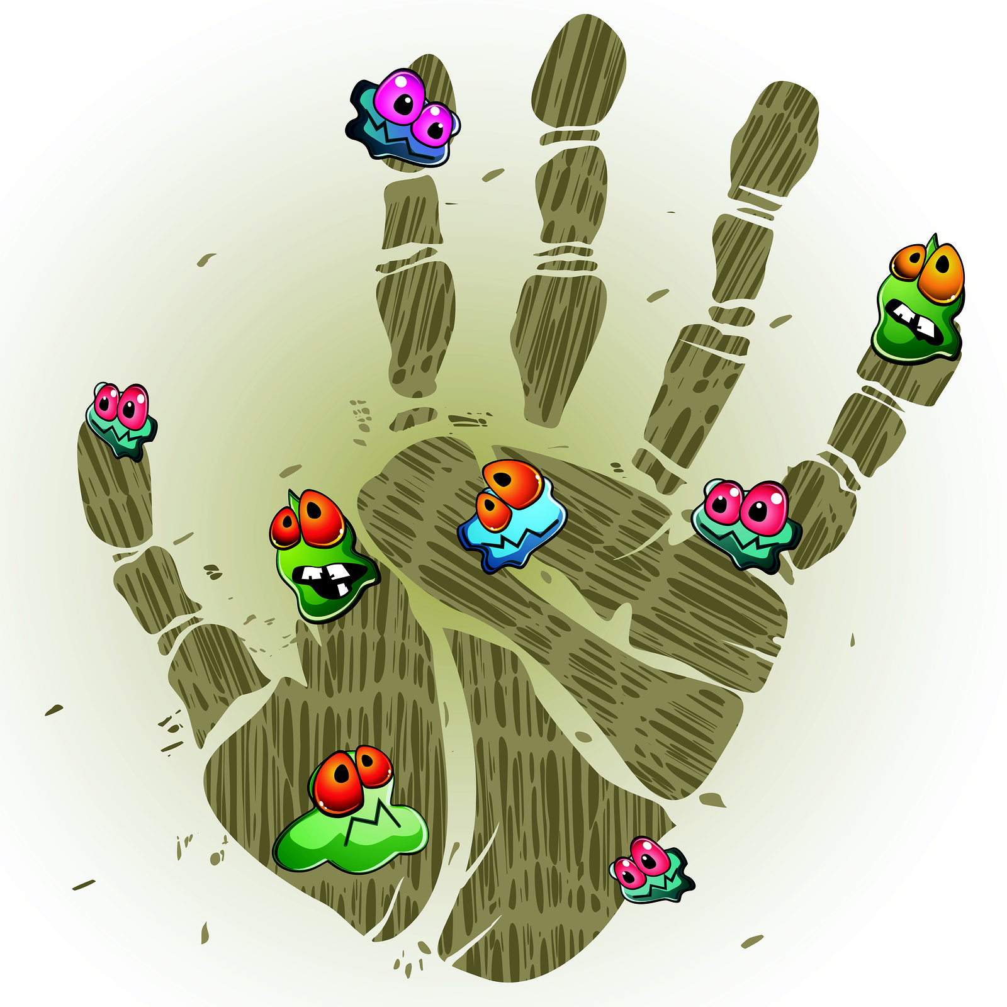
THE IMPORTANCE OF HAND WASHING

Slide 2
Do you know why we wash our hands?

Slide 3
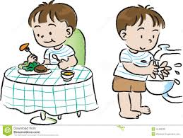
Wash your hands….
Before and after you eat

Slide 4
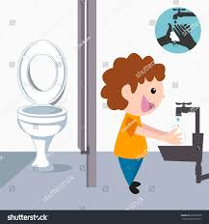
Wash your hands….
After using the bathroom

Slide 5
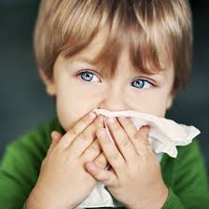
Wash your hands….
After you blow your nose

Slide 6
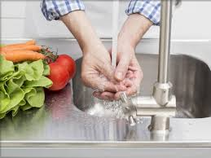
Wash your hands….
Before you cook

Slide 8
This way the germs wont spread on to other things or people

Slide 9
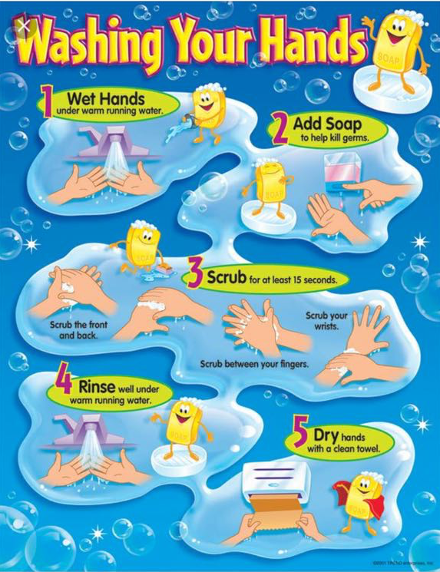

Slide 10
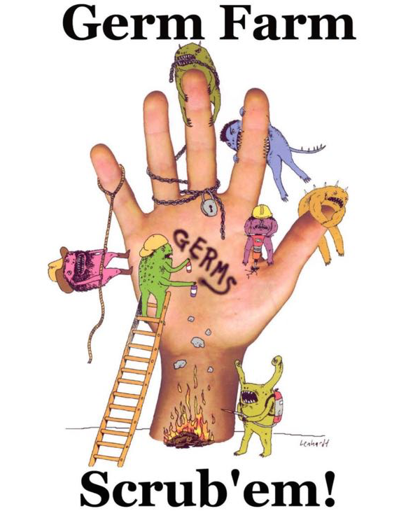

Slide 11
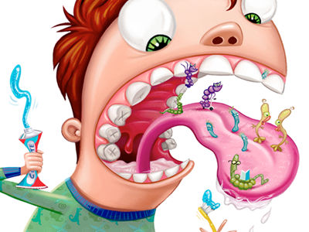
Do you know where else we have germs in our body!?

Slide 12
If you get sick, change your toothbrush when you feel better because the germs are hiding in your brush!

Slide 13
Change your toothbrush every 3 months if you want it to be germ free!

Slide 14
Brush your teeth 2 times a day, morning and night!

Slide 15
If your teeth touch, floss in between them so they are squeaky clean!

Slide 16
Go to the dentist every 6 months so the Dentist and Hygienist can make sure there are no nasty germs hiding in your mouth!

Slide 17
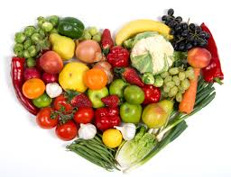
And always remember to choose fruits and veggies over candy!

Slide 18
Now let’s play a game and see how much you learned today!

Slide 19
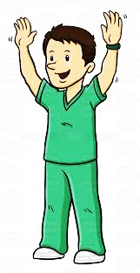
Thanks for having us come to Brooklyn Amity School!
Sajma Besim Navneet Iryna Maria

