Slide 1
FIELD-BASED COLLABORATIVE RESEARCH PROJECT
LAW 2301
ESTATES, TRUSTS AND WILLS

Slide 2
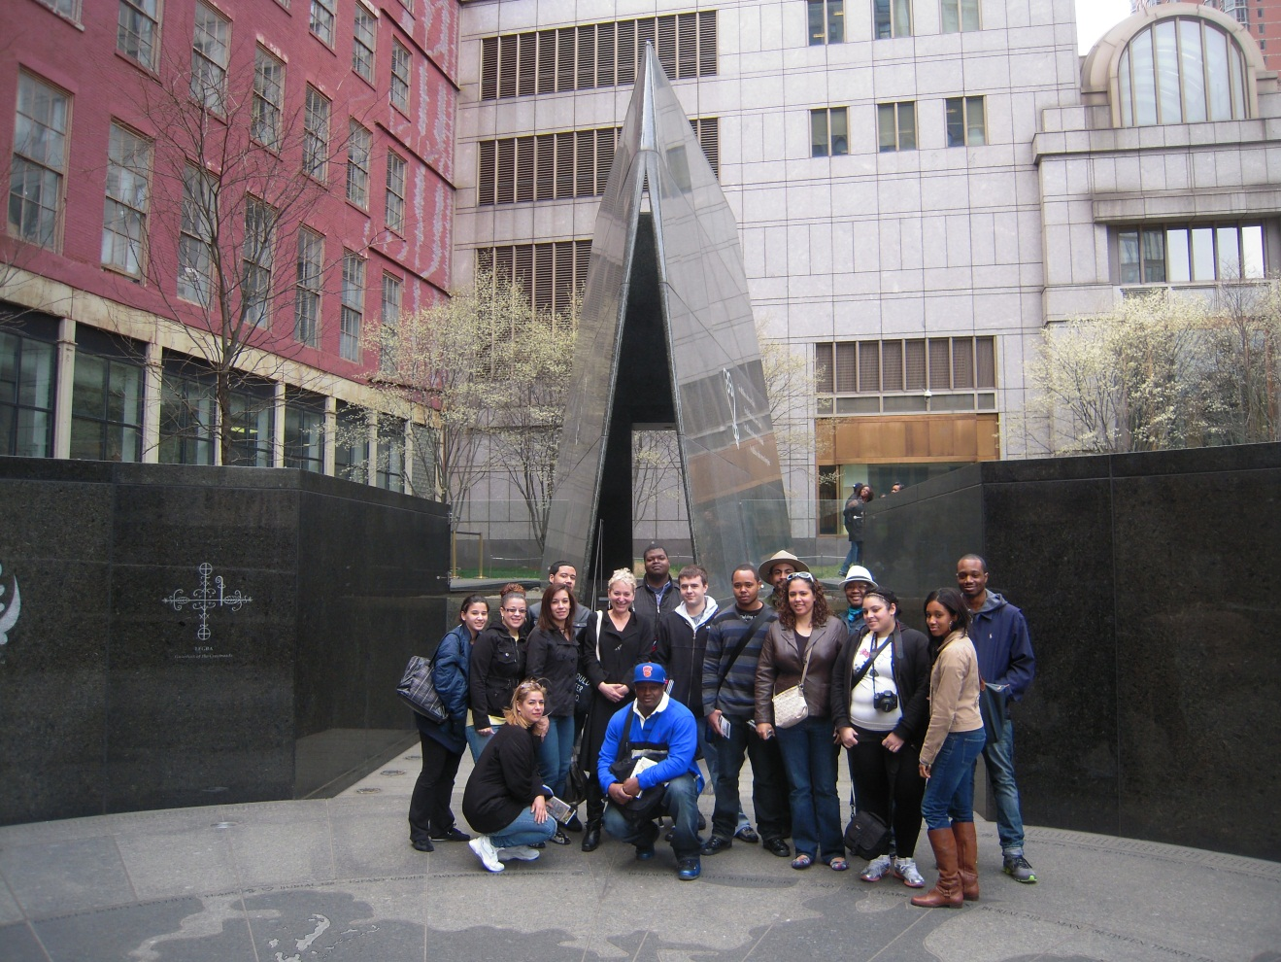
INVESTIGATIONS AT THE
AFRICAN BURIAL GROUND

Slide 3
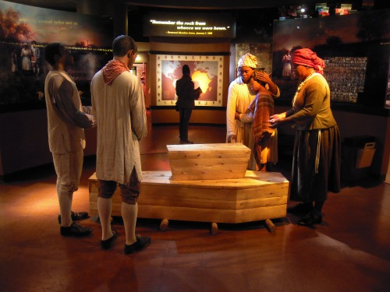
THANKS TO JULIA AND MARTA FOR THE INSPIRATION!
You can read about the genesis of this project in our class blog, The Dearly Departed.

Slide 4
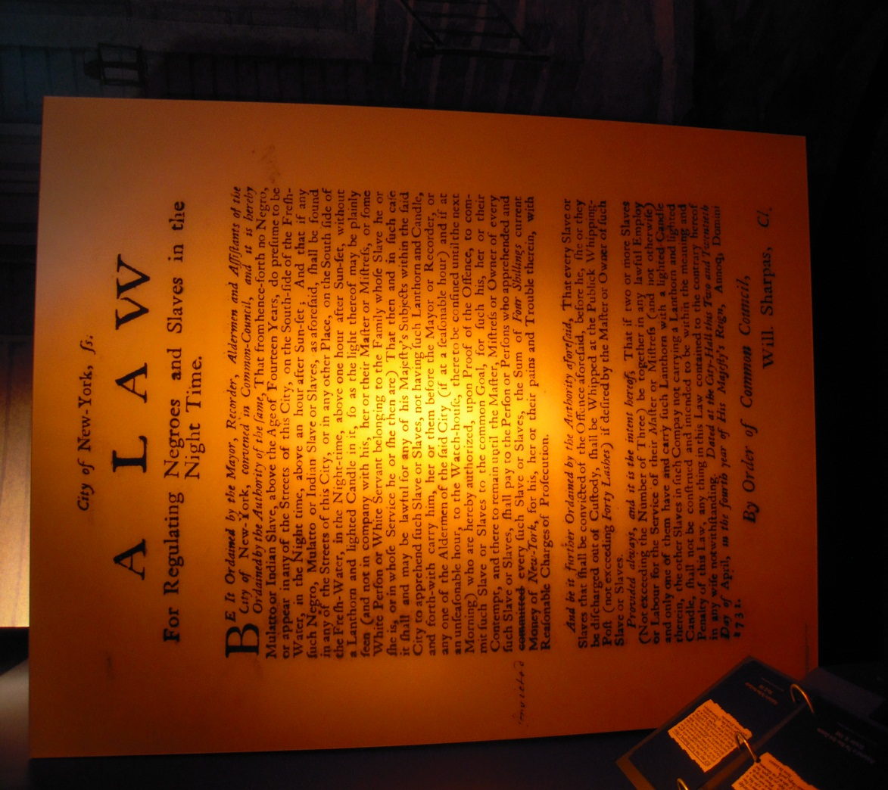
In this field-based collaborative research project, students will explore the “big question” of the laws of early New York and the historical, cultural and social effects of slavery on funerals, burial rituals and last wills and testaments

Slide 5
INSTRUCTIONAL PROCEDURES
a. Focusing event: A field trip to the African Burial Ground (290 Broadway) during Week Nine of the semester.
b. Teaching procedures:
1. Shared Readings:
National Park Service Brochure, Two wills from early New York
2. Lecture from a National Park Ranger during a one and one half hour visit to the Visitor’s Center where students can begin researching their assigned topics.
3. Student Research: Working in one of four teams, students will perform research, contribute to a wiki, write a one page memo and present their findings to the class.

Slide 6
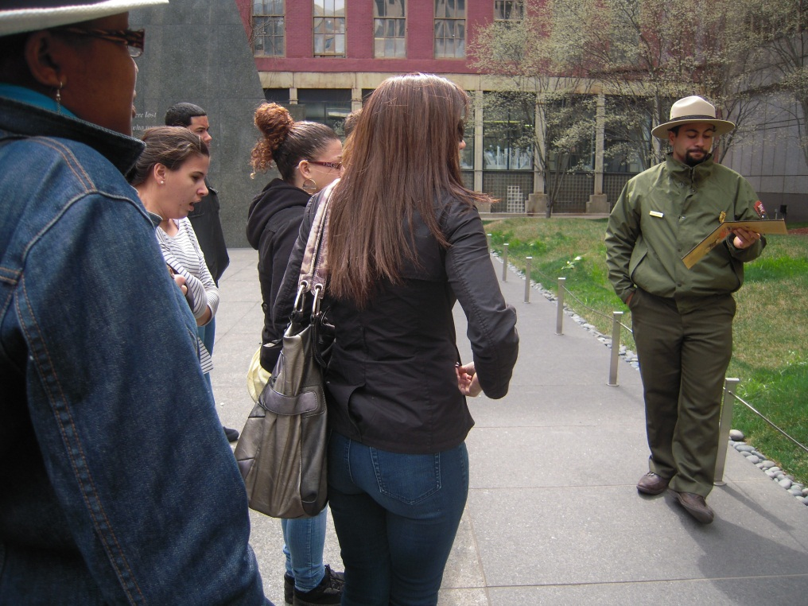
GENERAL EDUCATION COMPETENCIES
1.Communication Skills: the ability to read, write, speak and listen effectively.
2, Critical Thinking: the ability to analyze complex issues and to evaluate information.
3. Research and Computer Skills: the ability to acquire, evaluate and synthesize information using appropriate technology in an ethical and legal manner
4. Humanistic and Social Inquiry: an understanding of and respect for cultural diversity, the human experience and the interconnectedness of global and local concerns.

Slide 7
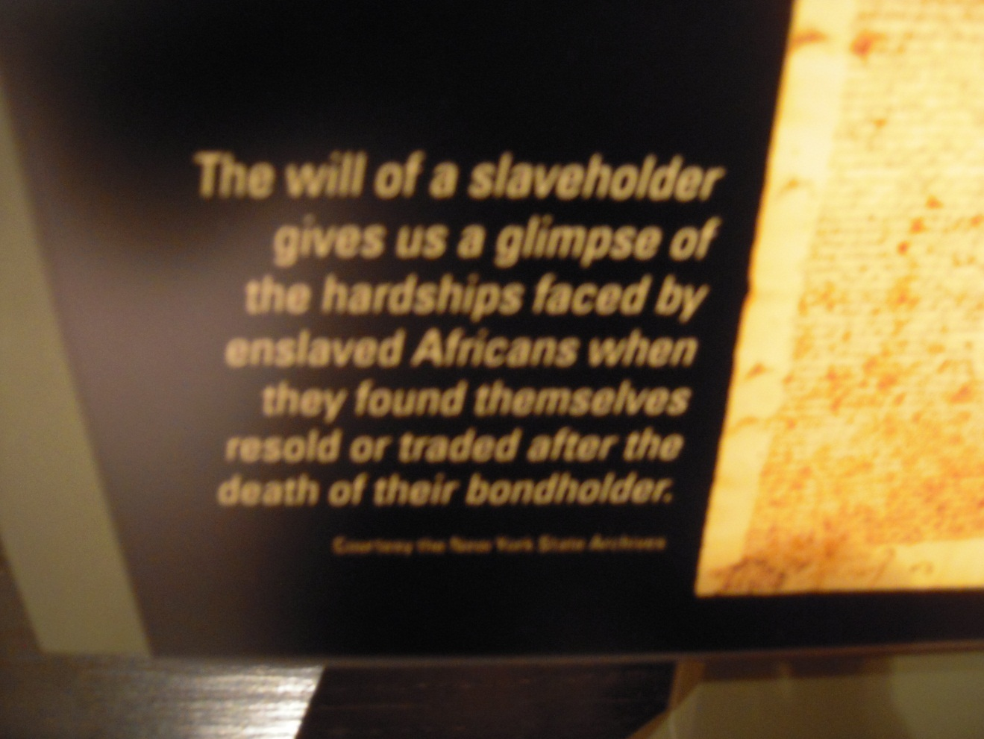
TEAM ONE: AFRICANS IN EARLY NEW YORK
Students will research:
Will laws/Slavery laws under the Dutch in New York (17th century)
Will laws/Slavery laws under the English in New York (18th century)
Real and personal property ownership laws in early New York

Slide 8
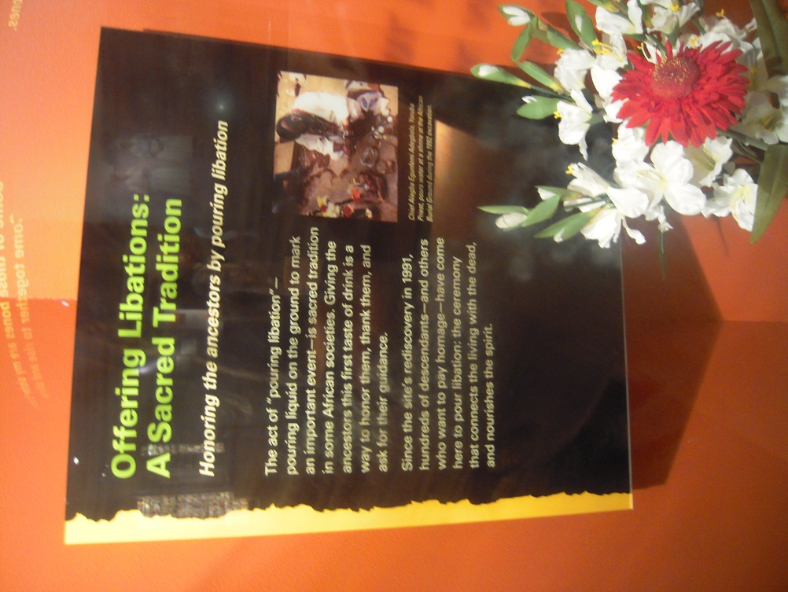
TEAM TWO: SACRED GROUND
Students will research:
History of the Burial Ground (to late 18th century)
Laws regarding early burials
Burial rituals
Gravegoods

Slide 9
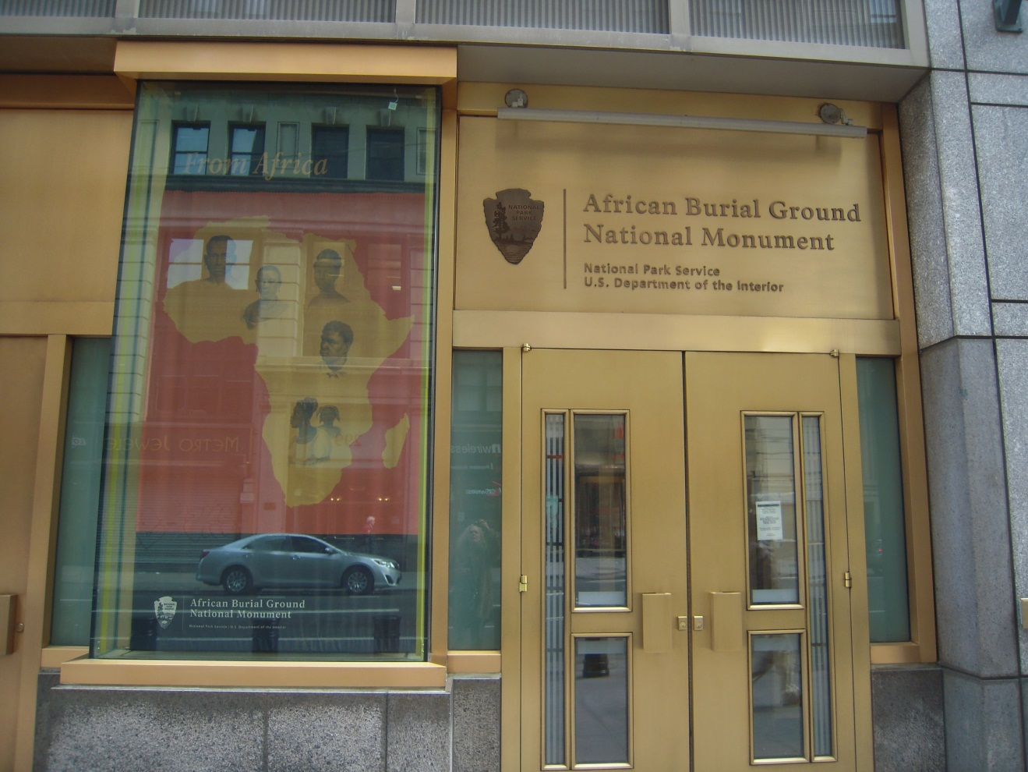
TEAM THREE: REDISCOVERY/REINTERMENT
Students will research:
Recent history of the Burial Ground – controversy and resolution
Modern New York law regarding cemeteries/burials/desecration of graves

Slide 10
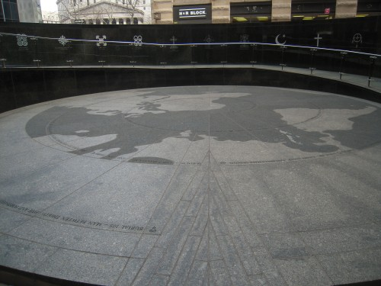
TEAM FOUR: REMEMBRANCE
Students will research:
Howard University findings
Design of the monument – importance of symbols
Modern day African burial practices

Slide 11
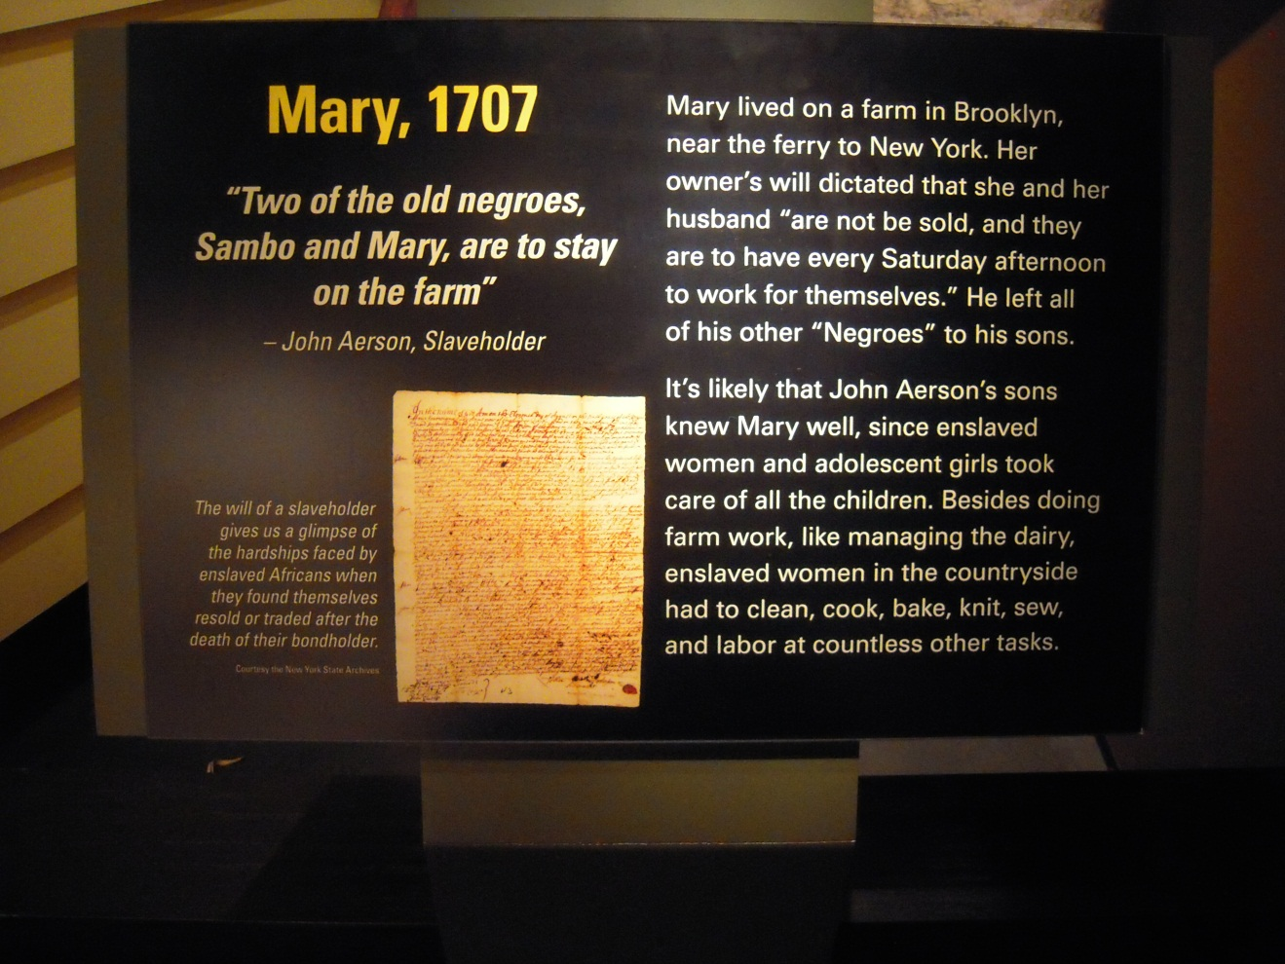
All students will also be required to analyze the will clauses in two historical wills as part of the Wills of the Rich and Famous assignment as well.

Slide 12
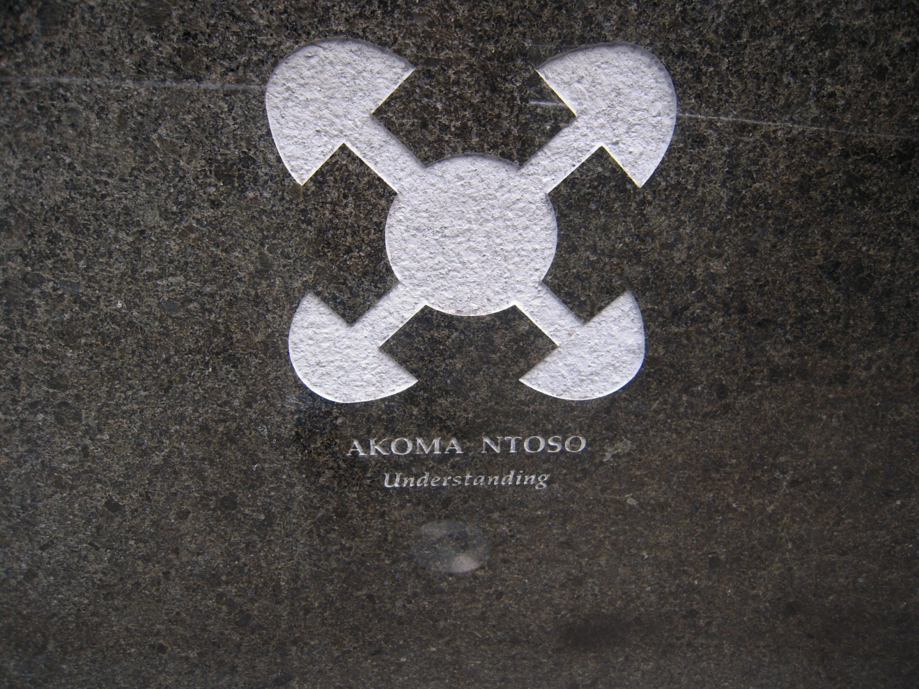
ASSESSMENT
1. Will analysis exercise
2. Individual memo – rubric
3. Team wiki posting – rubric
4. Oral presentation - rubric

