Slide 1
Taming African American Hair
Stephanie Diaz
Prof Covert
Africana Folklore Final

Slide 2
Don’t touch my hair !
Ever looked at a black girl’s hair and just wondered what it felt like ? Yeah well keep your thoughts and hands to yourself ! Curly haired girls go through a lot just to manage their hair. Time and Money ! Women spend a lot of money maintaining how they look, and they're willing to spend what they believe is necessary to do that. Statistics show that Rihanna pays her stylist Stephen about $23,000 per week.
Even though we go through the most pain through detangling, hot combs, flat irons, blow dryers we have the most unique kind of hair.
Curly hair is very fragile.
Weak hair causes split ends.

Slide 3
You don’t know much depth history on hair unless you know Madame CJ Walker
Madame CJ Walker was the first self-made female African American millionaire.
“I want the great masses of my people to take a greater pride in their personal appearance and to give their hair proper attention.” Walker
Madame Walker started the “hair-growing” business, she was the President and sole shareholder of 1,000 shares of stock.
She was an inspiration and a role model for many black and white woman.

Slide 4
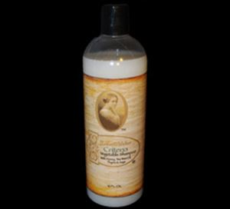
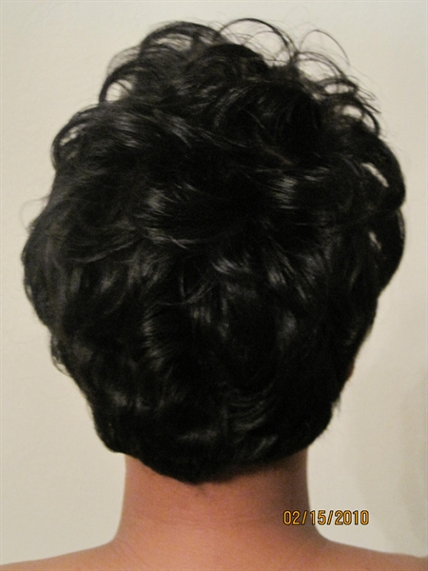
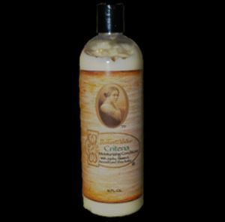
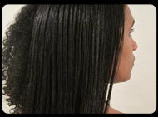
Madame Walker's CRITERIA VEGETABLE SHAMPOO perfectly cleanses hairstyling products, environmental impurities and oil from the hair, without stripping it of vital moisture, thus allowing the hair to protect, improve and repair itself.
Madame Walker's CRITERIA GLOSSINE CONDITIONER. This all natural product imparts tangle-free wet combing, enhances the hair's strength and resistance to breakage, helps to repair split-ends, and protects the hair from damage due to over-heating and over-drying, as well as environmental stresses such as dust, sun and smoke. This product can also be used on tinted hair.

Slide 5
Self Image
Black women rather silky straight hair
Straightened hair serves to being more acceptable in a white establishment
Straighter hair helps them feel accepted in their community and make them look more attractive
Some people feel as an afro is not presentable
Kids at school get bullied for having nappy hair

Slide 6
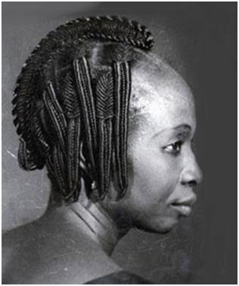
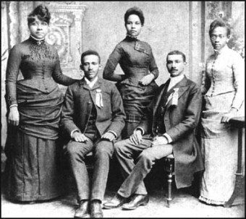
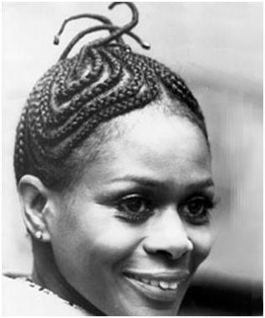
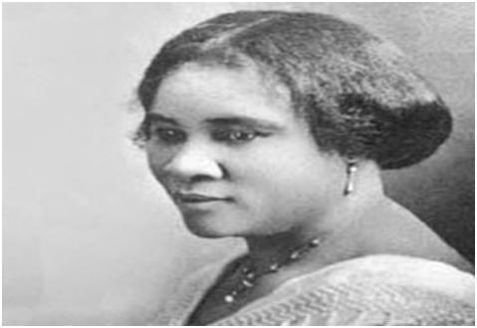
Timeline of black hair in history
In the 1400s, Black women wore their hair in Twists, locks and plaits.
In the 1800s, slaves rely on bacon grease, butter and kerosene as hair conditioners and cleaners.
In the 1880s, metal hot combs were invented. They used the hot comb to press and straighten kinky hair.
In the 1900s, cornrows became very popular. They used it popularly with braids.

Slide 7
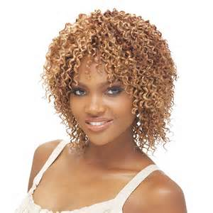
In 1971, Jheri curls was very popular In the black scene. The curly perm was a ultra-moist hairstyle that is also very common now.
In the 1990s, girls started using weave. In 2000, about 25% of all African American girls were wearing some type of hair addiction.
In 2013, weaves became very popular. Many girls from different ethnicity use weave. Weave has become a big part of every female’s appearance especially in the African Diaspora.

Slide 8
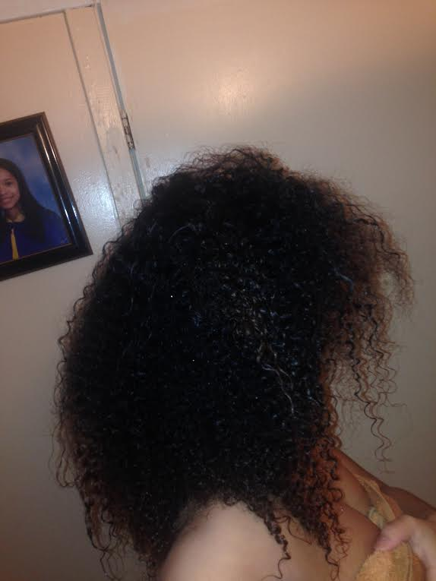
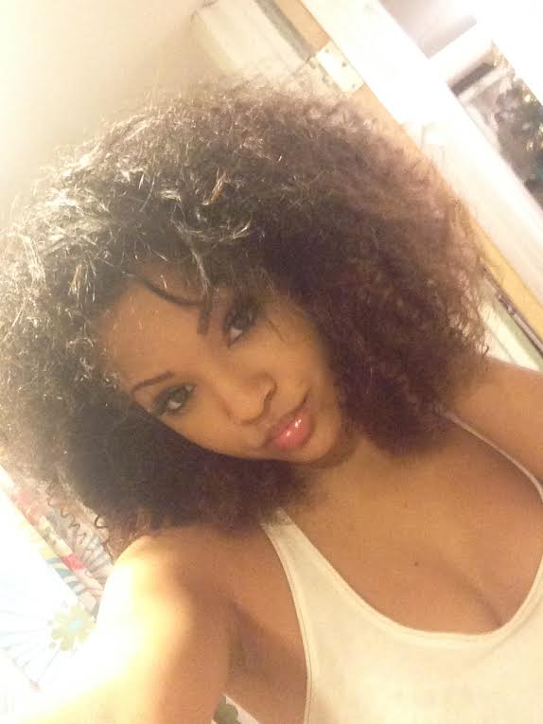
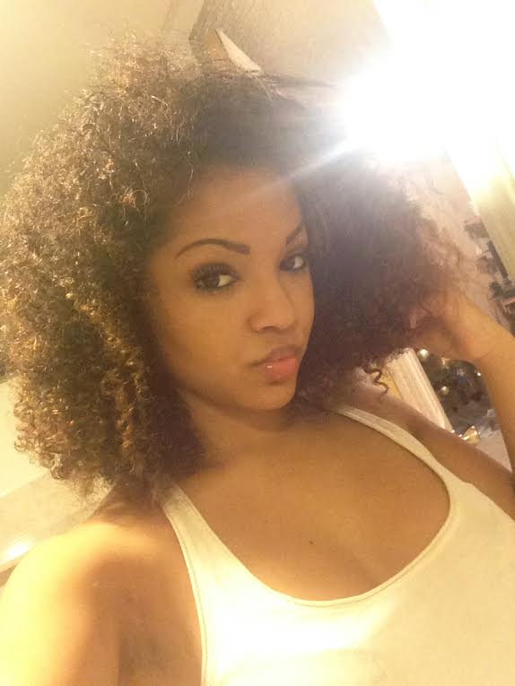

Slide 9
Bibliography
Wadyka,S. (2005) Treating the Scalp with Respect and Products.NewYork.NYTimes.com
http://www.madamewalker.net/
http://hellobeautiful.com/2012/06/26/rihanna-haircuts/
Louis,C. (2009) Black Hair, Still tangled in Politics.NewYork.NYTimes.com
Fischler,M. (2007) Taming Frizz and Setting Curls Free.NewYork.NYTimes.com

