Slide 1
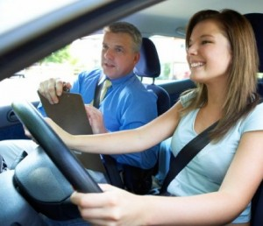
SKY Driving School Yao Fu, Sabina Cormier, Kareen Ejoh
Psych 2404
Prof. Russo-Dwane
Group 9
1

Slide 2
SKY Driving School
Whether you’re learning to drive, a new driver or an experienced driver, there is always an opportunity to learn or brush up on your driving skills and knowledge.

Slide 3
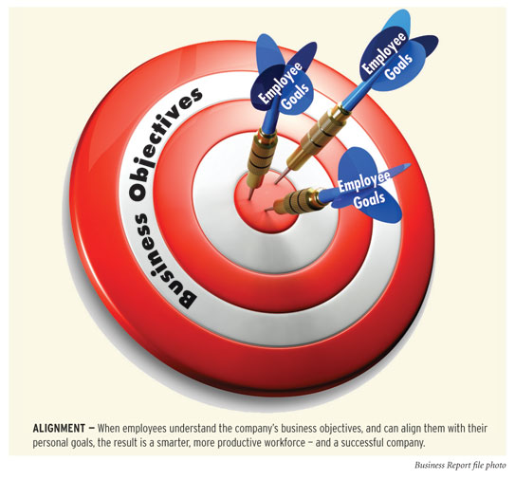
Our Mission:
Driving can be such a scary experience. At Sky Driving School our mission is to calm the fears and nervousness associated with driving. We offer a full service experience at Sky Driving School. Our instructors are college educated, professional and friendly. The relationships that we form with our students doesn't stop the moment they get their license.

Slide 4
Our Mission
We offer an array of skill classes geared toward providing knowledge on how to deal with situations that present themselves on the road while driving. We are licensed by the New York State Department of Motor Vehicles. Don't forget Sky's the limit!!

Slide 5
SKY Driving School
With the help of an I/O psychologist we developed interview techniques, rating scales, and psychological tests used to assess skills, abilities, and interests for the purpose of employee selection, placement, and promotion.

Slide 6
SKY Driving School
Sabina is responsible for the Human Resource Department, Kareen is responsible for Accounting and Office Management and Yao is responsible for Technical Support and Marketing.

Slide 7
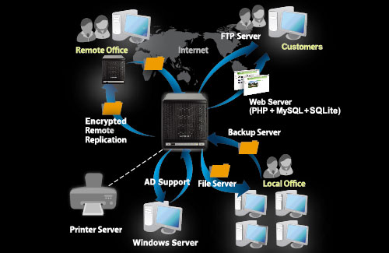
Yao:
Installing and maintaining company computers and electrical devices.
Creating our company website to promote our business.
Provide online training video for new drivers. Answer and reply to any of the concerns our customers.

Slide 8
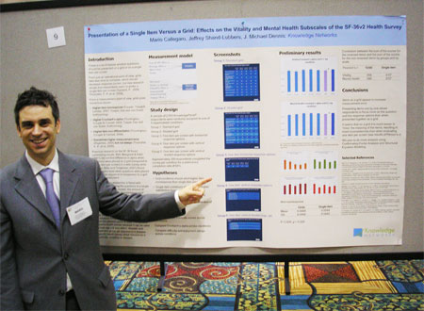
How to promote our business
Distribute fliers to potential customers at high schools, colleges, and to new immigrants.
Provide the multi-lingual support servers.
Provide coupons.
Promote our business through website (television and radio)

Slide 9
Sabina Cormier:
I am in charge of the Human Resource Department. In this role, I supervise the hiring, training of new employees. I also dictate and enforce company policy.

Slide 10
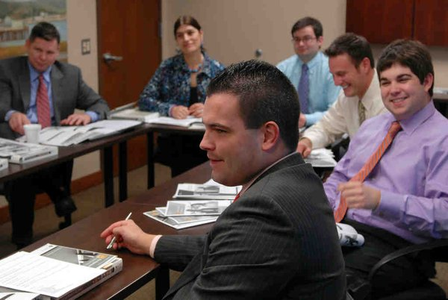
Our hiring process:
We will only accept applications for persons whom have completed and passed the DMV licensing requirements. Résumé, two professional recommendation letters, and 1-2 years of previous experience.
Applicants must agree to a thorough background check and provide their fingerprints.
Applicants must also agree to a drug screening & physical examination prior to being hired.

Slide 11
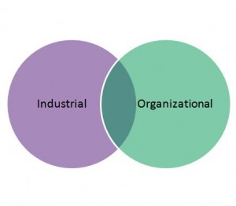
Hiring process cont.
Plan to hire 5-10 instructors.
Once hired as a part time, per diem employee they will be placed on a 6 month probationary period while their performance is under review. Full time employee status will be based on the passing & failing of students and paper & pencil questionnaires from the students after completed the course
Once hired, new candidates will be trained and educated on company policy. Training will include but not limited to:
Measuring current knowledge and experience;this would allow us to strengthen areas that need improvement.

Slide 12
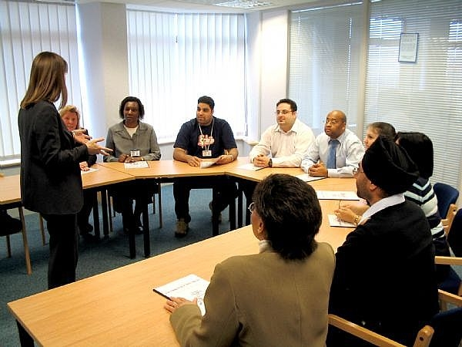
Hiring Process cont.
Set up workshops, Q&A sessions to promote our company’s core policies in addition to Diversity training.
Test their knowledge through questionnaires and web based exercises to ensure full comprehension of their role and our expectations.

Slide 13
Company Policy Agreement
Confidentiality Agreement- can specify that the confidential information is to be used only to evaluate the discloser's product and cannot be used in the recipient's business
Anti-Harassment Policy- harassment based upon an individual's sex, race, ethnicity, national origin, age, religion or any other legally protected characteristics will not be tolerated. All employees, including supervisors and other management personnel, are expected and required to abide by this policy.

Slide 14
Policy cont.
Drugs policy- All personnel are required to submit to job-related drug test, They may request independent testing of the same urine or blood sample for verification of the test results.
Subsequently all persons have the right to:
Be informed of the address of the laboratory that will test the specimen;
Provide any person who has tested positively and whose test results have been confirmed with the following information within 30 days of the date that the test was performed:

Slide 15
Policy cont.
A copy of the laboratory test including the test results;
A copy of this written policy on the use or abuse of controlled dangerous substances;
If applicable, written notice of the Company's intent to take disciplinary action or terminate employment.

Slide 16
Accident/Safety Policy
Safety belts shall be used by all students traveling in the vehicle including the instructors.
All accidents should be reported immediately to the local police department. Employees are responsible for reporting all accidents to their supervisor.
Do not use a telephone or text while driving. Stop the vehicle in a safe area to text or use a cell phone.

Slide 17
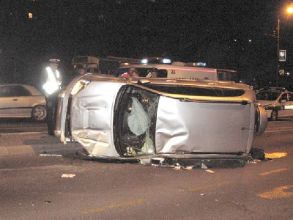
Accident/Safety cont.
Texting while driving is illegal in New York.
Drinking, possession of intoxicating liquor, illegal drugs in vehicles or driving while under the influence of alcohol or drugs is prohibited.

Slide 18
SKY Rules and Regulations
Driver's Education must be completed one (1) year from class start date.
Students must successfully complete 30 hours of classroom instruction. Students must pass each test with an 80% or better. Failure to accomplish this may result in a student having to repeat the classroom portion of the program for an additional fee.

Slide 19
Rules & Regulations cont.
Students are to be in the room and seated when roll is taken. Anyone arriving more than 15 minutes late, or habitually late will not be given credit for that session.
You will be allowed to miss up to four (4) classes, and must attend the session(s) that you have missed at a later time. Make-up of an absence may be made up during the appropriate day of the following session if space is available.

Slide 20
Rules & Regulations cont.
MISSING CLASSES WILL DELAY YOUR COMPLETION OF THE COURSE. Reasonable accommodations will be made for students with learning disabilities.
Show respect for your instructor and fellow classmates
NO CELL PHONES, NO TEXTING, NO PAGERS, NO HEADPHONES during class time or driving.

Slide 21
SKY Agreement Policy
I________________________, Agree to read, or have read to me, and will follow the rules and policies of SKY Driving School, Inc. I understand that failure to comply with these rules and policies may result in my dismissal from the program.
An understanding of the laws, a good safe attitude and the ability to be able to put the two together in a driving environment is SKY Driving School's goal.

Slide 22
Kareen Ejoh:
As the Office Manager my responsibilities revolve around the daily operations and functionality of the office, supervise office staff, maintaining office records. I am also the Accounting Manager for the business.

Slide 23
Office
Design and implement office policies
Establish standards and procedures
Organize office operations and procedures
Prepare time sheets
Review and approve supply orders
Update organizational memberships
Maintain office equipment

Slide 24
Staff
Assign and monitor clerical and secretarial functions
Recruit and select office staff
Orient and train employees
Provide on the job and other training opportunities
Evaluate staff performance through situational judgment tests, merit rating, and performance appraisal

Slide 25
Finance
Maintain day-to-day financial control of all services offered.
Ensure that all finances are properly administered and monitored, i.e. credit control.
Advise on the proper allocation of resources.
Ensure that appropriate financial regulations and controls are in place.

