Slide 1
T-mobile Family comes first.
Shawn Chowdhury

Slide 4
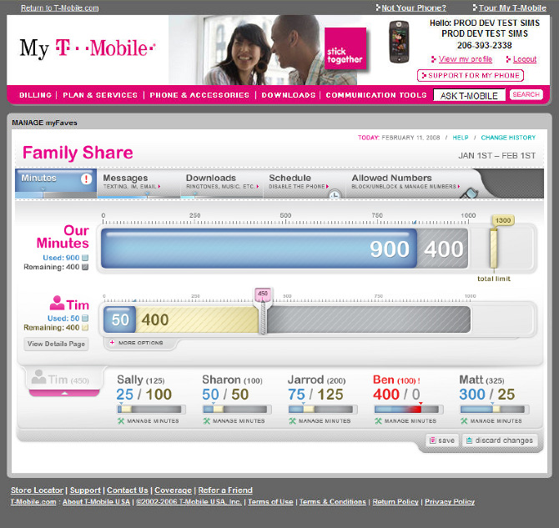
Introducing Family Allowance.

Slide 5
Six Major Principles Of Persuasion
Reciprocation
Commitment and Consistency
Social Proof
Authority
Liking
Scarcity

Slide 6
Simply by welcoming a parent to the store, they experience a sense of Reciprocation. Which will set a very positive environment right from the beginning. We ask the parent about their needs and values, what they do on a day to day basis, and if they enjoy their jobs if and how many children they have and how old their children are.
However sometimes an older parent will come into the store uninterested in the service wanting to be convinced. So the theory Commitment and Consistency will come in play. By praising them for making good past decision. Then following up with different ways to stress consistent values connecting old previously made actions and purchases with values underlying new actions and/or purchases made today. We can persuade older parents to get the service.
How to implement the Six principles.
According to Cialdini “People prefer to say ‘yes’ to those they know and like,” so by becoming more knowledgeable about the father or mothers prospects and existing preferences I’m given the upper hand on determining how to improve my sale while it’s in progress. After creating a sense of Liking and Reciprocation.
Social Proofing will come into play. More often than not T-Mobile employees will bring other parents into the conversation to ask them whether they enjoy the service or not. Without really knowing the outcome I have full confidence that the service is indeed good simply based on the positive environment previously created. This will make the parent more confident throughout the progression to getting their service.

Slide 7
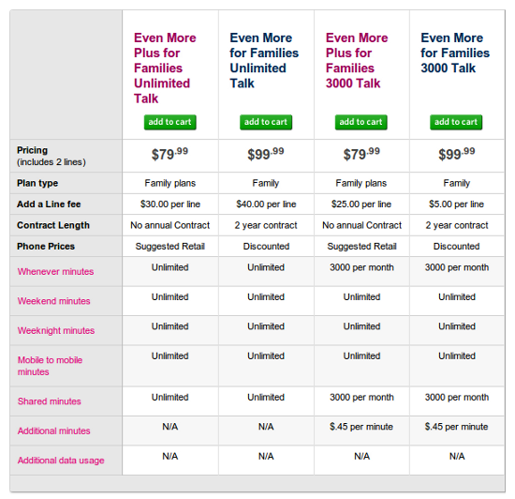
Old
Plans
Based
On
Individual
Needs

Slide 8
New
Plan
Based
on your Family Needs

Slide 9
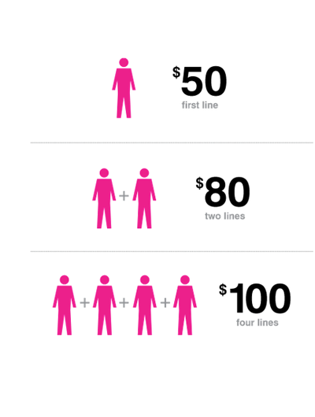

Slide 10
FIN

