Slide 1
Direct Fire The board game! Culmination Presentation
By:
Seku Burris

Slide 2
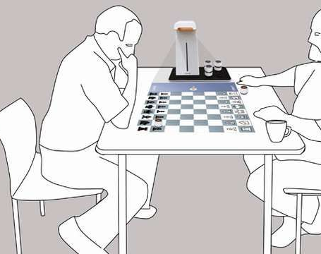
What is it?
Direct Fire is a 2-player, military based, strategy board game designed for kids 16 and up.
It is similar to the game of chess in that it requires you to think 1 step ahead of your opponent every turn.
Mistakes are heavily punishable and out maneuvering your opponent can easily put you in the lead if you are losing.
Prediction, timing and effectively using the effects of the board and the effects of the units is crucial to winning the game.

Slide 3
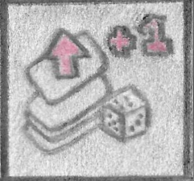
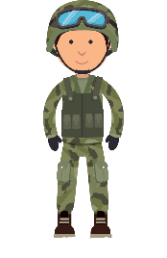
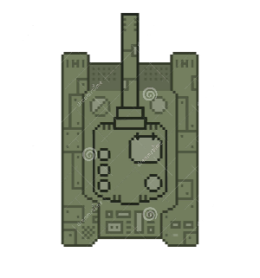
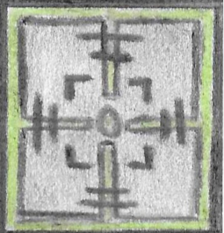
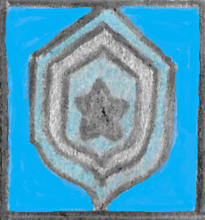
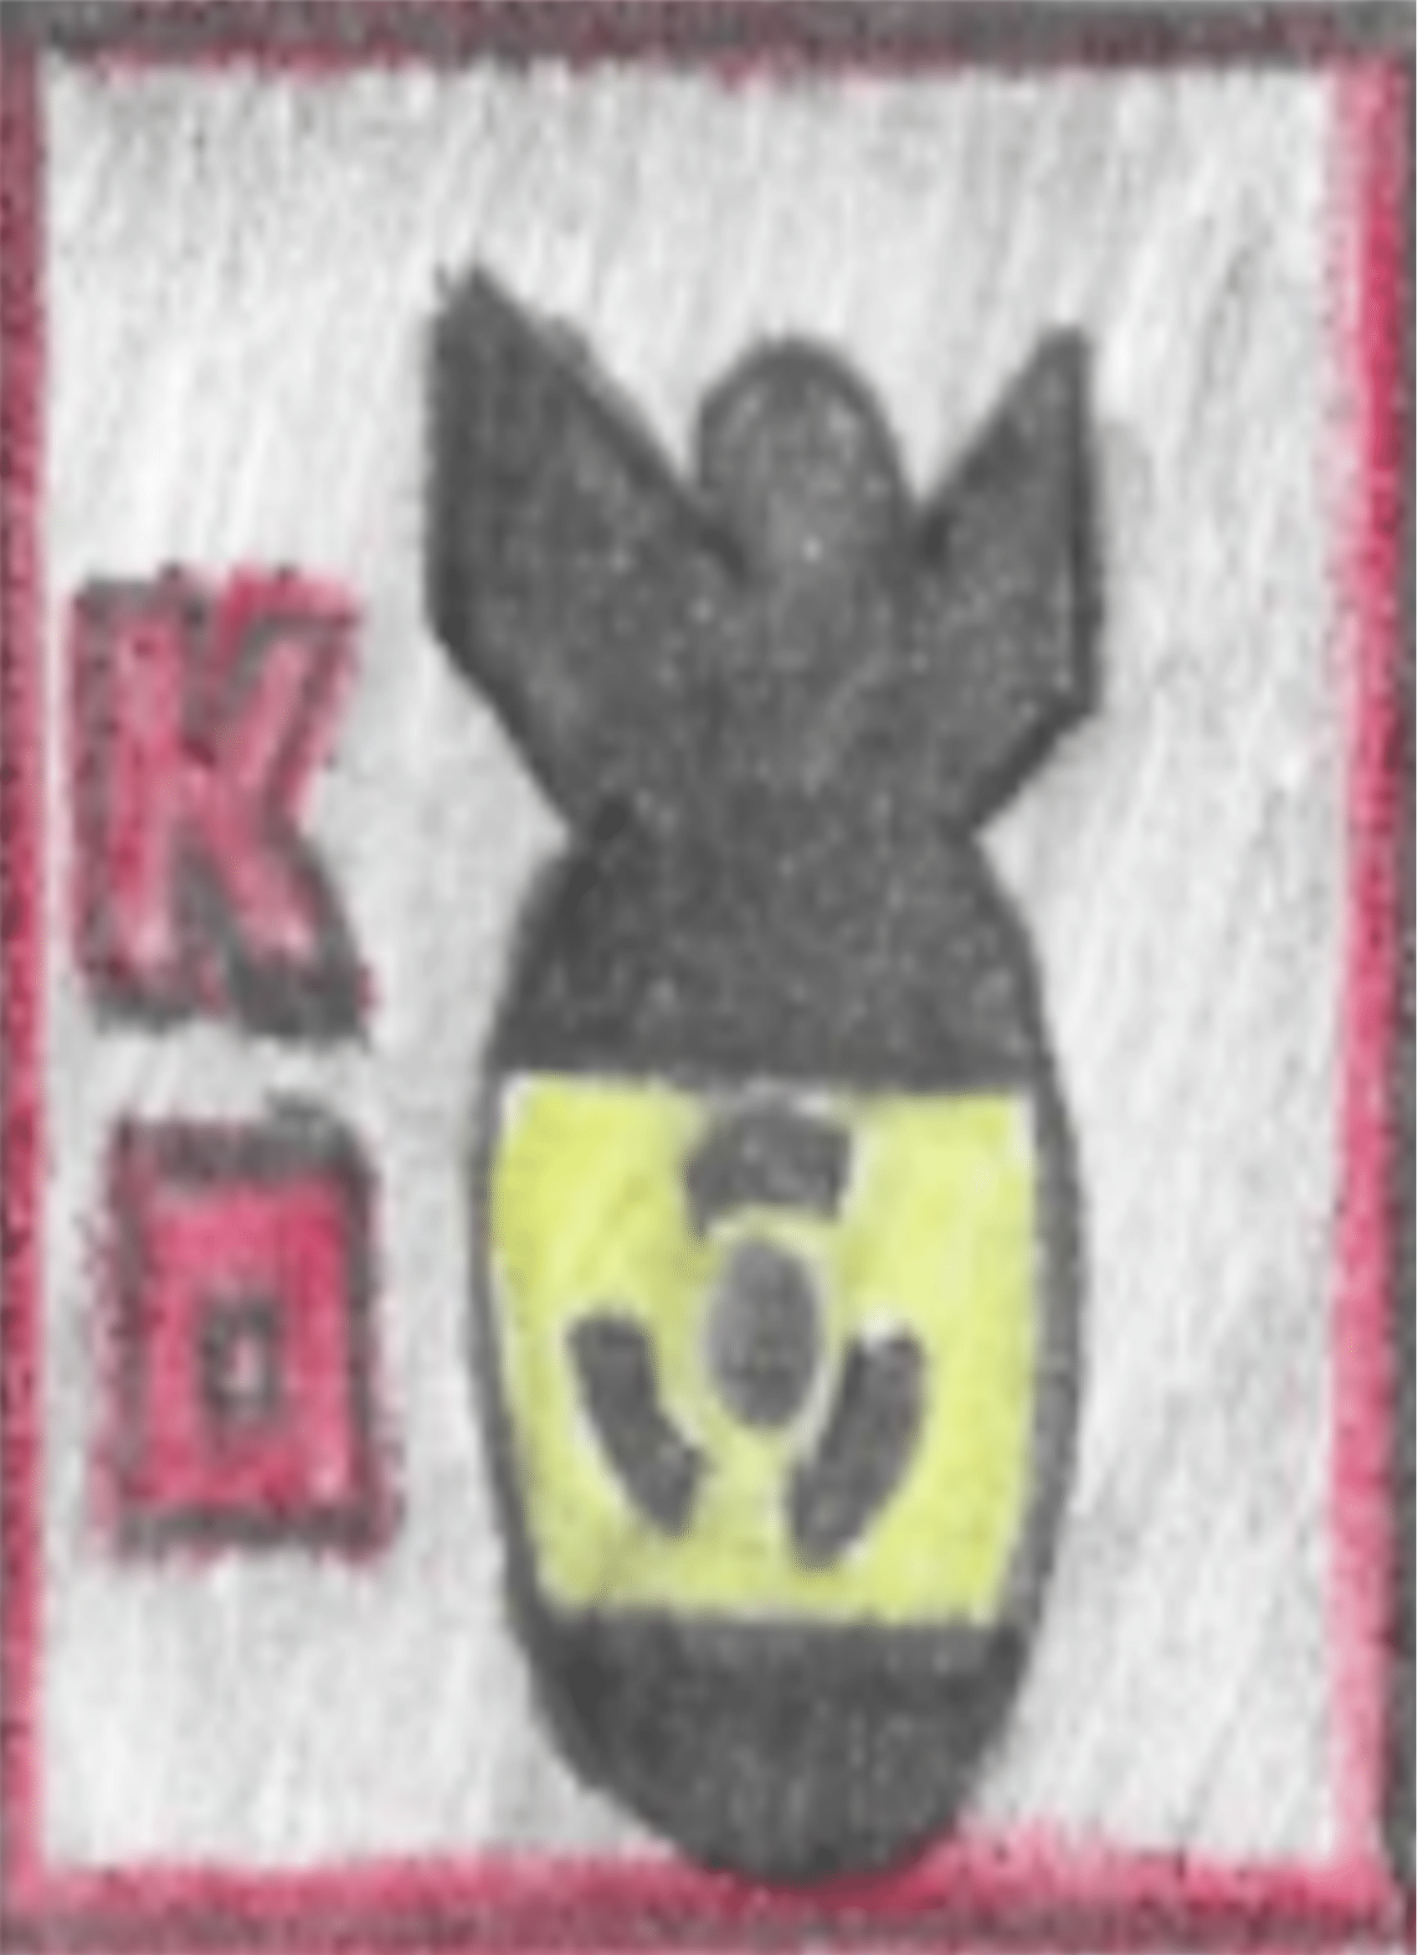
Board Effects, Abilities and Units
The +1 Square allows you to move 1 additional 6 Soldiers! 6 Tanks!
Unit during your turn
The attack square allow you to attack your
Opponents when you land on it.
Soldiers that land on the bunker square are
safe from all attacks.
The Nuke square can be used to automatically
win the game… If you can manage to land on it.

Slide 4
Win condition!
First person to get Nuked or lose all their piece LOSES

Slide 5
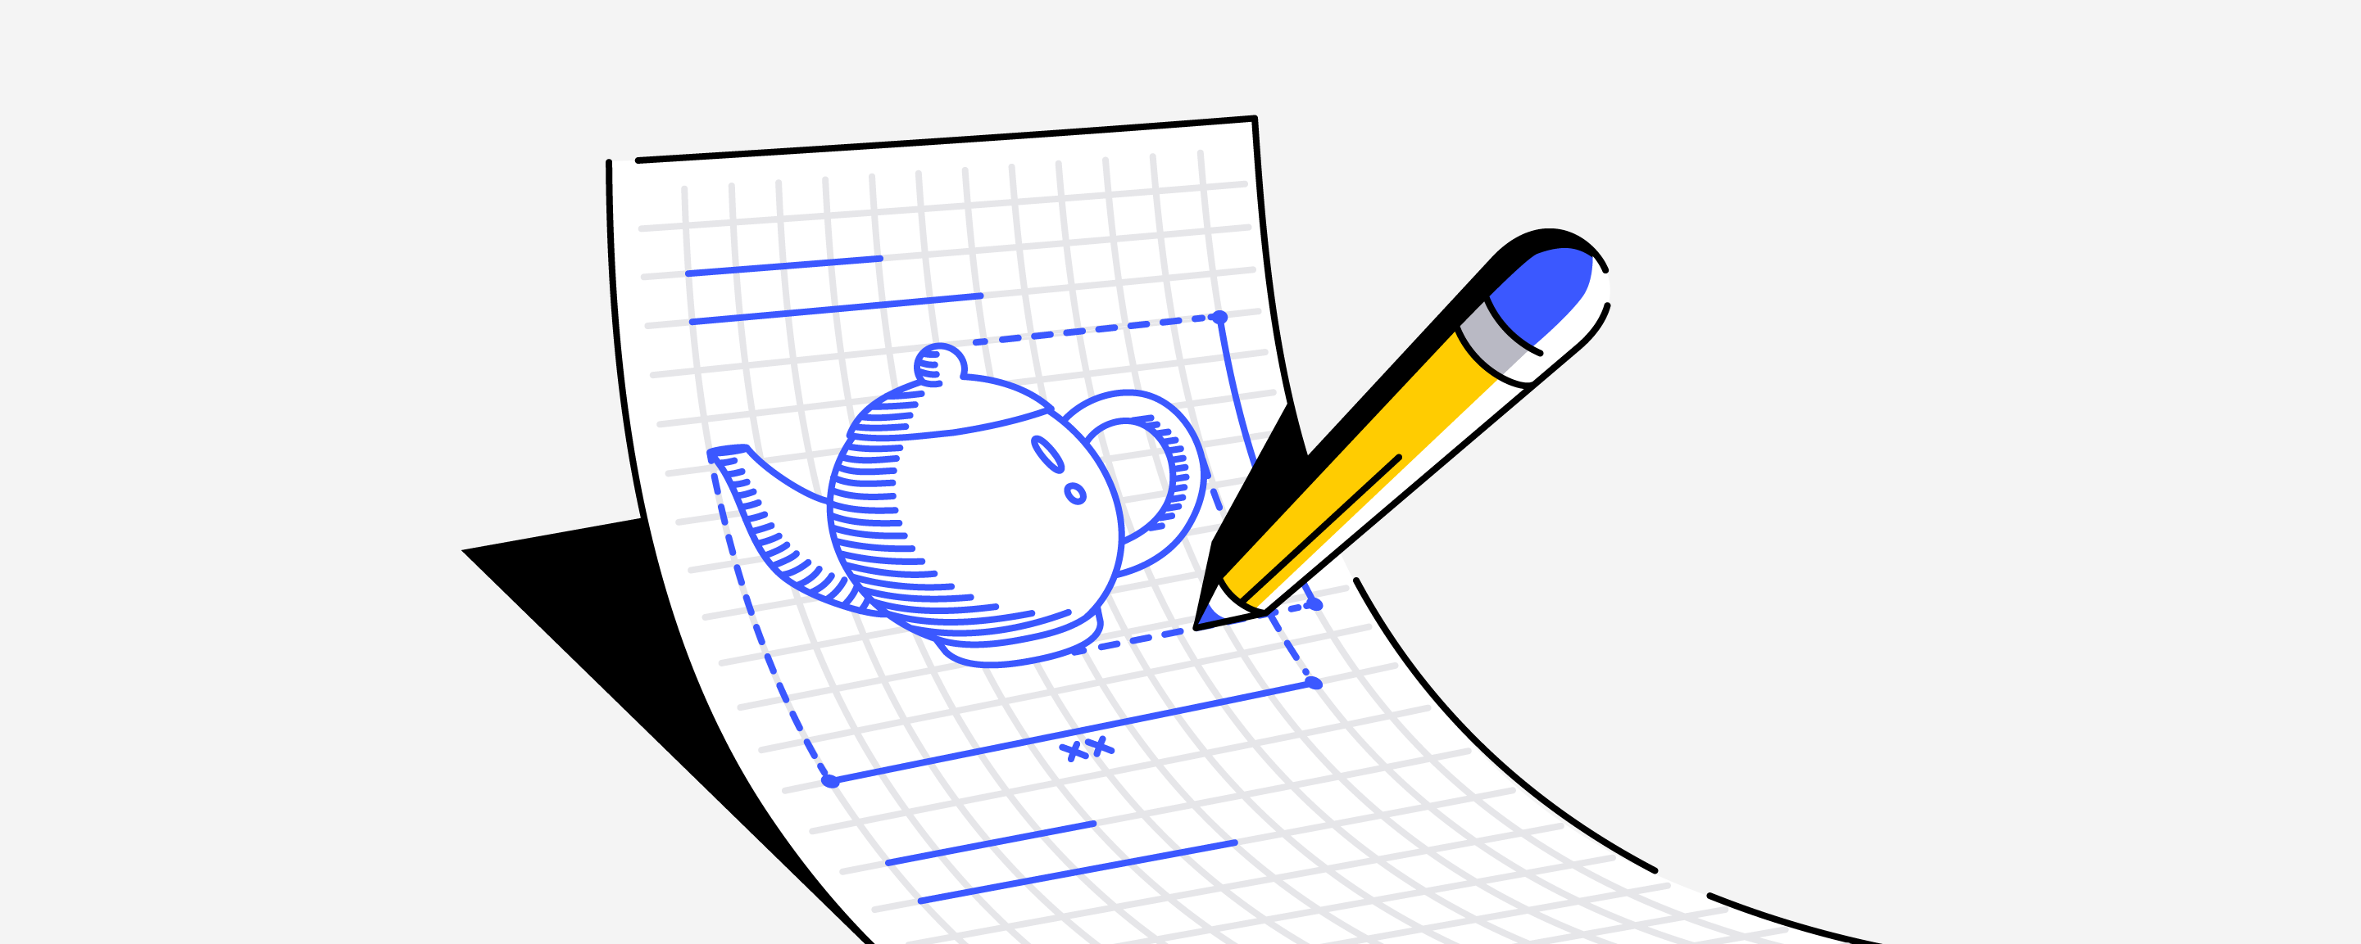
The idea
This was actually a game I came up with when I was young. However, when I was young the idea was never refined. When I designed the game that first time it only had 1 or 2 board effects and the game play strategy was way less complex. Effects and abilities could not stack and be used to create game changed combinations as they can in this game.
Additionally, the game didn’t require as much prediction in order to win and the board itself was way larger.
Lastly, the game never made it to a fully colored version, with 3-dimensional plastic models like this one did. I used paper with drawings on them and pennies to represent the units.

Slide 6
Improvements!
One of the main differences between this new version and the one I made when I was younger was the play testing sample size. I was able to make a lot improvements and changes to the game because I was able to learn what made the game bad as I watched different people play it over and over.

Slide 7
Making the new Game!
The game started off with just 2 board effects but as I play tested more and more I added several more. This was to make the game more interesting and to break up the monotony of it.
I decided to add 2 distinct units that had different abilities. These units were soldiers and tanks, and each unit is better in different situations. Additionally, this forces the player to use their resources wisely because moving the right unit at the right time can be the difference between winning and losing the game. This added another interesting level of complexity to the game.
I decided to invest in some plastic pieces to make the game feel more realistic and immersive. This also made the game feel more rewarding because removing a plastic 3d piece of plastic tank from the board after destroying it feels way better than removing a piece of paper.

Slide 8
Making the new Game!
After some more play testing I decided to add some more rules and restrictions to the game in order to prevent players from abusing certain mechanics and overpowered combinations. When creating complex games, one must always be on the look out for potential exploitations that may have slipped under the radar.
After reaching a point where I felt confident in the stability and solidness of the game mechanics, I decided to color game. This was done really to make it feel more official and immersive during game play.
Also, pretty much during this entire time, I was being advised by my culmination advisor Josni. So, he was giving me additional insight on how I could further improve my game.

Slide 9
Making the new Game!
Once I colored the game by hand, I scanned it into the computer so I could make any additional visual changes or edits digitally. This helped a lot because I was able to use image editing software to make changes to the board game without having to redraw the entire thing every single time.
On top of that once I had a more finalized version, I took my board game to staples and got it reprinted using the large format printer. This is because the game is larger than your standard sized computer paper and I had to staple multiple pieces of paper together every time I printed the game at home using my regular printer in order for the board to be laid down as one piece.

Slide 10
Making the new Game!
After getting the game reprinted, I attached it to some black chip board and colored the borders to make everything look more cohesive. The chipboard also added to the sturdiness of the game because the paper tended to fold and rip very easily with a solid backing.
Next, I worked on formulating the instructions and making them as clear as possible. This was something I was struggling with during the entire project because the game is so complex. There are so many overlapping effects and rules that it was hard to explain all of them in an easy understand way.
However, I did manage to finally create a pretty clear version of the instructions that people were able to MOSTLY understand after several attempts.

Slide 11
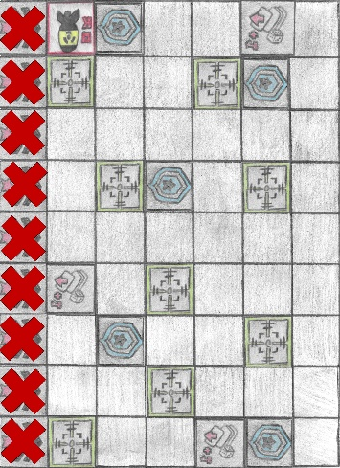
SHOW GAME!

Slide 12
Conclusion!
In conclusion this was something I’ve always wanted to do since I was young and first thought of this game. I enjoyed the process of making the game and I want to say thank you to Josni for helping me complete my culmination project!

