Slide 1
XEROX DIRECT Where you find the best Printers for your office and home.

Slide 2
Xerox Company Overview
The Xerox company sells their many of products through the Internet.
The Xerox company specializes in making and selling documents systems and services for business.
The company distributes a range of color, and black-and-white multifunction's devices.
Devices such as, printers, copier fax products, and document related software solutions.

Slide 3
Year founded?
In 1906 Xerox was founded as the Haloid Photographic Company.
The company size is 136,500 employees worldwide as of year 2010.
The headquarters is located at 45 Glover Avenue, P.O. Box 4505, Norwalk, Connecticut.

Slide 4
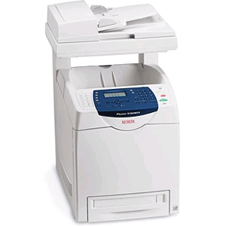
Phaser 6180MFP Printer
The Phaser Printer can hold a large amount of paper at once, 400 sheets to be exact, and can print on paper, transparencies via overhead, envelopes cards, labels, banners, coated paper, and bond paper.
The print speed for color is up 20 ppm and for black is up to 31 ppm.
Color standard PANTONE color aprroved.
Print features such as Banner sheet, Booklet printing, N-up, Overlays, Poster Printing.
Scan drivers for this printer are TWAIN, and WIA.
Scan file formats- JPEG, PDF, TIFF.
The cost of this Phaser printer comes up to $ 699.00

Slide 5
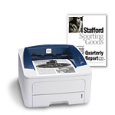
Phaser 3250
The Phaser 3250 has a standard paper capacity of 250 sheet tray plus one-sheet multipurpose tray.
Maximum paper size: legal 8.5 x14 inches and up to 30 ppm.
32 MB memory standard, 160 MB maximum and a 400 MHz processor.
Two-sided printing standard on all configurations.

Slide 6
Xerox History
1970 Xerox opened the Xerox PARC (Xerox Palo Alto Research Center) research facility.
1973 Xerox created the Xerox Alto, a small minicomputer.
1979 Xerox open its door to anyone in the industry and press.
1980s-1990s Xerox was going bankrupt.

Slide 7
Xerox History
1906 founded as the Haloid Company: named Haloid Xerox in 1958; named Xerox Corporation in 1961.
1959 introduced Xerox 914, the first plain paper photocopier using the process of Electro-photography later known as xerography.
1963 Xerox introduced the Xerox 813, the first desktop plain-paper copier.
1969 Xerox research Gary Stark weather modified a Xerox copier in which he made the first laser printer.

Slide 8
Strengths/Weakness
Xerox is a powerful American that keeps growing everyday.
Xerox operates in more than 160 countries.
Provides the world with new technology solutions and equipment.
Xerox is losing market shares with other companies such as Eastman Kodak and with their NexPress SX series lines of Presses.
Xerox one day was in bankrupt.

Slide 9
Competitors/ Key Financial
Some the competitors for the Xerox company are:
Canon, Hewlett-Packard, Ricoh Company,
Brother Industries, Eastman Kodak, Fujitsu,
Lexmark, FUJIFILM, Heidelberger Druckmaschinen and Epson.
As of 2010 Revenue: $21.633 billion
As of 2010 Net Income: $1.296 billion

Slide 10
References
http://en.wikipedia.org/wiki/Xerox
http://www.xerox.com/
http://www.xerox.com/digital-printing/enus.html
http://www.nytimes.com/2008/01/07/business/07cnd-adco.html
http://americanhistory.si.edu/collections/object.cfm?key=35&objkey=191
http://www.xerox.com/about-xerox/contact-us/enus.html#corporate
http://www.lexisnexis.com/hottopics/lnacademic/?verb=sf&sfi=AC00NBGenSrch

