Slide 1
Database Administration Overview
Oracle Database Administration Course by Ashwin Satyanarayana is licensed under a Creative Commons Attribution-NonCommercial 4.0 International License.

Slide 2
Objectives
Define database administration.
Understand database administration tasks.
Perform database administration tasks using Oracle 11g Enterprise Manager.
Understand Oracle 11g and SQL Server data storage structures.

Slide 3
Duties of the DBA
Manage Database Objects – Tables / Views / Procedures
Database performance
Security – Logons /Users / Roles
Clone data from Production to Development or Test
Manage backups and carry out DR plans.

Slide 4
Oracle Enterprise Manager
User account must have DBA role
Oracle Enterprise Manager (OEM)
Three-tier architecture
Console
Oracle Management Server (OMS)
Interacts with repository
Makes it easier for DBAs to administer multiple databases in organization’s network

Slide 5
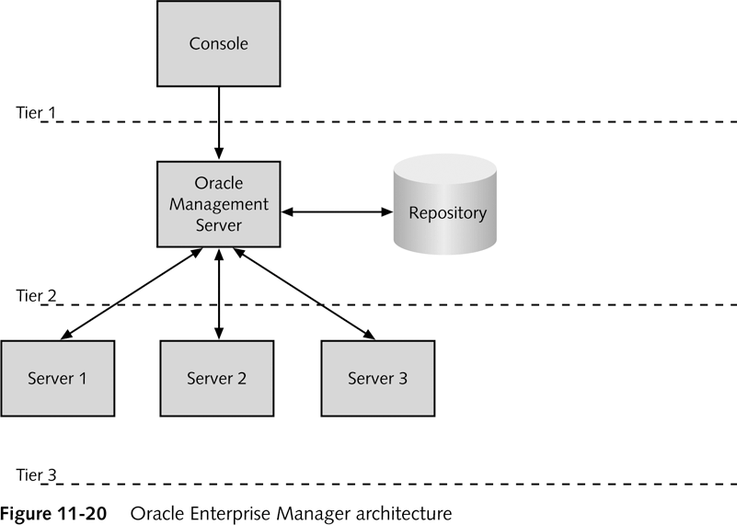
OEM Architecture

Slide 6
Managing Oracle 11g Data Storage
Like most DBMS’s structures
Tables
Constraints
Views / Procedures
Can be stored in physical data structures
Files on disk
Dedicated drive partitions
RAM

Slide 7
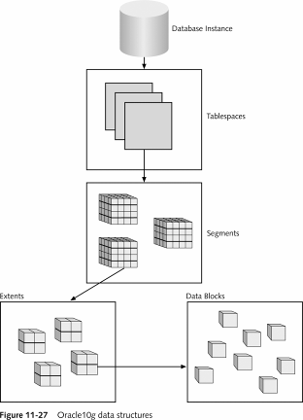
Oracle 11g Data Structures
Tablespace
One or more Data Files
Segment
Partitioned Data
Extent
Growth rule for segment
Data block
Database storage data block
Operating system blocks

Slide 8
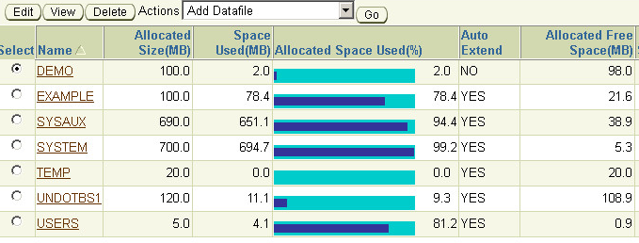
Tablespaces
One or more Data files
Stores all database structures + data
Tables, data, views, sp’s etc…

Slide 9
Datafiles
.dbf extensions
Store tablespace contents
Stored in Oracle_Base\oradata\SID
Use OEM to view and modify
Grow via Extents

Slide 10
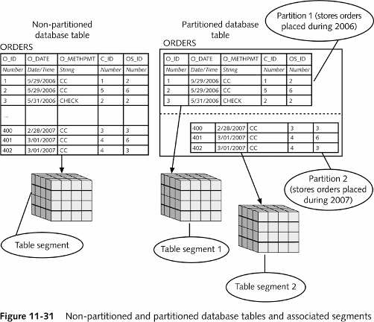
Segments – They Partition the data

Slide 11
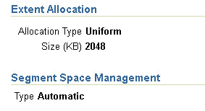
Extents – Smallest unit added to data file
Sequence of Data Blocks
When an insert grows beyond the data file size allocation, a new extent is added.
More efficient to add groups of data blocks vs. individual blocks.

Slide 12
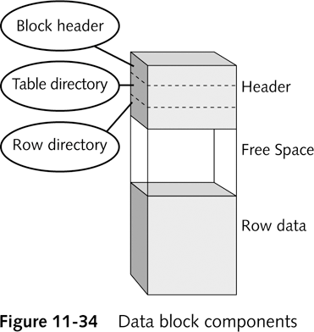
Data Blocks – Smallest Unit Read/Written

Slide 13
Managing Oracle 11g Data Structures
Create tablespace
Manage datafile extents
Autoextensible tablespace
Configure tablespace and datafile properties

Slide 14
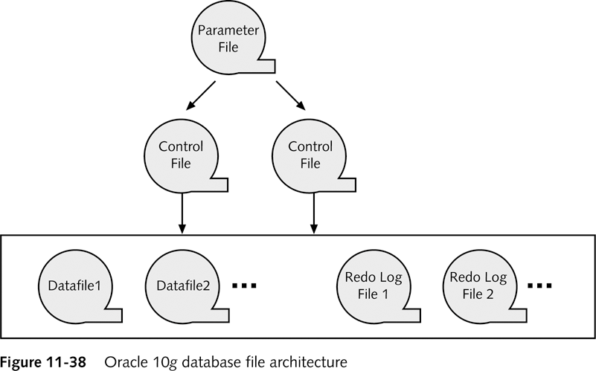
Oracle 11g Database File Architecture

Slide 15
Parameter File
Text file
Specifies configuration information about Oracle 10g database instance
init.ora
Stored in Oracle_Base\admin\SID\pfile folder
DBAs can edit parameter file
Modify database configuration

Slide 16
Control Files
Store information about database structure and state
Stored in Oracle_Base\oradata\SID
Three separate control files by default:
CONTROL01.CTL
CONTROL02.CTL
CONTROL03.CTL
All contain same data
At least one must be present

Slide 17
Redo Log Files
Records information to undo action query changes
.log extension
Stored in Oracle_Base\ORADATA\SID
Pre-image
Rollback segment

Slide 18
User Accounts

Slide 19
Creating and Managing User Accounts
Create new user account
General information about user account
System privileges user has in database
User’s tablespace quota on database server

Slide 20
Specifying General User Information
Use OEM
General page:
Name
Profile
Authentication
Default tablespace
Temporary tablespace
Status

Slide 21
Specifying System Privileges
System privilege
Object privilege
Enable new user to interact with Oracle 10g database
DBA grants system privileges
Use System Privileges page in Create User page
Admin Option

Slide 22
Tablespace Quotas
Specifies amount of disk space that user’s database objects can occupy in default tablespace
Must be assigned
Quota Size value:
None, default
Unlimited
Value

Slide 23
Editing Existing User Accounts
Use OEM
Select user account to be modified on Users page
General page opens
Select other links to modify properties

Slide 24
Roles
Database object
Represents collection of system privileges
Assign to multiple users
Create role
Can inherit privileges from other roles
Grant Role to User Account
Easier than manually assigning everything manually.

Slide 25
Startup / Shutdown

Slide 26
Starting /Shutting Down the Db
Shut down database periodically
Perform maintenance
Restart database

Slide 27
Creating an Administrative Connection
Shutting down database makes database unavailable for user connections
DBA must log onto database using administrative connection
SYS user account

Slide 28
Using OEM to Shut Down and Start a Database Instance
DBA shuts down database instance using Normal, Transactional, or Immediate shutdown option
Shutdown process performs five following tasks:
Writes contents of data buffer cache to datafiles
Writes contents of redo log buffer to redo log files
Closes all files
Stops all background processes
Deallocates SGA in server’s main memory

Slide 29
Instance Options
Startup
Shutdown
Start in one of two modes:
Unrestricted
Restricted
Specify one of four ways to handle existing user connections:
Normal
Transactional
Immediate
Abort

Slide 30
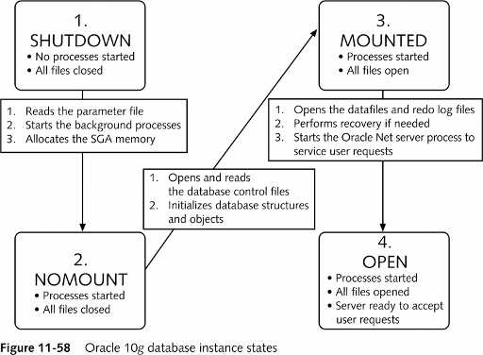
Oracle 11g Database Instance States

Slide 31
Overview
Control files
Redo log files
Data files
Database

Slide 32
Database Structure
Database
Tablespace
Data file
Logical
Segment
Physical
Extent
Oracle block
O/S Block

Slide 33
Database Hierarchy
Database Architecture
Physical: control, data, redo log, etc. files
Logical: tablespaces, segments, etc.
Tablespaces
Place to store tables
One or more OS files
One or more segments
Can be brought online “live”
Can be taken offline “live”
SYSTEM tablespace is important

Slide 34
Database Hierarchy (cont.)
Datafile
Belong to one tablespace
DBA can change size
Segments
One or more in a tablespace
Made up of one or more extents
Cannot span tablespaces
Can span multiple datafiles
Allocated for an object (e.g., table)
Extents
Set of contiguous Oracle blocks; as segment grows extents are added; May not span datafiles

Slide 35
Database Hierarchy (cont.)
Data Blocks
Finest level of granularity
Data stored in blocks
Smallest unit of storage that Oracle can allocate, read/write
One data block = multiple of OS block
DB_BLOCK_SIZE sets the size

Slide 36
SYSTEM and Non-SYSTEM Tablespaces
SYSTEM Tablespace -created with database
contains:
Data dictionary information
SYSTEM rollback segment
SYS, SYSTEM objects
Should not contain user data
Non-SYSTEM Tablespace contains:
Rollback segments
Temporary segments
Application data
Application indexes
Other user objects

Slide 37
Creating Tablespaces
Example
CREATE TABLESPACE app_data
DATAFILE ‘/DISK4/app01.dbf’ SIZE 100M,
‘/DISK5/app02.dbf’ SIZE 100M
EXTENT MANAGEMENT DICTIONARY
MINIMUM EXTENT 500K
DEFAULT STORAGE (INITIAL 500K NEXT 500K MAXEXTENTS 500 PCTINCREASE 0);
Select * from user_users
- see what your default ts is

Slide 38
Storage Parameters
The following parameters influence the segment storage allocation:
INITIAL: Amount of space alloc. for the first extent
NEXT: Amount of space alloc. for 2nd + rest extent
MAXEXTENTS
MINEXTENTS
PCTINCREASE
(NEXT = NEXT + PCTINCREASE*NEXT)

Slide 39
Space Management in TS
Dictionary-managed tablespaces:
Free extents recorded in data dictionary
Oracle use the data dictionary (tables in the SYS schema) to track allocated and free extents for tablespaces. Free space is recorded in the SYS.FET$ table, and used space in the SYS.UET$ table.
Locally managed tablespaces:
Free extents recorded in bitmap
Each bit corresponds to a data block or group of blocks
Bit value indicates free or used

Slide 40
Locally Managed Tablespaces
CREATE TABLESPACE user_data
DATAFILE ‘/u1/user_data.dbf’ SIZE 500M
EXTENT MANAGEMENT LOCAL
UNIFORM SIZE 10M [or AUTOALLOCATE];

Slide 41
Locally Managed Tablespaces
In a locally-managed tablespace, space management tasks are handled by bitmaps stored within the tablespace itself.
A bitmap is used to keep track of the block status in each datafile, whether they are free or used. Each bit in the bitmap maps to a block or a group of blocks in the datafile.

Slide 42
Allocation Types in LMTs
Allocation type specifies how the extent is being allocated by the system.
SYSTEM (AUTOALLOCATE)- Oracle manages the space. The extents are auto allocated by the system based on an internal algorithm. Allocation of extents is managed at the datafile level and such tablespaces will not compete for ST enqueue. Such tablespaces would have extents of varying sizes and would result in fragmentation and some space being wasted. This is a good alternative if the extent sizes of the various objects to be placed in the tablespace cannot be determined.
UNIFORM- All extents are of fixed size in the system. The size is provided when creating the LMT. This type gives all the benefits offered by LMT and one should aim at achieving this. The default size is 1M.

Slide 43
Convert between LMT and DMT
The DBMS_SPACE_ADMIN package allows DBAs to quickly and easily convert between LMT and DMT mode. Look at these examples:
SQL> exec dbms_space_admin.Tablespace_Migrate_TO_Local('ts1');
PL/SQL procedure successfully completed.
SQL> exec dbms_space_admin.Tablespace_Migrate_FROM_Local('ts2');
PL/SQL procedure successfully completed.

Slide 44
OMF and Tablespace
Any tablespace can be created using OMF, even the SYSTEM tablespace.
Achieved by setting the database parameter: db_create_file_dest parameter.
The default size for any OMF is 100M, and the datafile(s) are set to "AUTOEXTEND ON" with an "UNLIMITED maximum extent".
You can define a file size other than 100M for a datafile by including the DATAFILE keyword, and then including the SIZE parameter (without the filename)

Slide 45
OMF and Tablespace (cont.)
CREATE TABLESPACE new_tbs DATAFILE SIZE 500M AUTOEXTEND OFF;
CREATE TABLESPACE new_tbs DATAFILE SIZE 500M, SIZE 500M AUTOEXTEND OFF;
Uses two datafiles
When tablespaces fill DBA can create additional datafile: ALTER TABLESPACE ADD DATAFILE... command. (don’t give file name for OMF)
When you drop a tablespace that contains OMF, Oracle will remove the OMFs associated with that tablespace from the operating system.

Slide 46
OMF and Tablespace (cont.)
You can mix and match OMF with manually defined ones.
CREATE TABLESPACE new_tbs DATAFILE SIZE 500M, '/u10/MYDB/new_tbs02.dbf' SIZE 500M AUTOEXTEND off; (two datafiles; one OMF)
Oracle will create both the OMF and the manually defined datafile. If you drop the tablespace, Oracle will remove only the OMF, and the DBA will need to manually remove all datafiles that are not Oracle managed.
Can be extended to existing tablespaces that use manually created datafiles (For example, adding additional OMFs to an existing tablespace)

Slide 47
OMF and Tablespace (cont.)
Examples:
CREATE TABLESPACE auto_created_tbs;
CREATE TABLESPACE bigger_tbs DATAFILE 200M NOEXTEND;
Changing location of datafiles
ALTER SYSTEM SET db_create_file_dest = '/u10/app/oradata/MYDB';
CREATE TABLESPACE new_tbs DATAFILE SIZE 150M NOEXTEND;

Slide 48
Temporary Tablespace
Used for sort operations
Cannot contain any permanent objects
CREATE TABLESPACE sort
DATAFILE ‘/DISK2/sort01.dbf’ SIZE 50M
MINIMUM EXTENT 1M
DEFAULT STORAGE (INITIAL 2M NEXT 2M MAXEXTENTS 500 PCTINCREASE 0)
TEMPORARY;

Slide 49
Locally Managed Temporary Tablespace
Cannot use previous syntax
CREATE TEMPORARY TABLESPACE TEMP_TS TEMPFILE 'temp01.dbf' SIZE 256M EXTENT MANAGEMENT LOCAL UNIFORM SIZE 256K;
to alter and add another datafile
ALTER TABLESPACE TEMP ADD TEMPFILE ‘TEMP2.DBF’ SIZE 200M

Slide 50
Locally Managed Temporary Tablespace
Autoallcation is not allowed for temporary tablespace.
Temporary tablespaces should have fixed sized extents. Autoallocate would not make sense since extents, once allocated, are not freed -- the system manages them internally. You would have a lot of different sized extents being managed and that would just not be a good thing. They should be the same size and should be the sort_area_size

Slide 51
Adding Data Files to a Tablespace
Example
ALTER TABLESPACE app_data
ADD DATAFILE
‘/DISK5/app03.dbf’ SIZE 200M;
Tablespace APP_DATA
app01.dbf 1M
app02.dbf 1M
app03.dbf 2M

Slide 52
Adding Data Files to a Temporary Tablespace
- use the word TEMPFILE
ALTER TABLESPACE temp
ADD TEMPFILE
‘/DISK5/app03.dbf’ SIZE 200M;

Slide 53
Enabling Automatic Extension of Data Files
Example
ALTER TABLESPACE app_data
ADD DATAFILE
‘/DISK6/app04.dbf’ SIZE 200M
AUTOEXTEND ON NEXT 10M
MAXSIZE 500M;
Tablespace APP_ DATA
app01.dbf 1M
app02.dbf 1M
app03.dbf 2M
app04.dbf 2M

Slide 54
Changing the Size of Data Files Manually
Example
ALTER DATABASE DATAFILE ‘/DISK5/app02.dbf’ RESIZE 200M;
Tablespace APP_DATA
app01.dbf 1M
app02.dbf 1M
1M

Slide 55
Changing the Storage Settings
Example
ALTER TABLESPACE app_data
MINIMUM EXTENT 2M;
ALTER TABLESPACE app_data
DEFAULT STORAGE
(INITIAL 2M NEXT 2M
MAXEXTENTS 999);

Slide 56
OFFLINE Status
The tablespace that is offline is not available for data access.
The SYSTEM tablespace and any tablespace with active rollback segments cannot be taken offline.
Example
ALTER TABLESPACE app_data OFFLINE;

Slide 57
Moving Data Files: ALTER TABLESPACE
The tablespace APP_DATA must be offline.
The target data files must exist.
Example
ALTER TABLESPACE app_data RENAME DATAFILE ‘/DISK4/app01.dbf’ TO ‘/DISK5/app01.dbf’;

Slide 58
Moving Data Files:ALTER DATABASE
The database must be mounted.
The target data file must exist.
Example
ALTER DATABASE RENAME FILE ‘/DISK1/system01.dbf’ TO ‘/DISK2/system01.dbf’;

Slide 59
The READ-ONLY Tablespace Status
Example
ALTER TABLESPACE app_data READ ONLY;
The tablespace APP_DATA is only available for read operations.
Objects can be dropped

Slide 60
Making Tablespace Read-Only
The tablespace must be online.
No active transactions are allowed (prior to release 8i)
8i allows current trans. to complete
The tablespace must not contain active rollback segments.
The tablespace must not currently be involved in an online backup.

Slide 61
Dropping Tablespaces
The following statement removes the APP_DATA tablespace and all its contents.
Example
DROP TABLESPACE app_data
INCLUDING CONTENTS;

Slide 62
Obtaining Tablespace Information
DBA_TABLESPACES (V$TABLESPACE)
TABLESPACE_NAME
NEXT_EXTENT
MAX_EXTENTS
PCT_INCREASE
MIN_EXTLEN
STATUS
CONTENTS

Slide 63
Obtaining Data File Information
DBA_DATA_FILES (V$DATAFILE)
FILE_NAME
TABLESPACE_NAME
BYTES
AUTOEXTENSIBLE
MAXBYTES
INCREMENT_BY

Slide 64
Obtaining Data File and Tablespace Information from the Control File
V$DATAFILE
- TS# - NAME - FILE# - RFILE# - STATUS - ENABLED - BYTES - CREATE_BYTES
V$TABLESPACE
- TS# - NAME

Slide 65
Guidelines
Use multiple tablespaces.
Specify storage parameters for tablespaces.
Assign tablespace quotas to users.
Use locally managed tablespaces
Can have 1023 data files/tablespace
Notes:
Lesson Aim
<Enter lesson aim here.>

Slide 66
Summary
Understanding the logical database structure
Administering tablespaces

Slide 67
Review Questions
Create a dictionary managed tablespace dict_tbs with the datafiles app01.dbf of SIZE 200M and app02.dbf of size 300M, Minimum Extent 100K, Initial 100K, Next 200K, Maxextents 200
Create a locally managed tablespace with the datafile app03.dbf of size 300M autoallocated.
Add a new datafile to dict_tbs tablespace called app03.dbf of size 400M
Create a locally managed temporary tables loc_temp_tbs with tempfile temp1.dbf of size 400K with uniform size (extent management) of 256K? Can we use autoallocate in this case?

Slide 68
Review Questions
Add a new temporary file to the loc_temp_tbs tabespace called temp-2.dbf of size 260K
Resize the datafile app01.dbf to 300M
Rename the datafile app01.dbf to app02.dbf
Make the tablespace dict_tbs offline and read only.
Drop the tablespace dict_tbs including all its contents

Slide 69
Questions?

