Slide 1
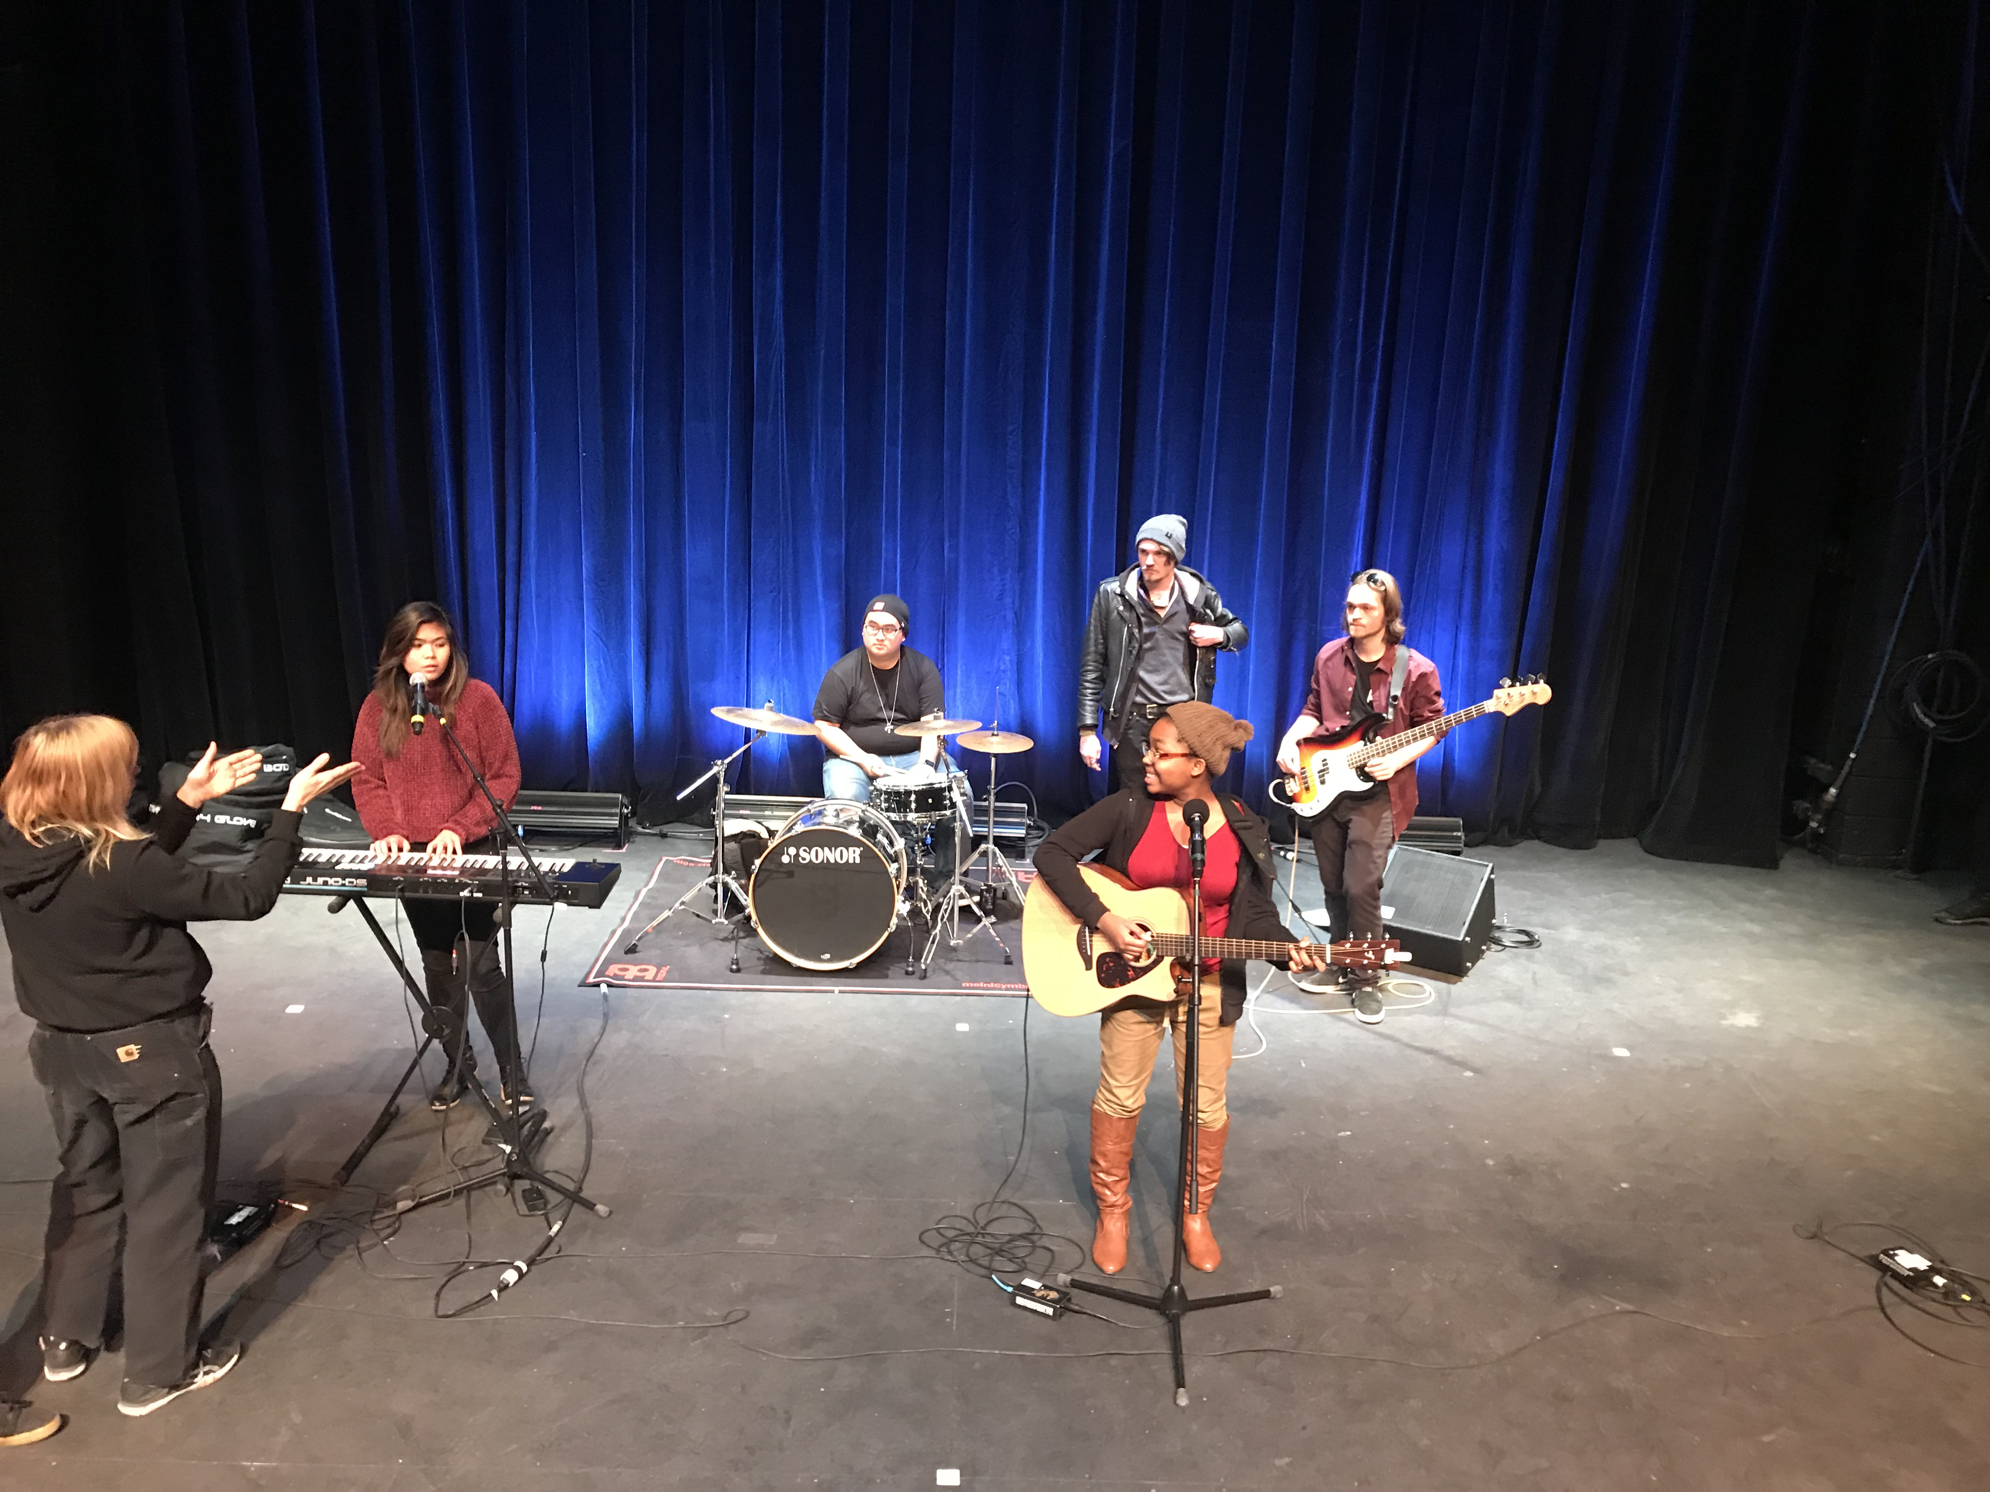
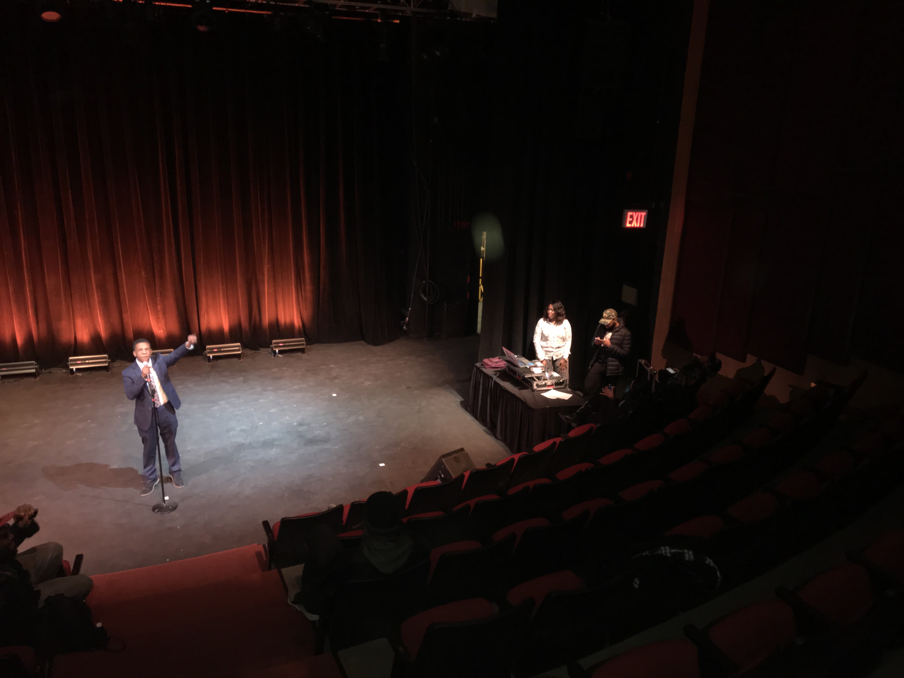
SpotLight 2017 Samuel Louis Jean/ Stage Manager Department of Entertainment Technology
Introduction example
For my culmination I will be the stage manager of Citytech’s talent show called Spot Light. The Stage Manager is a key position in any successful production. It has a unique function because it serves the dual function of guiding the student government production staff during the rehearsal period and then becomes the person in charge of the production during the actual performance.
The skills include:
1. The ability to work quickly and methodically.
Planning and coordinate meetings
Effective communications skills
The Process
meet with SGA and establish roles and responsibilities
coordinate production meetings
create calendar
establish deadlines
Create prompt book
Run rehearsals
Call show
PRODUCTION PHOTOS
Conclusion
After concluding all meetings, and rehearsals, I’d have to say that we had a successful show, mainly because we had an effective pro production. There were few adversities, and challenges during the process, but I was able to overcome those challenges due to efficient preparations. I look forward to Stage Managing many more shows.
Method Example:
Enforce safety in the theatre
Run Rehearsals
Meeting notes
Rehearsal notes
Contact sheets
Calendar
Liaison with SGA
Creating open lab call board
Prompt book
Load-in schedule
2. Procedural system of communication
and documentation
Transparent information sharing
Email
Texting
Wiki
Face to face meetings
Results
What happened
we had a successful show. The meetings before each helped us prepared & organized everything.
Show started on time
SGA was impressed with how the show turned out
Overcame all challenges
Show ended on time
Literature
Project Management class
Culmination class
Hypothesis
Was this project challenging?
The entire process is incredibly hard. it’s never easy. There are many variables and therefore many possible things that could go wrong.
Doing the prompt was the most challenging task because I had to wait on feedback from SGA regarding the performer’s technical needs.
Acknowledgements
Susan Brandt

