Slide 1
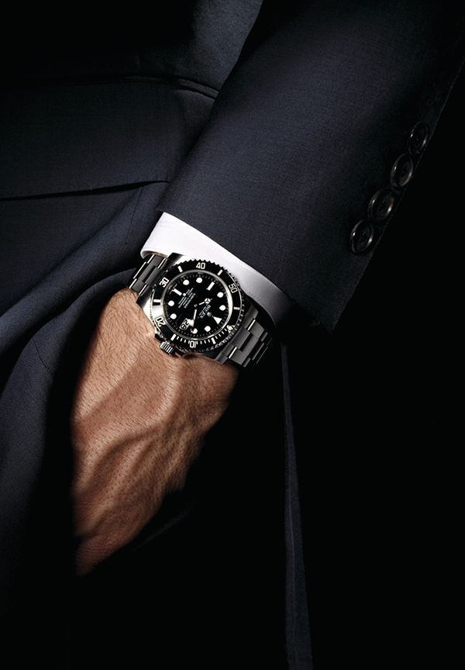
Rolex
Gabriel Fernandez
Crystal Llerena
Ruth Jordan
Ryan Cruz
Anderson Vieira
Itzel Lazaro

Slide 2
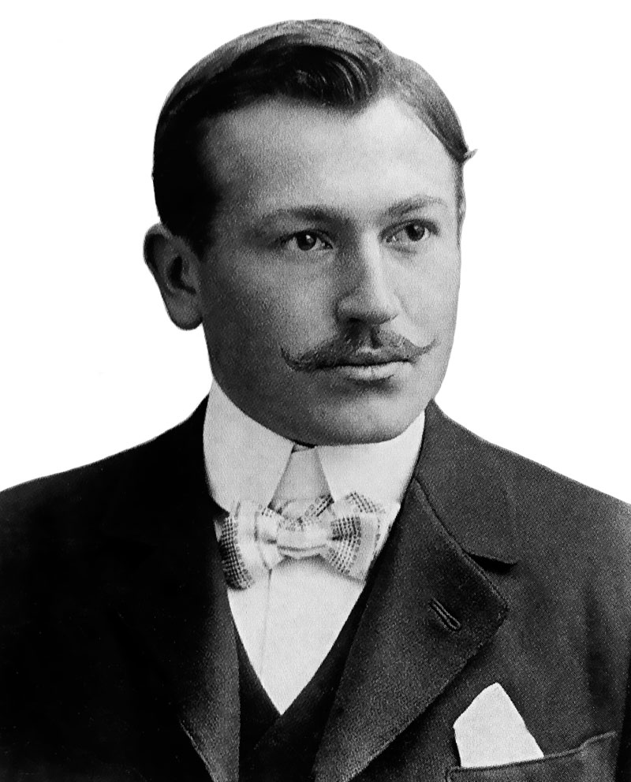
Hans Wilsdorf
1905: Found in London, England by Hans Wilsford and Alfred Davis who specializes in the distribution of timepiece.
1908: “ I tried combining the letter of alphabet in every possible way. This gave me some hundred names, but none .of them felt quite right. One morning, while riding on the upper deck of horse-drawn omnibus along cheap side in the City of London, a genie whispered ‘Rolex’ in my ear.” - Hans Wilsdorf
1944: Established The Hans Wilsford Foundation, private trust and does not pay corporate tax

Slide 3
About Rolex
Innovation
Largest Swiss luxury watch brand, producing about 2,000 watches per day.
Are the first of everything….
Waterproof watch (up to 10 hrs)
Automatically change date and day on the dial
Earn Chronometer certification
Rolex production
Some models are considered vintage and collectibles, while others continues to expand.
Offers different types of models within a specific type of wearers…
Swimming and diving- Rolex submariner; stand water pressure and still remain good condition
Features
Any size
Metals ( Gold, Stainless steel, White gold, two-toned, diamonds or pearls)

Slide 4
Situation Analysis
Rolex S.A is a Switzerland privately held company owned by Hans Wilsdorf Foundation, which was a foundation of Hans Wilsdorf and was left with all the rolex shares after his death.
Rolex’s Chance has many competitors of watches such as Hublot,Audemars Piguet, Cartier, and Patek Philippe. We believe the market for watches is at a high with the maturity level of the product cycle.

Slide 5
Research Foundation
In our ad campaign for the Rolex brand, we concluded that visual brand identity captures the consumer’s interest. As they project their personality to the brand and product. Essentially making the brand and product feel more personal.
The visual appeal and identity of the watch and brand is important to establish familiarity and a common identifiable brand imagery. The visual brand identity is the brand personality. To reinforce this idea, a verbal interview was done across NYC.

Slide 6
Proposed target consumer
The company Rolex itself is a high end company that is based on quality and elegance, and this model exhibits just that. This model is the most common bought model in our target market, which are middle class to upper class men in the ages of 21 to 55
Although our target market stretches all the way to those of the age of 55, we would still like to aim to target a younger audience and tap into the new norms of social media to keep brand awareness amongst the younger consumers.

Slide 7
Sales Promotion
Sales promotion is a marketing activity that adds to the original value proposition behind our product for a limited time in order to stimulate consumer purchasing sales.
Sampling Providing free samples is a technique used in order to introduce new products to the marketplace. Samples are given to the consumer in order to see how well they like the product, or try something that they normally wouldn’t go for. In our case we would give samples of our watch at a high-end event of our choice in a gift bag to guests.
Special pricing Providing an offer of a lower price to customers for a period of time or to a purchase of multiple quantities.

Slide 8
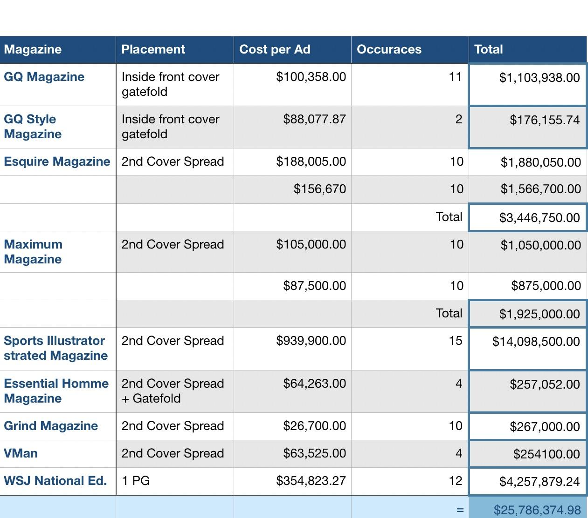
Media Plan and Schedule
Magazines
The plan displayed is our marketing schedule for the media vehicle choice being magazines to reach our target market.
Since our target market is middle class to upper class men ranging from the ages of 21 to 55.
Targeting the men who enjoy showcasing their wealth, and find pleasure in treating themselves to a very exotic and elegant watch that could potentially boost their lifestyles.

Slide 9
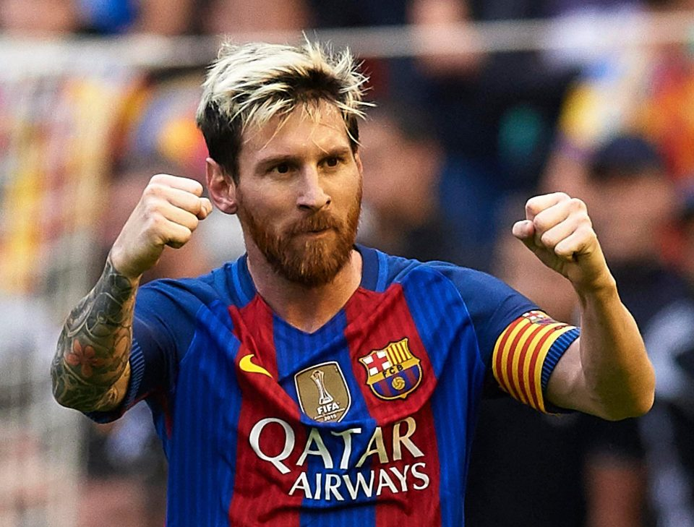
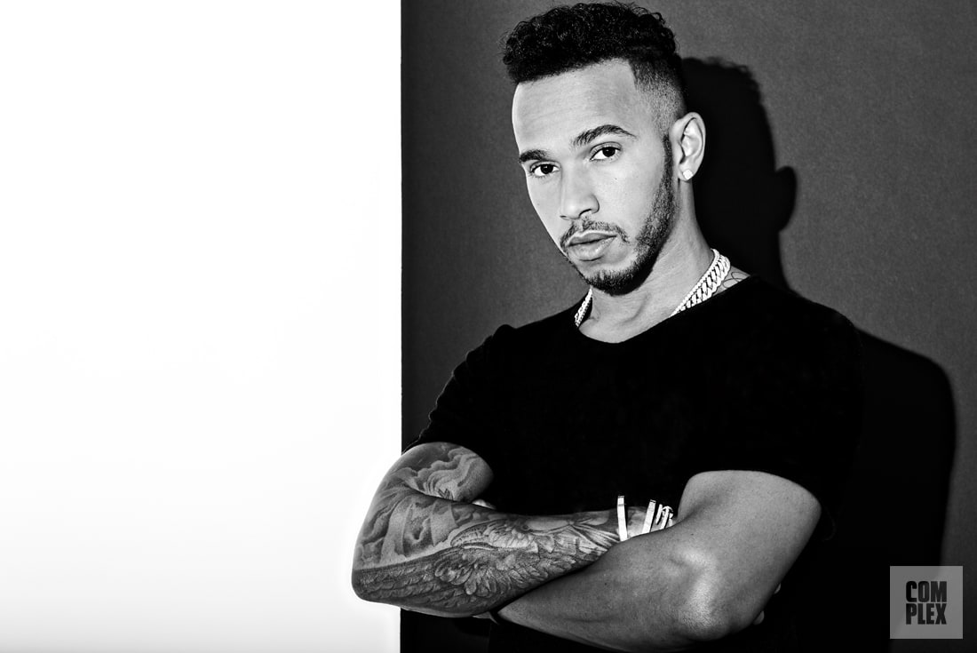
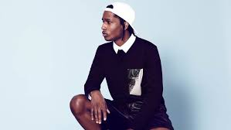
Celebrities
Our budget for talent/celebrity is $2,511,588.50.
The celebrities that we will be using in order to promote the campaign will be Lionel Messi at $1,000,000, Lewis Hamilton at $900,000 and ASAP Rocky at $611,588.50.
Lionel Messi, is an athlete that is currently acknowledged as the best football player in the world.
Lewis Hamilton, is a British Formula 1 racing driver, that has achieved legendary status in his sport.
ASAP Rocky, is a rapper which is currently at the forefront of high fashion.

Slide 10
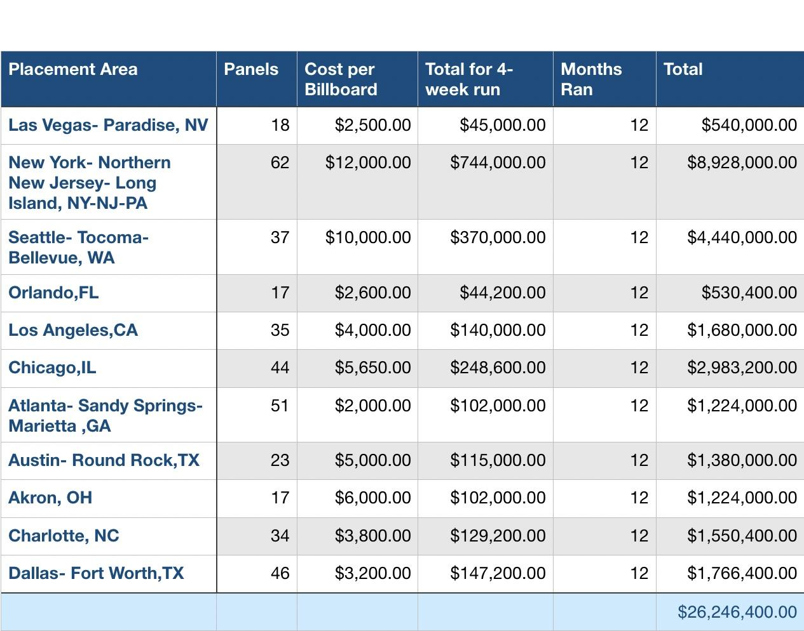
Billboards
Billboards
For the man on the go, driving to and fro, we have billboards in major U.S. cities.
Billboards are noticed because their messages are in bright bold colors and creative graphics.
A billboard in a great location for example a major city, interstate, or major highway will reach more people faster and easier than any other type of media.
Pricing provided from Lamar billboard services.

Slide 11
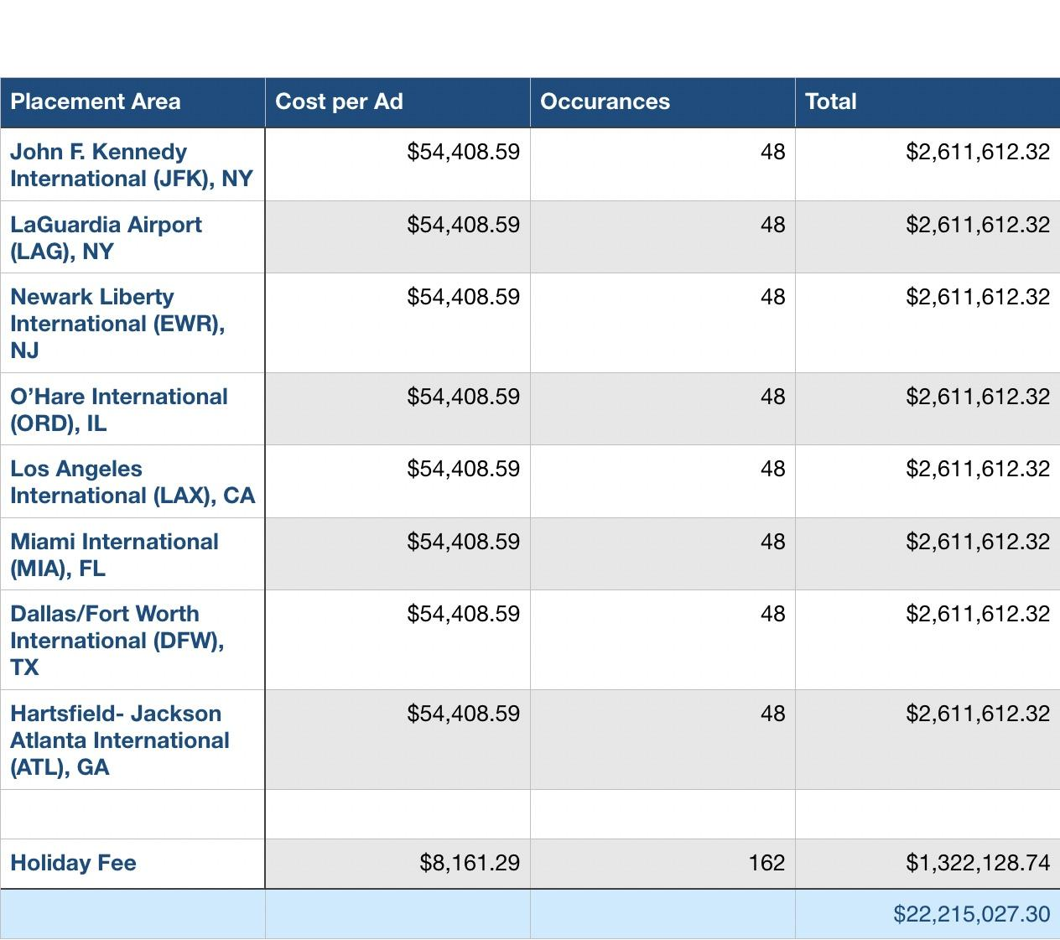
Airports
Airports
Once again, for the man on the go, we have airport billboards at major U.S. airports for our jetsetters to remind them that our watch is
Timeless Elegance.

Slide 12
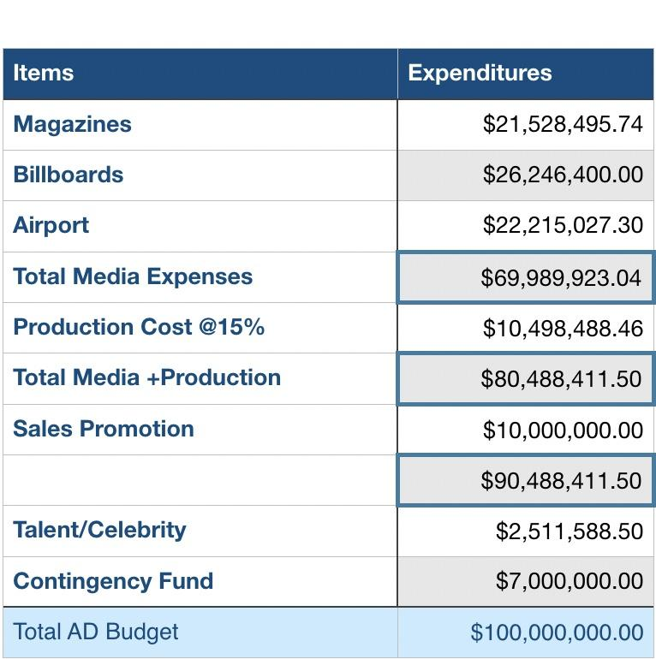
Budget
Budget
Given the task of creating an Ad Campaign for Rolex for $100,000,000 we have accounted for every cent being dedicated to our campaign.

Slide 13
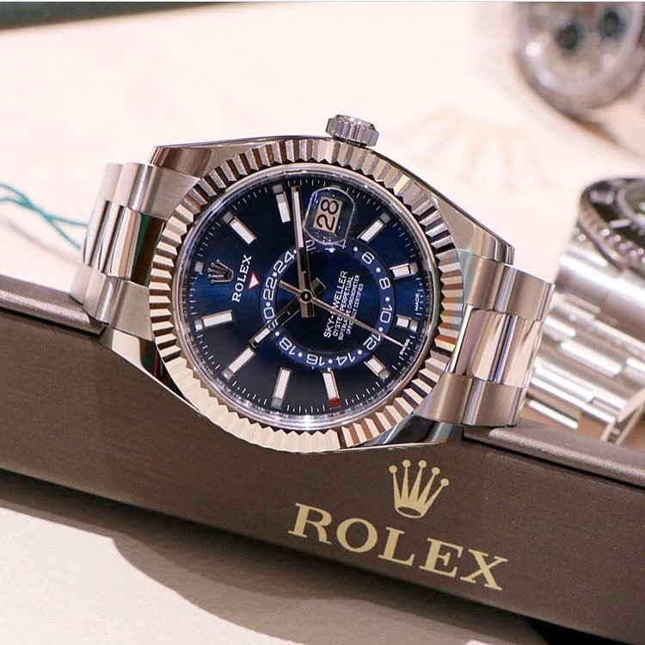
Creative Rationale
The creative theme for our advertisement campaign will be focused on our specific demographic which is; young middle class male.
It will be a total different concept than previous Rolex watch advertisements in the past.
As the centerpiece of our ad campaign, the product rolex will be prominently feature in a animated version.
This version is in a illustration form, specifically from two artist, one that is newer and one that is famous. They are Hattie stewart, a illustrator and Roy Lichtenstein a pop art artist.
The slogan for this ad campaign is “Timeless Elegance.” we decided to use this slogan because it seems to fit with our creative theme and also keeps true to the brand itself.

Slide 14
Reference
Rolex, (2017). History Of Rolex. [ONLINE] Available at:
https://pressroom.rolex.com/en/corporate/history-and-corporate/history-of-rolex.html.
[Last Accessed 18 October 2017].
Sanchez, Karizza, (2017). The Best-Dressed Men of 2017 (So Far). [ONLINE]
Available at: http://www.complex.com/style/best-dressed-men-2017/. [Last
Accessed 5 December 2017].
Sports Illustrated, (2017). Magazine Rates. [ONLINE] Available at:
https://www.simediakit.com/home/magazine/rates/. [Last Accessed 20 October 2017

