Slide 1
Stream Team
Devora Castillo- Project Director/Research Analyst
Ruth Jordan- Statistical Writer/Research Analyst
Kuto Dolo-Statistical Writer
Grace Tudee-Statistical Writer
Kaisha Ocasio-Research Analyst
Stream Team
Devora Castillo-

Slide 2
Objective: To research which music streaming App is most popular to our target population in the New York City area.
YouTube Converter
Impact record sales
Eminem (1.7M vs. 900k)
Cardi B (Triple Platnium)

Slide 3
What Does Streaming Music Mean?
⦿Streaming music started in the late 1990s-early 2000s with the advancement in technology
⦿It allows music providers (Spotify, iTunes, Tidal) to connect artist with the general public
⦿Different categories, genres, music groups
⦿Allows you to have music with you anywhere and
everywhere

Slide 4
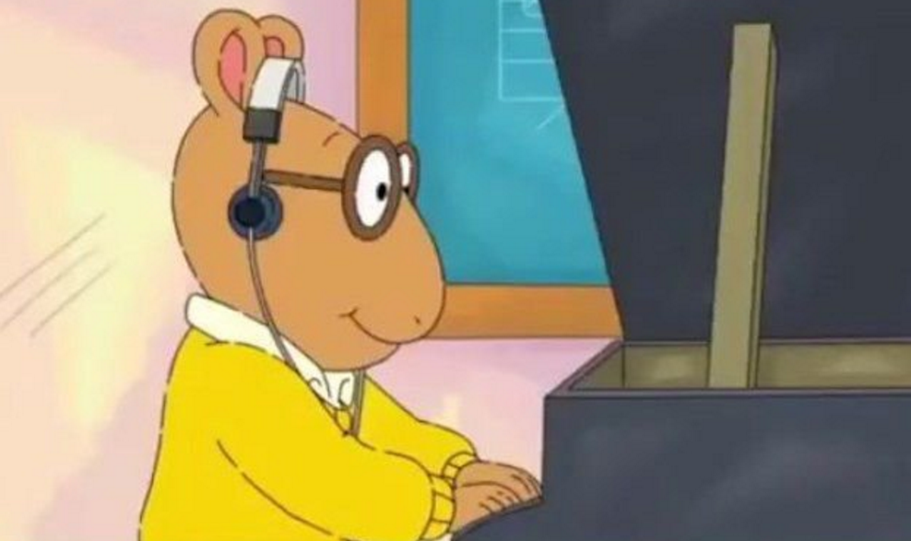
What is The Purpose of Music Streaming?
⦿Pass time
⦿Excerise
⦿Form of expression
⦿Cope with ideas/emotions
⦿Inspiration
⦿Set the mood
⦿Discovery
https://youtu.be/egHjkeiqjrA
https://youtu.be/TJrlScbTVMs
https://youtu.be/mT_5zokf8eI

Slide 5
Research Setup
Music is something everyone listens to but not everyone uses the same music streaming service.
We conducted this research to find out what are the most popular music streaming services and why.
Music is known to be a stress relieve for most, so some people prefer to pay a certain amount each month to guarantee good quality service.
This research was made to to find out what people really think about their music streaming services. Is it worth having or not?

Slide 6
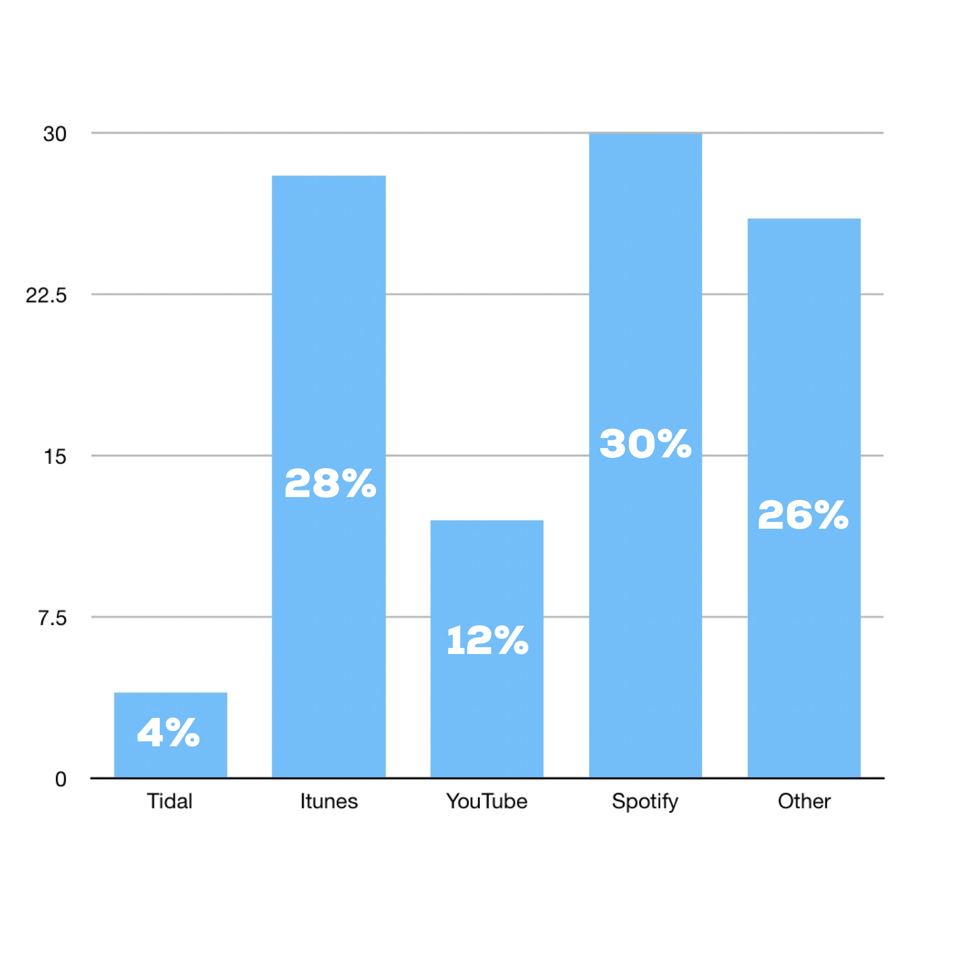
When respondents were asked which streaming service they listened to the most ...
We found that Spotify was the most used streaming service amongst our respondents.
Itunes came in second place.
Following Pandora for third under the “Other” comments.

Slide 7
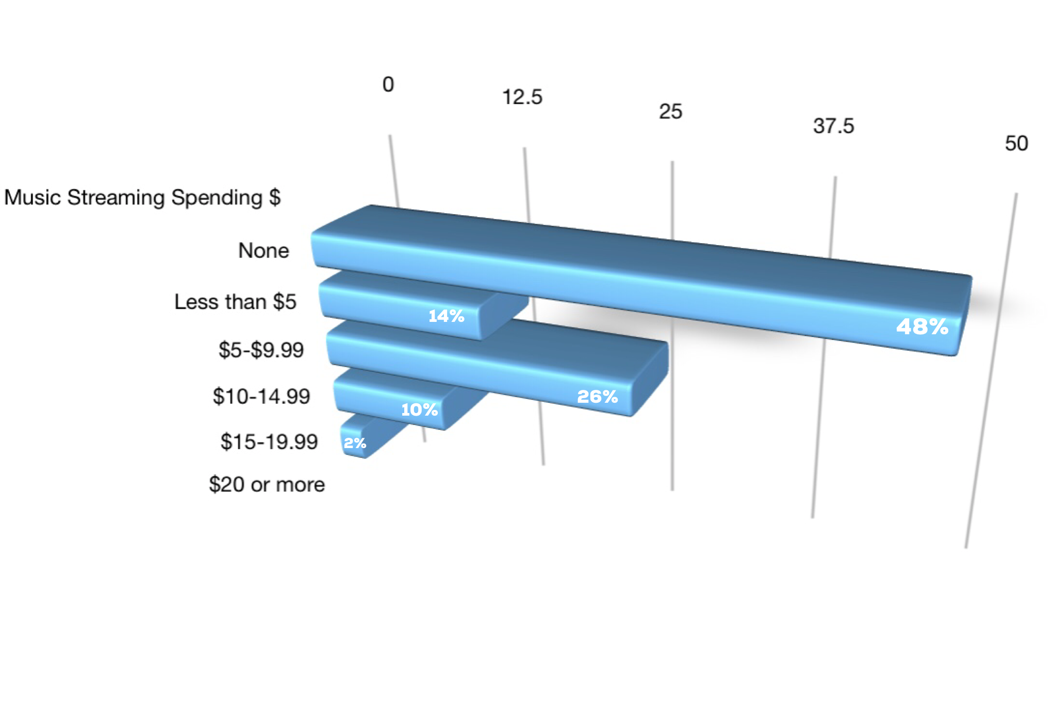
When respondents were asked how much they paid for their streaming service...
At almost 50%, 48% of our respondents don’t pay a dime for their music streaming service.
While 28% pay within the price range of $5- $9.99, where the standard pricing for tidal, and premium pricing for Apple Music and Spotify fall.

Slide 8
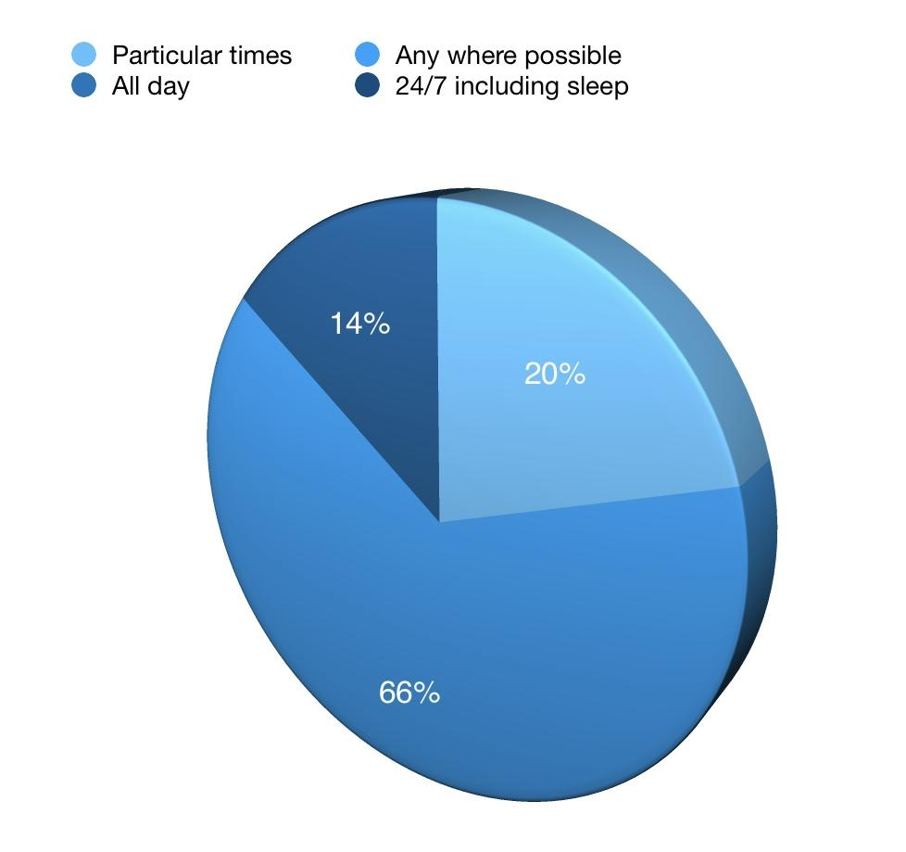
How our respondents are listening ?
We found a large part of our respondents,at 66% are listening to music anywhere possible.
While some go as far as listening 24/7 at 14%.

Slide 9
Conclusion
Respondents who payed for their music streaming service were more satisfied and also benefited from specialized settings than those that did not.
The survey concluded that most respondents have considered tidal as their choice of service if it wasn't for the price.

