Slide 1
Haute & Hoot Product Line
Yelissa Vasquez, Amy Chen, Khalifa Francois, Vivienne Liang, Ruth Jordan

Slide 2
About Haute & Hoot
Haute & Hoot is a winter coat company in New York City focusing on making their customers look their best, feel warm, and adding a little hoot of laughter to their cold day.The company specializes in making various styles of two-shelled coats, each coat including inner and outer shells having different levels of warmth. Each coat will have a tag attached indicating the warmth level with funny and unique names that are easy to remember allowing customers to identify which one they’ll need to grab in the morning. Haute & Hoot offers three levels of warmth that can be added onto each outerwear. They would consist of “Super cozy”, “Roasting by the fire”, and finally “The Oven”.

Slide 3
Target Market
Age: 20-35
Gender: Female/Male
Income: Minimum Wage
Occupation: Student/ entry-level job
Location: NYC
Lifestyle: A person who has a great sense of fashion not living beyond their needs. Very fashion forward and understands different aesthetics and attributes of certain designs.

Slide 4
Keys To Success
Marketing: Marketing will be the first strength to our success and a huge competitive edge.
Professionalism: Which includes everything from maintaining great quality and creating our very best designs.
Individual Attention: Each client's experience will be tailored to his or her’s preference.
Repeat business/Recommendations: Giving the kind of service that brings people wanting to keep shopping with us. Even if we expand and venture on to other items of clothing they will have loyalty to our company.
Fantastic Location: Located in NYC however, Pop-up shops will be introduced in other states that are necessary

Slide 5
Competitors with Comparable products
Canada Goose- Designer priced brand
Warm and protective winter coats
Pros: Good for harsh weather conditions
Cons: uses real fur and goose feather based down, very similar coat styles
Moncler- Designer priced brand
Style and warmth
Pros: Lightweight, comfortable, warm, more styles
Cons: Goose feather down, voluminous styles
H&H difference: use animal friendly materials, Fuego Technology fabrics, manipulatable, various coat designs, less expensive

Slide 6
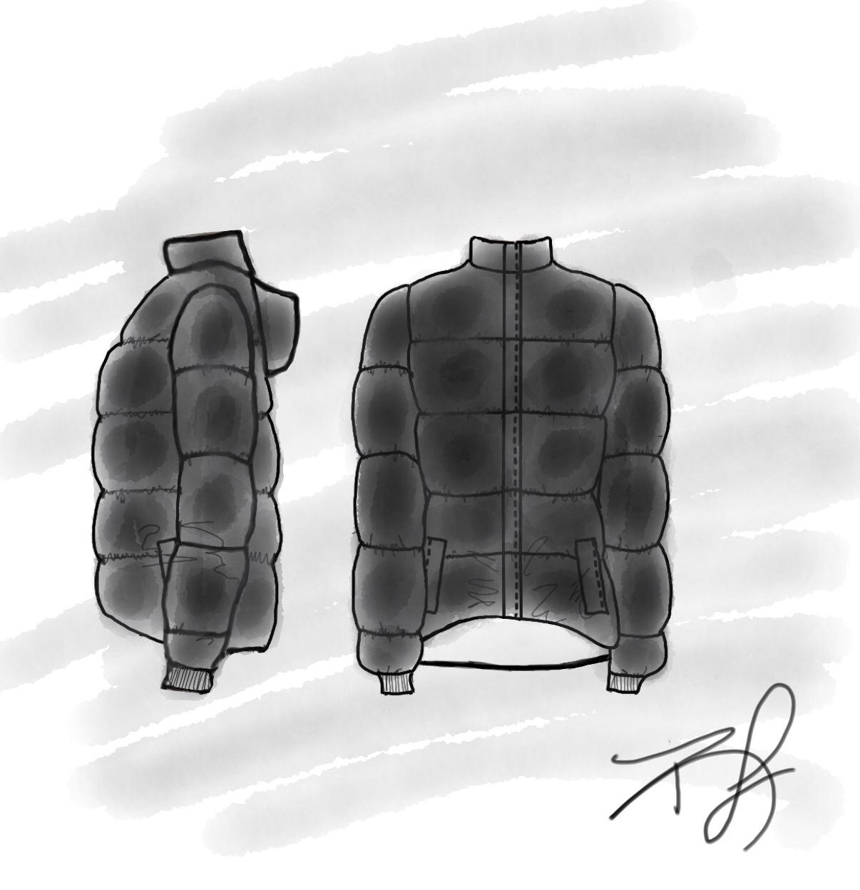
Crop Bubble Puffer Jacket
For our trendy woman that loves cropped no matter the season.
Key components are warmth retention and handling weather elements.
The Nylon shell is filled with Primaloft fiber as an alternative to down feathers.
Calculated cost to make $80.20
Retailed at Haute & Hoot for $175.00

Slide 7
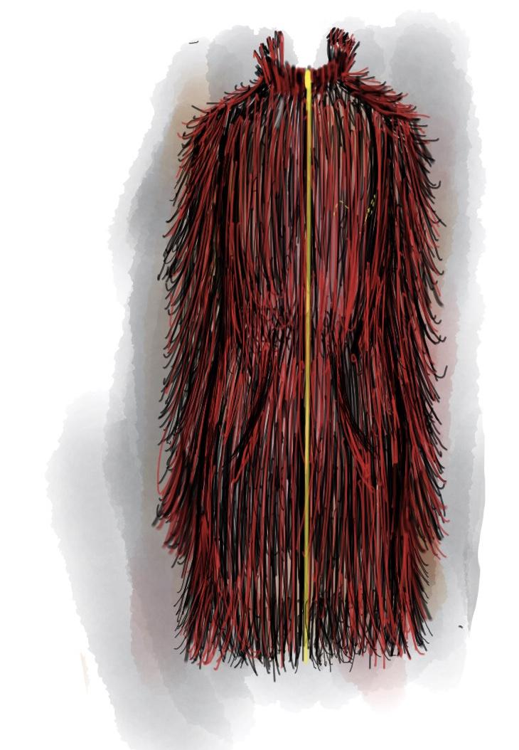
The Faux Fur Coat “Super Cozy”
Our trendy woman’s statement piece
On the current trend color: red.
Outer fabric a heavyweight, super soft faux fur.
Inner lining a breathable, waterproof polyester.
Also doubles as a inner shell when reversed.
Calculated cost to make $100.19
Retailed at Haute & Hoot for $215

Slide 8
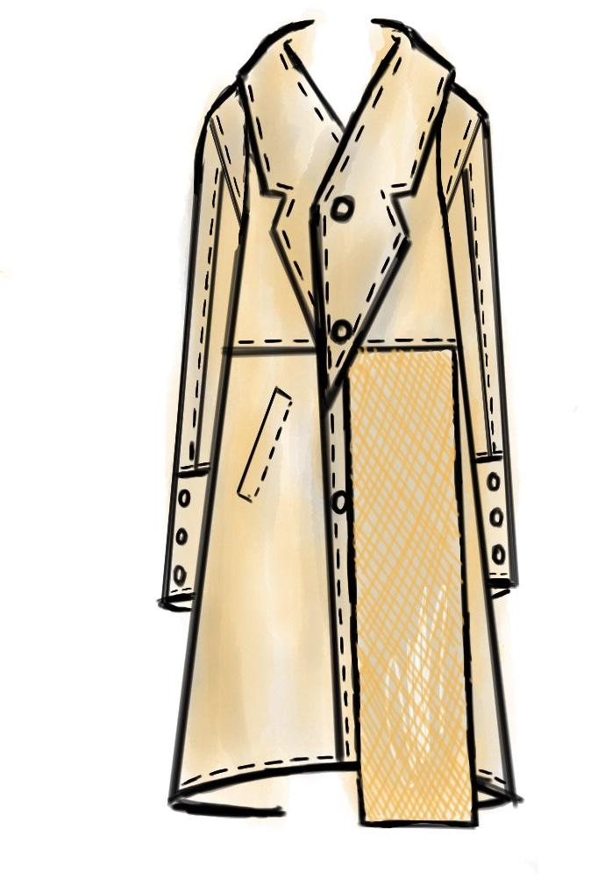
Deconstructed Trench Coat
For our our lover of all things minimalistic, and high end.
Our take on deconstructed, lightweight, without a lining.
Made of a waterproof nylon material
Calculated cost to make $30.38
Retailed at Haute & Hoot for $75

Slide 9
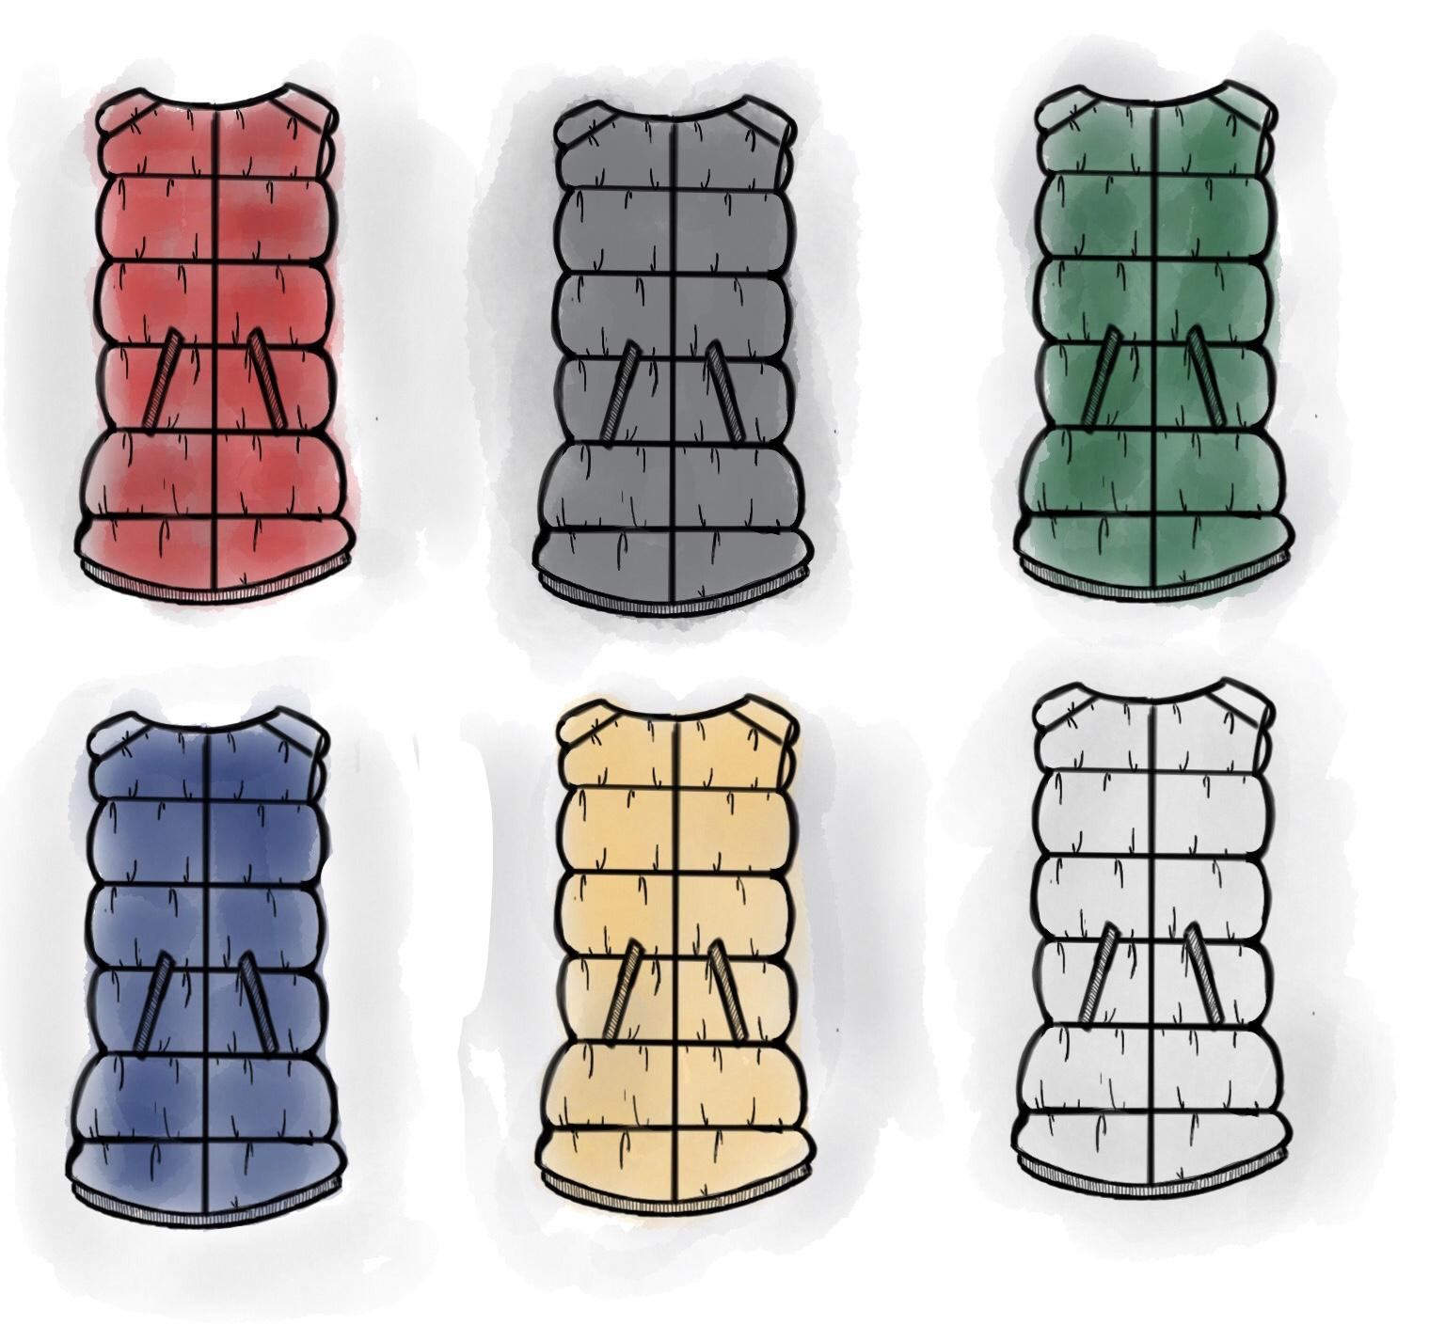
Inner Shells
Made in a variety of colors, our inner shells can be worn as vest, but their main feature is to be interchangeable in our coat and jacket garment.
Calculated cost to make “Toasty” 3oz ”$59.96
Retailed at Haute & Hoot for $130
Calculated cost to make “Fuego”6oz $68.46
Retailed at Haute & Hoot for $150

Slide 10
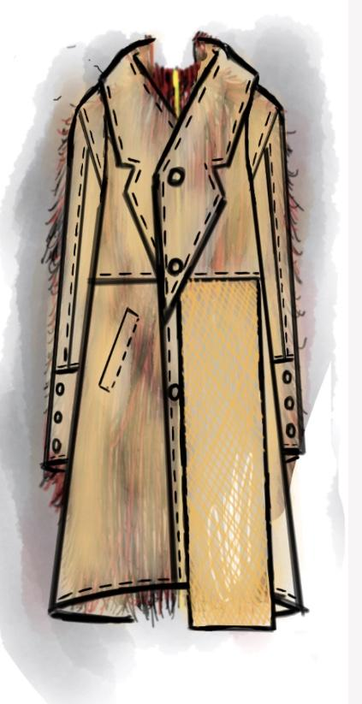
“Roasting by the Fire” in action….
+
=

Slide 11
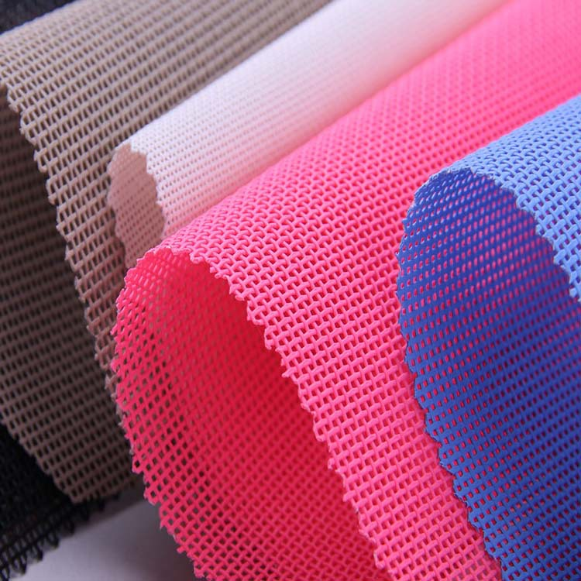
Polyester
Strong
Resistant to stretching and shrinking
Resistant to most chemicals
Quick drying
Easy to wash

Slide 12
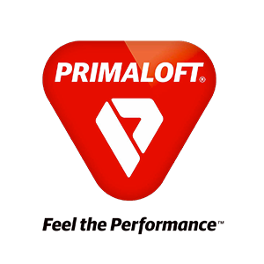
PrimaLoft
Wind resistant
Dries faster than down
As soft and warm as down
Compresses as down
Waterproof
Thermally efficient

Slide 13
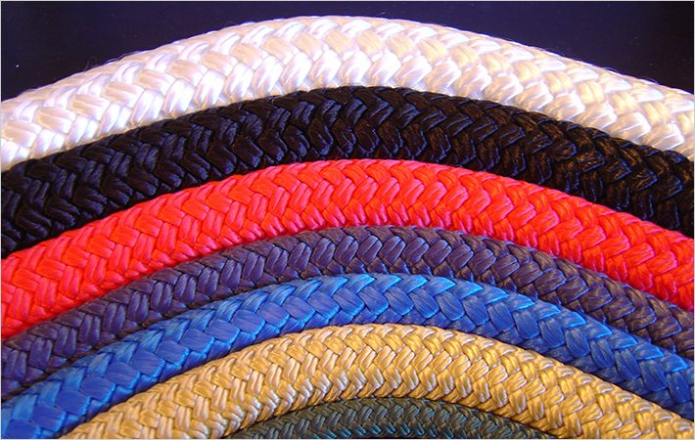
Nylon
Strong
Softer than polyester but also stronger
Resists stretching and shrinking
Dyes well
Heat sensitive

Slide 14
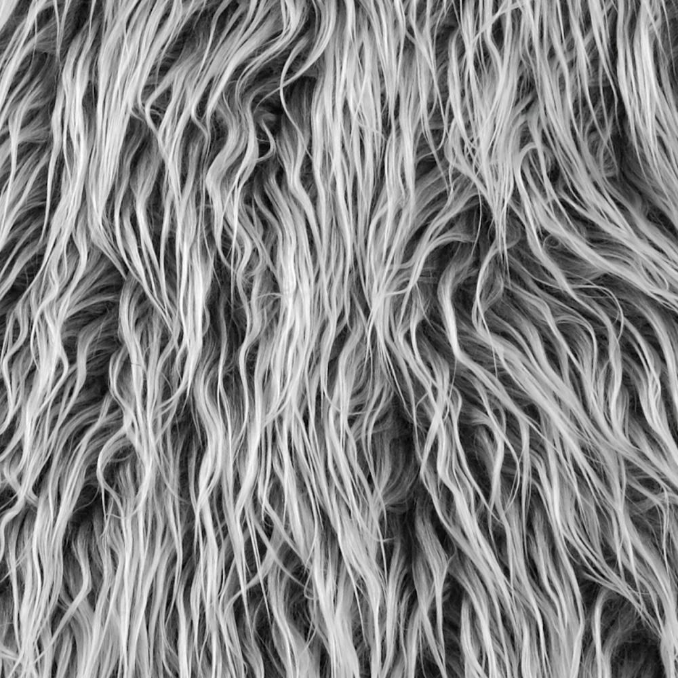
Faux fur
lightweight and strong
Imparting a fluffy quality to the garment.
Highly resistant to heat, sunlight
Resistant to smoke
Good stability during laundering

Slide 15
Quality Control & Merchandising
Defect guides used to measure quality and garment standard
Closed specifications (right materials used efficiently and that requirements are met)
Each garment label would include: fiber content, manufacturer, and country of origin
Any material greater than 5% will have to be listed under content’s name, anything under 5% can be labelled as “other”
Goal would be offering the right styles in the right colors and sizes in the right amount of quantities to the right target market
Hopefully have department stores and retailers such as Urban Outfitters to further increase the exposure of the brand

