Slide 1
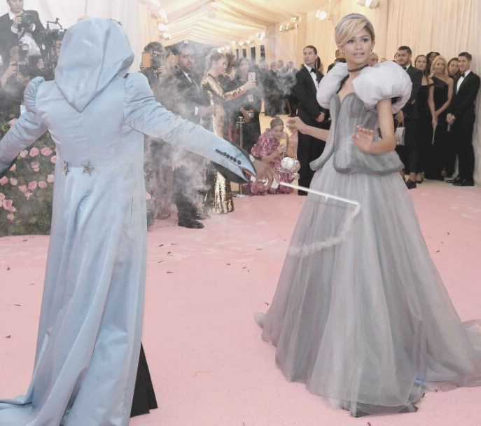
WEARABLE
TECH.
BY RUTH JORDAN

Slide 2
WHO, WHAT, WHEN,
WHERE,
HOW?
For this year's 2019 MET Gala, actress, singer, designer, and Lancome ambassador Zendaya arrived portraying Cinderella with her stylist Law Roach as as her Fairy GodBrother.
In order to recreate the Cinderella scene, the grey silk Tommy Hilfiger Dress features wiring and technology hidden beneath the bustle of the gown allowing it to transform visually and physically.

Slide 3
WHAT ARE WE LOOKING AT
Electrical Wiring
Motors
Technical Bustle
Led Light Strips
WEARABLE TECH.

Slide 4
THEME
The book’s theme is often related to its central message, which reveals a deeper layer of meaning to the story. Shown through the characters, symbols, and plot, themes can teach readers a lesson or present an interesting idea.
SECRET OF A FANGIRL
PAGE 06

Slide 6
THANK YOU SO MUCH!
WEARABLE TECH

