Slide 1
BRANDS THAT ARE CONSCIOUSLY TRYING TO CHANGE THE ENVIRONMENTAL DETRIMENT OF THE FASHION INDUSTRY
WHAT ARE THE PROBLEMS WE FACE & WHAT ARE THEY DOING TO ADDRESS THEM.
RUTH JORDAN

Slide 2
Did you know ?
"In 2015, the fashion industry produced
1.2 billion tonnes of CO2 equivalent - more
emissions than international flights and
maritime shipping combined"
(CHLOE FARAND, 2018)

Slide 3
ISSUES
CAUSED
BY THE FASHION
INDUSTRY
THE TOP ENVIROMENTAL ISSUES THE FASHION INDUSTRY ARE DIRECTLY CORRELATED WITH:
1. Plastic Pollution
2. Water Stress and Pollution
3. Toxic Chemicals

Slide 4
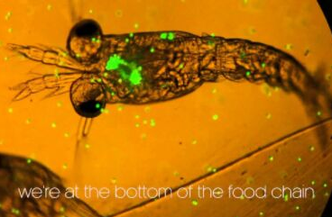
PLASTIC POLLUTION
HOW THIS RELATES TO THE FASHION INDUSTRY?
Microplastics!
- A third of all microplastics released into the oceans are from the synthetic textiles used in the fashion industry.
-Each time an item of clothing is washed, up to 700,000 microscopic fibres make their way into the oceans where they can be swallowed by sea life, becoming part of the food chain and potentially ending up on consumers' plates, The Institution of Mechanical Engineers has warned. (Farand, 2018)

Slide 5
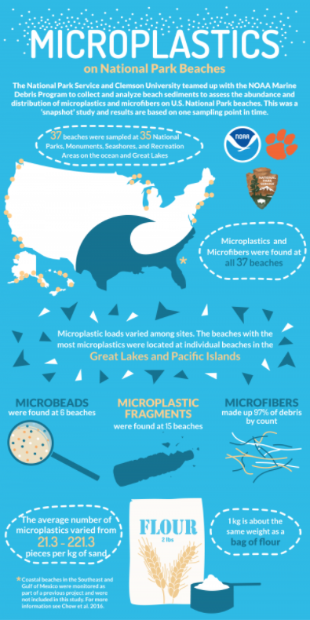
SEE HOW CLOSE TO HOME

Slide 6
WATER STRESS
-The fashion industry is the third largest user of water globally after oil and paper. This is due to the extreme use of water when manufacturing fiber and textile of garments.
-It’s estimated that the fashion industry currently uses around 79 billion cubic meters of water per year, which is 2% of all freshwater extraction globally, and represents more than one tenth of the water used by all types of global industry. On current trends, this amount is set to double by 2030. (Common Share, 2018)
-Globally, it’s thought that around 8,000 synthetic chemicals are used to turn raw materials into textiles, and estimates 20% of the world’s industrial water pollution at the feet of fashion’s textile-dyeing and treatment processes.
(Benson, 2018)
"It takes 2,720 liters of water (as much as you’d drink over a three-year period) to make a T-shirt. And your favorite pair of jeans? Almost 10,000 liters of water went into creating them." (Benson, 2018)

Slide 7
WATER STRESS
TEXTILE DYING
There are more than 10,000 dyes used in textile Manufacturing alone nearly 70% being azo dyes which is complex in structure and synthetic in nature.
HEALTH IMPACTS
ENVIROMENTAL IMPACTS
Long-term or accidental over exposure of chemical dyes will likely result in health hazards if not handled properly for the worker as well as the consumer in the long run.
- The most common hazard of reactive dyes is respiratory problems due to the inhalation of dye particles. Sometimes they can affect a person’s immune system and in extreme cases the next interaction with the substance could be dramatic. This is called respiratory sensitization and symptoms include itching, watery eyes, sneezing and symptoms of asthma such as coughing and wheezing.
- Dyeing and finishing processes often act as irritants, causing skin irritation, itchy or blocked noses, sneezing and sore eyes. Formaldehyde-based resins, ammonia, acetic acid, some shrink-resist chemicals, some optical whiteners, soda ash, caustic soda and bleach. Certain reactive, vat and disperse dyes are also recognized as skin sensitive .
The usage of cotton has been increasing constantly throughout the past century . Cotton fibers are mainly dyed using azo dyes which are one of the largest groups of synthetic colorants used in the industry.
These same azo dyes are found to be complex in nature and have been found to show carcinogenic evidences on reductive cleavage. These dyes are capable of altering the physical and chemical properties of soil, deteriorating water bodies and causing harm to the flora and fauna in the environment. It was observed that the toxic nature of dyes causes death to the soil microorganisms which in turn affect the agricultural productivity.
As the is no current technique to completly remove the toxicity of the dye from water the probability of consumption on the dye in our water source if not discarded correctly can cause permanent blindness, rhabdomyolysis, acute tubular necrosis supervene, vomiting, hypertension, vertigo and, upon ingestion, oedema of the face, neck, pharynx, tongue and larynx along with respiratory distress .
(HASSAAN,2017)

Slide 8
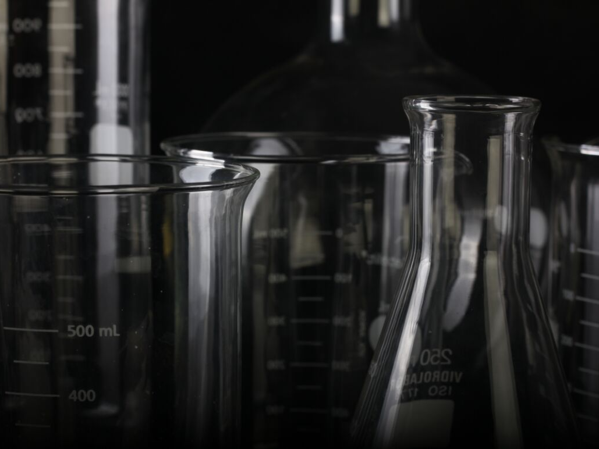
TOXIC CHEMICALS
1. Insecticides
Conventional cotton accounts for 25% of the insecticides used worldwide. Residue from insecticides which are transferred from soil to boll, make their way into the fibers of our clothing. The slightest trace of pesticide exposure has been linked to brain, fetal damage, and sterility in humans.
2. Petrochemical Fibers
Fibers such as nylon, polyester, acrylic, acetate or triacetate actually assist with restriction of natural bodily toxin release.
3. Formaldehyde
The used of this chemical originally used to preserve dead bodies has been used as a finishing treatment on many garments to preserve its newness after its first wear for example wrinkle-free garments. This chemical often can be attributed to dermatitis and lung cancer.
4. Perfluorocarbon
Often found in apparel and footwear clothing that are weatherproof and stain resistant. This chemical is linked to kidney and testicular cancer, obesity and decreased response to vaccines. Also flame retardant fabrics have been linked to infertility, reduced IQ, endocrine disruption and breast cancer.
(PLELL,2018)

Slide 9
FASHION
BRANDS WORKING TO ADDRESS THE ENVIROMENTAL DETRIMENT
ETHICAL & AFORDABLE
1. Kton
2. PACT
3. G-Star RAW
4. PANGAIA

Slide 10
KTON
WHAT THEY ARE DOING ?
Working directly with Egypt's cotton farming families to rebuild the Egyptian Cotton industry and create better business pratices.
-They use the raw cotton, which is in the process of becoming 100% certified organic, bought directly from the families at set pricing to create their garments.
Fabric is sent out to their own cut- and sew factory, cutting out the middle man, and ensuring fair wages for workers.
They are a Certified B Corp ensuring that the business has an equal responsibility to the community and the planet not just its share holders.
Price point: $28-80
Range: Women's & Mens
(Kton, 2019)

Slide 11
PACT
WHAT THEY ARE DOING ?
They are creating a PACT to be sustainable as, 48,890,679 Gallons of water have been saved by Pact customers thus far.
-They source only 100% organic cotton.
-Their Factory is Fair Trade Certified ensuring that wages are fair to those who work there.
-They don't use any toxic dyes in any of the garments made, and no pesticides as they only use organic cotton to make their garments.
Price point: $7-160
Range: Women's, Men's, Baby, Kids, & Bedding
(Pact, 2019)
HTTPS://WWW.YOUTUBE.COM/WATCH?V=HPULWYE28MW

Slide 12
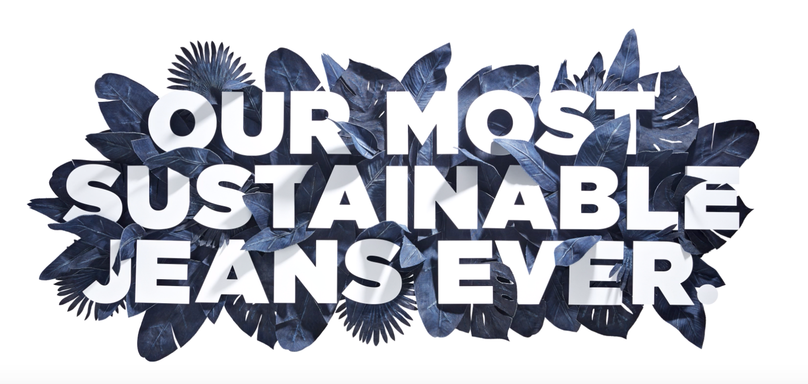
G-STAR RAW
WHAT THEY ARE DOING ?
RFTPi jeans by G-Star Elwood
'Most Sustainable Jeans Ever'
-They are made from 100% organic cotton.
-Dyed using the worlds cleanest Indigo dying technology to create its color, at 70% fewer chemicals and no salts.
-Utilizes sustainable washing techniques as it only uses 10 liters of water to wash throughout processing, while a regular pair of denim would use 40-70 liters of water .
-Thats not all they reuse and recycle 98% of the water from the process while the other 2% is lost though evaporation.
(Benson, 2018)
Price point: $160-280
Range: Women's & Men's
HTTPS://WWW.YOUTUBE.COM/WATCH?V=QUHZ5YP1E5G&FEATURE=YOUTU.BE

Slide 13
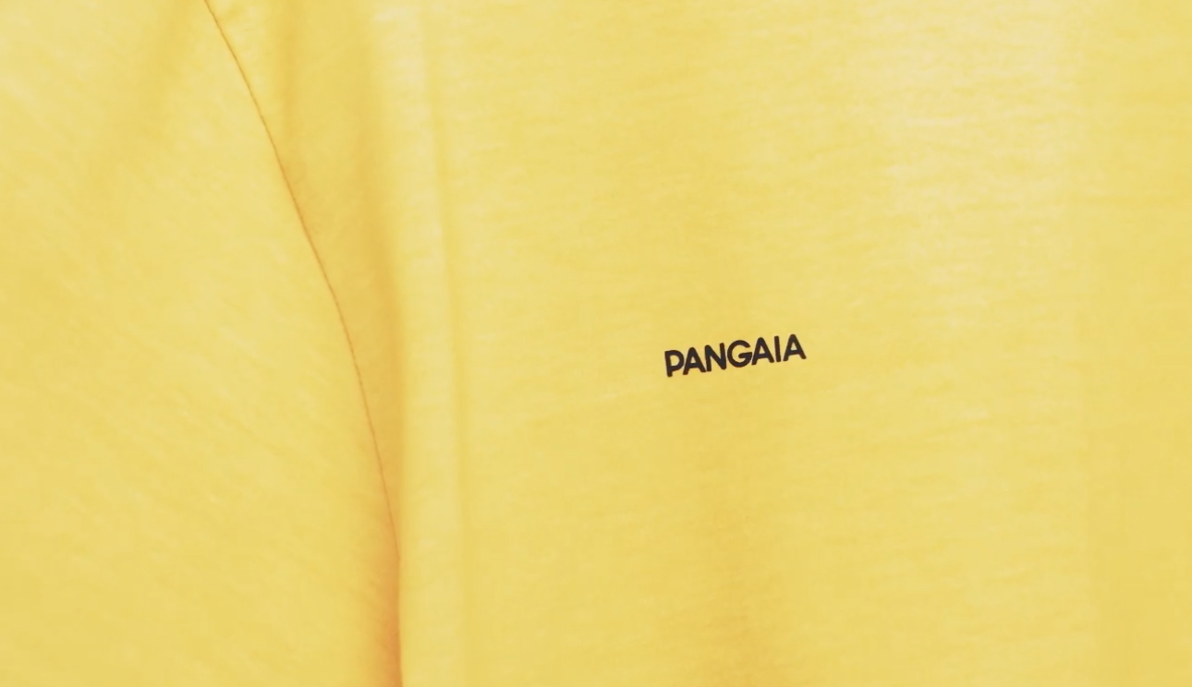
PANGAIA
WHAT THEY ARE DOING ?
-They use all natural dyes by coloring their shirts with the use of plants. By using plants, fruits, vegetables, and food waste they are able to create a variety of hues and tones.
-They integrate seaweed fibers that grows in abundance in the ocean to avoid the use of land, water and pesticides of traditional farming.
-Use of natural pepermint oil on ther garments as an antibacterial treatment .
-VeganTech using dried wild flowers as an alternative to goose down.
-Every product comes in biodegradable TIPA packaging that had the ability to fully disappear in 24 weeks in a compost bin.
-Beach clean up efforts to clean up the environment and incorporate the items into the process of how their products are made.
Price point: $150-300
Range: Women's & Mens
(Pangaia, 2019)
https://www.youtube.com/watch?v=7R8jU_1ACRc

Slide 14
I believe now more than ever before, brands are trying to step up and do the right thing. The amount of harm the fashion industry has imposed on the environment can't be rectified overnight, but with new technologies and clear visibility the consumer now has, brands will choose to change as long as we don't turn a blind eye.
THANK YOU!

Slide 15
References
Benson, S. (2018, March 22). It Takes 2,720 Liters Of Water To Make ONE T-Shirt - As Much As You'd Drink In 3 Years. Retrieved March/April, 2019, from https://www.refinery29.com/en-us/water-consumption-fashion-industry
Farand, C. (2018, September 13). Fashion industry accounts for more than a third of ocean microplastics, report warns. Retrieved April, 2019, from https://www.businessgreen.com/bg/news/3062698/fashion-industry-accounts- for-more-than-a-third-of-ocean-microplastics-report-warns
Kton. (2019, April 17). About. Retrieved April, 2019, from https://kotn.com/about
Pact. (2019). About Fair Trade Organic Cotton Clothing | Pact. Retrieved March/April, 2019, from https://wearpact.com/about
Pangaia. (2019). Technologies. Retrieved from https://www.thepangaia.com/pages/technologies
PANGAIA: Recycled materials [Advertisement]. (2018, December 13). Retrieved April 17, 2019, from https://www.youtube.com/watch?v=7R8jU_1ACRc
Plell, A. (2018, January 05). There Are Hidden Chemicals In Our Clothing. Retrieved April, 2019, from https://remake.world/stories/news/there-are-hidden-chemicals-in-
our-clothing/
Stegemann, Krista. (2017, September 29). Microplastics on National Park Beaches Infographic | OR&R's Marine Debris Program. Retrieved April 17, 2019, from https://marinedebris.noaa.gov/images/microplastics-national-park-beaches- infographic

