Slide 1
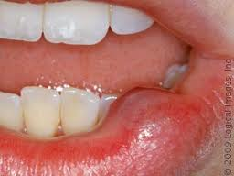
Mucocele
Revital Tsypkin
Histology & Embryology Sec. 8216
December 2012

Slide 2
What is a Mucocele?
A mucocele is a painless, thin sac on the inner surface of the mouth caused by a blocked salivary gland. Mucoceles commonly occur inside the lower lip but can also be found in other places inside the mouth, including the roof of the mouth (palate) and the floor of the mouth.
Swelling ranges in size from a few millimeters to several centimeters in diameter.
Mucoceles are harmless. However, if left untreated, they can form a permanent bump or scar on the tongue, palate, inside the cheeks, the floor of the mouth, or around the lip.
Mucoceles are common and occur in about 1 out of 500 adults. They can develop in the general population, but most commonly young adult who are 20-30 years old. There is no relationship between the occurrence rate of mucoceles and any particular race or gender.
Mucoceles can affect regular eating and speaking routine of patients.

Slide 3
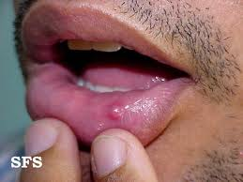
What is a Mucocele?

Slide 4
Etiology
Mucoceles can happen when a salivary gland is injured or blocked. Many salivary glands exist in mouth, secreting saliva. Saliva is made of water, mucus and enzymes.
Saliva moves from a gland into mouth through tiny tubes called ducts. Sometimes, one of these ducts can be cut, the saliva pools at the cut spot, and causes a swelling, or a mucocele. Mucoceles commonly occur inside the lower lip because of the biting habit, but it also can be found in other places inside the mouth, including the roof of the mouth and the floor of the mouth. A mucocele can form around piercings that have been inserted into the lips or tongue. Some medicines can thicken saliva, and it can plug up a salivary gland and cause mucoceles. Mucoceles also can occur if one of ducts is blocked and saliva is congested up in the duct. If swelling occurs because the submandibular duct is blocked, the mucocele is called a ranula. A ranula is quite large and appears under the tongue or on the floor of the mouth. A mucocele developed on the gums is called epulis.

Slide 5
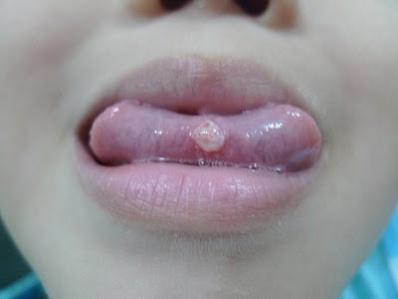
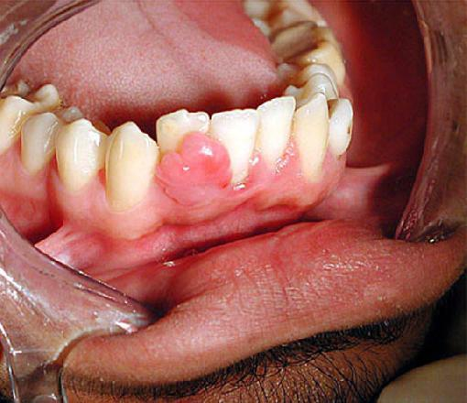
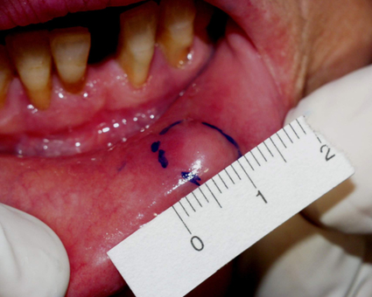
Mucoceles
ranula
epulis

Slide 6
Treatment
Some mucoceles spontaneously resolve on their own after a short time. Others are chronic and require surgical removal.
Several types of procedures are available for the surgical removal of mucoceles. These include laser and minimally-invasive techniques which means recovery times are reduced drastically.
Micro-marsupialization is an alternative procedure to surgical removal. It is simpler, less traumatic, and well-tolerated by patients, especially children .
A non-surgical option that may be effective for a small or newly identified mucocele is to rinse the mouth thoroughly with salt water four to six times a day for a few days. This may draw out the fluid trapped underneath the skin without further damaging the surrounding tissue.
If the mucocele persists, individuals should see a dentist to discuss further treatment.

Slide 7
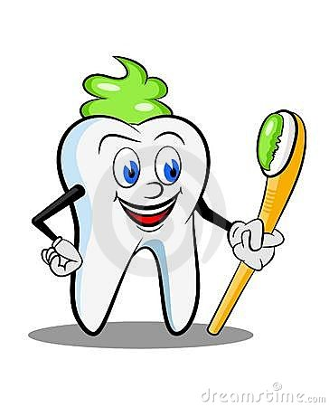
Mucoceles & Dental Hygiene
The dental hygienist should look for a rubbery, bubble-like swelling during intraoral examination. A mucocele can usually be diagnosed simply by looking at it.
The dental hygienist should inform the prevention of mucoceles to patients who has tendency of biting mouth tissues and advise them to receive the proper treatment for their oral health and comfort.

