Slide 1
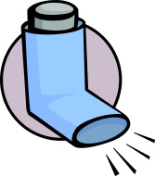
ASTHMA
BY: Elzbieta Goliaszewski
Rozina Marku
Revital Tsypkin
http://www.istockphoto.com/illustrations/asthmatic#136d49d6

Slide 2
Asthma ?
Asthma is a chronic inflammatory lung disease.
1.Recurring symptoms
2.Reversible airway narrowing
3.Bronchospasm

Slide 3
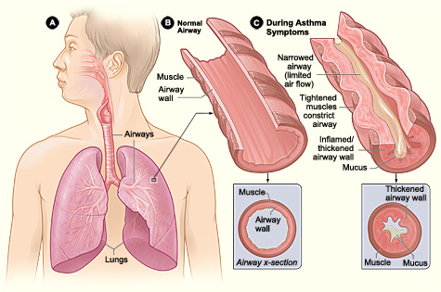
http://www.nhlbi.nih.gov/health/health-topics/topics/asthma

Slide 4
What may cause asthma ?

Slide 5
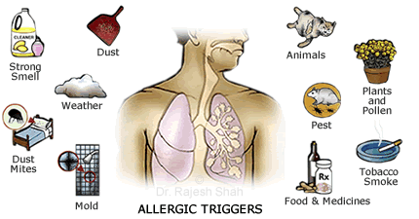
Causes of Asthma
Genetic : family history, hay fever, viral upper respiratory infections (cold) obesity
Environmental Allergens, pollen, dust, , exposure to cigarette smoke, molds, animals
http://www.askdrshah.com/app/asthma/asthma-causes.aspx

Slide 6
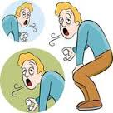
Clinical Signs & Symptoms
Coughing
Wheezing
Chest Tightness
Shortness of Breathe
http://www.fotosearch.com/illustration/asthma.html
May worsen at night, during exercise, with a cold, or when exposed to allergens

Slide 7
How many classifications of Asthma are there?

Slide 8
Classification
Mild Intermittent- attacks occur 2 days/week; or less than 2x a month night attack.
Mild Persistent – attacks occur more than 2x/week & night symptoms more than 2x/month.
Moderate Persistent- Daily attacks & night attacks more than 1x/week. Affect daily activity.
Severe Persistent- Frequent attacks, nonstop say symptoms & recurrent night symptoms.

Slide 9
What are the most common drugs used to treat asthma ?

Slide 10
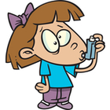
Quick Relief / Short Acting Drugs
MAO: Beta₂ Agonists
Albuterol
Levalbuterol
Metaproterenol
Terbutaline
Side Effects:
Anxiety
Tremors
Restlessness
Headache

Slide 11
Long Acting Drugs
MOA: Beta₂ Agonist, Bronchodilator of at least 12 hrs. after single dose
Long-Acting:
Salmeterol
Formoterol
Corticosteroids: Anti inflammatory & used in combination with long- acting drugs.
Side Effects:
Nervous
Increased Heart Rate
Upset stomach
Trouble sleeping

Slide 12
Leukotriene Modifiers
MOA: Leukotriene Receptor Antagonist- prevent leukotriene from binding to its receptors .
Leukotriene Synthesis Inhibitors- prevent synthesis of leutorkine by blocking the enzyme.
Generally used in combo with corticosteroids
Mild Asthma
Montelukast (Singular)
Accolate
Zyflo CR
SIDE EFFECTS:
Headache
Dizziness
Stomach pain
Tiredness

Slide 13
Exercise induced asthma
Exercise-induced asthma is narrowing of the airways in the lungs that is triggered by exercise or physical exertion.
Most people with chronic asthma experience symptoms of asthma during exercise. However, there are many people without chronic asthma who develop symptoms only during exercise.

Slide 14
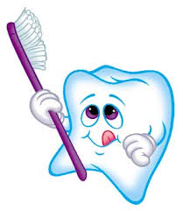
Role of DH
Update patient's health history at every visit
Confirm that they have taken their most recent scheduled dose of medication
Patient’s inhaler should be available if needed
Be aware of the potential for dental materials and products that exacerbate asthma.
Patient’s appointment should be in the late morning or the late afternoon.
Avoid prolonged supine positioning.
http://www.dentistryiq.com/articles/2013/02/six-steps-to-making-hygiene-a-profit-center.html

Slide 15
Managing an Acute Asthmatic Attack
Discontinue the dental procedure and allow the patient to assume a comfortable position.
Establish and maintain a patent airway and administer b₂ agonists via inhaler or nebulizer.
Administer oxygen 6-10 liters via face mask, nasal hood or cannula. If no improvement is observed and symptoms are worsening, administer epinephrine subcutaneously
Document in time form the beginning of the event.
Alert emergency medical services-911.
Maintain a good oxygen level until the patient stops wheezing and/or medical assistance arrives.

Slide 16
Web pages I used: add in the work-cited
http://www.nhlbi.nih.gov/health/health-topics/topics/asthma
webmd.com/asthma/guide/asthma-medications
http://www.aihw.gov.au/asthma/medicines/
http://www.dentalgentlecare.com/asthma_management_in_dental_treatment.htm
http://www.webmd.com/asthma/guide/exercise-induced-asthma

