Slide 1
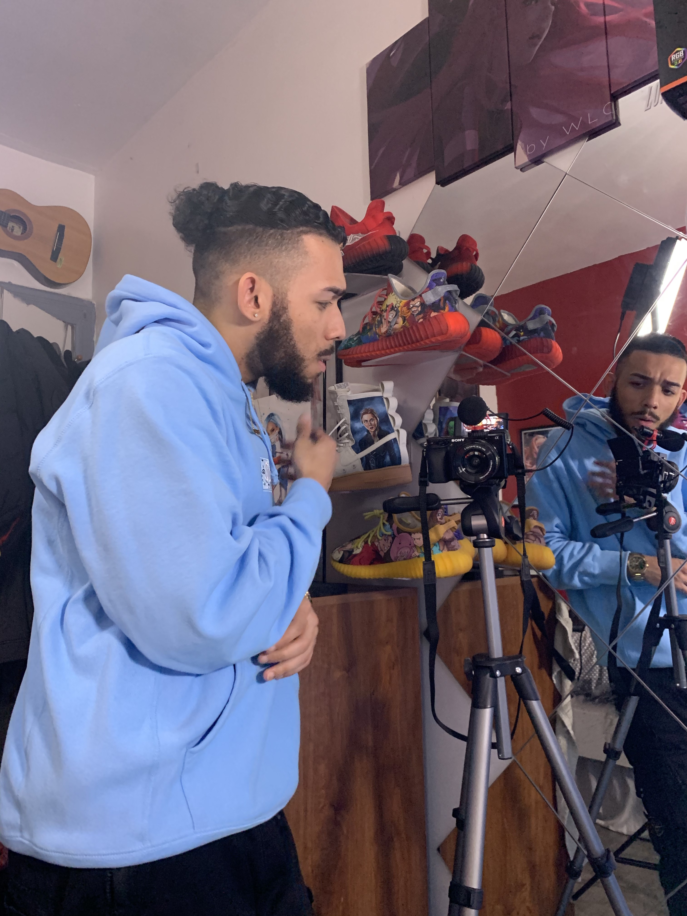
Introduction
It’s More Than Sneakers
I have filmed a short documentary exploring the business world of reselling sneakers and what it has become today. In this documentary I have sat down with five influential individuals in the reselling industry, where each person is discussing their personal experiences and growth of reselling. This documentary is around 13 minutes long, however due to COVID-19, production was cut short. The information given in this documentary targets individuals who are simply curious and/or wants to join the business of reselling. The way I have scripted my interviews are in the form of a pyramid which I call a “sneaker pyramid.” The “sneaker pyramid” is when a buyer gets a sneaker from a retailer (ex: Footlocker), therefore the first interview is an employee of Footlocker. It then splits into two categories ( regular customers & resellers). The second interviewee is an individual who resells sneakers as a full time job to his fellow colleagues. The documentary also introduces an individual who is considered an influencer. An influencer job in this case is to purchase and review sneakers for the sole purpose of influencing other individuals/influencers on why they should/shouldn’t purchase this particular sneaker. Another topic spoken about is resellers buying multiple pairs of high in demand sneakers, so the can sell them for cash at reselling platforms such as Stock X and Goat. Finally at the top of the pyramid are the entrepreneurs who instead of selling to these platforms they base their prices off them for their personal business/company gains and grows from the profits being made from reselling sneakers because the money being earned isn’t going towards other reselling platforms but the own business.
Challenges
Rafael Miranda/ Director, Producer,Editor
Department of Entertainment Technology
-The Sony 6000 camera wouldn't play back the footage I shot
-Had to reshoot a whole interview because it was shot in slow motion
-Hard drive kept on ejecting by its self and would have to relink all my media
-Issues with downloading Avid Media composer
-The latest update to Avid wasn’t compatible with my latest update of MacOS Catalina
-Computer kept shutting down
-Premiere Pro kept freezing
-A interview had to get rescheduled due to the weather
-One subject I was interviewing was taking it as a joke and getting people to join him in the camera
-A lot of background noise while shooting the interviews
-Time management
-Working with peoples schedules
-Coming up with different questions for each person
-Talking to people I don't know personally
-COVID-19
-Working with a camera I never used before
-Teaching myself how to use premiere pro
-Waking up early to get footage of curtain releases
-The placement of the camera depending on the room
Calendar
Materials
-Dec 2019: started getting B-Roll
-Feb 5th: 1st interview was shot
-Feb 9th : 2nd was shot (however there was no audio)
-Feb 15th: had to get in contact with the 2nd person I interviewed to reshoot
-Feb16th: reshot the second interview
-Feb 25th: tried to shoot the 3rd interview but it got canceled due to the weather
-Feb 29: tried again but he was called to work early
-March 2nd: the 3rd interview was shot
March 12th: shot the 4th interview
-Editing started on April 3rd
*5th to be shot after COVID-19
*Everyday I was out getting B-roll
-Adobe premiere software (monthly)- 22
-Hard drive -$65
-Sony 6000 camera-$600
-Sony 6100 camera-$838.32
-IMac- $1,359.85
-External shot gun mic-$21.75
-Gorilla pod- $32.14
-Ultra Led video light- $14.10
-32G SD card- $18
-128G SD card-$68
-Sony batteries x3-$180
-Tripod- $25
-AA battery x2-$3
-Camera bag- $25
-Metro card (monthly)- $381
Camera wall battery charger- $30
-amazon prime account (only for 2 months)-$24
Budget Total: $3,707.16
Conclusion
Process
Results
Acknowledgment
As the director there were many careful planning involved in the production of this short film. Such as who to interview, what questions to ask and how long the whole film was going to be. Also I knew I wanted to do something with sneakers but didn’t know what exactly to do either the history or sneakers or the resell market of it. Had to email people and even talk to ask them if they would like to be apart of my documentary. Then had to do my research on which shoes were coming out each week to wake up early and get footage. As I'm getting people to interview I also was getting people to join my crew to help me out on this short film. Then schedule different shooting days that work with the people I'm interviewing and work with my 2nd camera person. While I would be shooting those interviews on those days everyday I would be out just getting B-roll. Towards the middle of march is when I would start to edit while I would still continue to get B-roll because each weekend a different shoe is getting released.
-Gained knowledge of Adobe premiere
-Collected enough B-roll
-Obtained an important interview before the person moved out of the state
-Collected 4 out of the 5 interviews I needed
-Got the first 13 mins of my short film completed
-built great connections
The short documentary film creates an informative experience for those who have always been curious about the industry. The end product is still in the process as of right now. Im still missing 1 more interview and once quarantine is over I will get to it that I get that interview. The last interview I need is with a Stock X associate that will break down how it all works and her point of view of the sneaker market. What I got now is a rough cut that’s 13 mins. Once I get the last interview and more B-roll I will mix it in with the other footage making it a little longer. This is the longest project I have ever edited and worked on. My goal as of right now after editing and shooting this short film is to get a job as an assistant editor and improve my skills to the point I could get a better job at a larger entertainment company like SONY , Disney etc. I will also be posting the whole documentary film after its done on YouTube and use it for my portfolio to get a job at complex. Things didn’t go as planned especially due to COVID-19 so many things were changed however I had to work with what I had. I hope to receive a positive criticism from my pees and professor, that will help me father my skills and use that feedback to improve on the final cut to show to a future job.
Mario Trevino - Advisor
Tony Giovannetti- Professor

